Slide 1
Understanding the Arts and Humanties Standards: The Key to Designing an Integrated Lesson
Dr. Catherine Richmond-Cullen
Elizabeth Parry-Faist
PAEP May 2, 2020

Slide 2
What is Co-Teaching?
Classroom Teacher
Artist
Academic content
Reminds students of what they know
Adds enrichment
Assisting with behavior
Teaches arts standards
Instructs arts content
Lesson designed to connect to academics
Engages students

Slide 3
Part 1: Understanding the Arts Standards
Elements and Principles
Historical and Cultural Perspectives/Content
Critique
Aesthetics

Slide 4
FRAMEWORK for STANDARDS

Slide 5
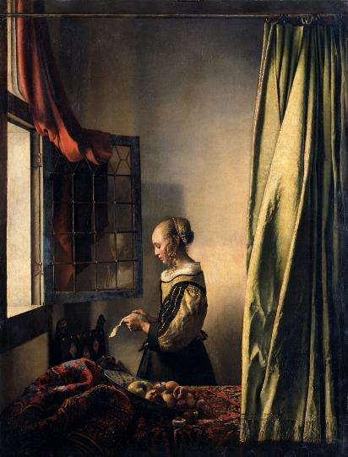
The Elements of Design
Color
Shape / Form
Line
Space
Texture
Value
Notes:
Textual evidence/ story map/ size, magniture, direction, balance

Slide 6
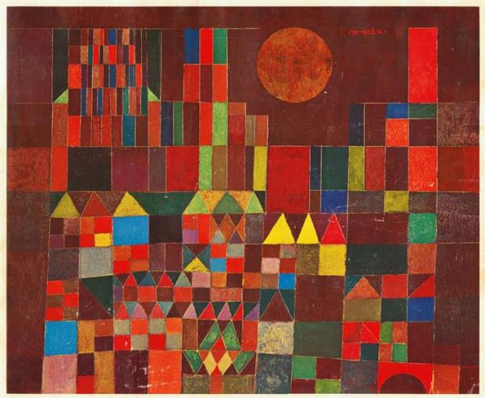
The Principles of Design
Balance
Contrast
Emphasis / Focal Point
Movement / Rhythm
Proportion / Scale
Repetition
Unity / Harmony
Notes:
Related skills….

Slide 7
Notes:
Textual evidence/ story map/ size, magniture, direction, balance/analsyis compare contrast…..

Slide 8
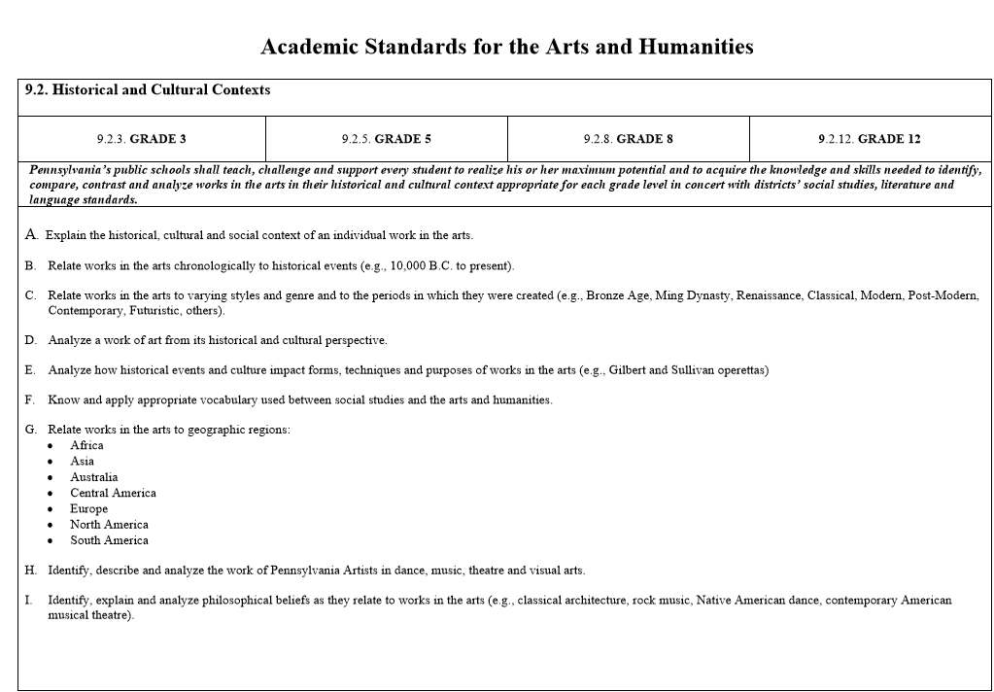

Slide 9
Notes:
Vermeer, add stuff abobut historical conte

Slide 10
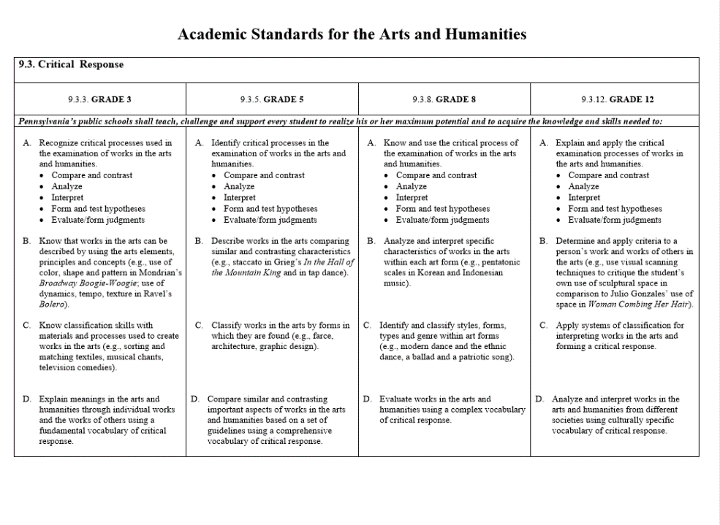

Slide 12
Relationship to Academic Content
Identify critical processes in the examination of works in the arts and humanities.
Compare and contrast
Analyze
Interpret
Form and test hypotheses
Evaluate/form judgments

Slide 14
Part 2: Lesson

Slide 15
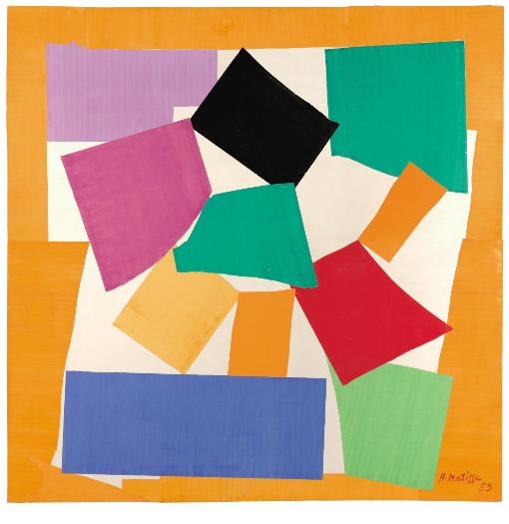
What does this art piece represent?

Slide 16
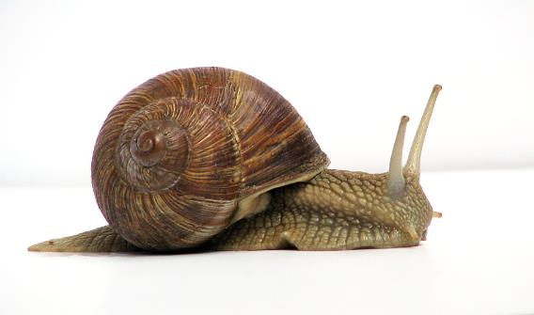
The Snail
The Snail is a collage by Henri Matisse. The work was created from summer 1952 to early 1953. It is pigmented with gouache on paper, cut and pasted onto a base layer of white paper measuring 9'4³⁄₄" × 9' 5". The piece is in the Tate Modern collection in London.

Slide 17
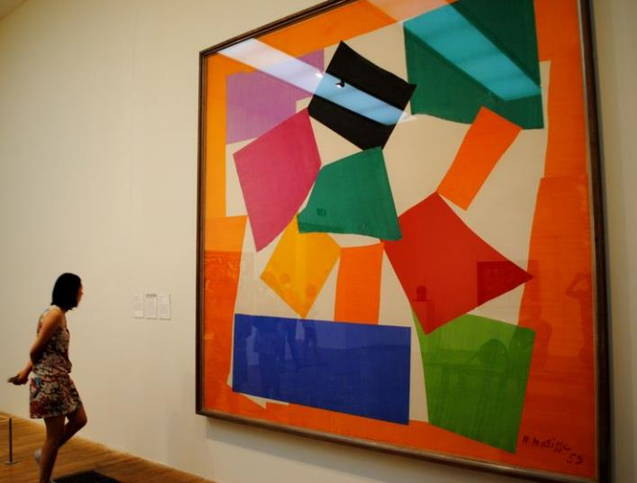
“I first of all drew the snail from nature, holding it. I became aware of an unrolling, I found an image in my mind purified of the shell, then I took the scissors".

Slide 18
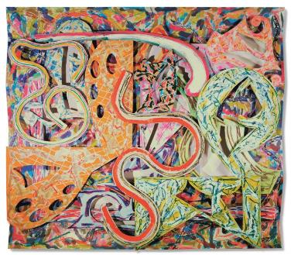
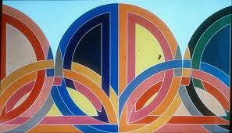
Shape
Two dimensional / geometric & organic

Slide 19
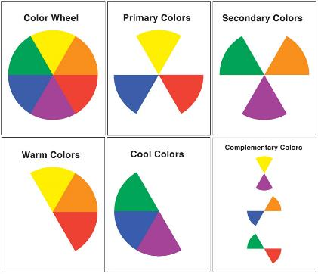
Color
Hue, saturation, and brightness

Slide 20
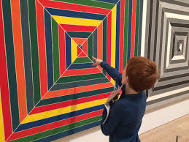
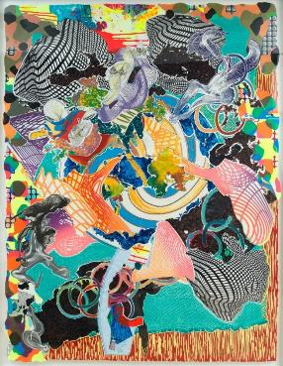
Repetition
More than one design element

Slide 21
Lesson on Elements and Principles/Art Making
Assignment was to use the selected elements and principles of art.
Choose an everyday object as you shelter in place.
No specific materials required.
Non-representational piece.
Demonstrative symbolism

Slide 22
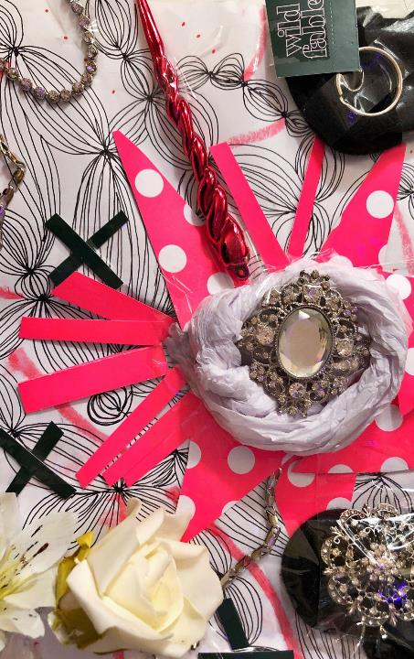

Slide 23
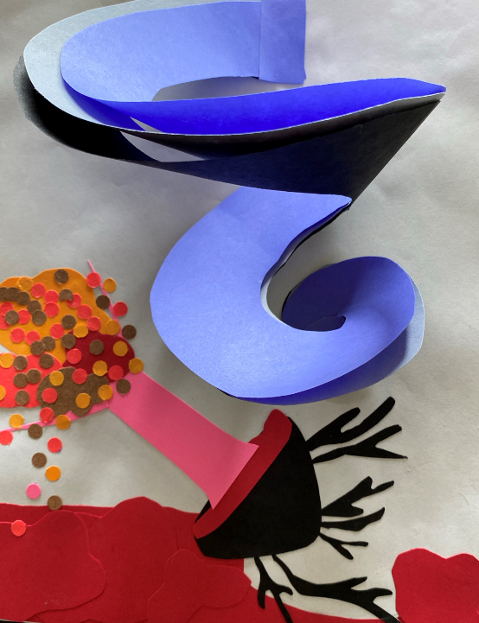

Slide 24
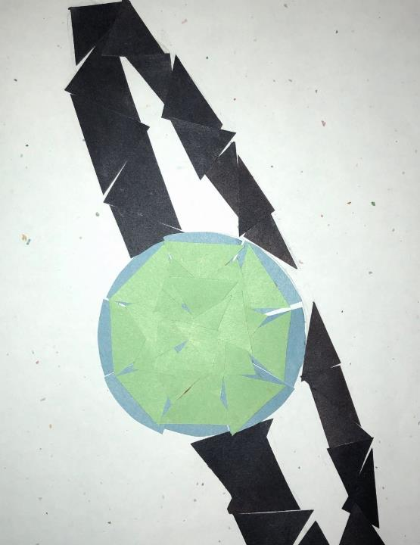

Slide 25
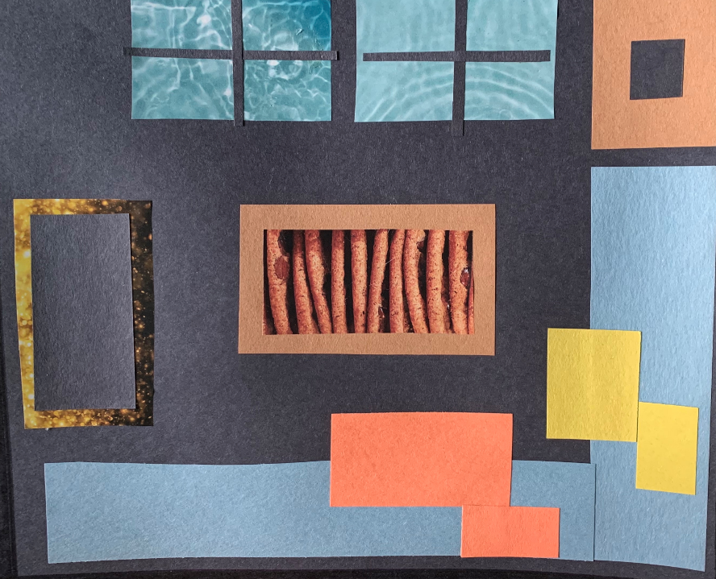

Slide 26
