Slide 1
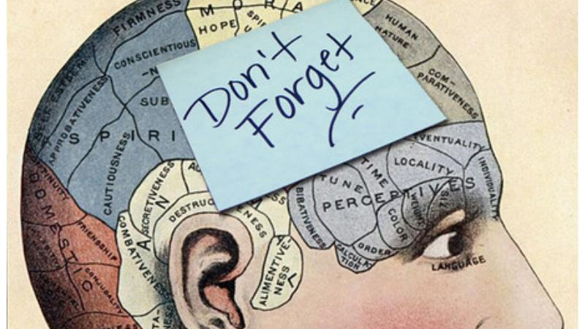
Memory: A Powerful Tool
This Photo by Unknown Author is licensed under CC BY-NC-ND

Slide 2
OUCH!
If you wanted to create an education environment that was directly opposed to what the brain was good at doing, you probably would design something like a classroom.
Medina (2008)

Slide 3
What is memory?
The most important aspect of memory is retrieval.
Notes:
Forming new memories and storing past memories is the brain’s responsibility. Retrieval has to do with the learning process

Slide 4
Declarative and Non-Declarative Memory Systems
Memorizing information that can be declared and experienced in the conscious awareness of students. (the car is red, the sky is blue)
Memorizing that does not involve conscious awareness. (driving a car and riding a bike or tying a shoe)

Slide 5
How memories are processed
Inputs (words, texts, pictures) are captured by the senses and sent to the thalamus: the server or center switch
Inputs are routed to other areas for processing in the cerebrum (visual to occipital lobe, language to temporal lobe)
The brain begins to form a rough sensory impression of the information
Amygdala: if any threats are perceived everything STOPS!!!
Inputs held in the frontal lobe in short term memory about 5-20 seconds

Slide 6
How memories are processed
Inputs are filtered for lack of importance or connection or meaning.
Relevant inputs routed to hippocampus where it is indexed (filed) and sent to the cortex for storage.
Inputs are stored where they were originally sensed or perceived.
New memory is processed over hours, days and weeks.
FACT: 90 % of that which they learn they forget in 30 days!!!!

Slide 7

Fast Fact
We really do NOT know how the brain keeps track of things.

Slide 8
Encode – Storing – Retrieving - Forgetting
Elaborate encoding = stronger memory
  Present compelling, relevant, information with real world examples and with MEANING – brain has natural predilection for pattern matching
  Introduction is the most important part- the more brain structures recruited the better the memory. (cues for memory)
  Memories are found where they were initially inputted. REUSE strengthens neural pathways.
  Retrieval can be improved by replicating the environment around the initial encoding.

Slide 9
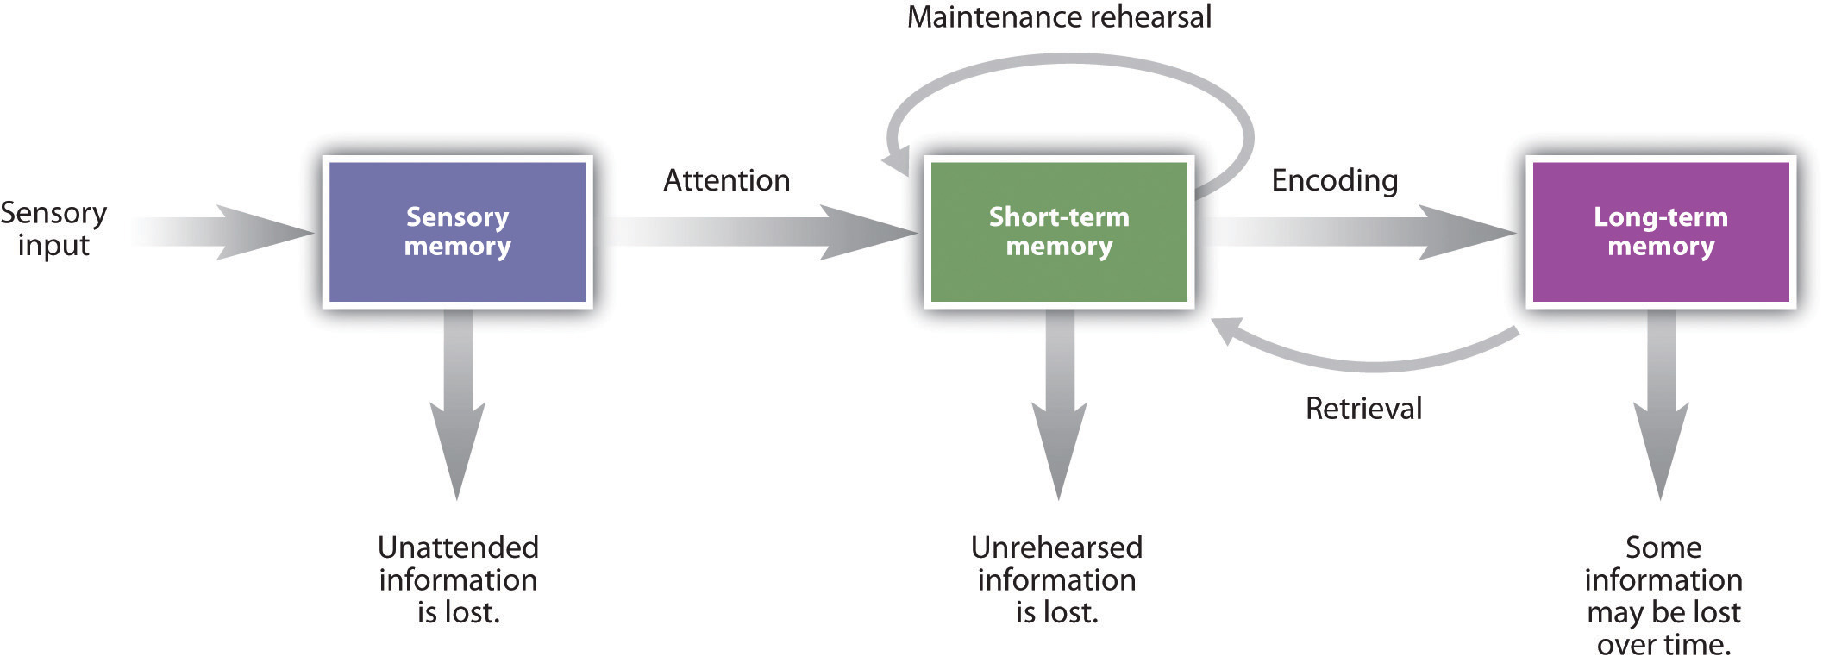
This Photo by Unknown Author is licensed under CC BY-SA-NC

Slide 10
Practicing Retrieval
Every time a memory is retrieved, the memory becomes more accessible in the future.
Creating coherent and integrated mental representations of complex concepts
Deep learning creates the abilities to solve new problems and draw new inferences
Notes:
The more we retrieve the memory the better able we are to use it to think, create, infer….start at level 1 DOK and moves to level 4

Slide 11
Repeated Retrieval
Practice in multiple and varied settings – arts learning as integration
Mass retrieval practice – repeating over and over right after the experience is NOT effective.
Spaced retrieval practice – produces long-term results
Notes:
Passive repetitive reading of information produces little or no benefit for learning

Slide 12
Rote Learning
Simple memorization based on repetition: short lived, poorly organized and does not support transfer of knowledge.
Meaningful Learning: OPPOSITE
  Long-lasting and durable
  Coherent and well-organized
  Supports transfer, inferencing and problem solving
Notes:
Retrieved retrieval supports meaningful learning

Slide 13
Retrieval Practice:
How to….
Learn information, put aside and study/practice at intervals actively trying to retrieve the information
Promotes meaningful learning
Works through multiple materials: multimedia, texts, arts learning

Slide 14

How to Practice Effectively
Learning from artists on effective practice

Slide 15
Effective Practice Strategies
Focus on practice: avoid distractions
  Working memory limitations
  Using visual aids or the arts

Slide 16
Effective Practice Strategies
Start out slowly and build for speed and endurance
  Only perfect practice makes perfect
  Timed tests must be limited and build for endurance
  Strengthen practice through multiple means

Slide 17
Effective Practice Strategies
Employ frequent repetitions with allotted breaks
  Teach students then engage them thorough multiple spaced practice sessions.
  One and done will never store
  Current school schedule does not enforce practice – classes scheduled and never revisited throughout the day.

Slide 18
Effective Practice Strategies
Practice in the mind: using imagery assist students in “seeing” success
Emotional and cognitive connections strengthen the memory

Slide 19
Your Ideas
Work in teams to discuss specific ways you can promote repeated retrieval in your classroom.
Remember you can use many and varied sources/ways to retrieve materials.

