Slide 1
What’s In A Story?

Slide 2
OBJECTIVES
OF THIS LESSON

Slide 3
OBJECTIVES
Identify the parts of a story
Collaborate to create a character
Write a character description

Slide 4
MATERIALS
FOR THIS LESSON

Slide 5
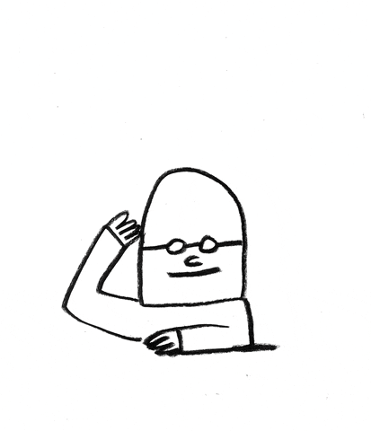
MATERIALS
Paper and pencil
Your attention
and imagination
An object at your desk

Slide 6
WARM UP
Notes:
warm up of weight – use hands first (1-10) then get up and move

Slide 7
VOCABULARY

Slide 8
VOCABULARY
What do you know about
STORIES?
A story is an account of imaginary or real people and events told for entertainment.

Slide 9
VOCABULARY
The Parts of a Story:
character
setting
plot
conflict
resolution

Slide 10
PASS OR PLAY!

Slide 11
Is this character shy or
outspoken?
Where do they live?
What type of music does
this character dance to?

Slide 12
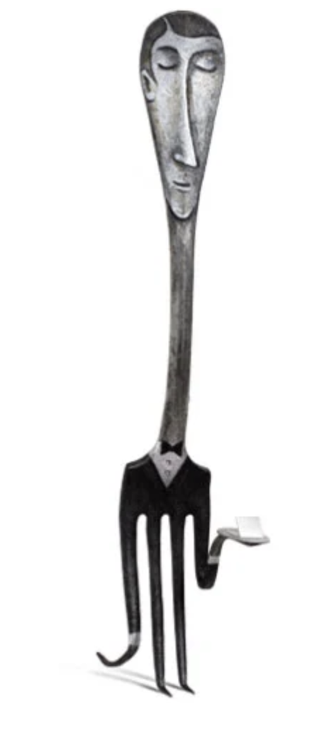
What are this character’s hobbies?
What makes this character happy?
What makes this character angry?

Slide 13
What type of books does this
character read?
Where do they live?
Who are their friends?

Slide 14
INSTRUCTIONS

Slide 15
INSTRUCTIONS
Choose an object at your desk
That object is now your a character
Brainstorm ideas for your character
write them down
Notes:
model using second camera

Slide 16
CHARACTER PROMPTS
Where do they live?
What is their job?
What are their hobbies?
What is their favorite food?
What makes them happy? Sad? Angry?
What music do they love?
Where do they want to travel?
Who are their siblings?
What weather do they dislike?
What is a book they like?
What is a habit they have?
Notes:
model using second camera

Slide 17
REFERENCES

Slide 18
REFERENCES
Character object artwork from artist Gilbery Legrand: http://gilbert-legrand.com/
Animation: giphy.com Serge Bloch

