Slide 1
WELCOME BACK, CLASS!
FINAL MINI PROJECT #4

Slide 2
WHAT ARE WE DOING TODAY?
SHOWING OFF YOUR PREVIOUS MINI PIZZA PROJECTS ☺
GET EXCITED ABOUT SUMMER BREAK SOON! – SHARE FUN & RELAXING PLANS ☺
THINK OF AT LEAST 2 MATH PROBLEM-SOLVING METHODS IN YOUR DRAWINGS.
MULTI-MATH MADNESS CASTLES DRAWINGS!

Slide 3
MATERIALS TO HAVE READY...

Slide 4
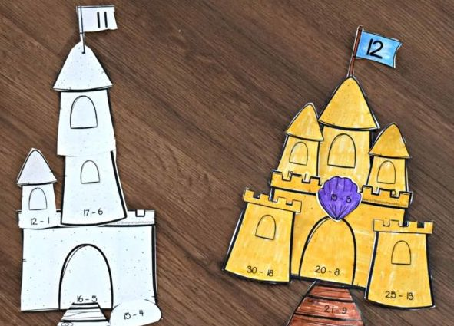
MULTI-MATH MADNESS CASTLE
DRAW A CASTLE (IT CAN BE MADE OF ANYTHING AND EVERYTHING! FOOD, SAND, GEMS, CLOUDS, MONEY, ETC.)
DRAW ON TIERS OF WINDOWS, DOORS, BRIDGES, WATER, PEAKS, AND A FLAG AT THE TIPPY TOP!
PICK A RANDOM NUMBER AND WRITE IT IN THE FLAG (THIS IS YOUR ANSWER.)
IN EACH SECTION OF YOUR CASTLE (MAYBE EVEN IN THE CLOUDS TOO) WRITE IN MATH PROBLEMS OF ANY KIND THAT EQUAL YOUR NUMBER IN THE FLAG!
ADD SOME COLOR AND ENJOY YOUR FORTRESS!

Slide 5
NICE JOB & HAVE A GREAT SUMMER!

