Slide 1
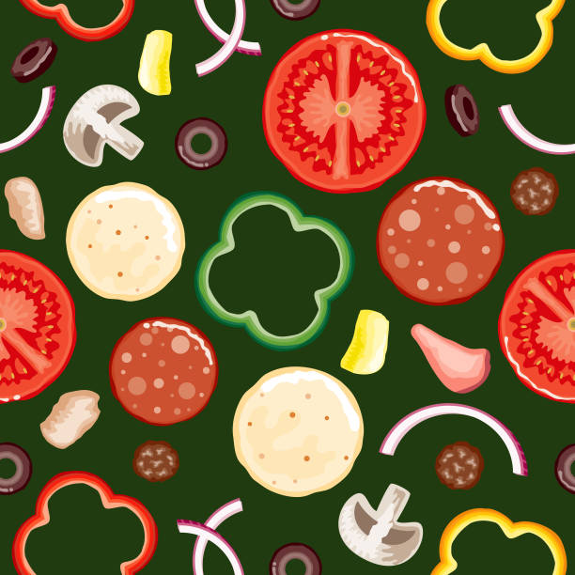
WELCOME BACK, CLASS!
Mini Project #4
3/31/22 & 4/1/22

Slide 2
WHAT ARE WE DOING TODAY?
Showing off your finished Pointillism projects ☺
Warm-up exercise.
Review some vocab.
Fraction to decimal pizza drawings.

Slide 3
MATERIALS TO HAVE READY FOR TODAY...

Slide 4
WARM-UP: If you owned food truck, what kind of food would you make?

Slide 5
DECIMALS VOCAB REVIEW
Decimal – A number that has a digit in the tenths place, hundredths place, and beyond.
Decimal Point – A period separating the ones and the tenths in a decimal number. Such as 0.8 or $3.77.
Equivalent Decimal – Decimals that have the same value.
Digit - A symbol used to write numbers. The ten digits are 0,1, 2, 3, 4, 5, 6, 7, 8, and 9.

Slide 6
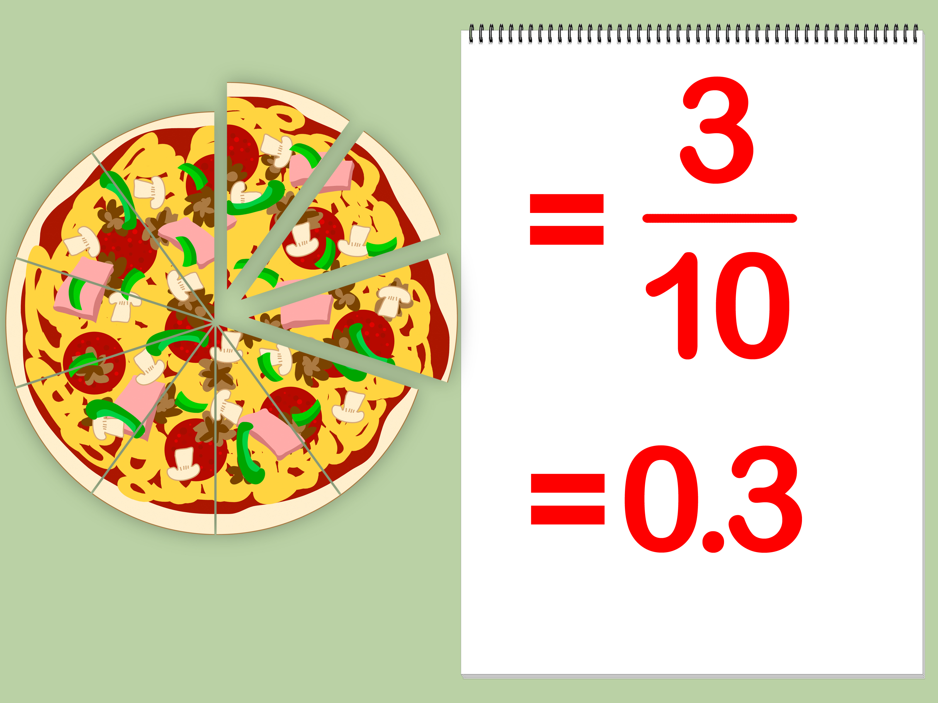
FRACTION TO DECIMAL PIZZA!
Draw a pizza pie (can be square or round) You’re welcome to draw more than one ☺
Draw on lots of toppings!
Create fractions based on how many slices and different toppings you have.
Convert the fractions into decimals.
Enjoy & share your tasty drawing!

Slide 7
SEE YOU ALL NEXT TIME! ... GREAT JOB ☺

