Slide 1
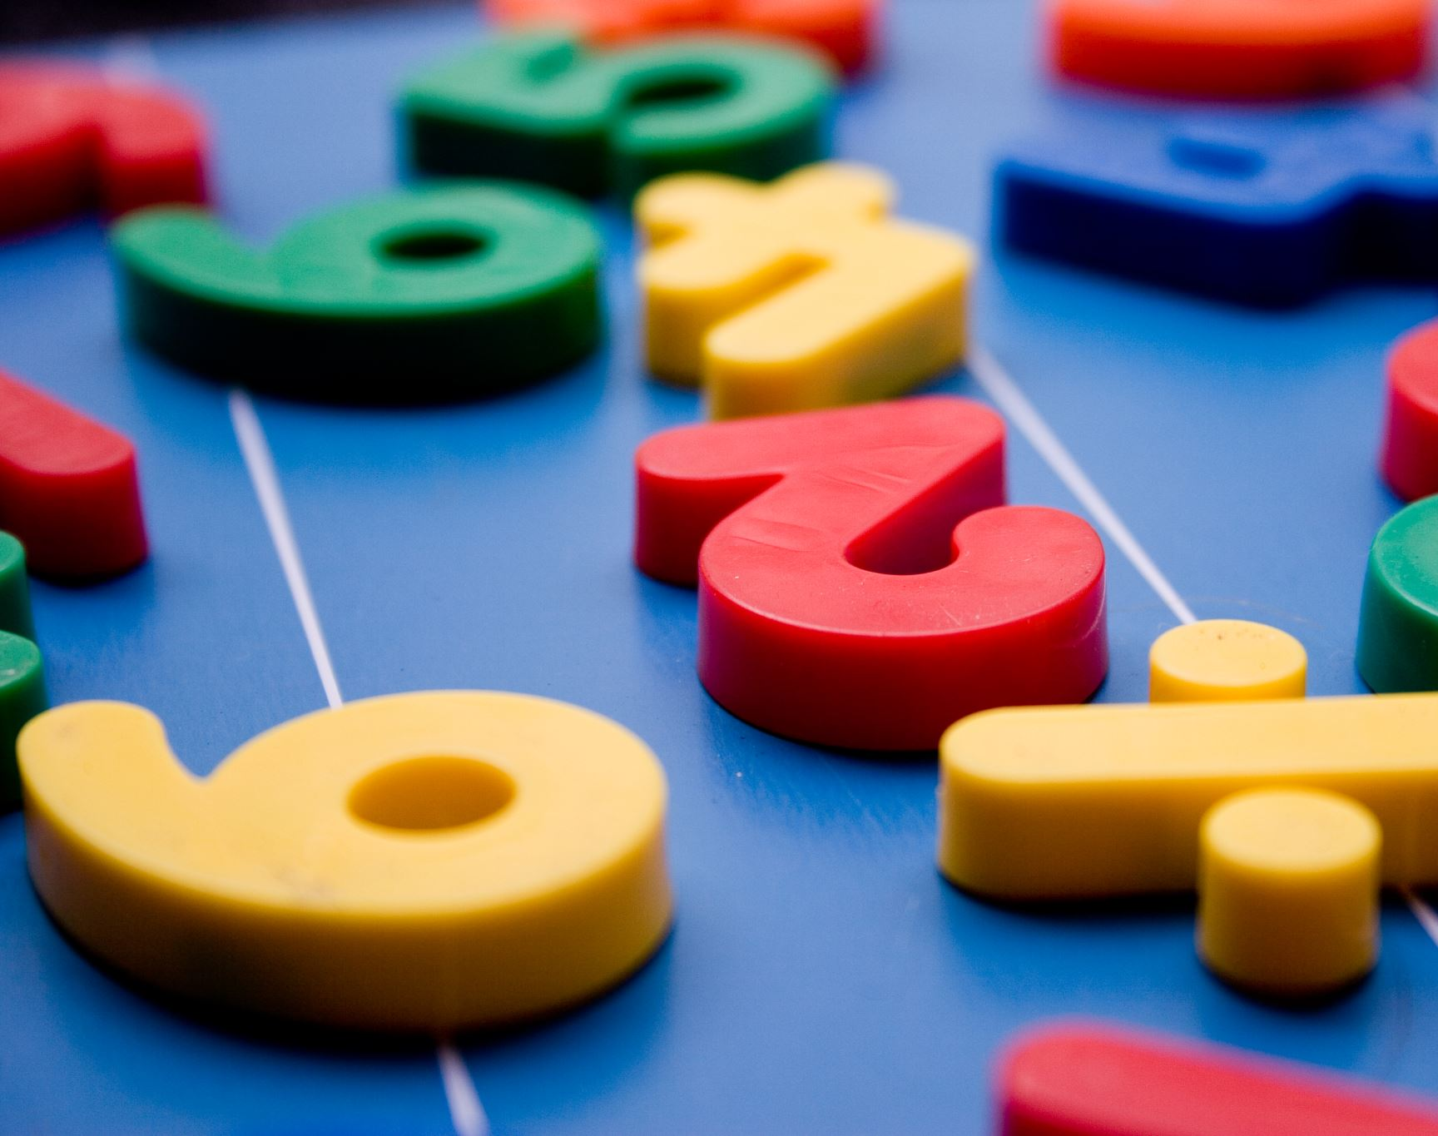
Neuropsychological Perspectives on Mathematics: Content and Practice Standards
Dr. Catherine Richmond-Cullen
PAEP Arts Link
August 4, 2020

Slide 3
Statistics
Only 33 percent of students in 4-8 grades are working at the Proficient level
Most students are working at the Basic level
PISA scores: USA is 40 out of 41 countries with a below average score average: 490 USA: 470 LOWER THAN 36 EDUCATIONAL SYSTEMS WORLDWIDE.

Slide 4
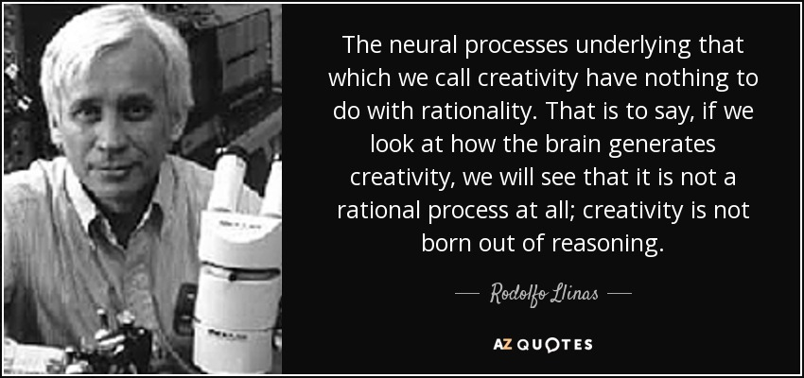

Slide 5
The Big Three
Conceptual understanding: access concepts from different perspectives
Procedural fluency: develop automaticity and speed to free up cognitive resources.
Problem Solving: quantitative reasoning to solve real world problems.

Slide 6
Conceptual Understanding: we are all literacy coaches
Conceptual knowledge allows students to understand why a particular procedure is important.
Oral and written discourse.

Slide 7
Reflection
How do you currently teach each of the three aspects of application of mathematics in your classroom curriculum?
Procedural Fluency
Conceptual Understanding
Problem Solving and Reasoning

Slide 8
Content mathematics
Number properties and operations: measures students’ understanding of ways to represent, calculate and estimate.
Measurement: assesses students’ knowledge of measurement for attributes as capacity, length, area, volume, time and angles.
Geometry: measures students’ knowledge and understanding of shapes in two and three dimensions and relationships between shapes such as symmetry and transformations.
Data analysis, statistics and probability: measures student’s understanding of data representation characteristic of data sets, experiments and samples and probability.
Algebra: Measures students’ understanding of patterns, using variable, algebraic representation and functions.

Slide 9
Standards for mathematical practice
Make sense of problems and persevere in solving them
Reason abstractly and quantitatively
Construct viable arguments and critique the thoughts of others.
Model with mathematics.
Use appropriate tools strategically.
Attend to precision.
Look for and make use of structure. (properties)
Look for and express regularities in repeated reasoning.

Slide 10
Reflection
Are you planning with the practice standards? What ways do you see the teaching artists have demonstrated an application of these standards?

