Slide 1
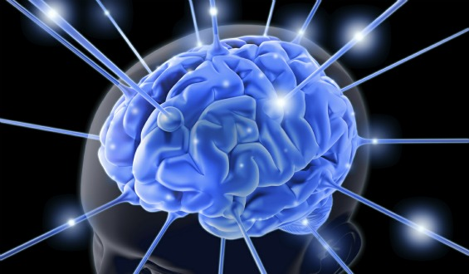
Neurolearning 101 Why ARTS?
©Dr. Catherine Richmond-Cullen, Ed.D, Assistant Professor
The University of Scranton
PAEP Arts Link
February 22,2020

Slide 3
Cerebral Cortex: Hello Arts Brain!!!!!!
Frontal Lobe- associated with reasoning, planning, parts of speech, movement, emotions, and problem solving
Parietal Lobe- associated with movement, orientation, recognition, perception of stimuli
Occipital Lobe- associated with visual processing
Temporal Lobe- associated with perception and recognition of auditory stimuli, memory, and speech

Slide 4
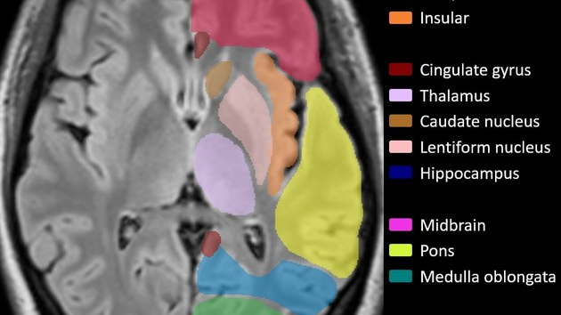

Slide 5
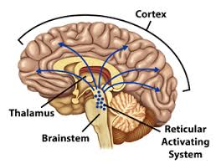
Reticular Activating System: Neurons See, Hear, Taste and Touch
Controls sleeping, waking and attention
Acts as a sophisticated filter
It is your brain’s executive assistant
What do I value?
What do I fear?
What are my goals?

Slide 6
RAS Neuroimage

Slide 7
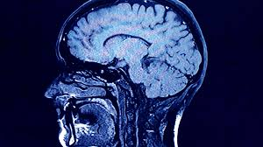
Limbic System

Slide 9
Limbic System: Emotional Brain Get My Attention Teacher!!!!
Thalamus: Diagnosis of all sensory data: taste, touch, visual and auditory.
Hypothalamus: Emotional behavior related to homeostasis, emotion, thirst, hunger, circadian rhythms, and control of the autonomic nervous system.
Amygdala: fear center, emotional center The Amygdala Hijack
Hippocampus: converts short term to long term memory, remembers objects and people
Pons: relays messages from the cortex to the cerebellum
Paleomammilian cortex

Slide 11
Hemispheric Responsibilities

Slide 12
Neuroimages of hemishperisity

Slide 15
How the Brain Learns! Thank you Arts!!!!
RAT: Information enters at the brain stem: sensory stimuli
Limbic System: Emotional decisions are made
Searching: The brain looks for that which it has learned/stored
Processing: The frontal lobe/short term memory is engaged
Storage: The information is sequentially stored in long term memory

Slide 16
Memory Facts
Working memory is limited as per chronological age
We are wired to learn 7 items
Memory stores in patterns
Teaching with chunking and engagement
Convergence zones
Plasticity

Slide 17
Learning Principles:
All learning is physiological
Every brain is unique
Learning is developmental: dormancy vs. disability
Learning is social
The search for meaning is innate.

Slide 18
Learning principles
We must learn skills/facts in meaningful contexts.
We learn in patterns
We learn parts and wholes simultaneously
We learn unconsciously and consciously
Emotions control learning

Slide 19
Functional Cortical System: Neurocognitive Abilities : I am wired for the Arts!
Unit 1: Arousal Activation: Reticular Activating System
Attention/stimulus
Unit 2: Perceptual Integration : Posterior Brain
Occipital, Parietal, Temporal
Simultaneous (visual spatial) /Sequential (verbal and movement)
Unit 3: Higher Level Executive Functioning: Anterior Brain/Frontal
Direct toward goal
Develop plan to achieve
Inhibit distractions

Slide 20
PASS Theory: Alexander LURIA (A smart Russian) Teach me how I learn BEST
Planning
Attention
Simultaneous
Sequential

Slide 21
Demonstrations in Learning
Planning
Thinks before acting
Creates plans
Uses strategies to achieve goals
Attention
Focus attention to one thing at a time without distractions.
Simultaneous
Understanding of how parts and wholes combine to see the big picture.
Successive
Works with numbers
Works with words or ideas in a specific sequence

Slide 22
PASS Theory and the Creative Process
Planning: Preparation in arts learning
Information retrieval
Determine, apply, self-monitor, and self-correct
Attention: Incubation of creative ideas
Focus on stimuli while inhibiting responses on to competing stimuli
Simultaneous: Illumination of thoughts into symbolic representations
Understanding parts and wholes
Visual spatial stimuli and logical grammatical verbal statements
Successive: Implementation of ideas during the creative process
Integrate information into specific serial order in which each element is related to only those that proceed it. Sequence, order, sounds, movements

Slide 23
PASS Theory: Planning
Units 1 & 3
Focus on stimuli while inhibiting responses on to competing stimuli
Unit 1: arousal
Unit 3: sustain

Slide 24
PASS Theory: Attention
Units III and I
Information retrieval
Determine, apply, self-monitor, and self-correct

Slide 25
PASS Theory: Simultaneous
Unit 2
Understanding parts and wholes
Visual spatial stimuli and logical grammatical verbal statements

Slide 26
PASS Theory: Successive
Unit 2
Integrate information into specific serial order in which each element is related to only those that proceed it. Sequence, order, sounds, movements

