Slide 1
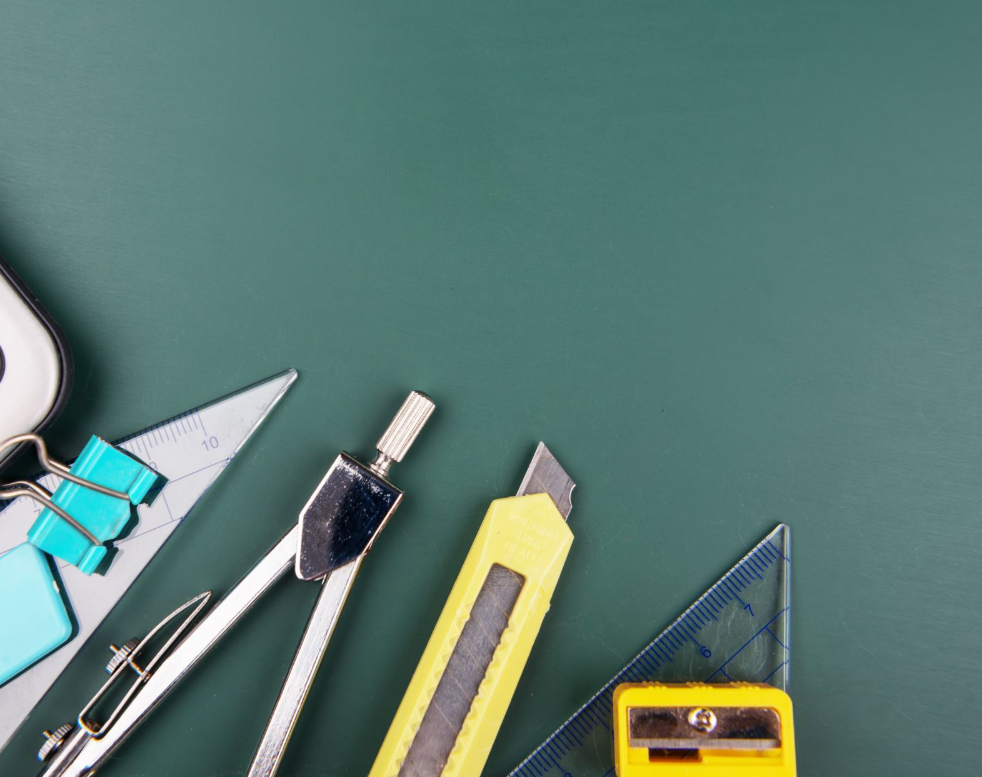
Math First©
Catherine Richmond-Cullen, Ed.D
President, neuroLEARN, llc
For PAEP Arts Link

Slide 2
Child Centered Mathematics
Children learn to think creatively and critically.

Slide 3
Procedural Fluency
Students learn to solve equations and learn basic information and facts.

Slide 4
Problem Solving
Students learn to process math by using strategic thinking practices and tools.

Slide 5
Conceptual Understanding
Students learn to communicate their understandings through oral and written discourse

Slide 6
Algorithm LAST!!!!!!!!!!!!!!!!!!!!

Slide 7
Limit this…..

Slide 8
Inventive Strategies
Allow children to create their own multiple ways to solve the problems.

Slide 9
Productive Struggle
The creative process requires struggle for success.

Slide 10
Shifts in Common Core Mathematics
Focus
Coherence
Fluency
Deep Understanding
Applications
Dual Intensity

Slide 11
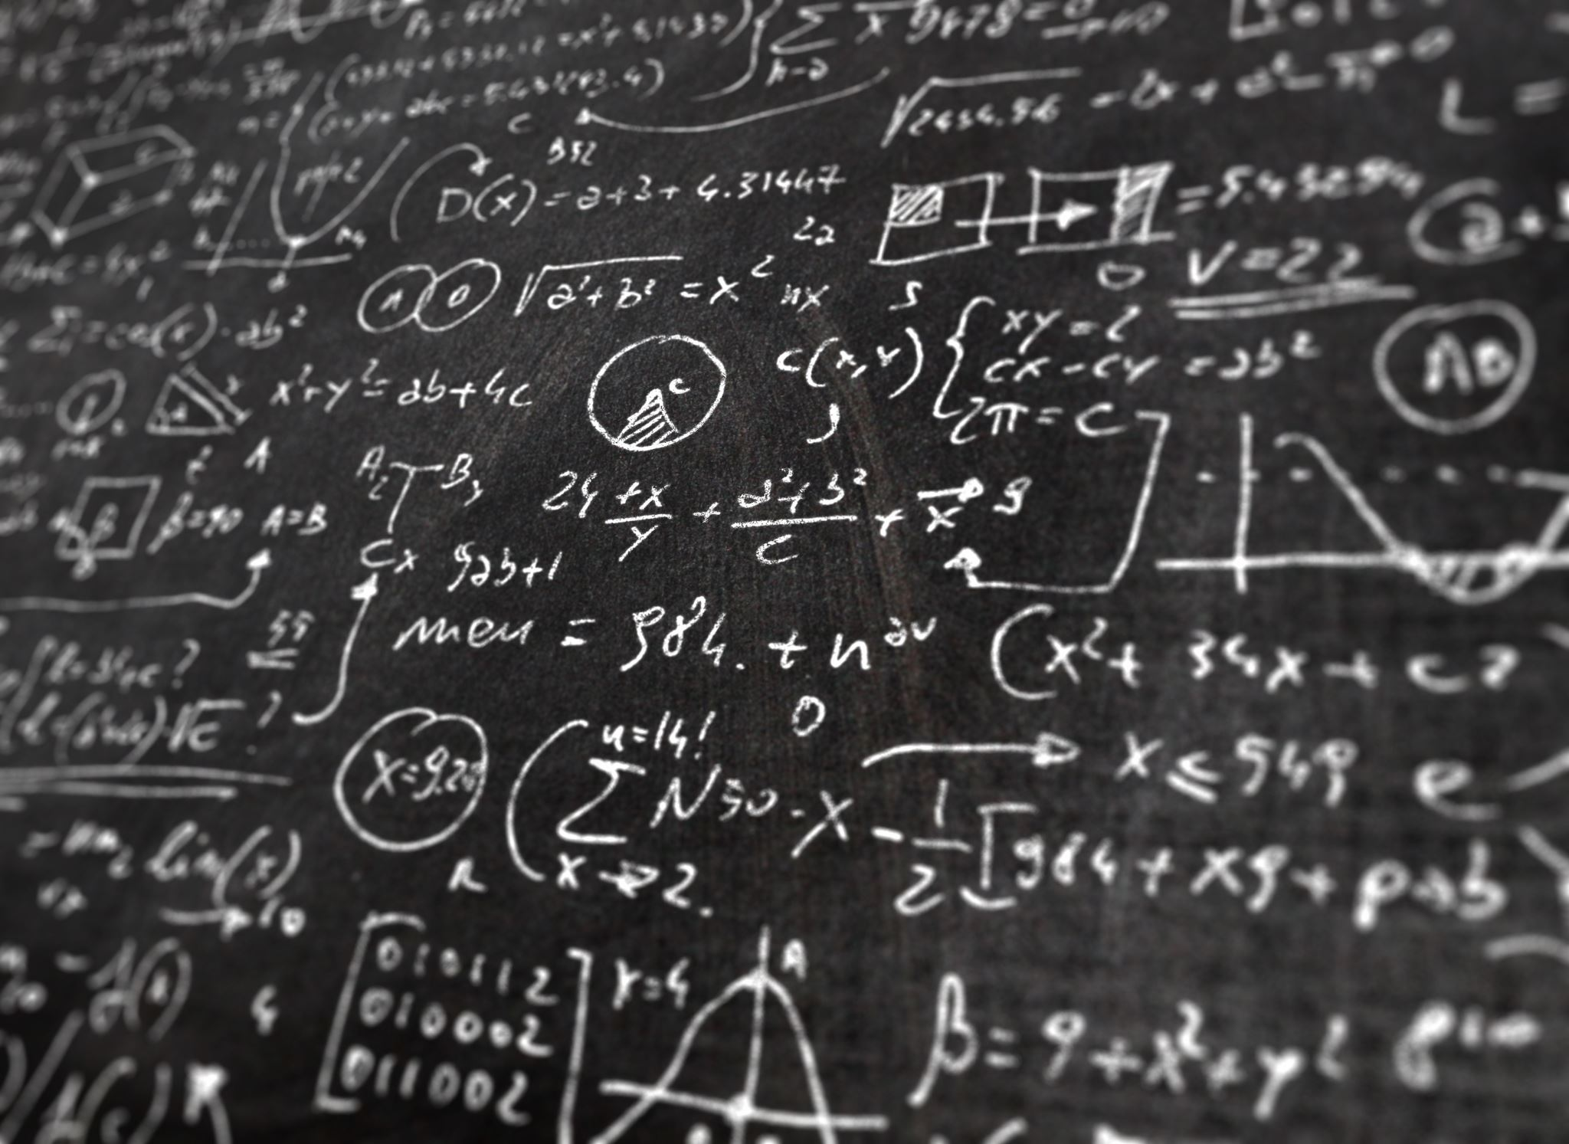
Language Demands for Mathematics
Function
Vocabulary
Discourse
Syntax
Precision

Slide 12
NCTM Process Standards
Problem Solving: Looking at pictures, are all oranges round?
Reasoning and Proof: Do all oranges have 8 seeds? How do we know?
Communication: Tell how you know.
Connections: Let’s make a graph of fruit.
Representations: What number sentence can we make? Draw a picture.

Slide 13
PA Common Core Content Standards
Numbers and Operations
Algebraic Concepts
Geometry
Measurement, Data, and Probability

Slide 14
PA Common Core Practice Standards
Make sense of problems and persevere in solving them.
Reason abstractly and quantitatively.
Construct viable arguments and critique the reasoning of others.
Model with mathematics.
Use appropriate tools strategically.
Attend to precision.
Look for and make use of structure.
Look for and make sense of regularity in repeated reasoning.

