Slide 1

WELCOME BACK, CLASS!
PROJECT #3 – INTRO
MEETING #7
1/13/22 & 1/21/22

Slide 2


Gather these materials: Markerboard, eraser, and marker ☺

Slide 3

Warm-up exercise: Draw a quick doodle of a new Oreo cookie flavor that you would like to try! ☺

Slide 4
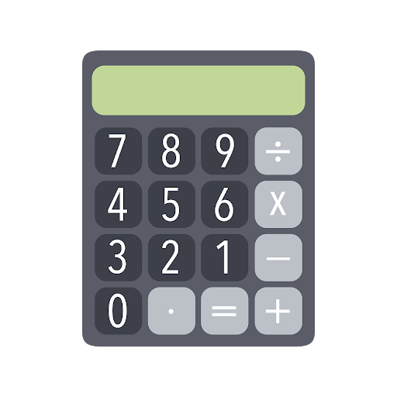

What are we going to be doing? Connecting Art & math!

Slide 5


What do you know about hands in art, math, & language?

Slide 6
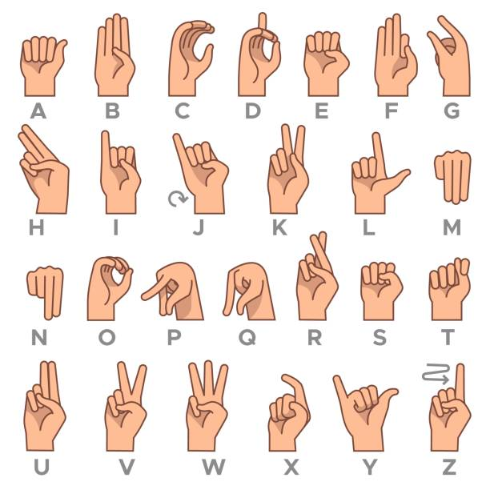

We use hands for counting, directing, sign language, creating art, telling time, writing, and much more! ☺

Slide 7


We see hands while we are out and about! ☺

Slide 8

... Even in the dark with shadow puppets! ☺

Slide 9
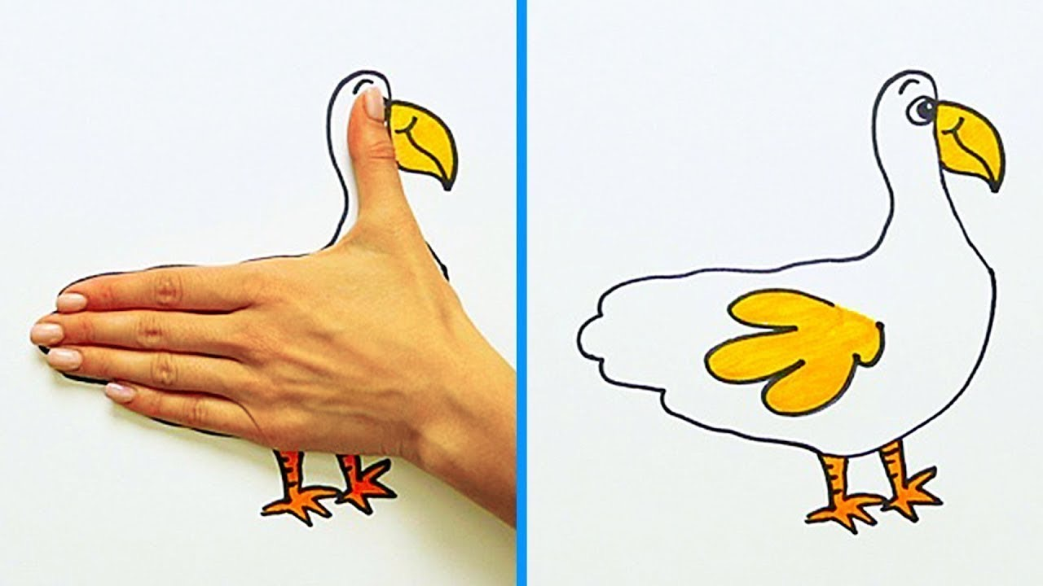

Some project examples: Hand Animal Drawing
What does 1,000 divided by 10 equal?
That equals 50!

Slide 10

Lesson vocab for division & hand art in math:
Dividend – A number that is being divided.
Divisor – The number that divides the dividend.
Remainder – The number that is left after one whole number is divided by another.
Divide – An operation on two numbers in which the first number is split into the same number of equal groups as the second number.
Variable – A letter or symbol used to represent an unknown quantity.

Slide 11
Lesson vocab for division & hand art in math:
Contour – The outline of the object or objects.
Shape – The visual appearance of something or someone.
Line – A mark that is short or long.
Vertical – A mark that travels up and down.
Horizontal – A mark that travels left to right.
Diagonal – A mark that travels at a slant.

Slide 12

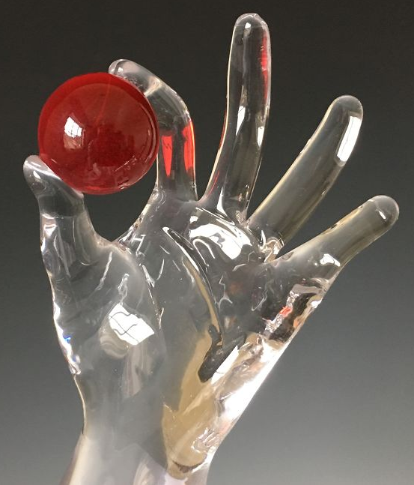

Hand Art in Today’s World: Shaping Glass – Jen Violette (present)
https://www.youtube.com/watch?v=6BGbD3xcQUM&t=1s

Slide 13

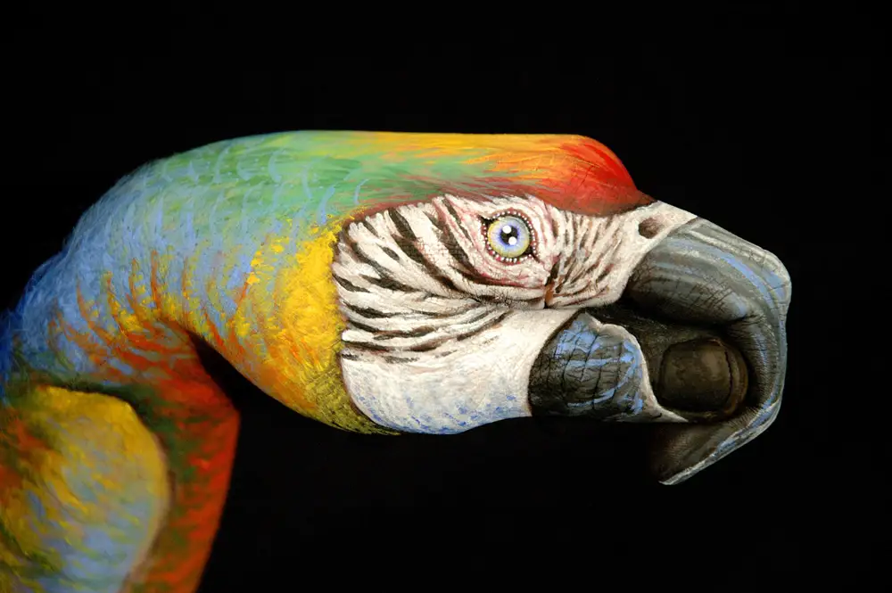

Hand Art in Today’s World: Animal Shapeshifting Painting
https://www.youtube.com/watch?v=ADEJh4fcoG4

Slide 14


Hands in Animation: Disney’s Ratatouille (2007)
https://www.youtube.com/watch?v=o3mb_SfuyLY

Slide 15

Closure
What did we accomplish with our project?
What did we learn about hands in art and division?
How did we connect art & math today?

Slide 16
Extension art activities
http://weavesilk.com
https://www.mathplayground.com/index_geometry.html
https://www.sheppardsoftware.com/mathgames/menus/geometry.htm
http://www.colorwithleo.com/artstudio.php?PHPSESSID=46aae1ddc70aa2b00571af541ea33790

Slide 17

See you next time!

