Slide 1
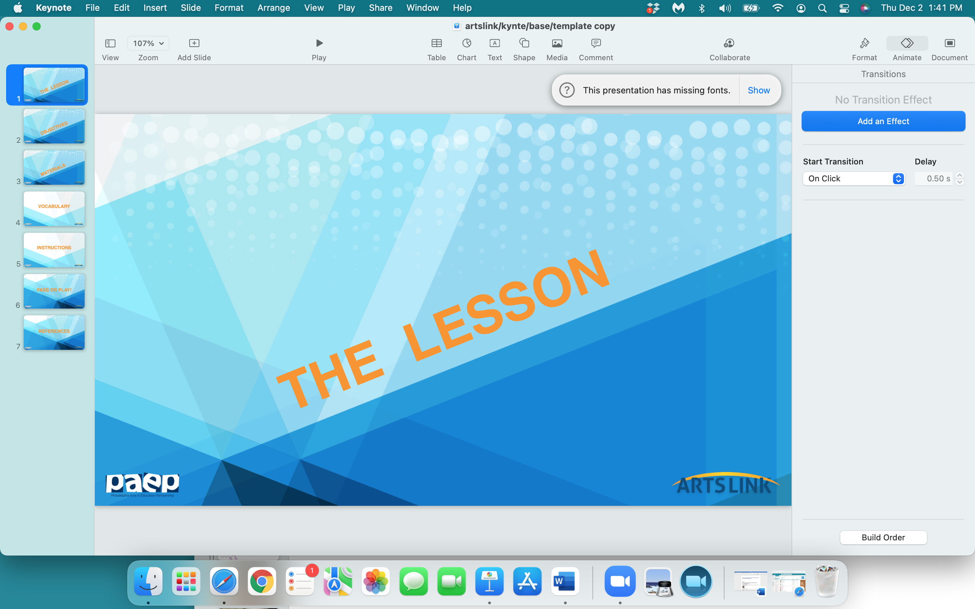

Slide 2
THE
SHAPE
OF
YOUR
SHAPE

Slide 3
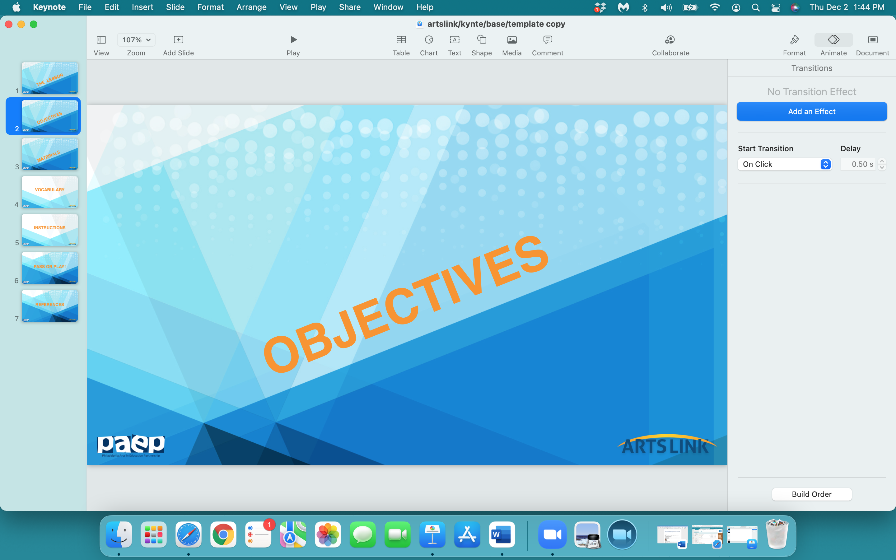

Slide 4
In the next 2 sessions, we will:
study the abstract work of Elizabeth Murray
sketch, create and color your personal shape
learn about the ‘meaning’ of colors
design and create the ‘background' for all the class’s shapes
mount and glue all shapes onto the ‘background’ - creating a class ‘sculptured painting’

Slide 5
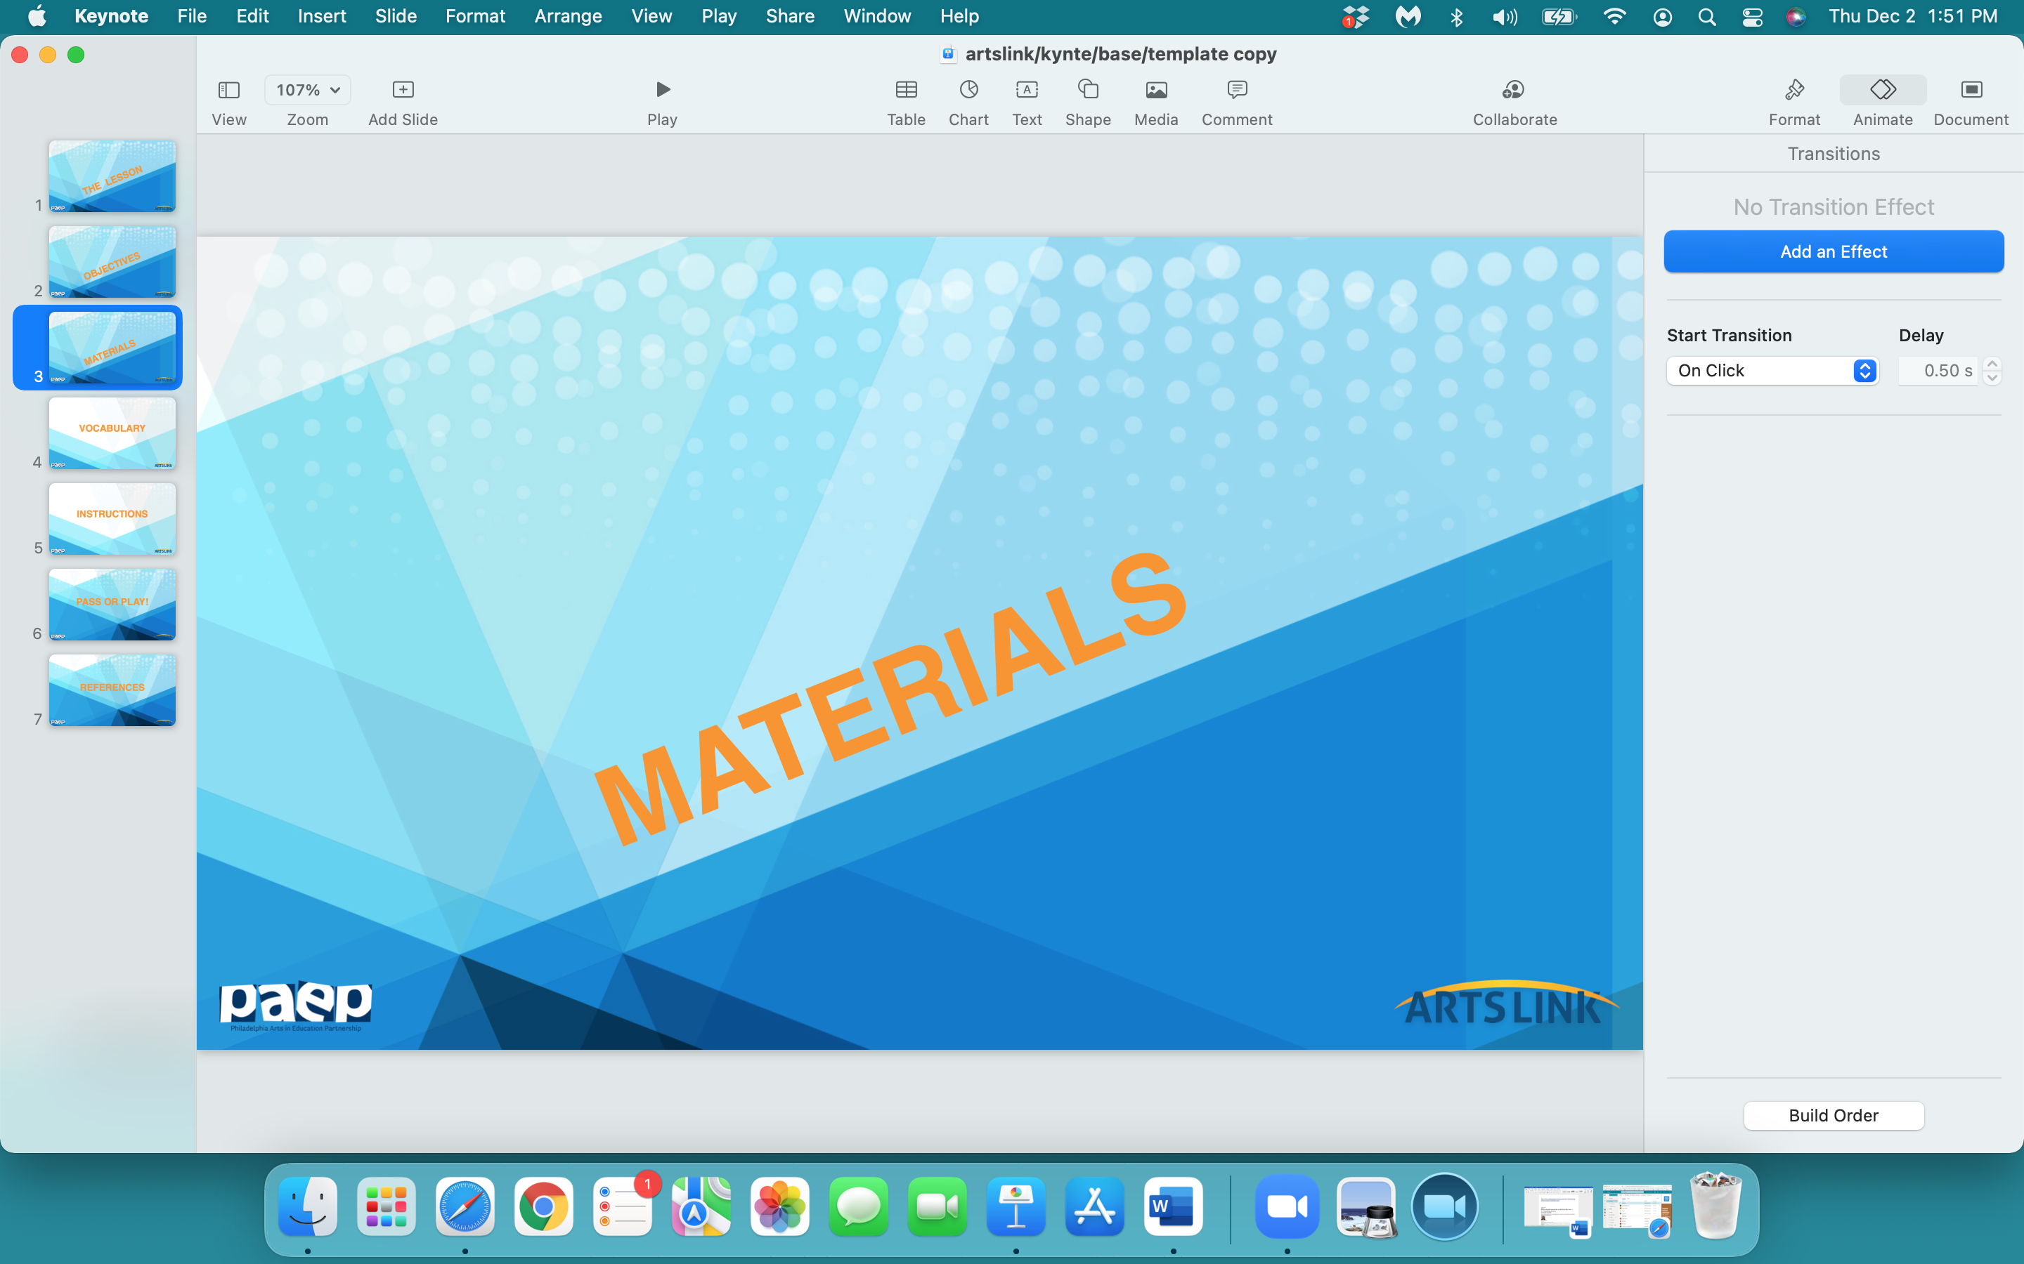

Slide 6
notebook
pencil
scissors
poster board
markers
colored pencils
glue stick (for session #2)

Slide 7
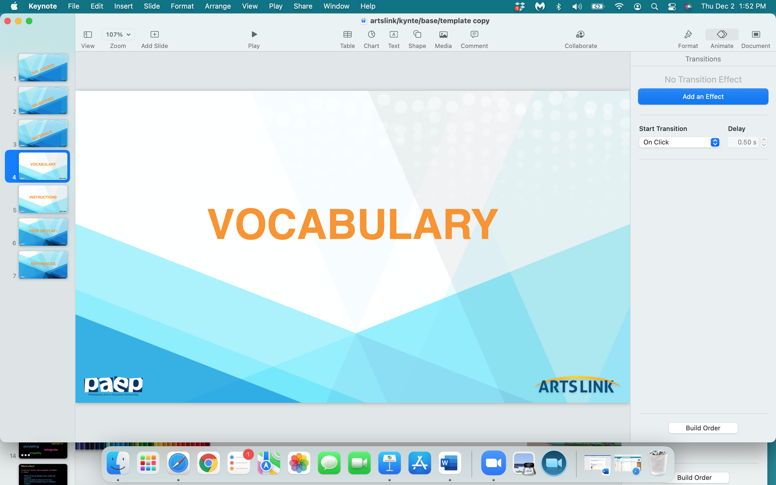

Slide 8
shape
Elizabeth Murray
‘sculptured painting’
‘meaning’ of colors
configuration
contour

Slide 9
The
Meaning Of Colors

Slide 10
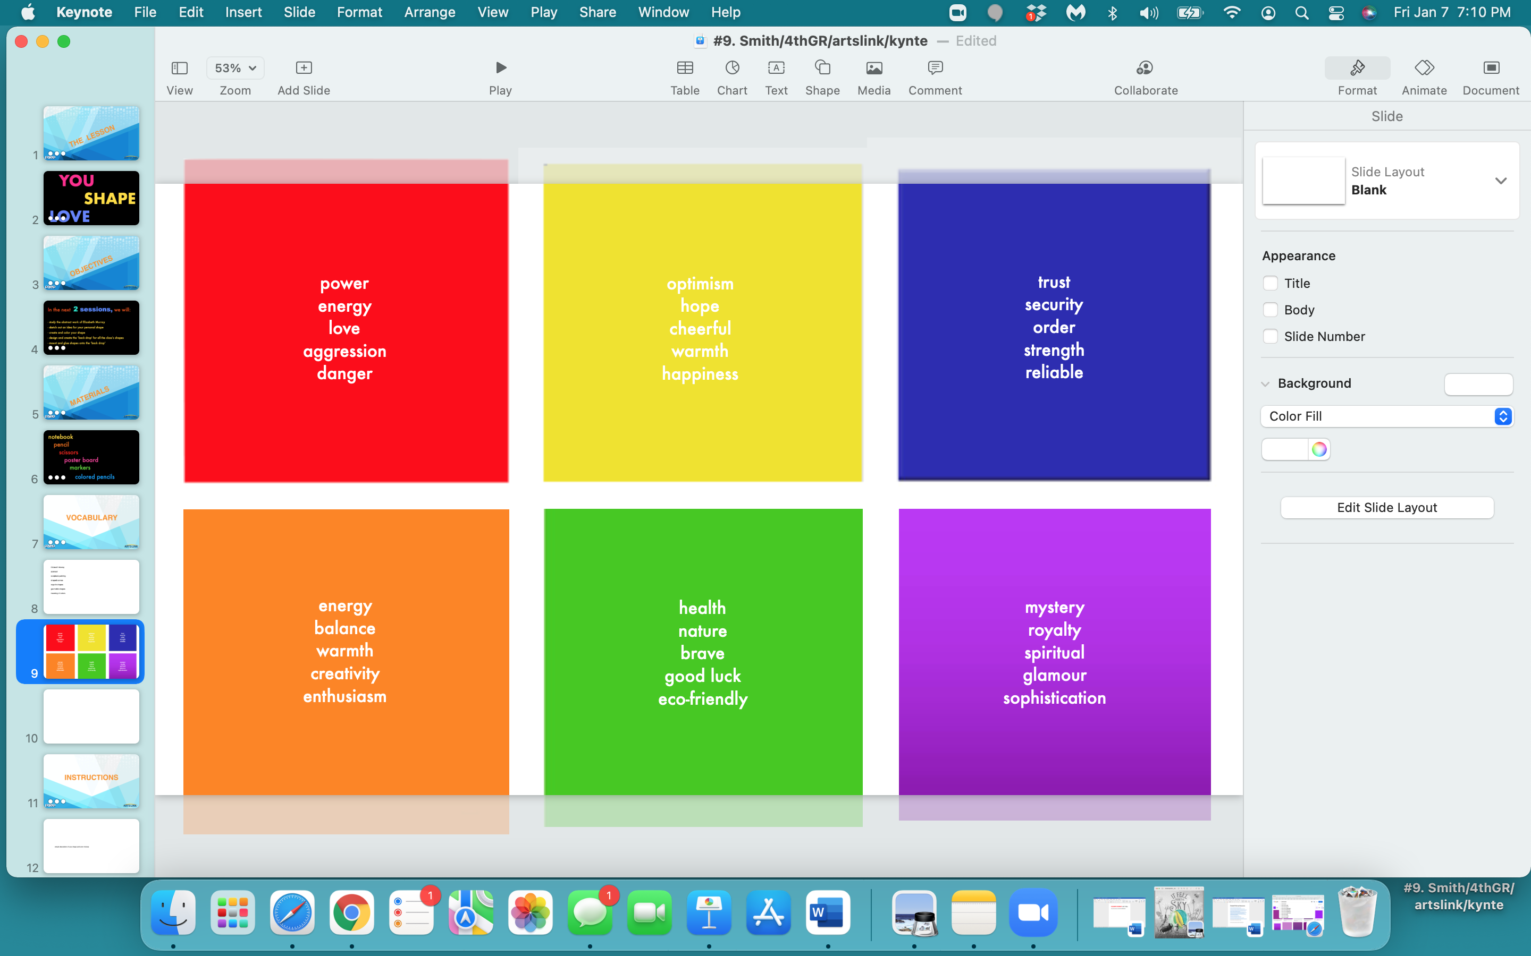

Slide 11
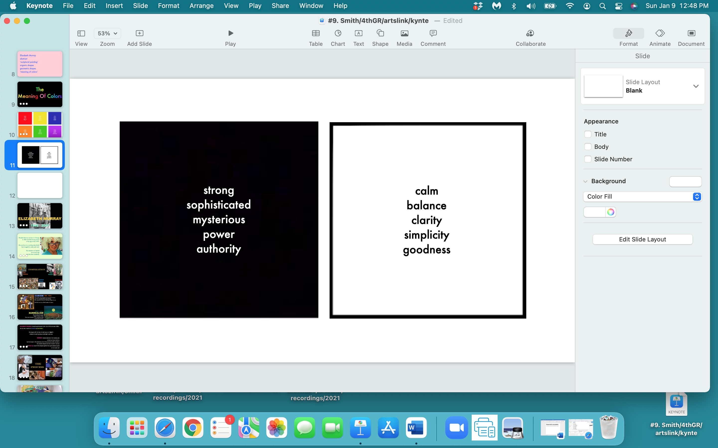

Slide 12
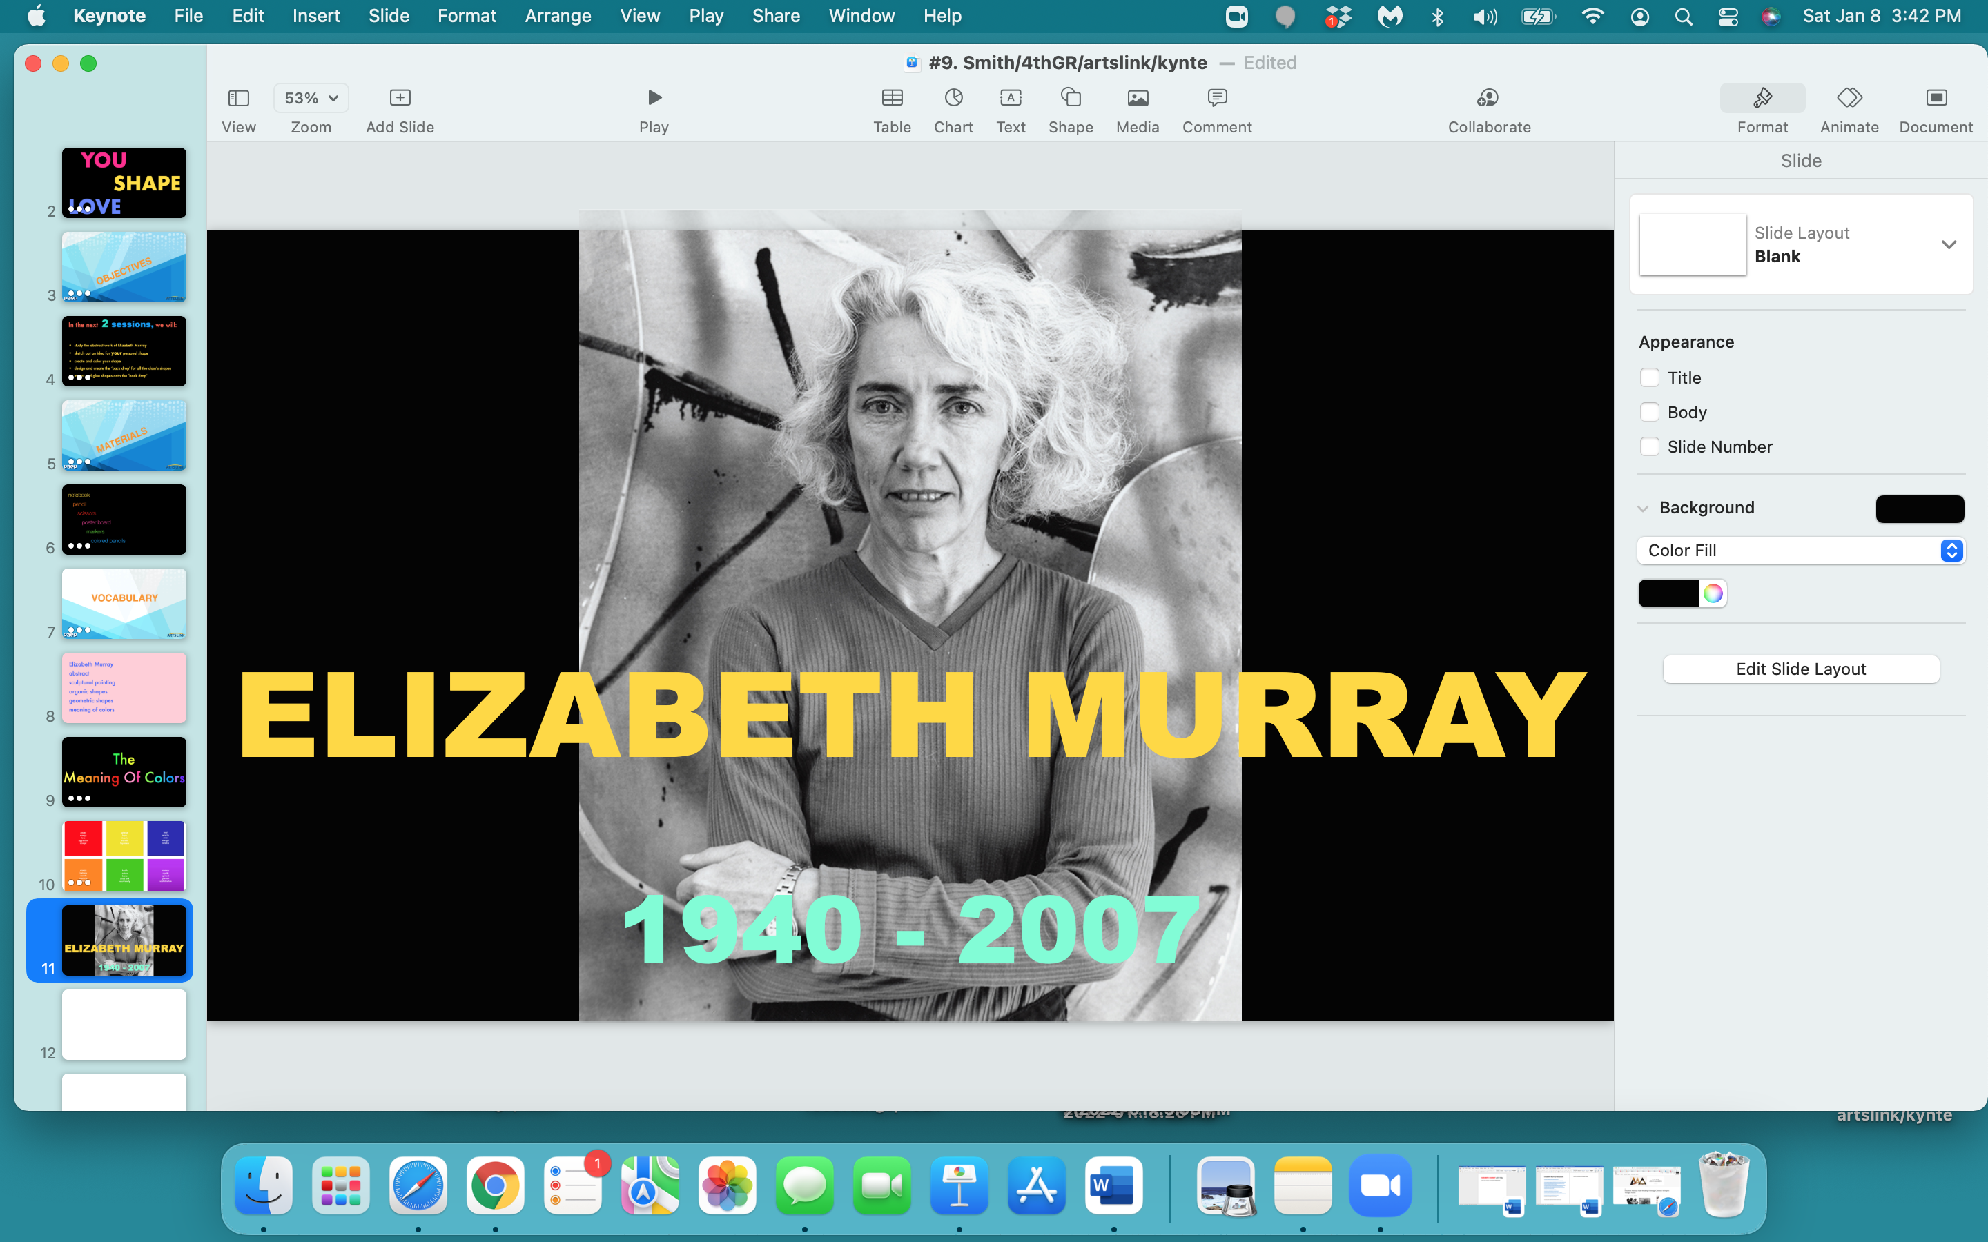

Slide 13
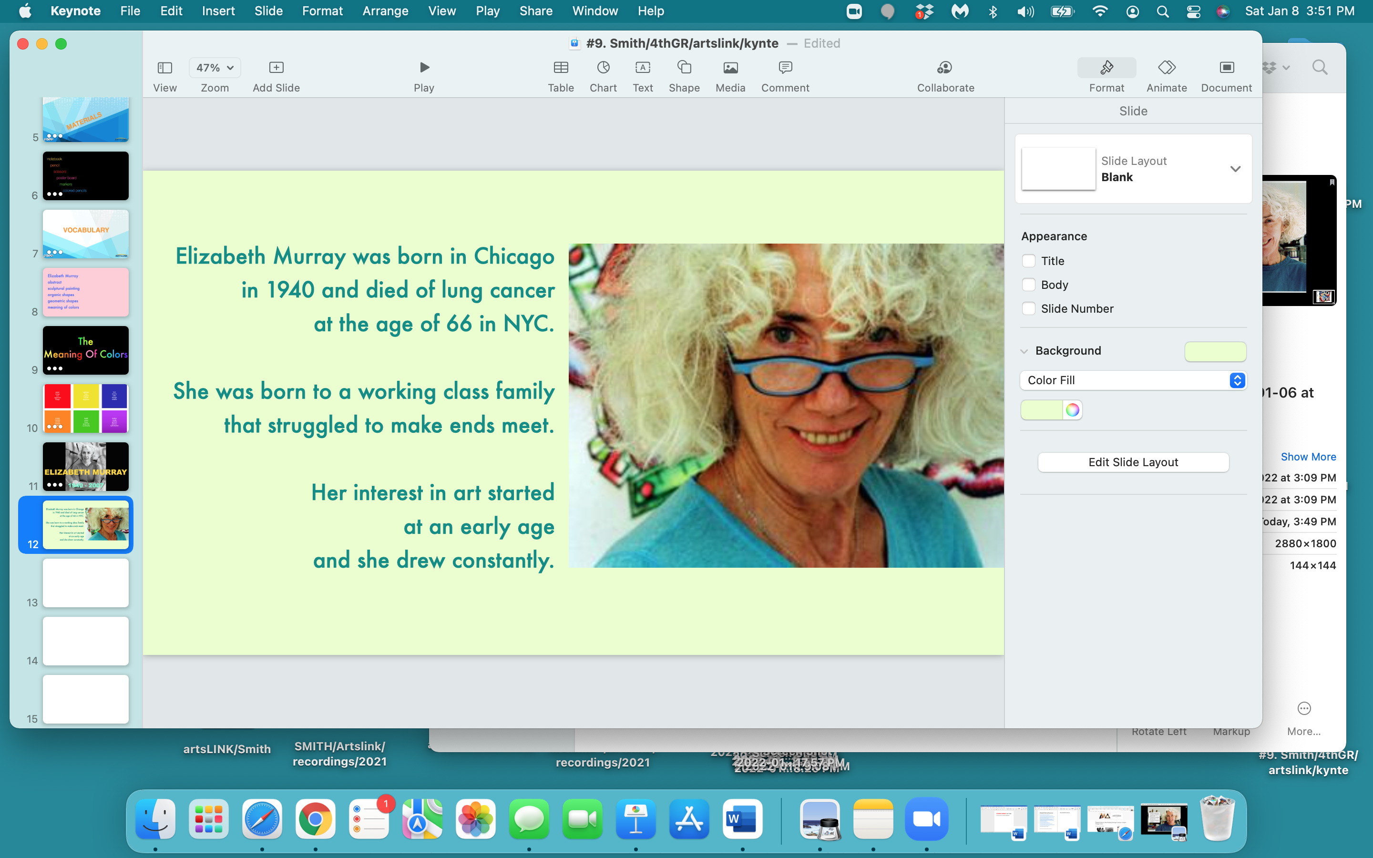

Slide 14
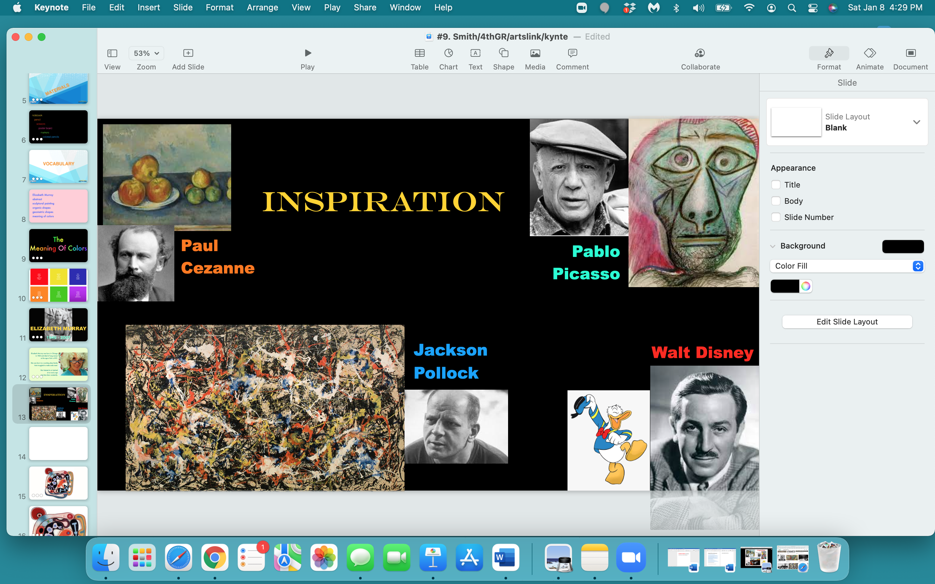

Slide 15
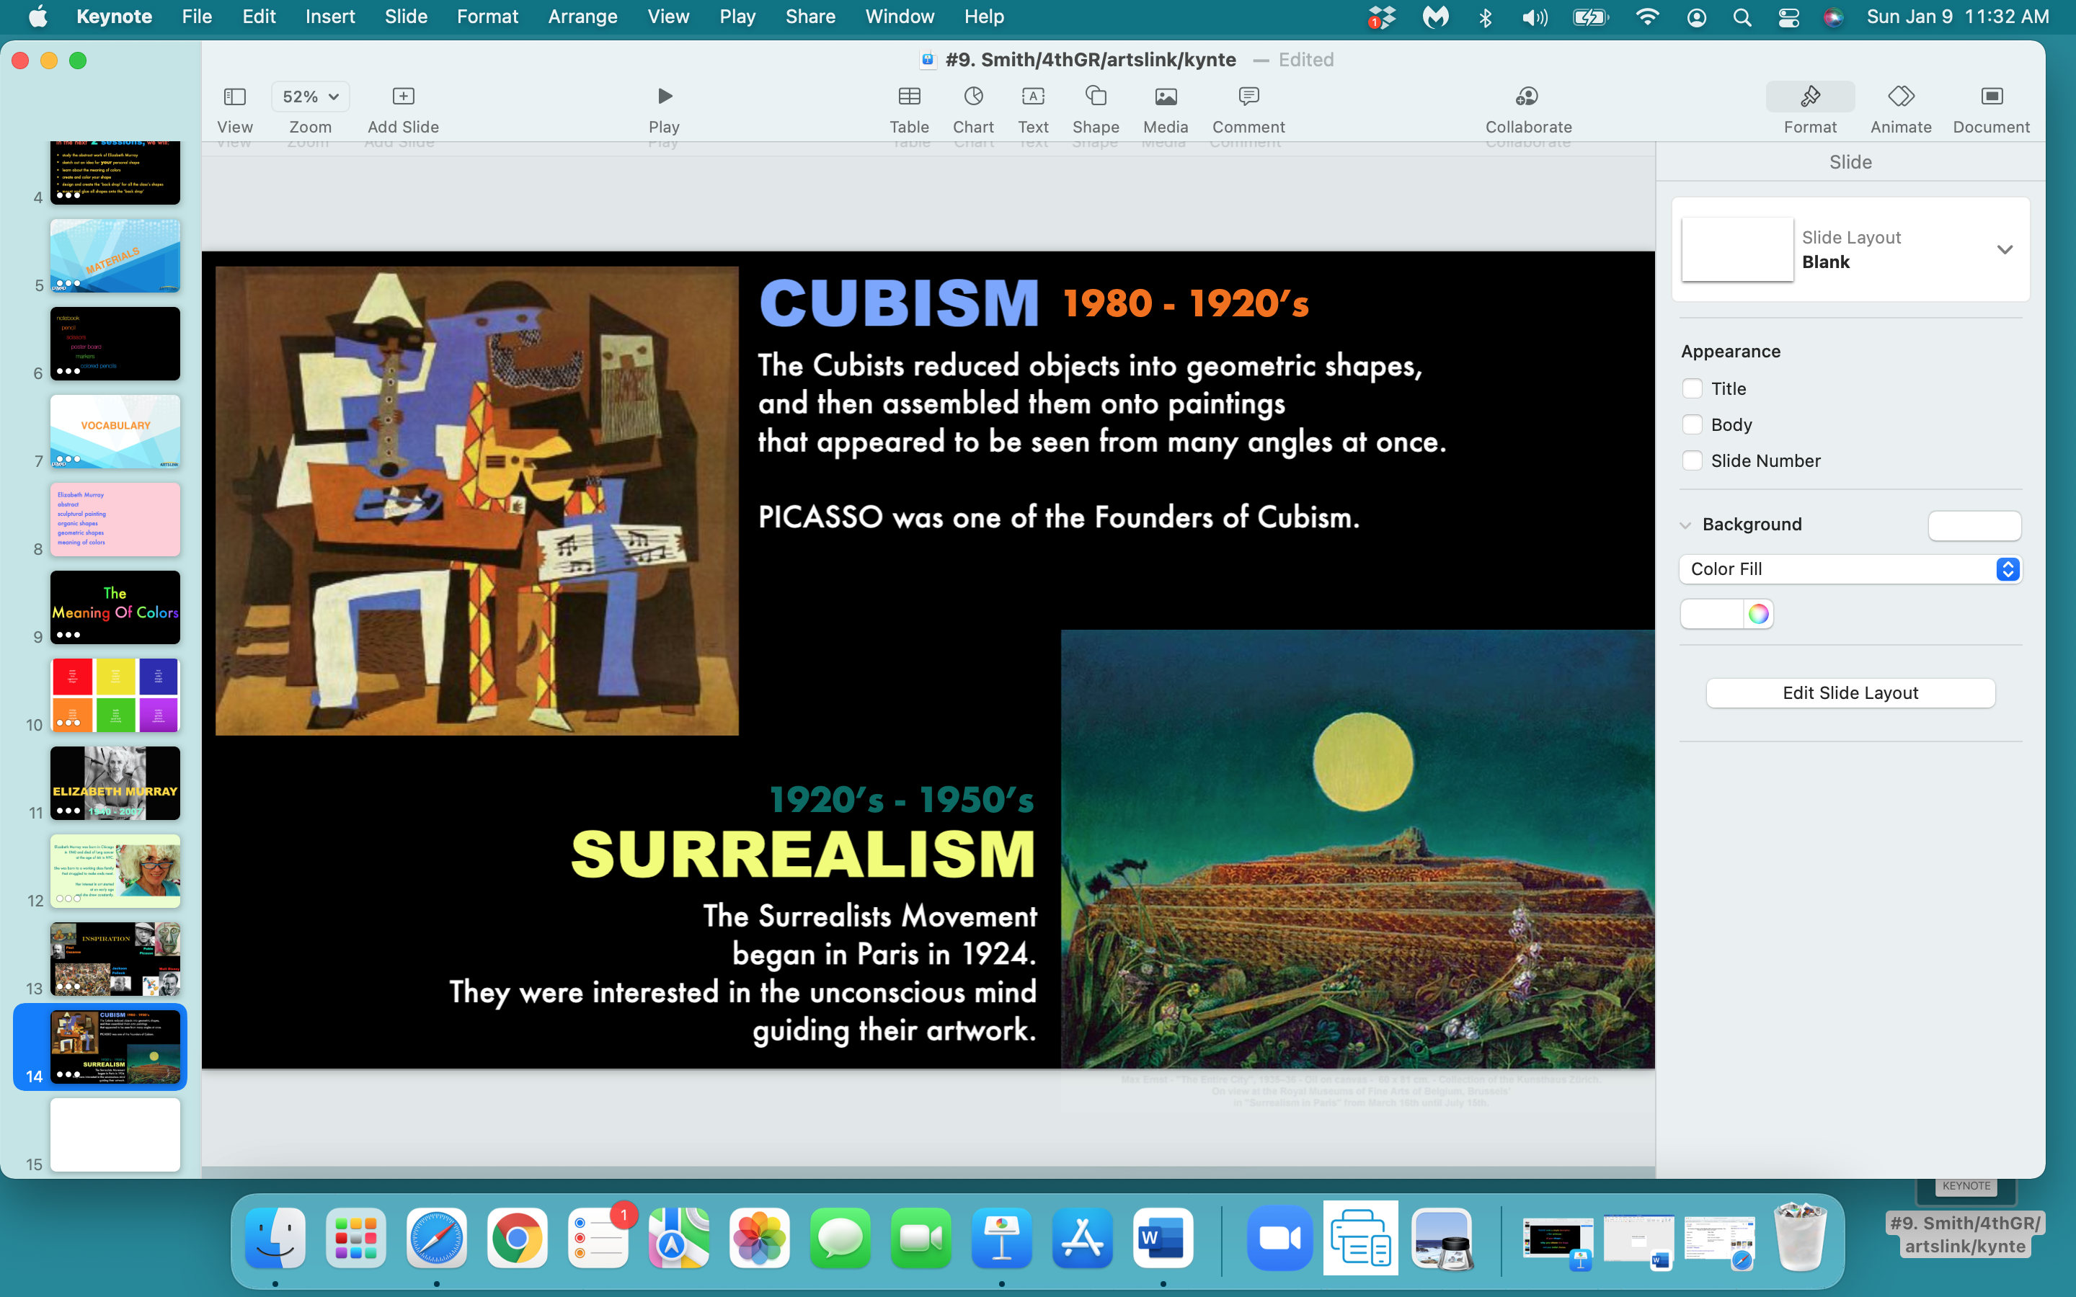

Slide 16
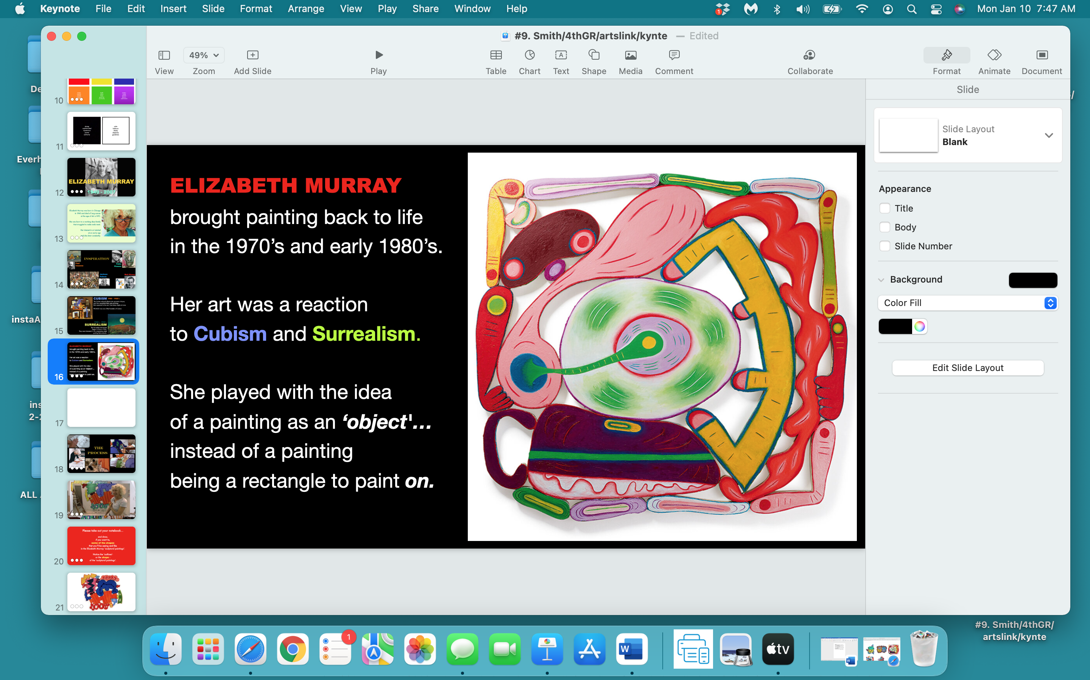

Slide 17
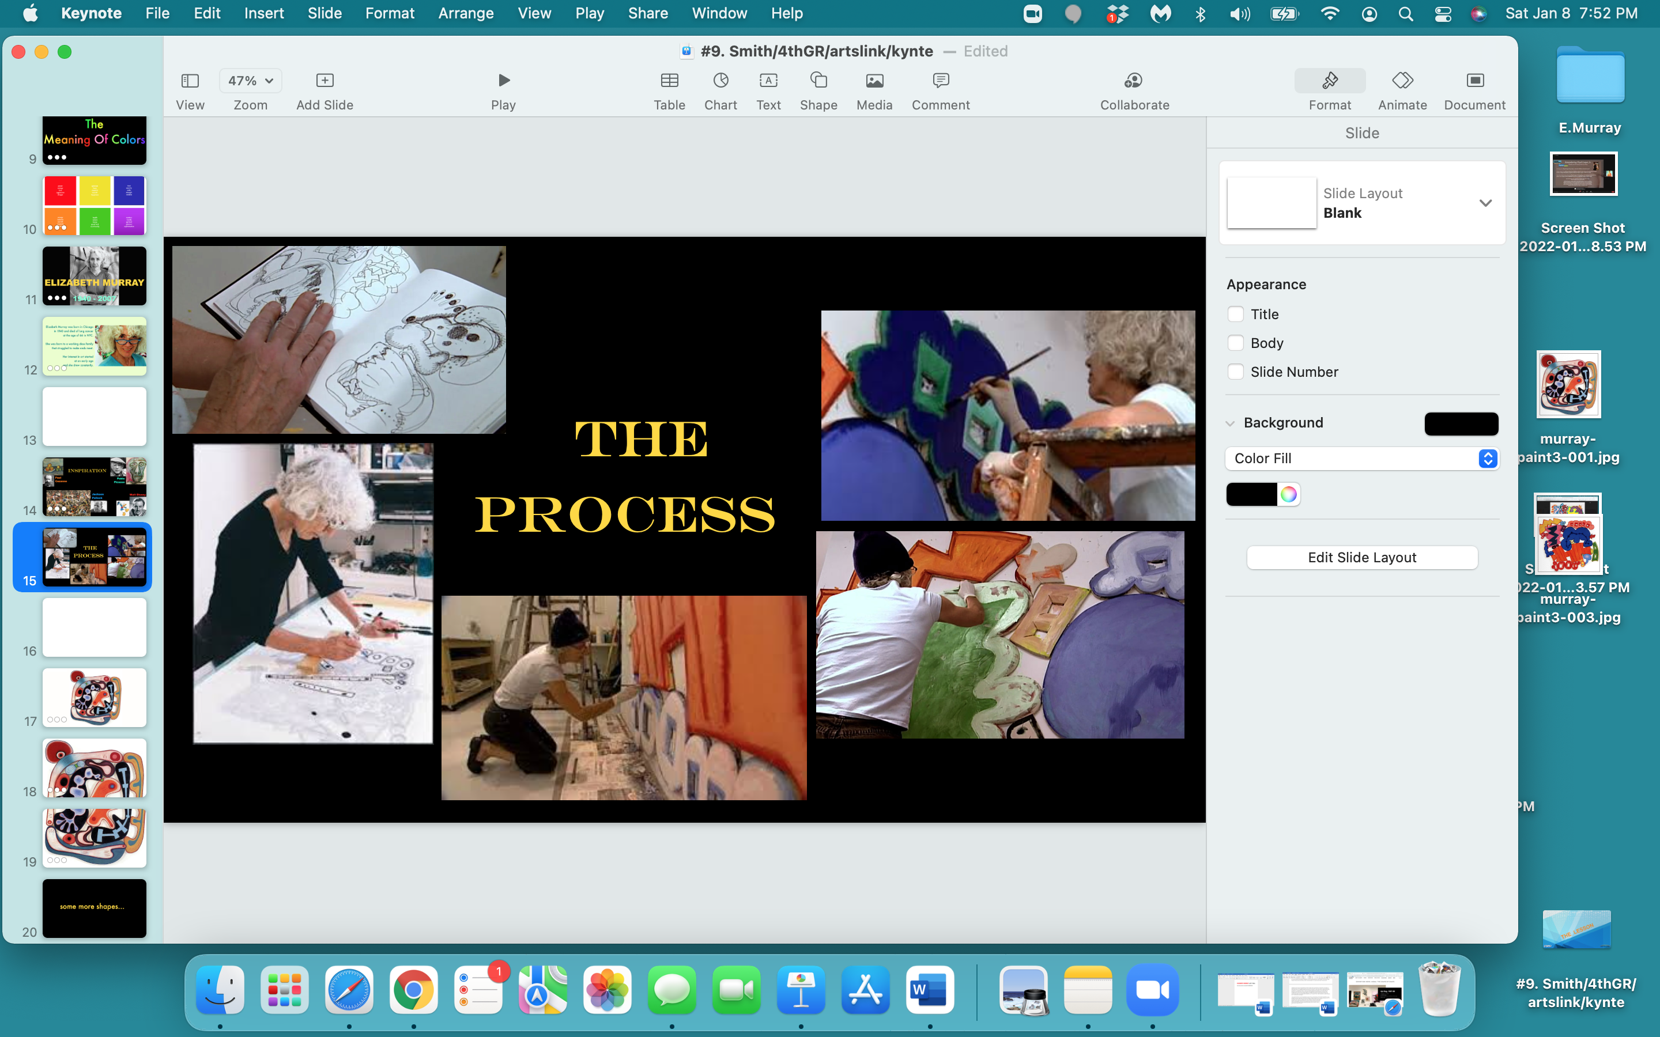

Slide 18
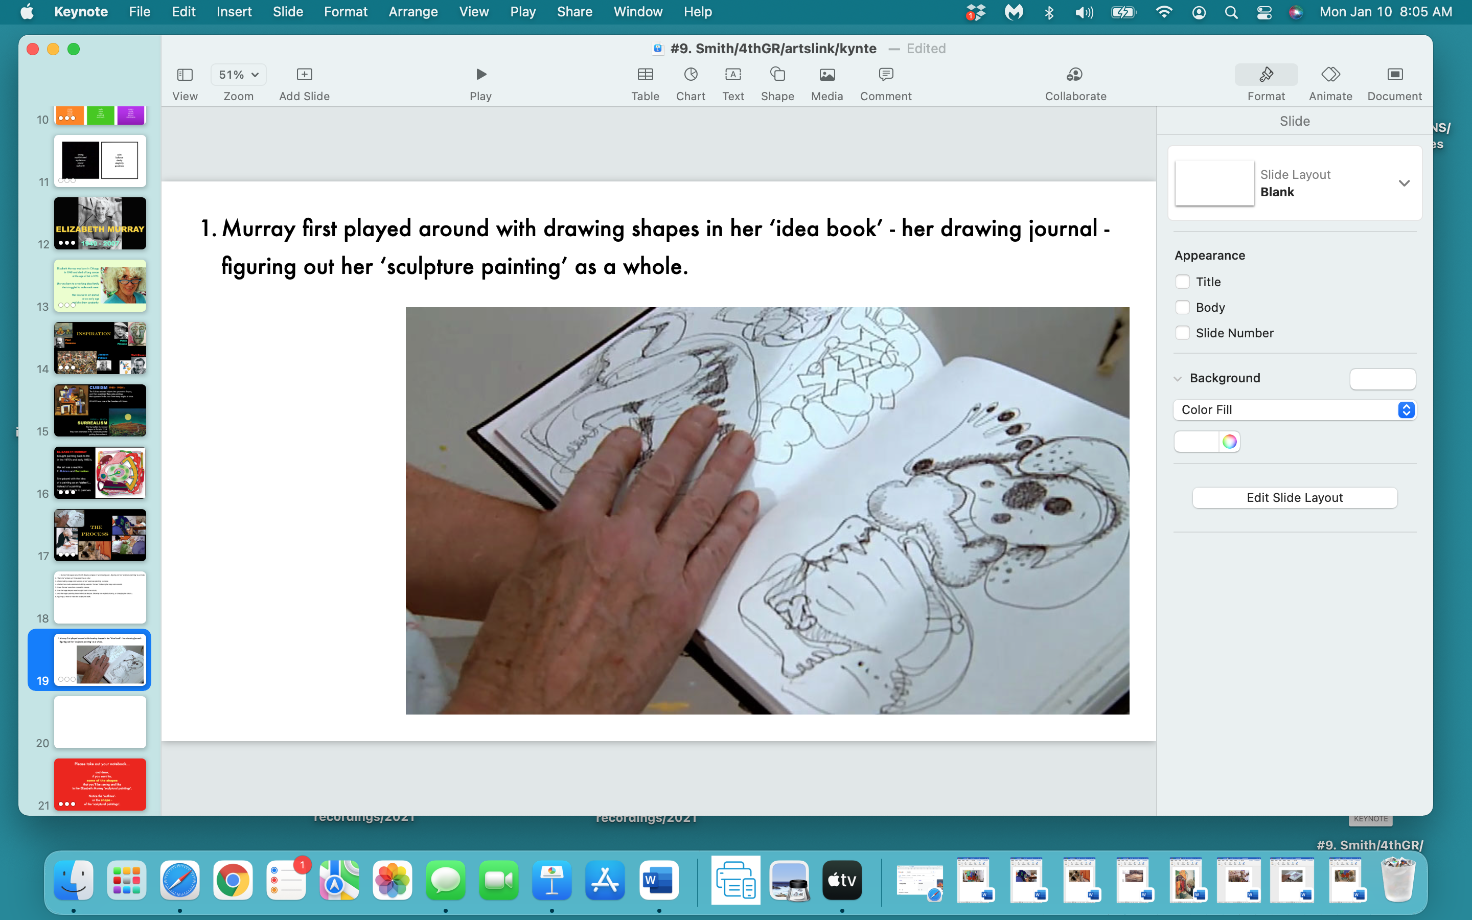

Slide 19
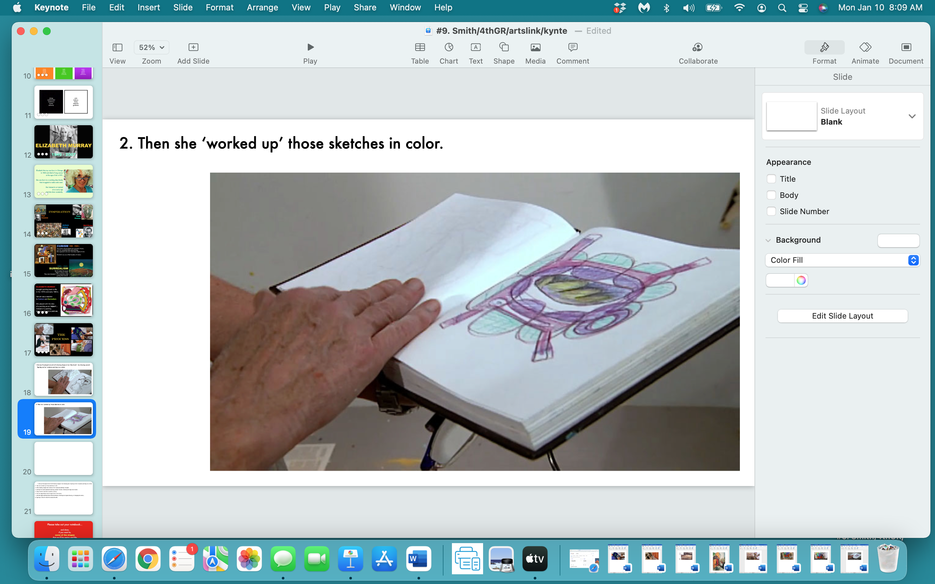

Slide 20
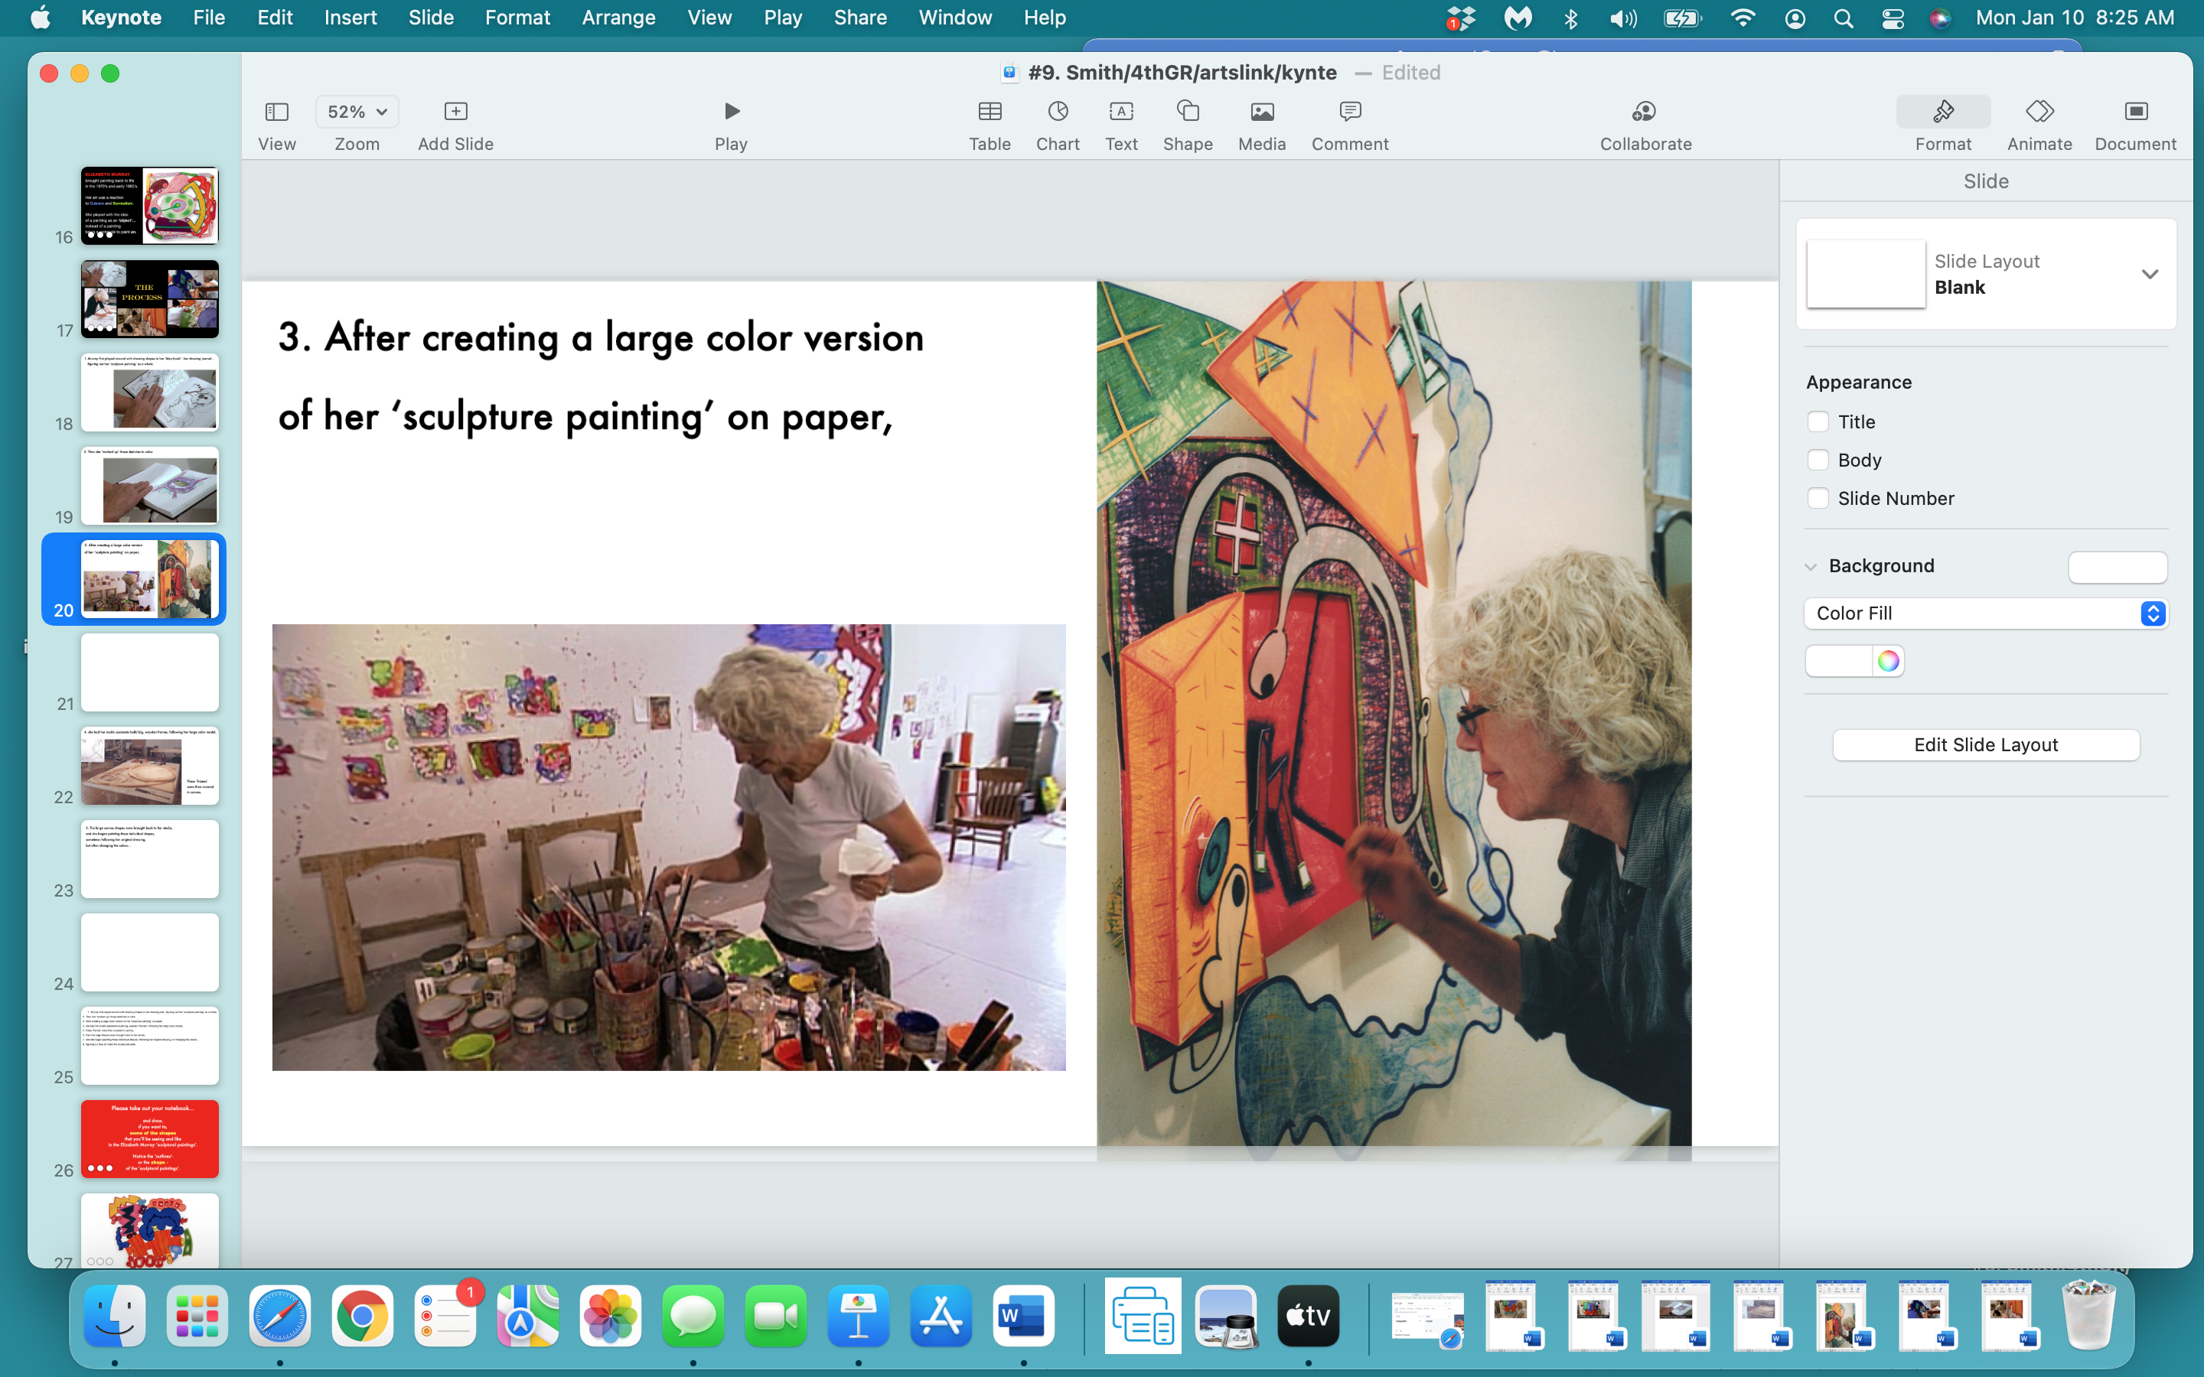

Slide 21
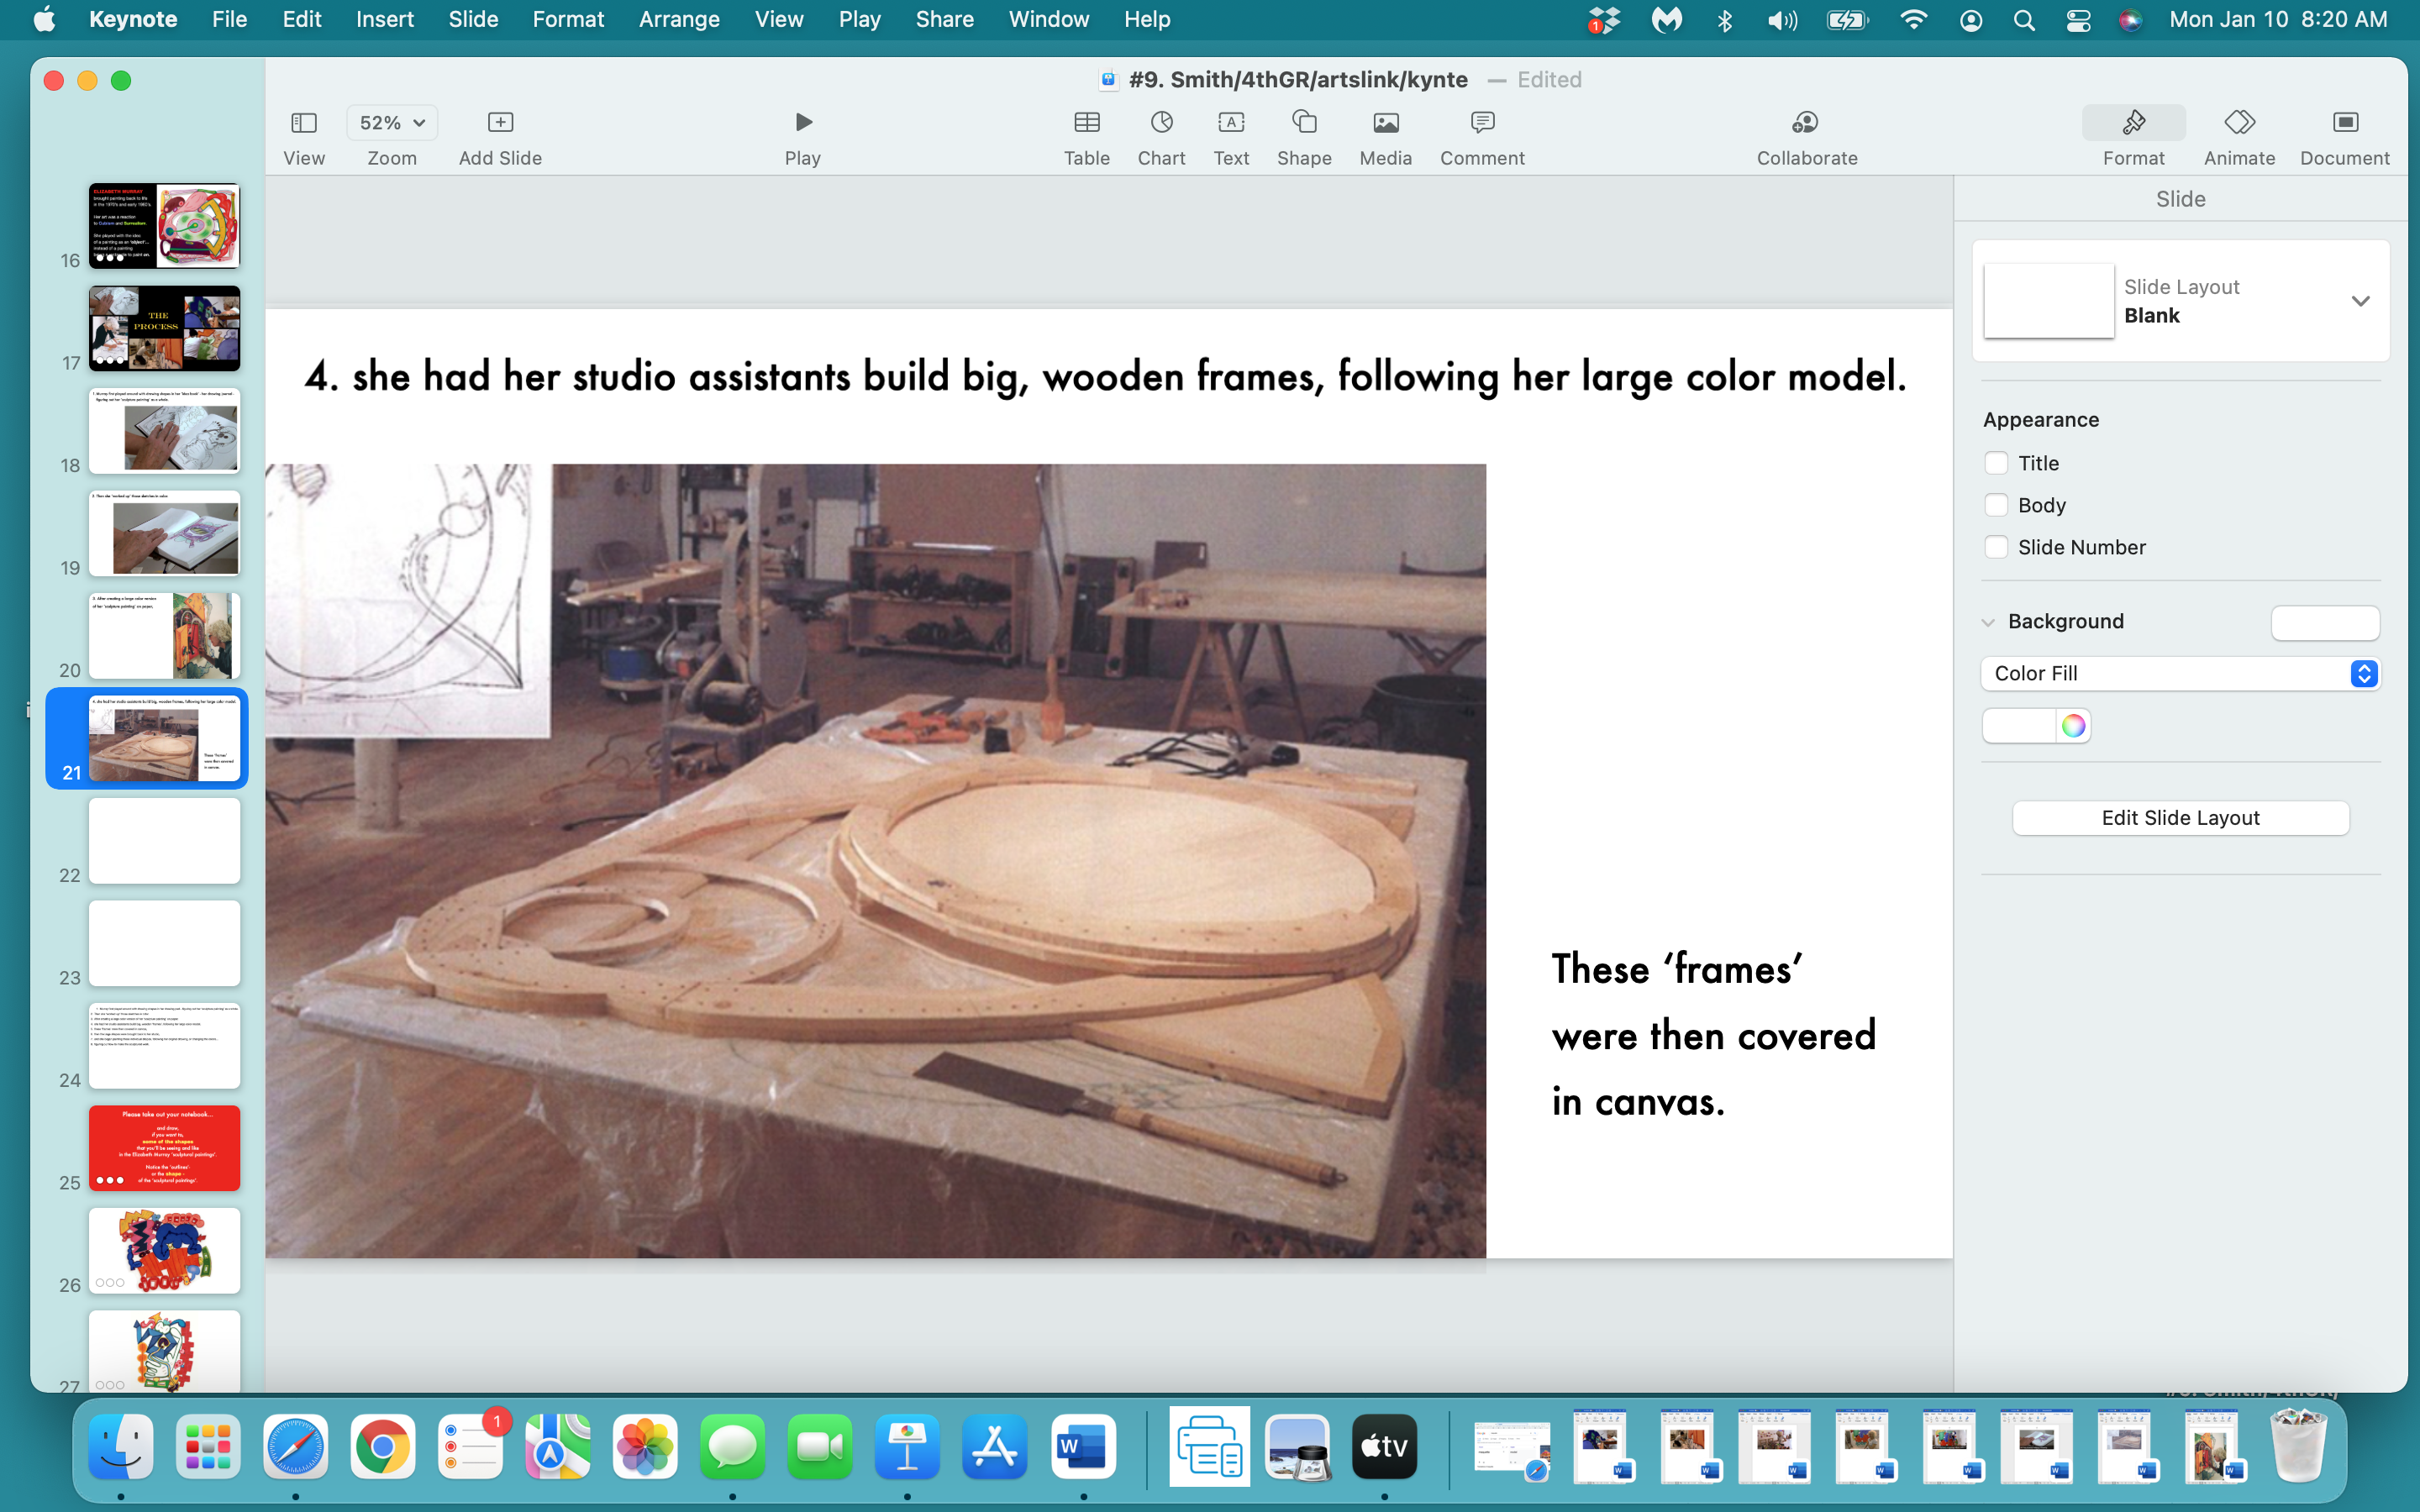

Slide 22
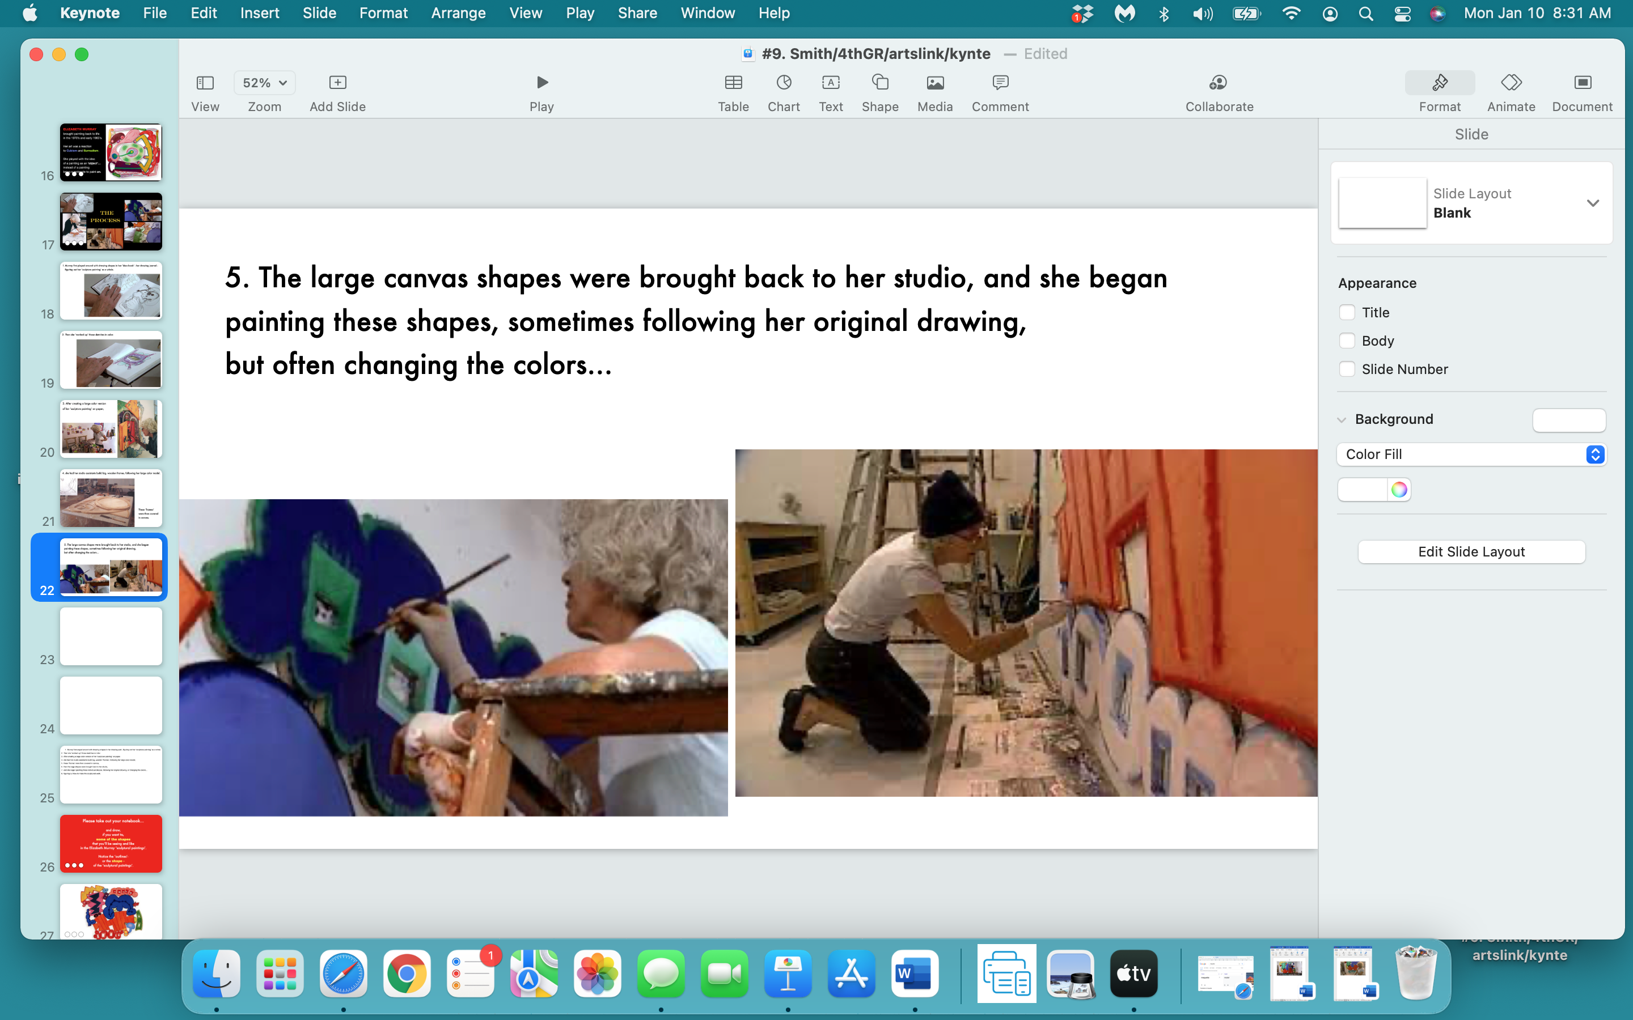

Slide 23
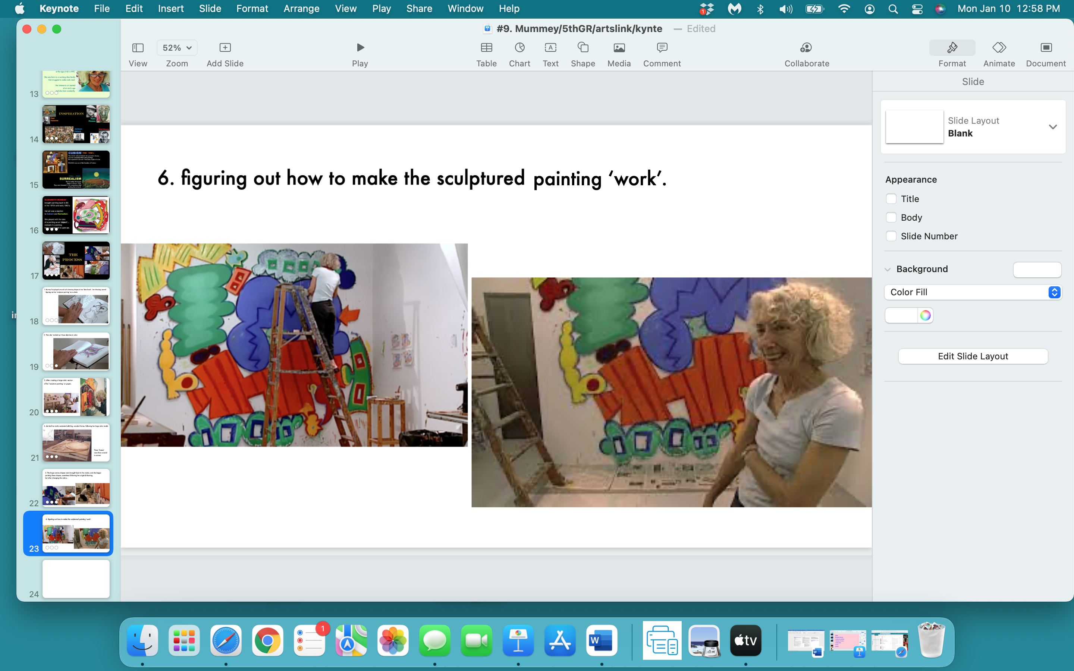

Slide 24
Please take out your notebook…
and draw,
if you want to,
some of the shapes
that you’ll be seeing - and like -
in the Elizabeth Murray ‘sculptured paintings’.
Notice the ‘outlines’-
or the configuration -
of the ‘sculptured paintings’.

Slide 25
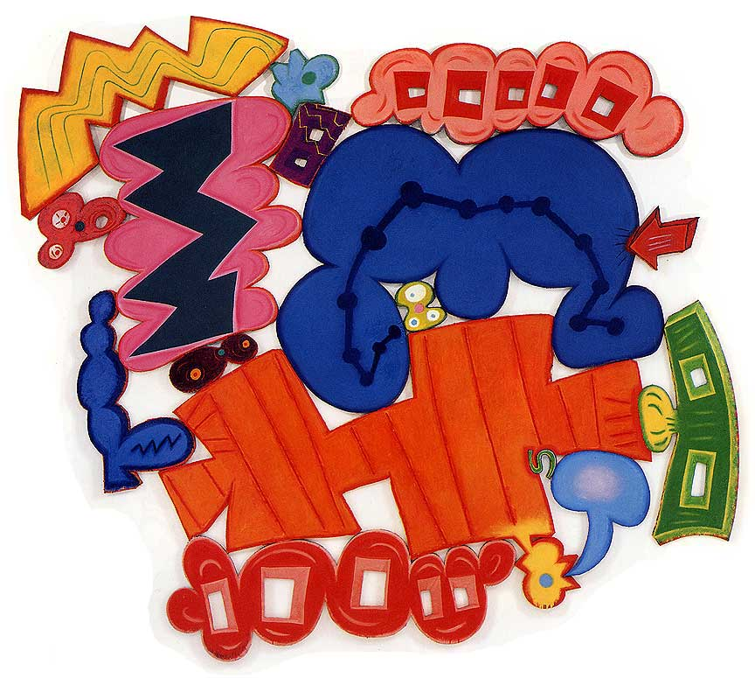

Slide 26


Slide 27
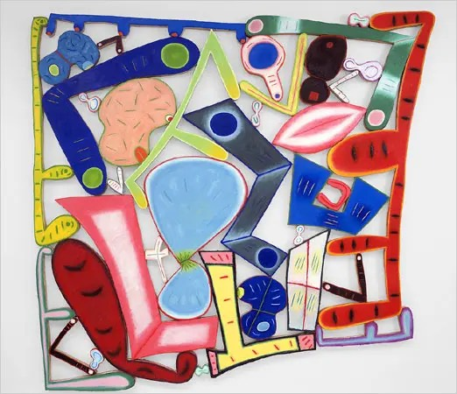

Slide 28
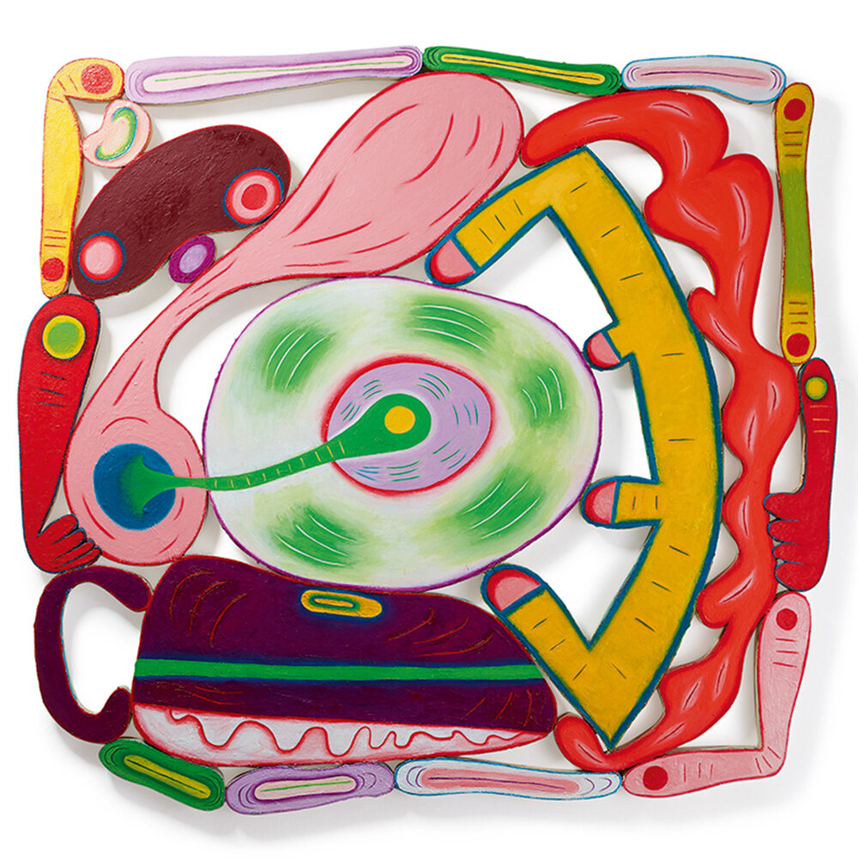

Slide 29
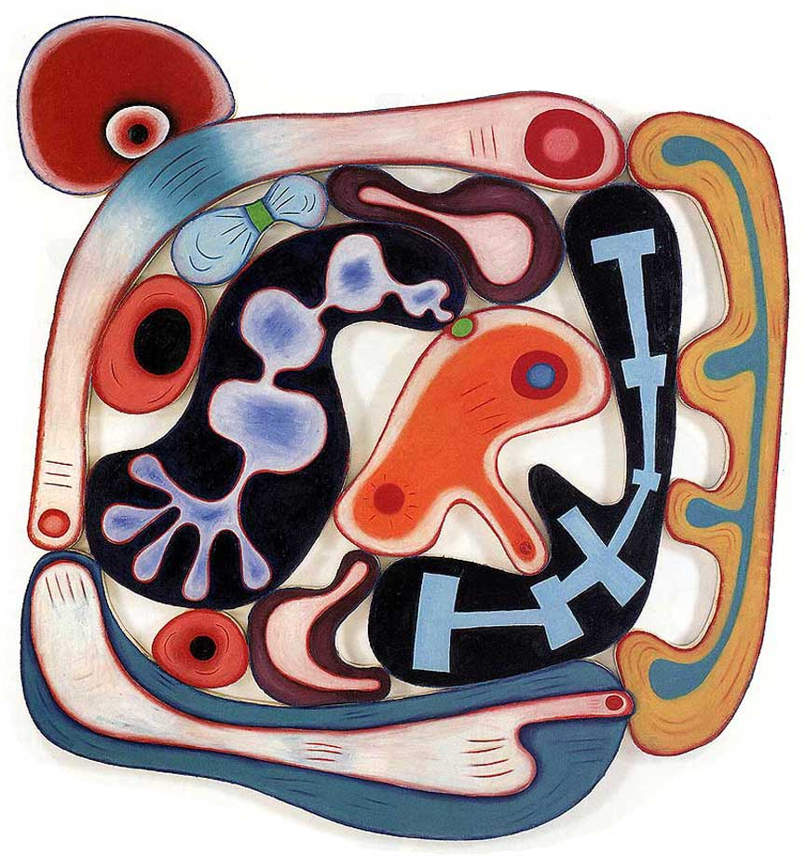

Slide 30
some more shapes…

Slide 31
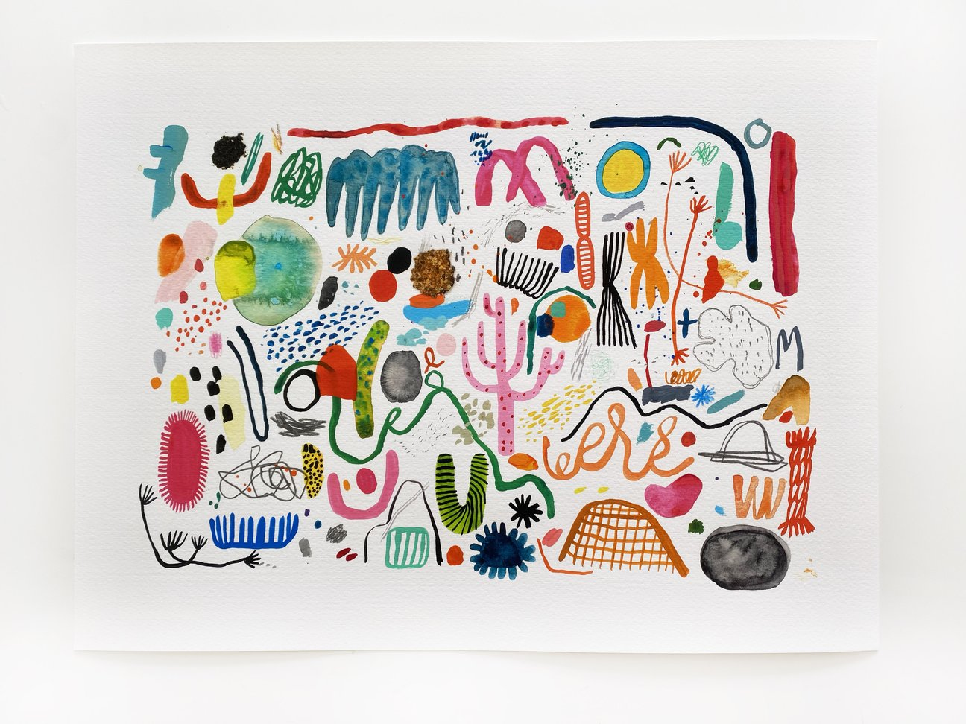

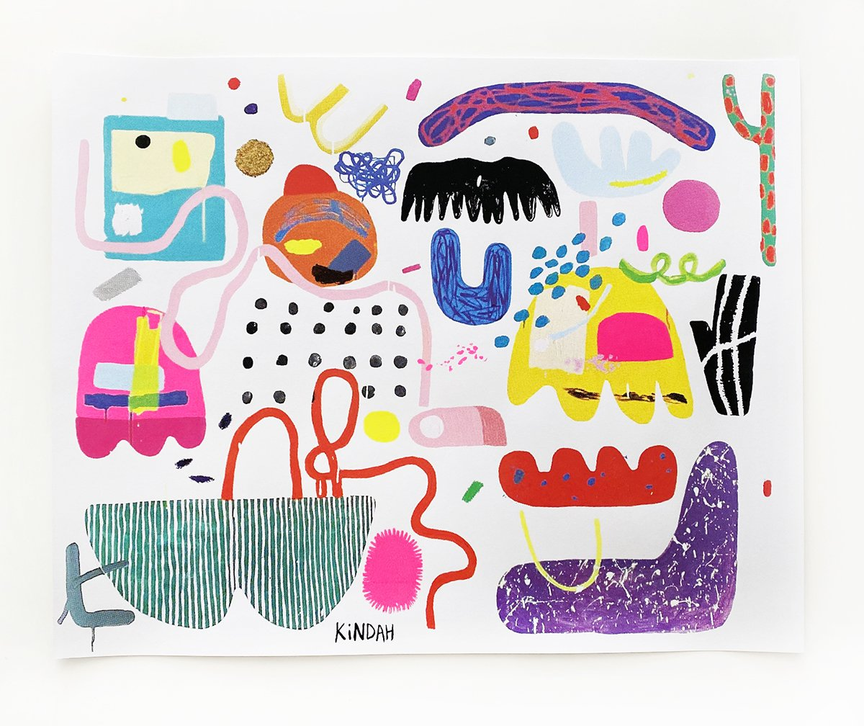

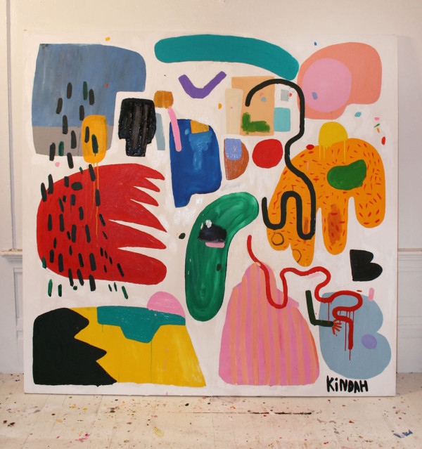
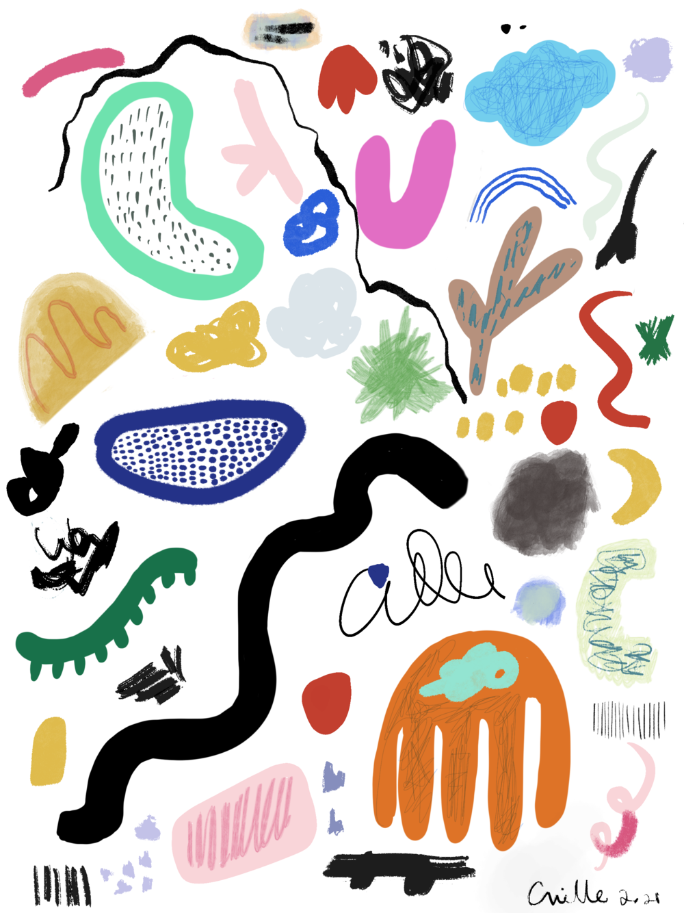
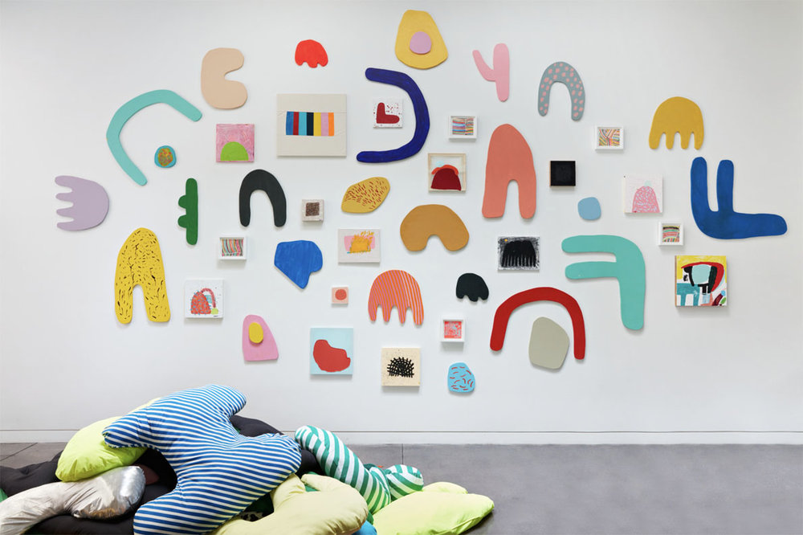
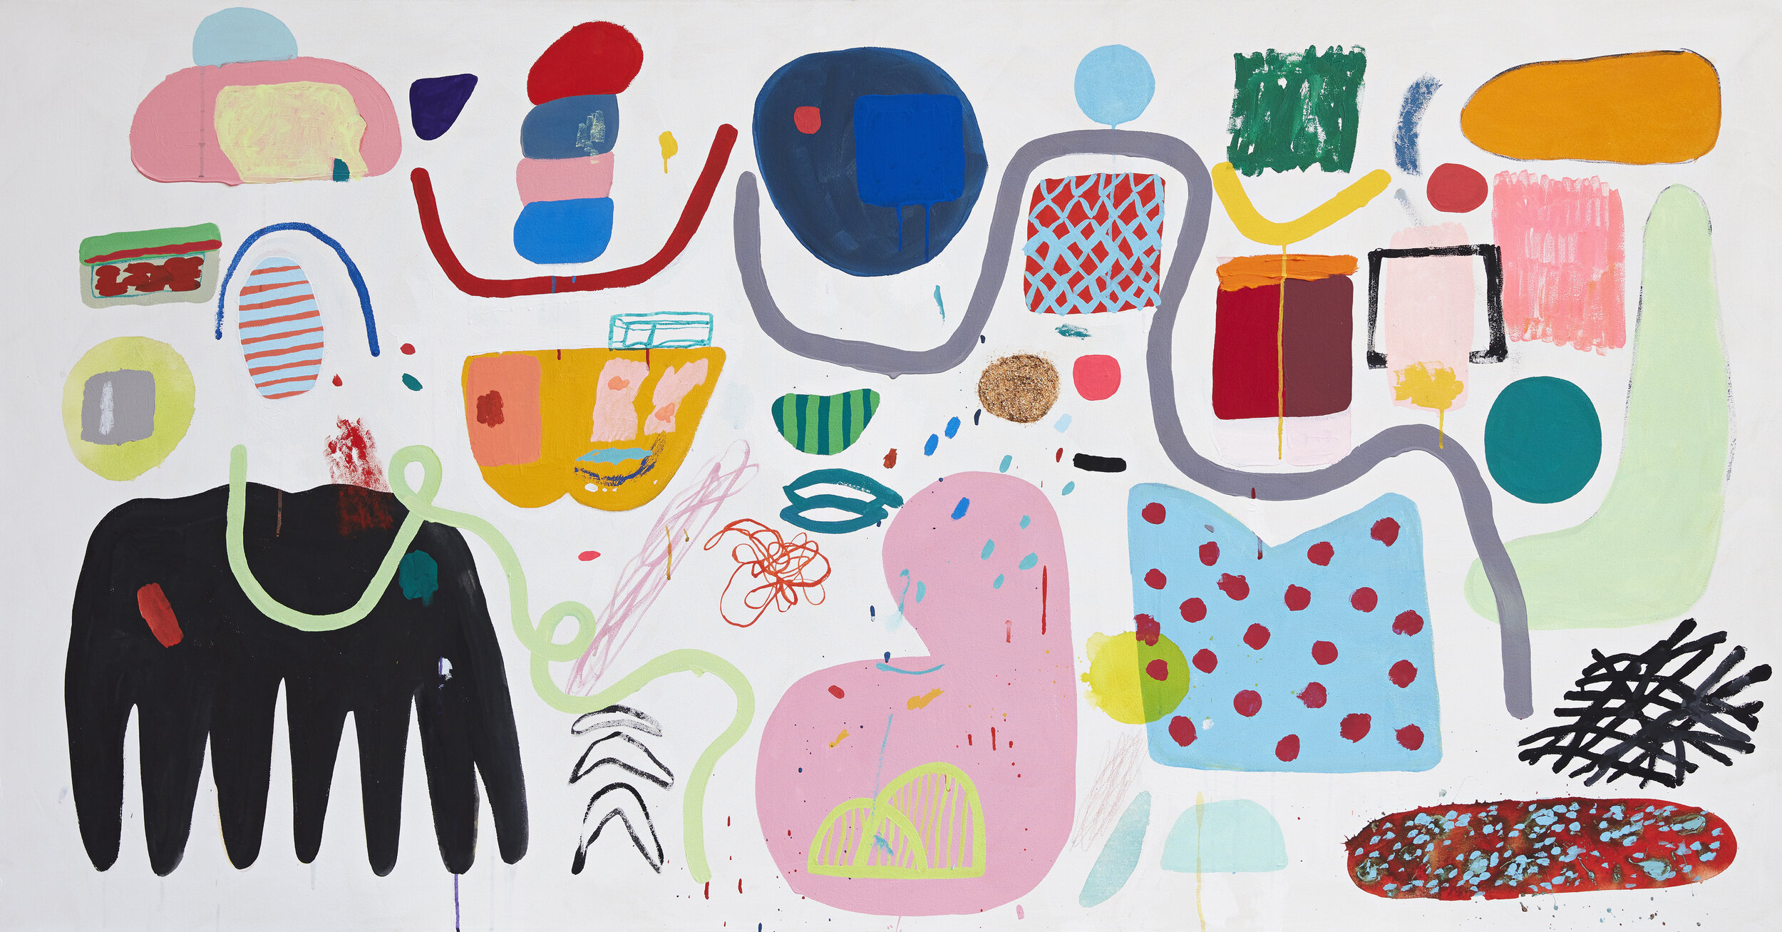

Slide 32
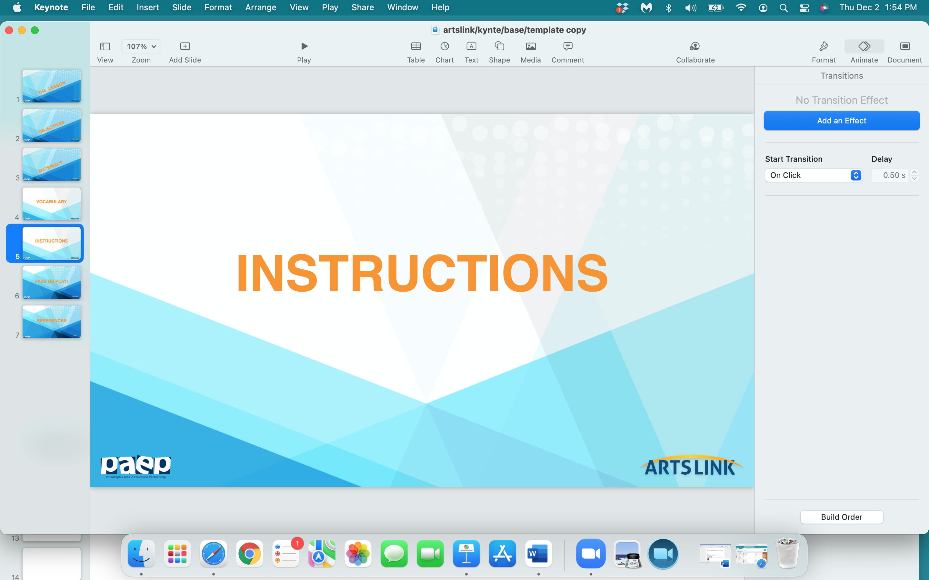

Slide 33
The Instructions:
Sketch your shape in your notebook in pencil…make several sketches.
Color your shape in your notebook - try out different colors.
Now - figure out how big or how small you want your shape to be…
and draw your shape (in pencil) on a sheet of poster board.
Several students will be able to draw
and cut out their shapes
from one sheet of posterboard.

Slide 34
4. OK - you’ve drawn your shape on a section of the posterboard.
Cut off that section of posterboard,
bring the section back to your desk
and start coloring your shape.
Do you want a ‘border’ in your shape?
Once your shape is colored - finished - cut it out of the posterboard.

Slide 35
5. Now comes the next challenge.
As a class - figure out the overall configuration of the background -
the shape of the background.
If you used 8 posterboards to cut out all the classes’ shapes,
then you must use 8 posterboards to make up the background.
Makes sense - right?

Slide 36
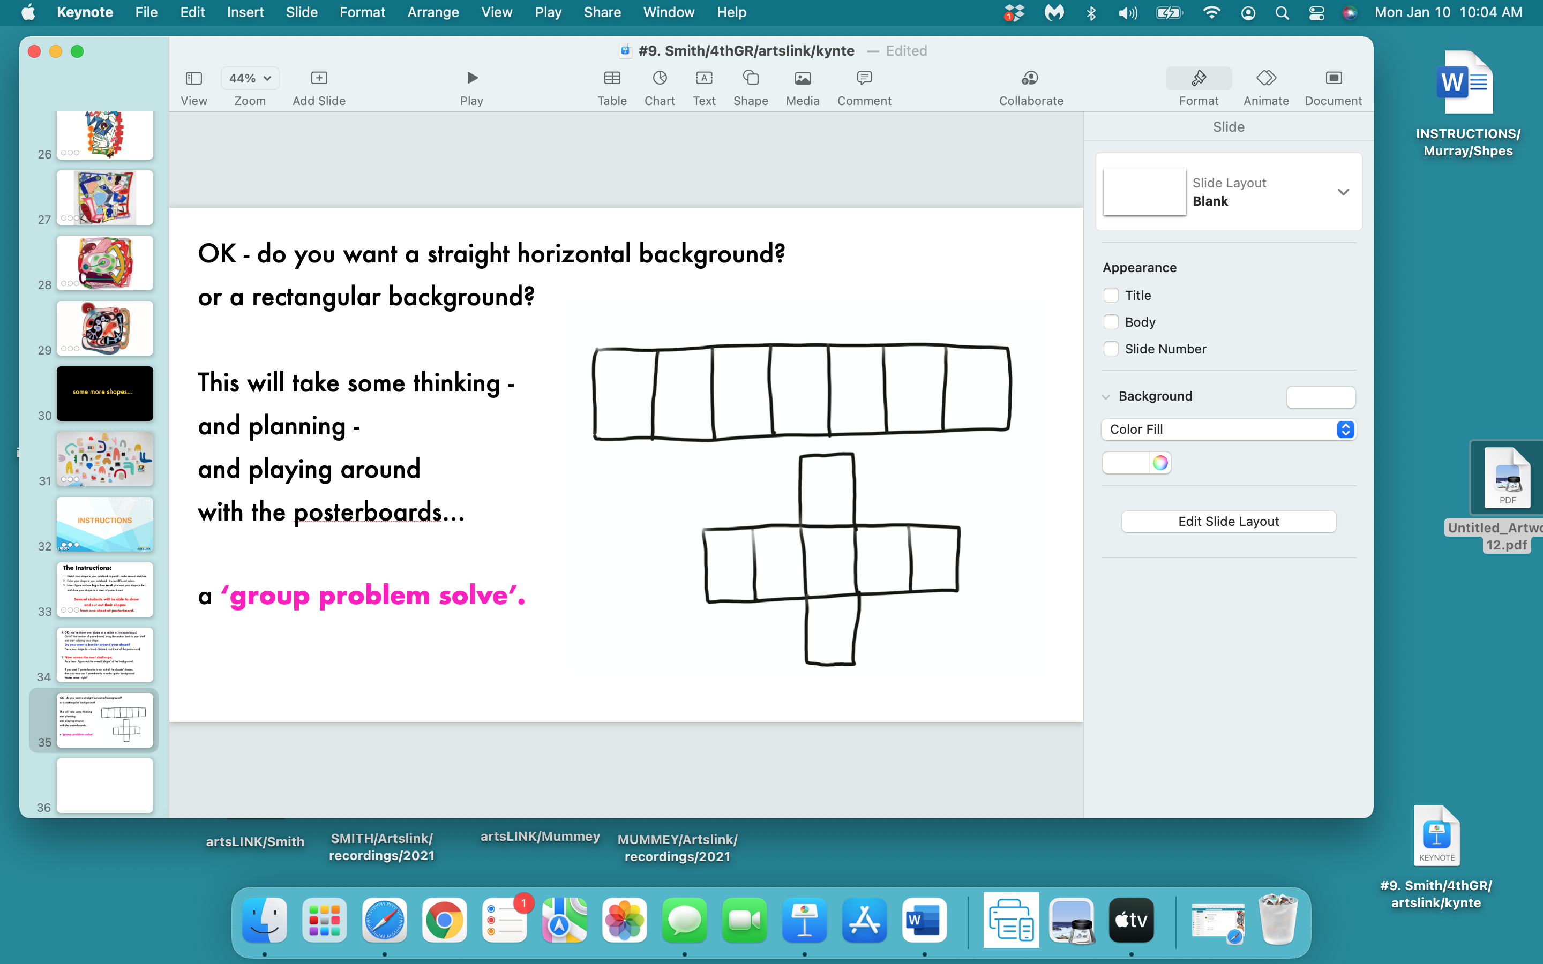

Slide 37
Once you have
the configuration -
or the shape -
of your background
figured out…

Slide 38
place everyone’s finished colored shapes
on the poster board ‘background’.
Do you want all the shapes to ’touch’
the other shapes?
or not?
Figure out the best configuration -
the best arrangement - of shapes…
and glue them down.

Slide 39
IF YOU WANT TO DO THIS…
cut ‘around’ all the shapes on the background…
creating a background that is ‘contoured’,
or curved,
around all the shapes
(just like Elizabeth Murray’s ‘sculptured paintings’).

Slide 40
  E X T E N S I O N A C T I V I T Y :
Write a simple description -
(a few sentences) -
of your shape…
why you chose that shape,
  and why you chose the colors you did.

Slide 43
Elizabeth Murray:
“For a couple of years, I’ve been working with
cutting out shapes and kind of glomming them together.
You know - like - making a zigzag shape
and sort of a rectangular shape
and a circular bloopy fat cloudy shape…
and they are cartoony
and blumpy and rounded and sort of wacky”.

Slide 44
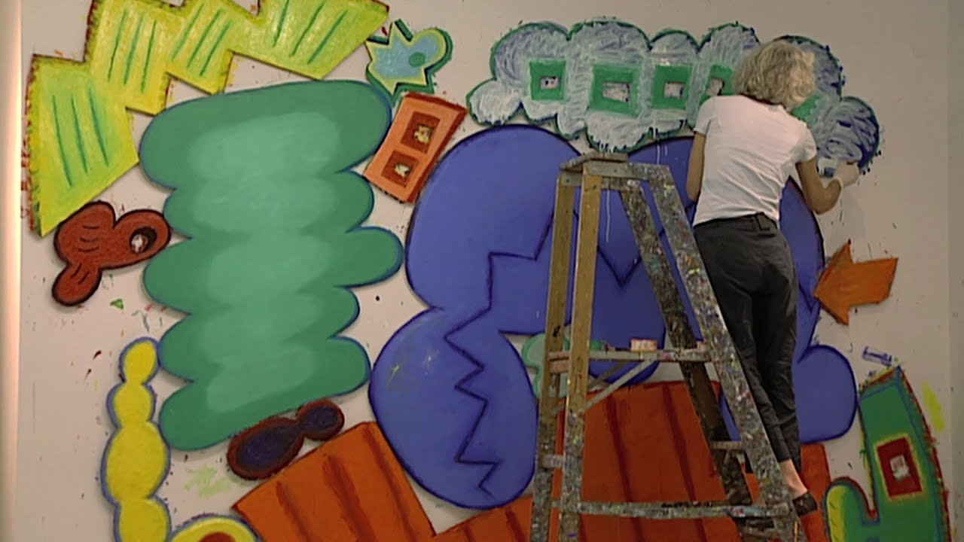

Slide 45
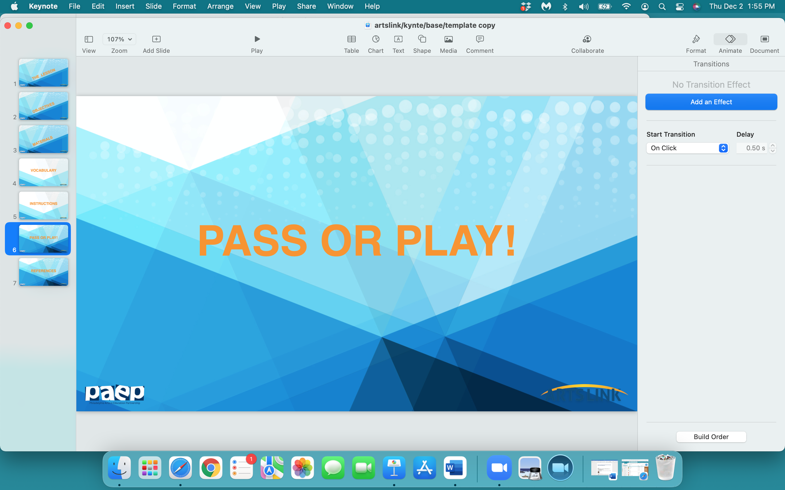

Slide 46
what one thing
did
you
learn
today…pass or play?

Slide 47
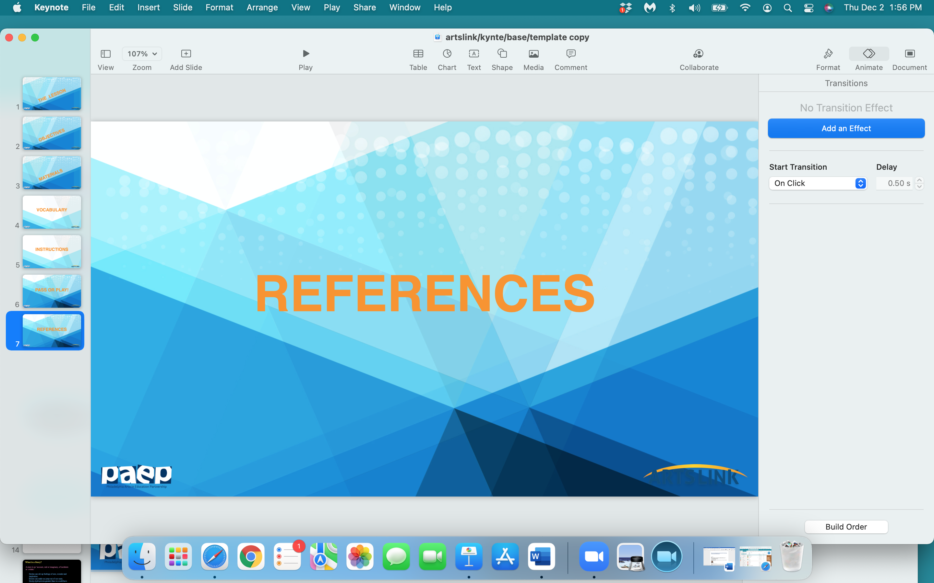

Slide 48
https://www.incredibleart.org/lessons/high/wendy-paint.htm
https://www.moma.org/research-and-learning/teachers/lessons-for-early-learners
http://art-paper-scissors.blogspot.com/2015/01/this-was-fun-little-lesson-my-long-term.html
http://www.methowarts.org/wordpress/wp-content/uploads/2020/04/art-Page-1-from-Methow-Arts-Art-Pages-for-3RD-GRADE-4.20.2020-1.pdf
https://www.pbs.org/wnet/americanmasters/blog/everybody-knowselizabeth-murray-who-was-elizabeth-murray-3-things-you-should-know-about-the-genre-bending-artist/
https://www.artnews.com/art-news/retrospective/archives-elizabeth-murray-shattering-expectations-abstract-painting-1984-9339/
https://www.moma.org/calendar/exhibitions/102?
https://www.artsy.net/artist/elizabeth-murray/works-for-sale
https://art21.org/wp-content/uploads/2017/03/art21_season_two_guide.pdf
http://art-paper-scissors.blogspot.com/2015/01/this-was-fun-little-lesson-my-long-term.html
https://www.slideshare.net/ctanasse46/elizabeth-murray-ppt
https://nymag.com/arts/art/features/36057/
https://www.joy2learn.org/painting-with-elizabeth-murray/tools/oil-paint/
https://www.theartstory.org/artist/murray-elizabeth/

