Slide 2
Tell Me
A
Painting

Slide 6
your journal / notebook
pencil
eraser

Slide 8
top
bottom
right
left
center
portrait
landscape
foreground
background

Slide 9
Let’s do one for fun…

Slide 10
take your notebook, a pencil and your chair and face the back of the room - facing away from the screen
listen to the directions
we’ll have 5 minutes for this…

Slide 13
The purpose of this challenge is –
EFFECTIVE COMMUNICATION.
When you do this activity, one partner is going to draw a sketch of a painting that only the other partner can see.
OK - let’s divide into pairs.
One student will be the ‘describer’.
The other partner will be the ‘drawer’.

Slide 14
Describers:
Describers may only communicate using their words.
Describers may only ‘describe’ the painting – you are not allowed to turn around to look at your partners’ drawing.
Keep your voice at a low level so that the other drawers can hear their partner’s descriptions/directions.

Slide 15
Drawers:
Your only drawing tool is a pencil.
Drawers are not allowed to look at the paintings – but you may ask as many questions as you want.
Partners will have a chance to switch roles after the first round.

Slide 16
You’ll have 5 minutes for this activity.
After the 5 minutes are up, the ‘drawers’ should turn around and compare their sketch to the original painting.

Slide 17
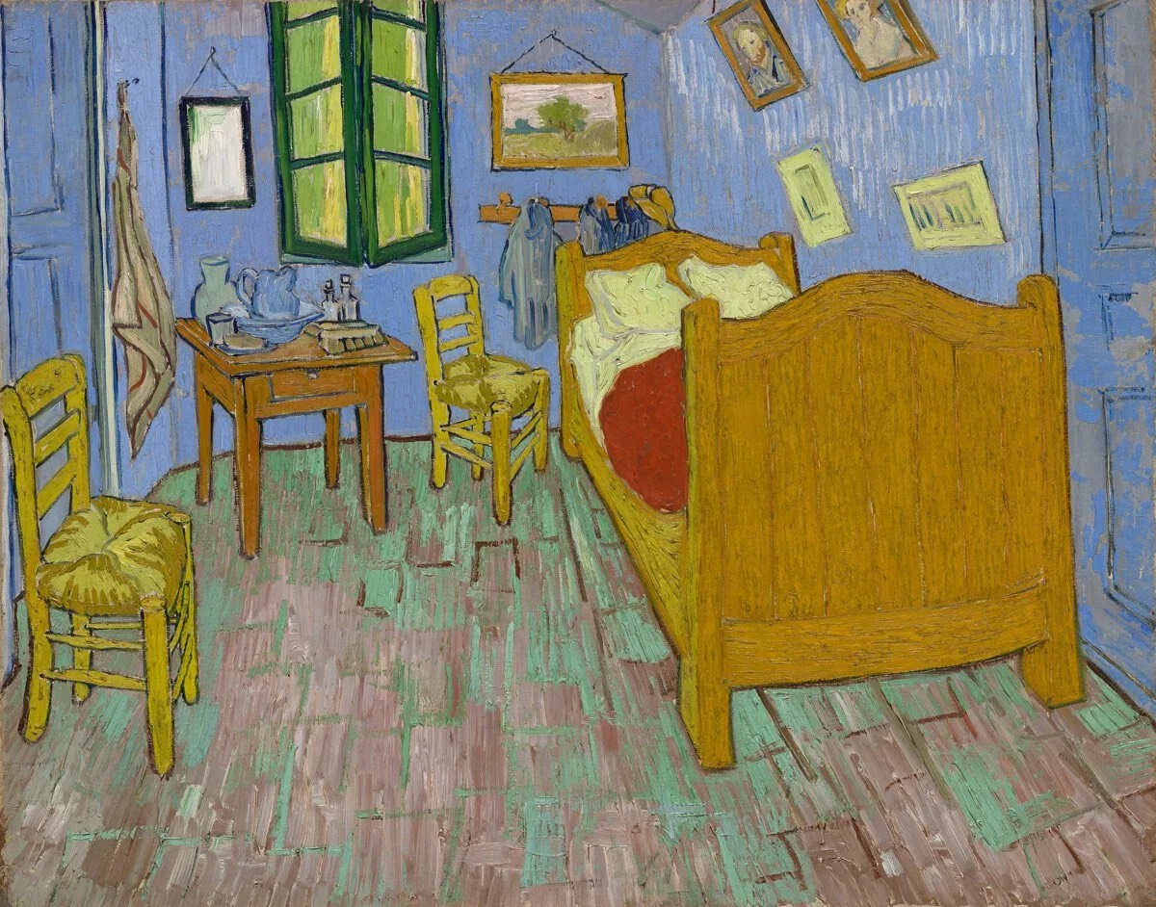

Slide 18
For the ‘describers’:
what worked well in the first round, and what could you do better in the next round?
For the ‘drawers’:
what worked well in the first round, and what could you do better in the next round?
Now – let’s switch roles and do this again…

Slide 19
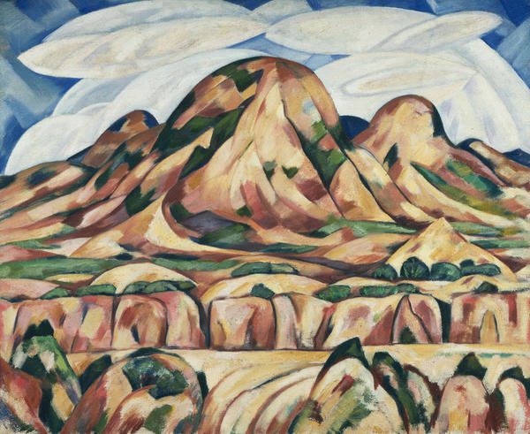

Slide 20
What was challenging
about this activity?

Slide 25
what one thing
did
you
learn
today…pass or play?

Slide 27
https://www.philamuseum.org/doc_downloads/education/lessonPlans/13076_EDU_Lesson-Plan_SEPT-2019_082019.pdf

