Slide 2
SHOW ME
YOUR
MONEY

Slide 4
In the next hour, you will:
- define what money is & understand why we need money
- understand the symbols on US paper currency
- design your own paper money
- write about what you value and what you would buy with your money
- and why

Slide 6
notebook
any white paper
pencil
eraser
scissors
colored pencils, markers
ruler

Slide 8
money
currency
barter
‘cowrie shell’
portable
denomination

Slide 12
A Little History
on
MONEY

Slide 16
So - all money needs to be:
portable able to be easily carried around
durable it needs to be tough, so that it won’t break or tear
limited needs to be able to be limited in quantity, so that
you can control how much there is of it
divisible the money needs to be able to be divided - a dollar
is divisible into pennies

Slide 20
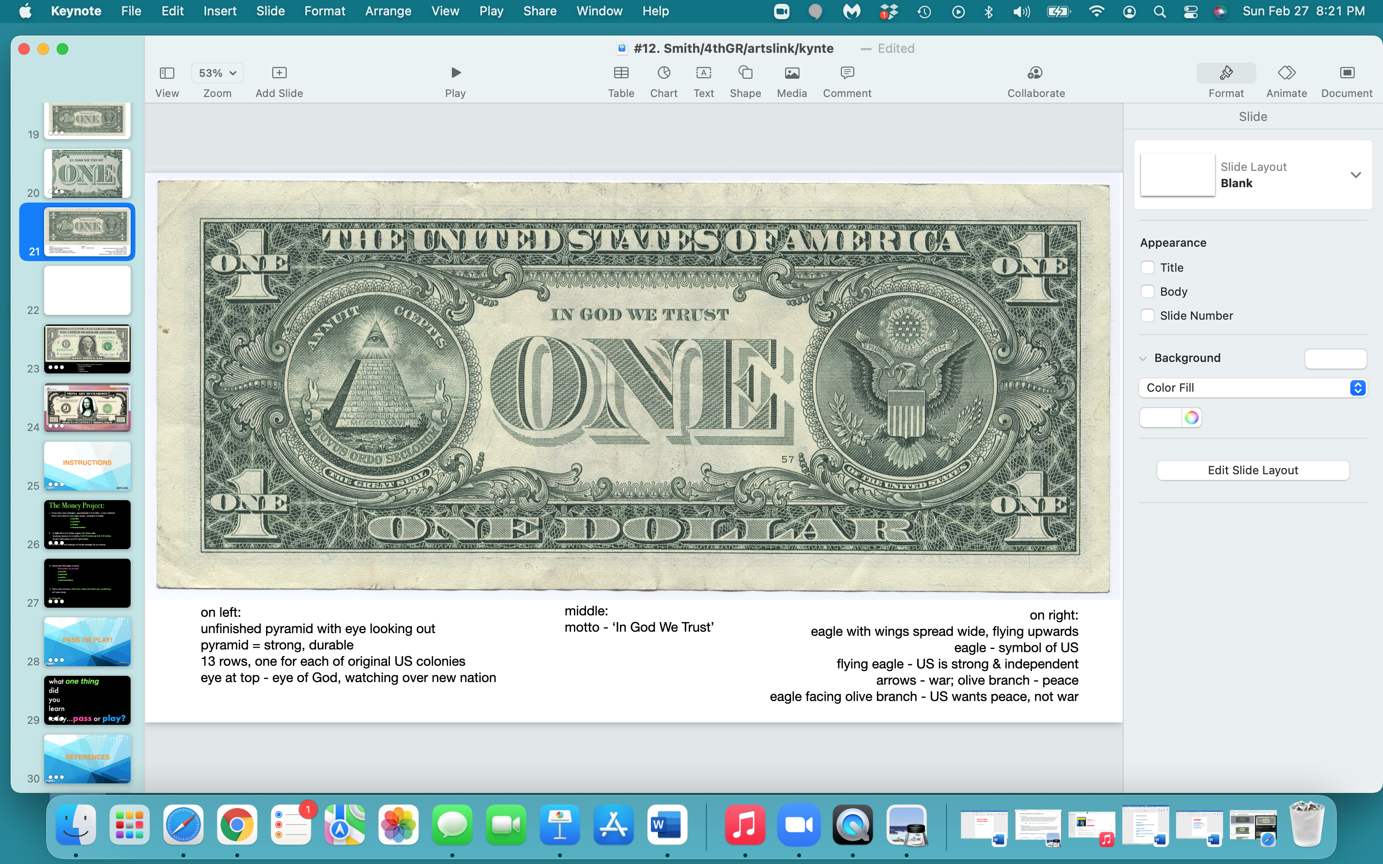

Slide 22
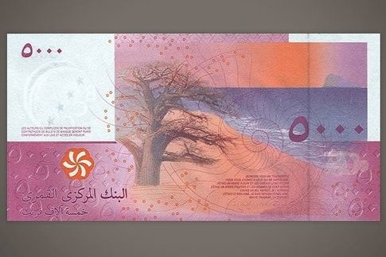
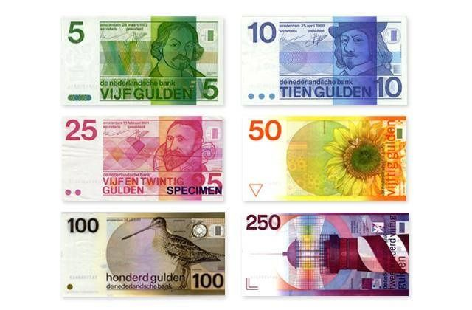
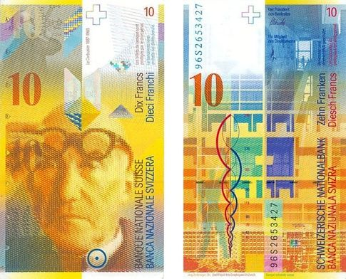
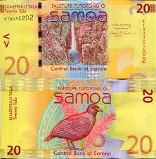
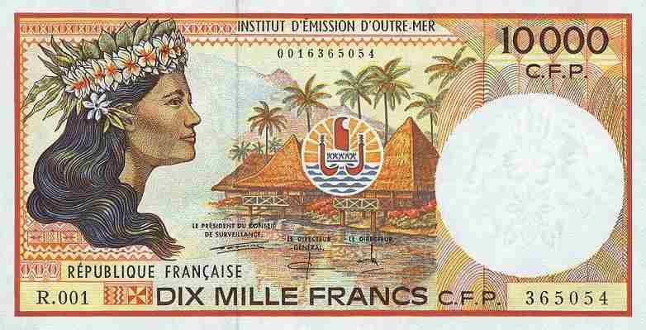
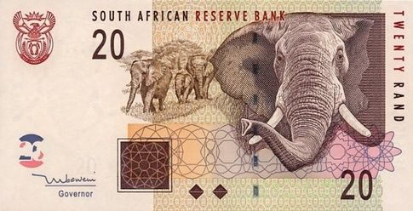
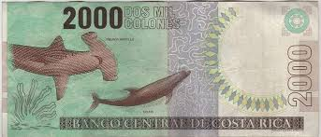

Slide 23
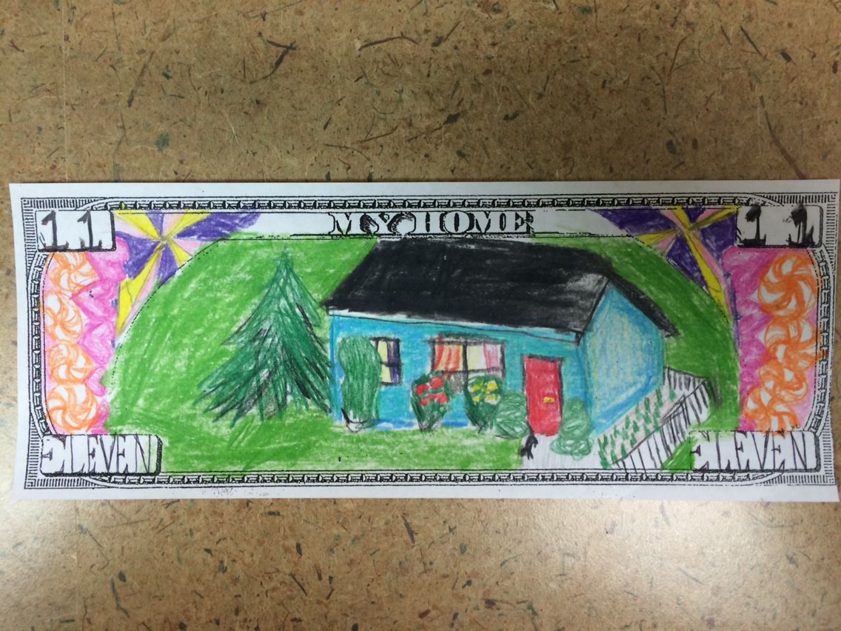
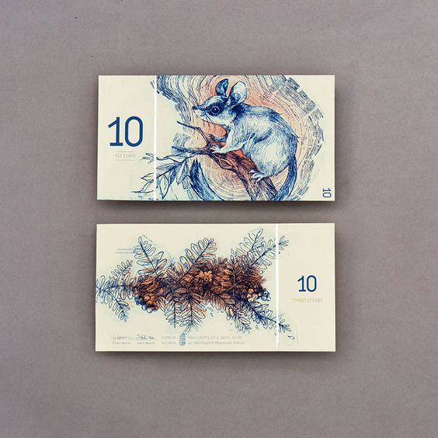
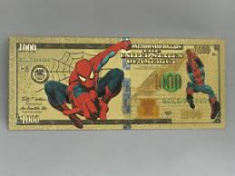
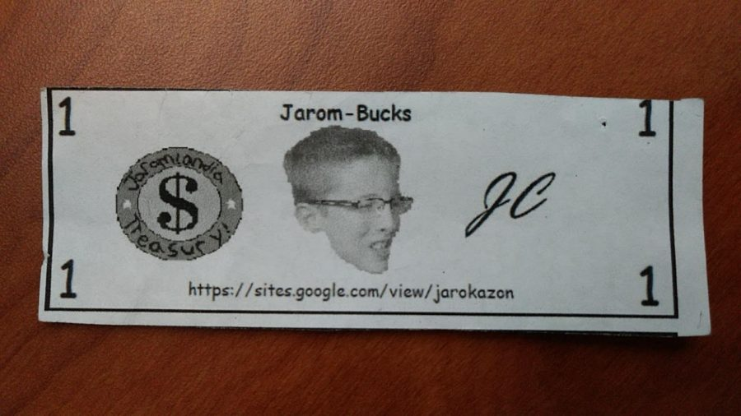
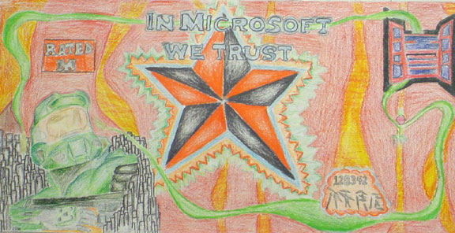
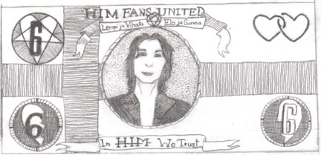
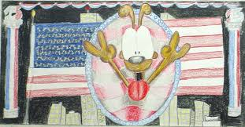
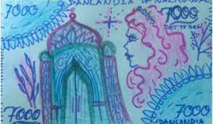

Slide 25
The Money Project:
Please draw some rectangles - approximately 2 X 6 inches - in your notebook. You can sketch out some ideas for your money - and remember to include:
a border - only a suggestion, but it does ‘frame’ your money, more ‘finished’
a portrait or an image - this determines your money’s ‘theme’
a motto - a phrase symbolizing the ‘idea’ of your money, or ‘principle’
a denomination - the ‘value’ of your money, what it’s worth
A dollar bill is 6.41 inches long by 2.61 inches wide. So please measure 2 &1/2 inches by 6 inches on your white paper.
3. This 2.5 X 6 inch rectangle will be the rectangle for your final paper money.

Slide 26
4. To create your final paper currency:
after you’ve picked the sketch that you love in your notebook…
- draw your border on your final white rectangle - if you want a border
- figure out where your denomination will go on your final white rectangle
- draw the portrait or image on your final white rectangle
- write the motto on your final white rectangle
5. Think about and write down on another piece of paper:
- what you value and what you would buy with your money…
and why.

Slide 28
what one thing
did
you
learn
today…pass or play?

Slide 30
https://amhistory.si.edu/ourstory/pdf/money/money_design.pdf
https://www.education.com/activity/article/design-create-family-money/
https://constitutioncenter.org/learn/educational-resources/activities/design-your-own-dollar-bill
https://www.youtube.com/watch?v=-IBHbe-t-X4
https://99designs.com/blog/creative-inspiration/20-examples-worlds-best-currency-design/
https://www.vintag.es/2018/08/american-money-design.html
https://www.incredibleart.org/lessons/middle/alix-super.htm

