Slide 1
Integrating Content PAEP Professional Development
Dr. Catherine Richmond-Cullen, Assistant Professor,
University of Scranton
&
Elizabeth Parry Faist, PCA Arist

Slide 2
Making Meaning
The brain requires meaning making in order to learn new information.
The brain connects new and stored information in a logical and meaningful way.

Slide 3
Part 1: Understanding the relationship among the subject areas
Statement of Learning: In Part 1 you will learn how math, ELA and the arts are connected and how integration strengthens memory.

Slide 4
Semantics: making meaning of the language
Formal: logical aspects, sense, reference, implication and form
Lexical: word meaning and relations
Conceptual: cognitive structure

Slide 5
Making Meaning with Mathematics
Procedural Fluency : Procedure and Verbal
Conceptual Understanding: Semantics
Math Reasoning and Problem Solving: Procedure, Verbal and Semantics

Slide 6
Arts Learning
Elements and Principles of Arts – Historical and Cultural Information = core of art making/skill set
Critique – using semantics to evaluate art
Aesthetics – conceptual understanding of art

Slide 7
The 5 Big Ideas in Reading
Phonemic Awareness: Verbal
Phonics: Verbal and Procedure
Vocabulary: Verbal - Lexical Semantics
Fluency: Procedure - Formal Semantics
Comprehension: Formal and Cognitive Semantics (language and other functions of the cerebral cortex such as movement, perception)

Slide 8
Comparing Math & Arts Competencies/Concepts
Mathematics
Arts and Humanities
Procedural Fluency/ Verbal/ Procedure
Conceptual Understanding/ Semantics
Problem Solving/Reasoning/ Verbal, Procedural/Con. Understanding
Elements and Principles
Critique and Aesthetics
Art Making

Slide 9
Part 2: Cognitive Processing
Statement of Learning: In Part 2 you will apply integration strategies to solve a problem through multiple content areas.

Slide 10
Cognitive Process of Meaning Making
Develop a basic skill set
Build on those skills to increase semantic abilities
Develop conceptual understanding
Solve a problem that demonstrates our abilities in specific content.

Slide 11
1. Develop a Basic Skill Set: Verbal Skills Arts: Elements and Principles Math: Geometry, Numbers and Operations
Shape – 2 Dimensional Shapes - Geometry
Repetition – Pattern Recognition, Regularity/ Numbers and Operations
Scale - Magnitude - Numbers and Operations

Slide 12
2. Build on those skills to increase semantic abilities. Arts: view works of art that demonstrate elements and principles Math: practice math thinking
Math: Using inventive thinking strategies to enable students to discover new ways of thinking and problem solving.
ELA: Verbal and written discourse.

Slide 13
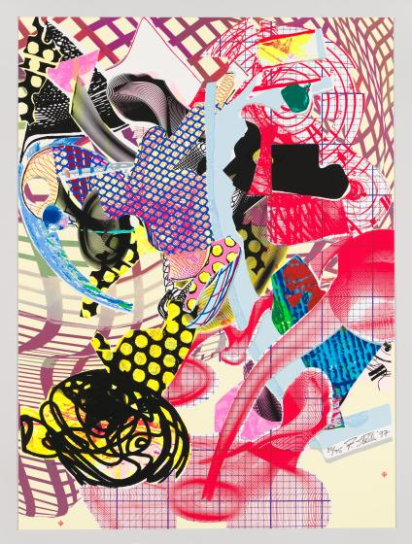
Shape
Circle
Square
Triangle
Frank Stella
Coxuria 1997
https://whitney.org/collection/works/12182

Slide 14
Repetition: Shape, color, patterns

Slide 15
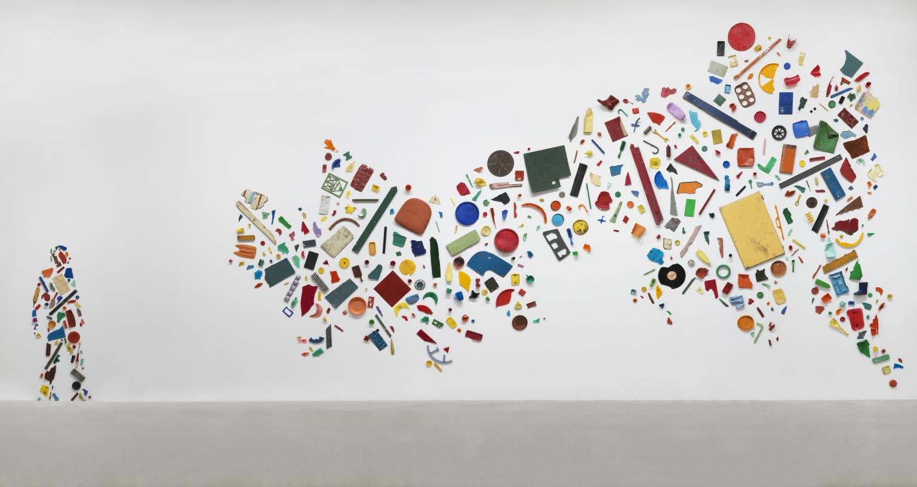
Scale: How large, how small
https://www.tate.org.uk/art/artworks/cragg-britain-seen-from-the-north-t03347
© DACS 2020
License this image

Slide 16
Develop Conceptual Understanding: Practice the skills and discuss application of new learning
Using the graphic organizer, working in pair/share groups complete the tasks assigned.

Slide 17
Solve a Problem that demonstrate new abilities: Create a work of art demonstrating knowledge and understanding cognitively
Make a collage using 3 shapes you learned in math this week.
Repeat the shapes to demonstrate your understanding of patterns.
Make the shapes different sizes to demonstrate that you understand some numbers are larger and some numbers are smaller.

