Slide 1
Welcome back, class!
Project #3 Finished – Mini Project
Meeting #13
02/16/2022

Slide 2
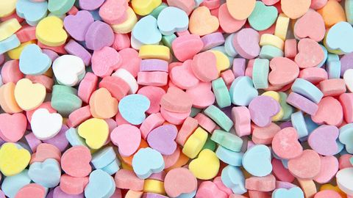
What special day was just celebrated this week?

Slide 3
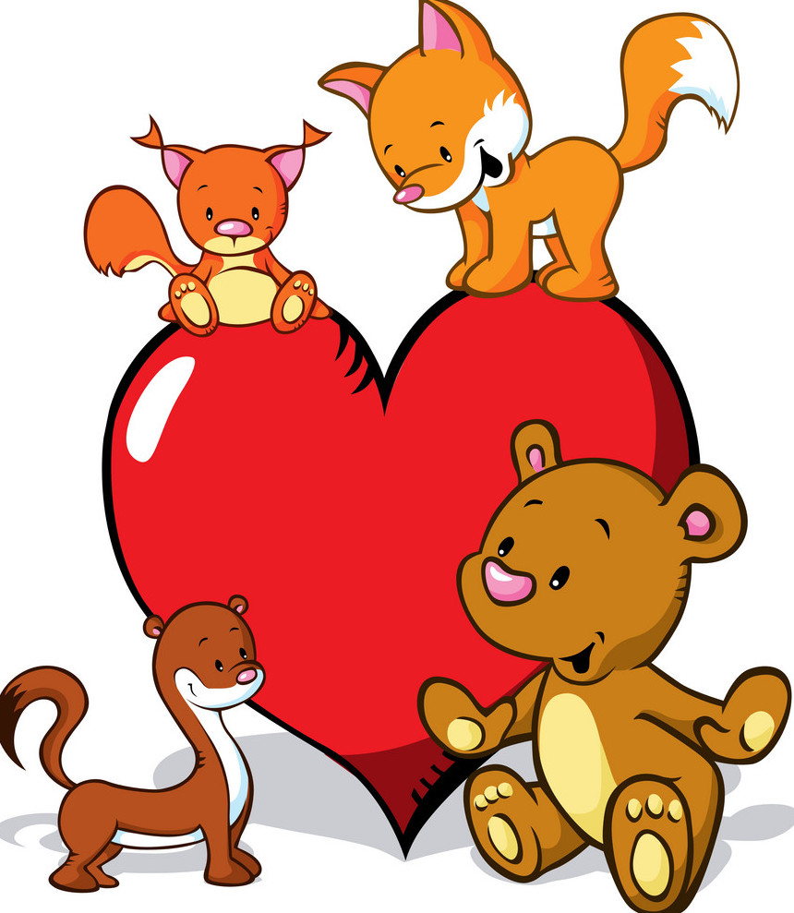
”Hearty” Creature Mini Project ☺

Slide 4
Instructions ☺
Your creature or animal should primarily include hearts!
Your creature can be any combo of color(s).
You can divide up the heart shapes to create wings, eyes, noses, ears, etc.!
Have fun creating!

Slide 5
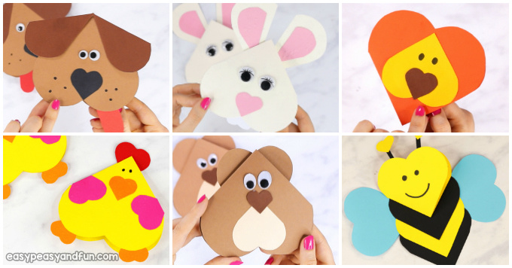
Examples ☺

Slide 6
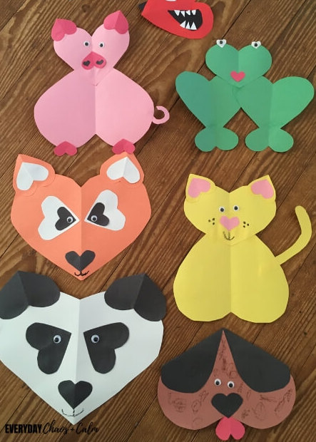
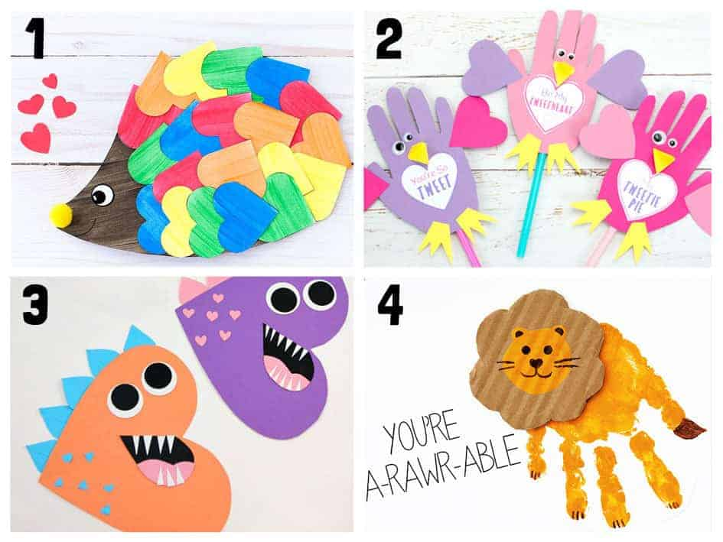
Examples ☺

Slide 7
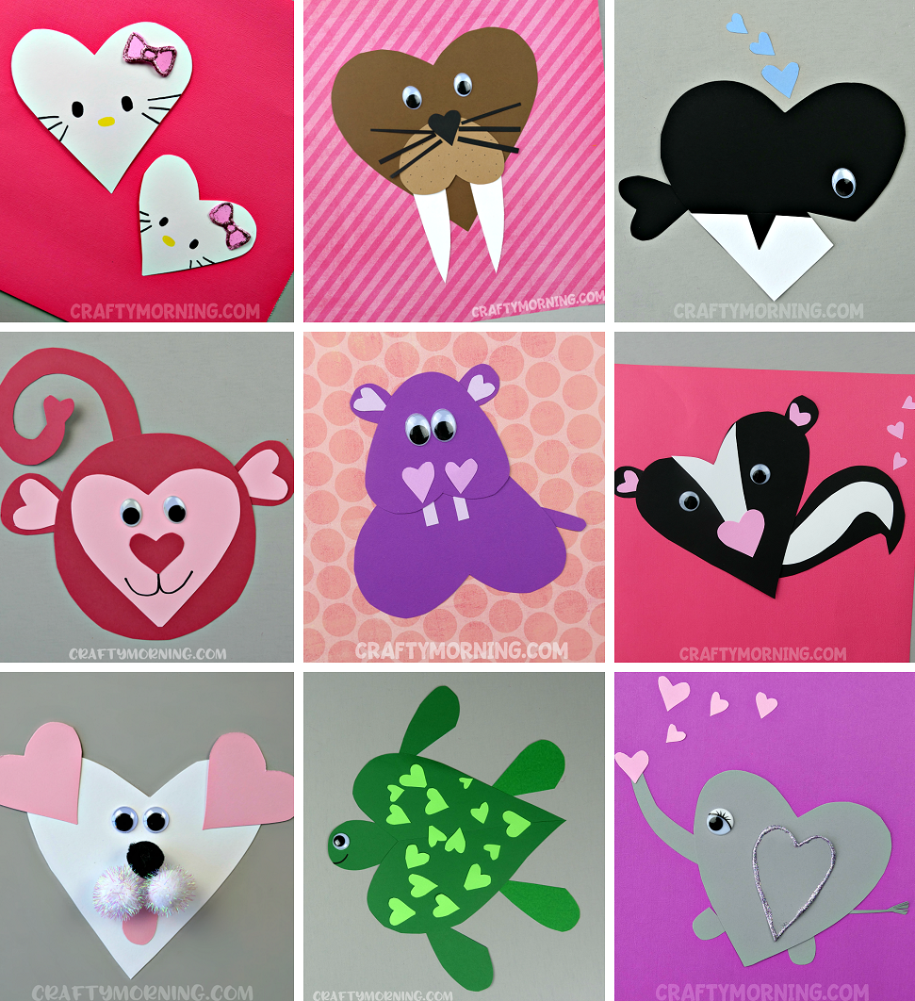
Examples ☺

Slide 8
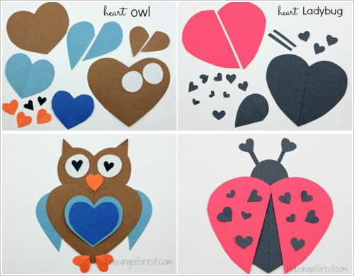
Example broken down ☺

