Slide 1
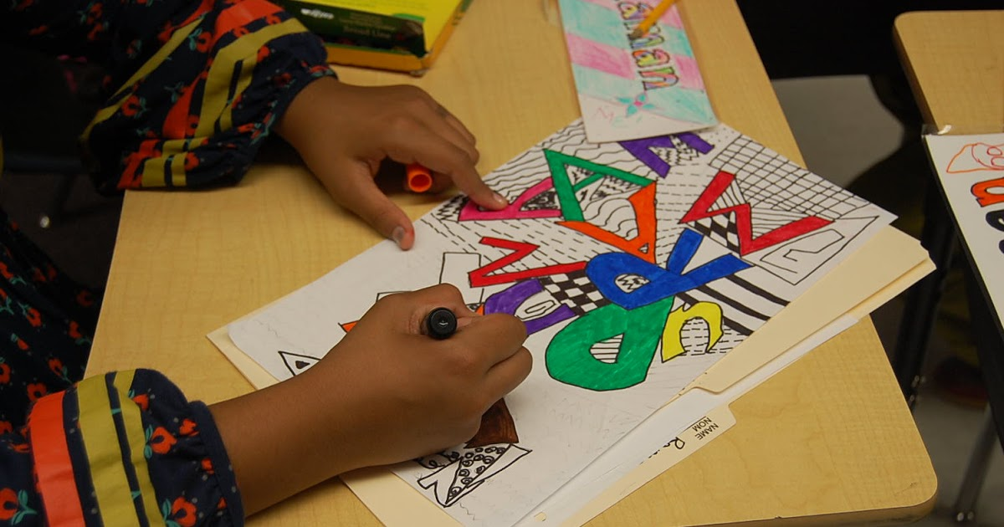

Framework Review
This Photo by Unknown Author is licensed under CC BY-SA-NC
Dr. Catherine Richmond-Cullen
PAEP Arts Link
Artists Professional Development
This Photo by Unknown Author is licensed under CC BY-SA-NC

Slide 2
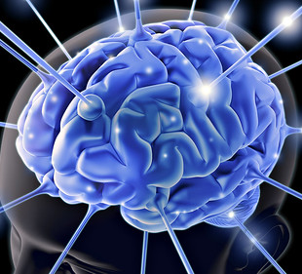
Why integrate the content areas?
Engage the entire brain
More brain = more memory

Slide 3
Framework for Creating and Teaching Engaging Lessons ©Richmond-Cullen, 2020
Statement of Learning
Today you will review how research on learning can be applied to a virtual classroom to engage students more effectively.

Slide 4
Cerebral Cortex
Frontal Lobe- associated with reasoning, planning, parts of speech, movement, emotions, and problem solving
Parietal Lobe- associated with movement, orientation, recognition, perception of stimuli
Occipital Lobe- associated with visual processing
Temporal Lobe- associated with perception and recognition of auditory stimuli, memory, and speech

Slide 5
The Process Outlined
Stimulus through the RAS and sensory engagement
Activation of the limbic system for emotional connections to make meaning
Search for information stored on related content in order to establish patterns
Circuits engaged to stimulate frontal lobe where short term memory and the attentional system are housed.
Limited attention means chunking the information taught
Engagement for assured storage and retrieval.

Slide 6
Teaching Framework:
5 Simple Steps
Wake up the Brain: Do something creative
Stimulate their Memories: brainstorm and imagery.
Teaching vocabulary for discourse.
Shared
engagement
Help them store in their memory.

Slide 7

Wake up the Brain: 5 minutes
Start with engagement….have them DOING something right away or watch you do something
Use sensory experiences: what do they see, hear, smell, taste….what is happening around them?

Slide 8
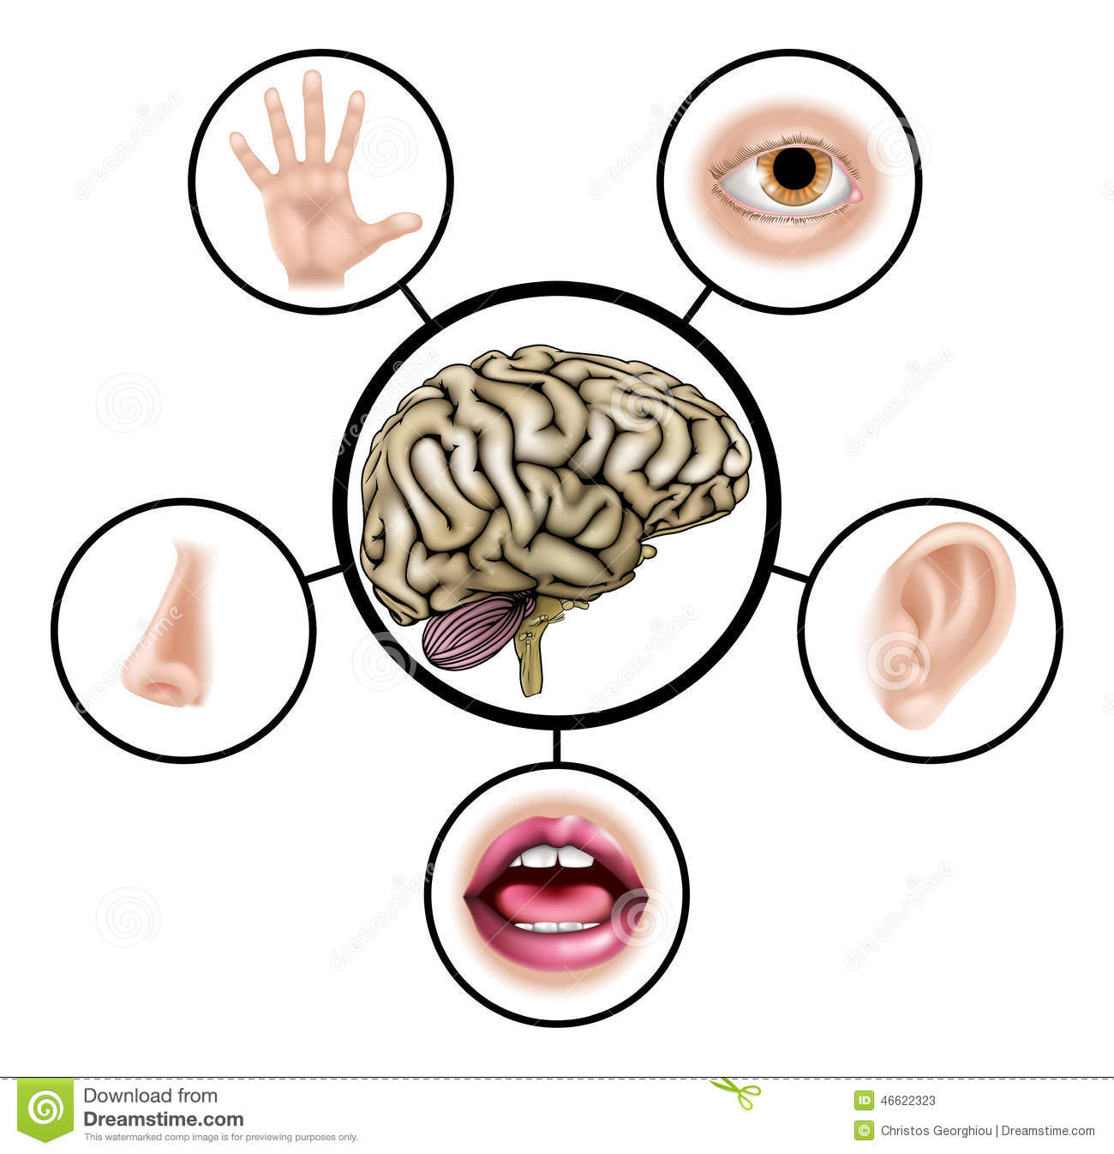
How should you begin your lessons?
      Get their attention through sensory stimulus.

Slide 9
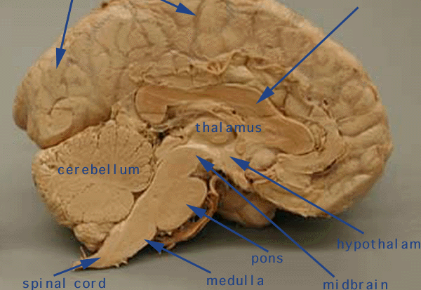
Limbic System:
Emotional Connections First
Notes:
The neocortex occupies the bulk of the cerebrum. This is a six-layered structure of the cerebral cortex which is only found in mammals. It is thought that the neocortex is a recently evolved structure, and is associated with "higher" information processing by more fully evolved animals (such as humans, primates, dolphins, etc). For more information about the neocortex, click here.

Slide 10
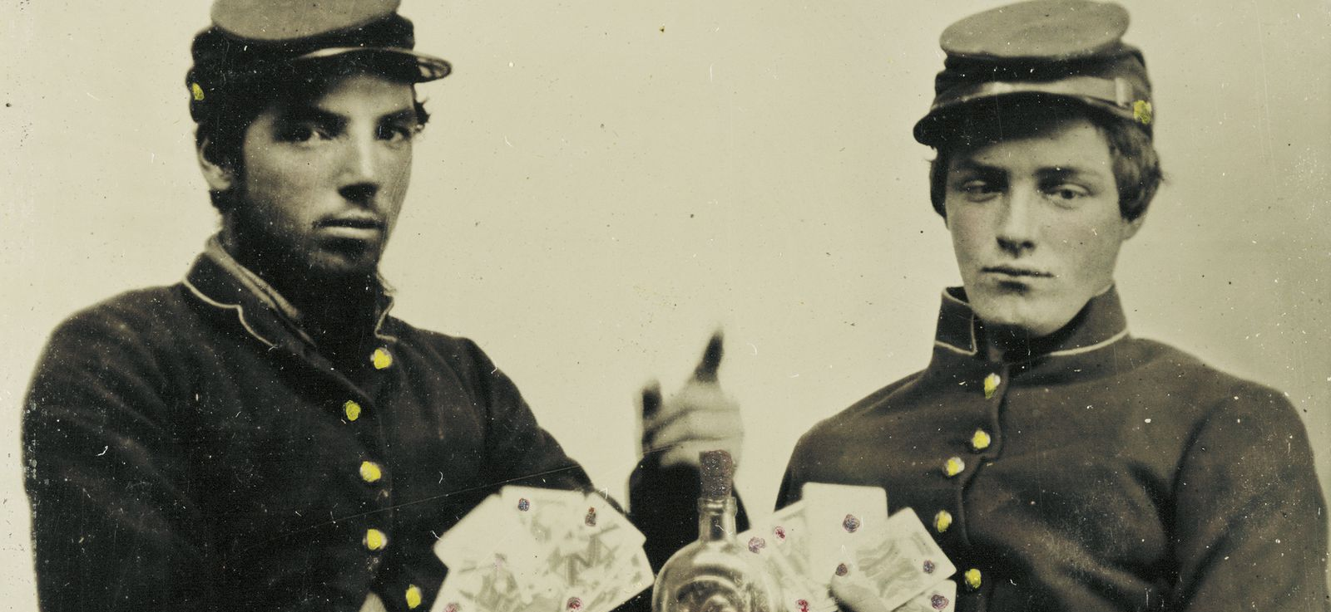
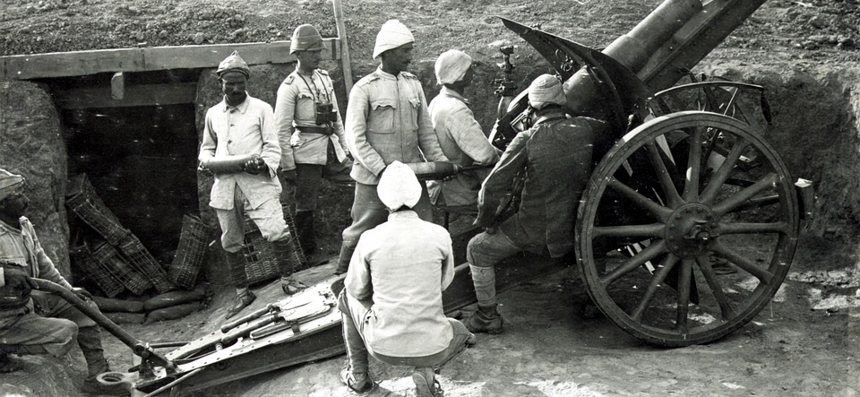
Information about the content through visual images

Slide 11
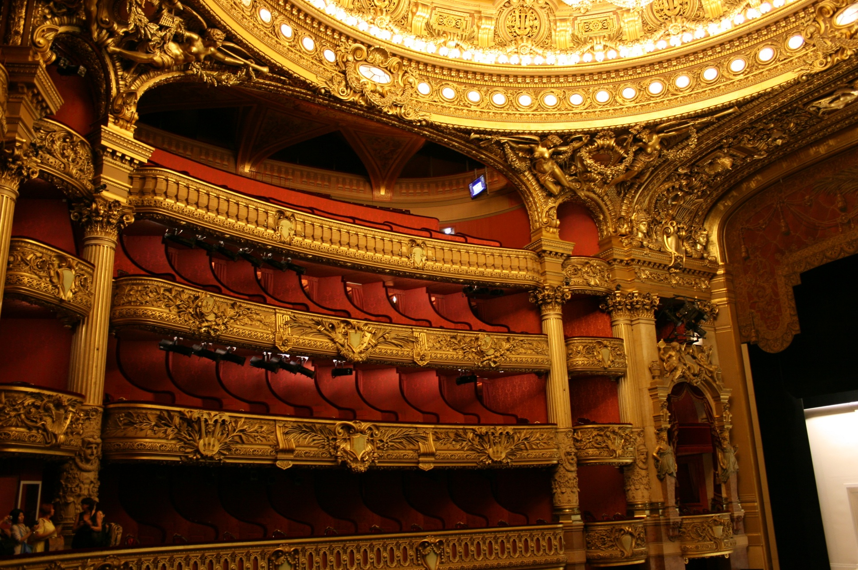
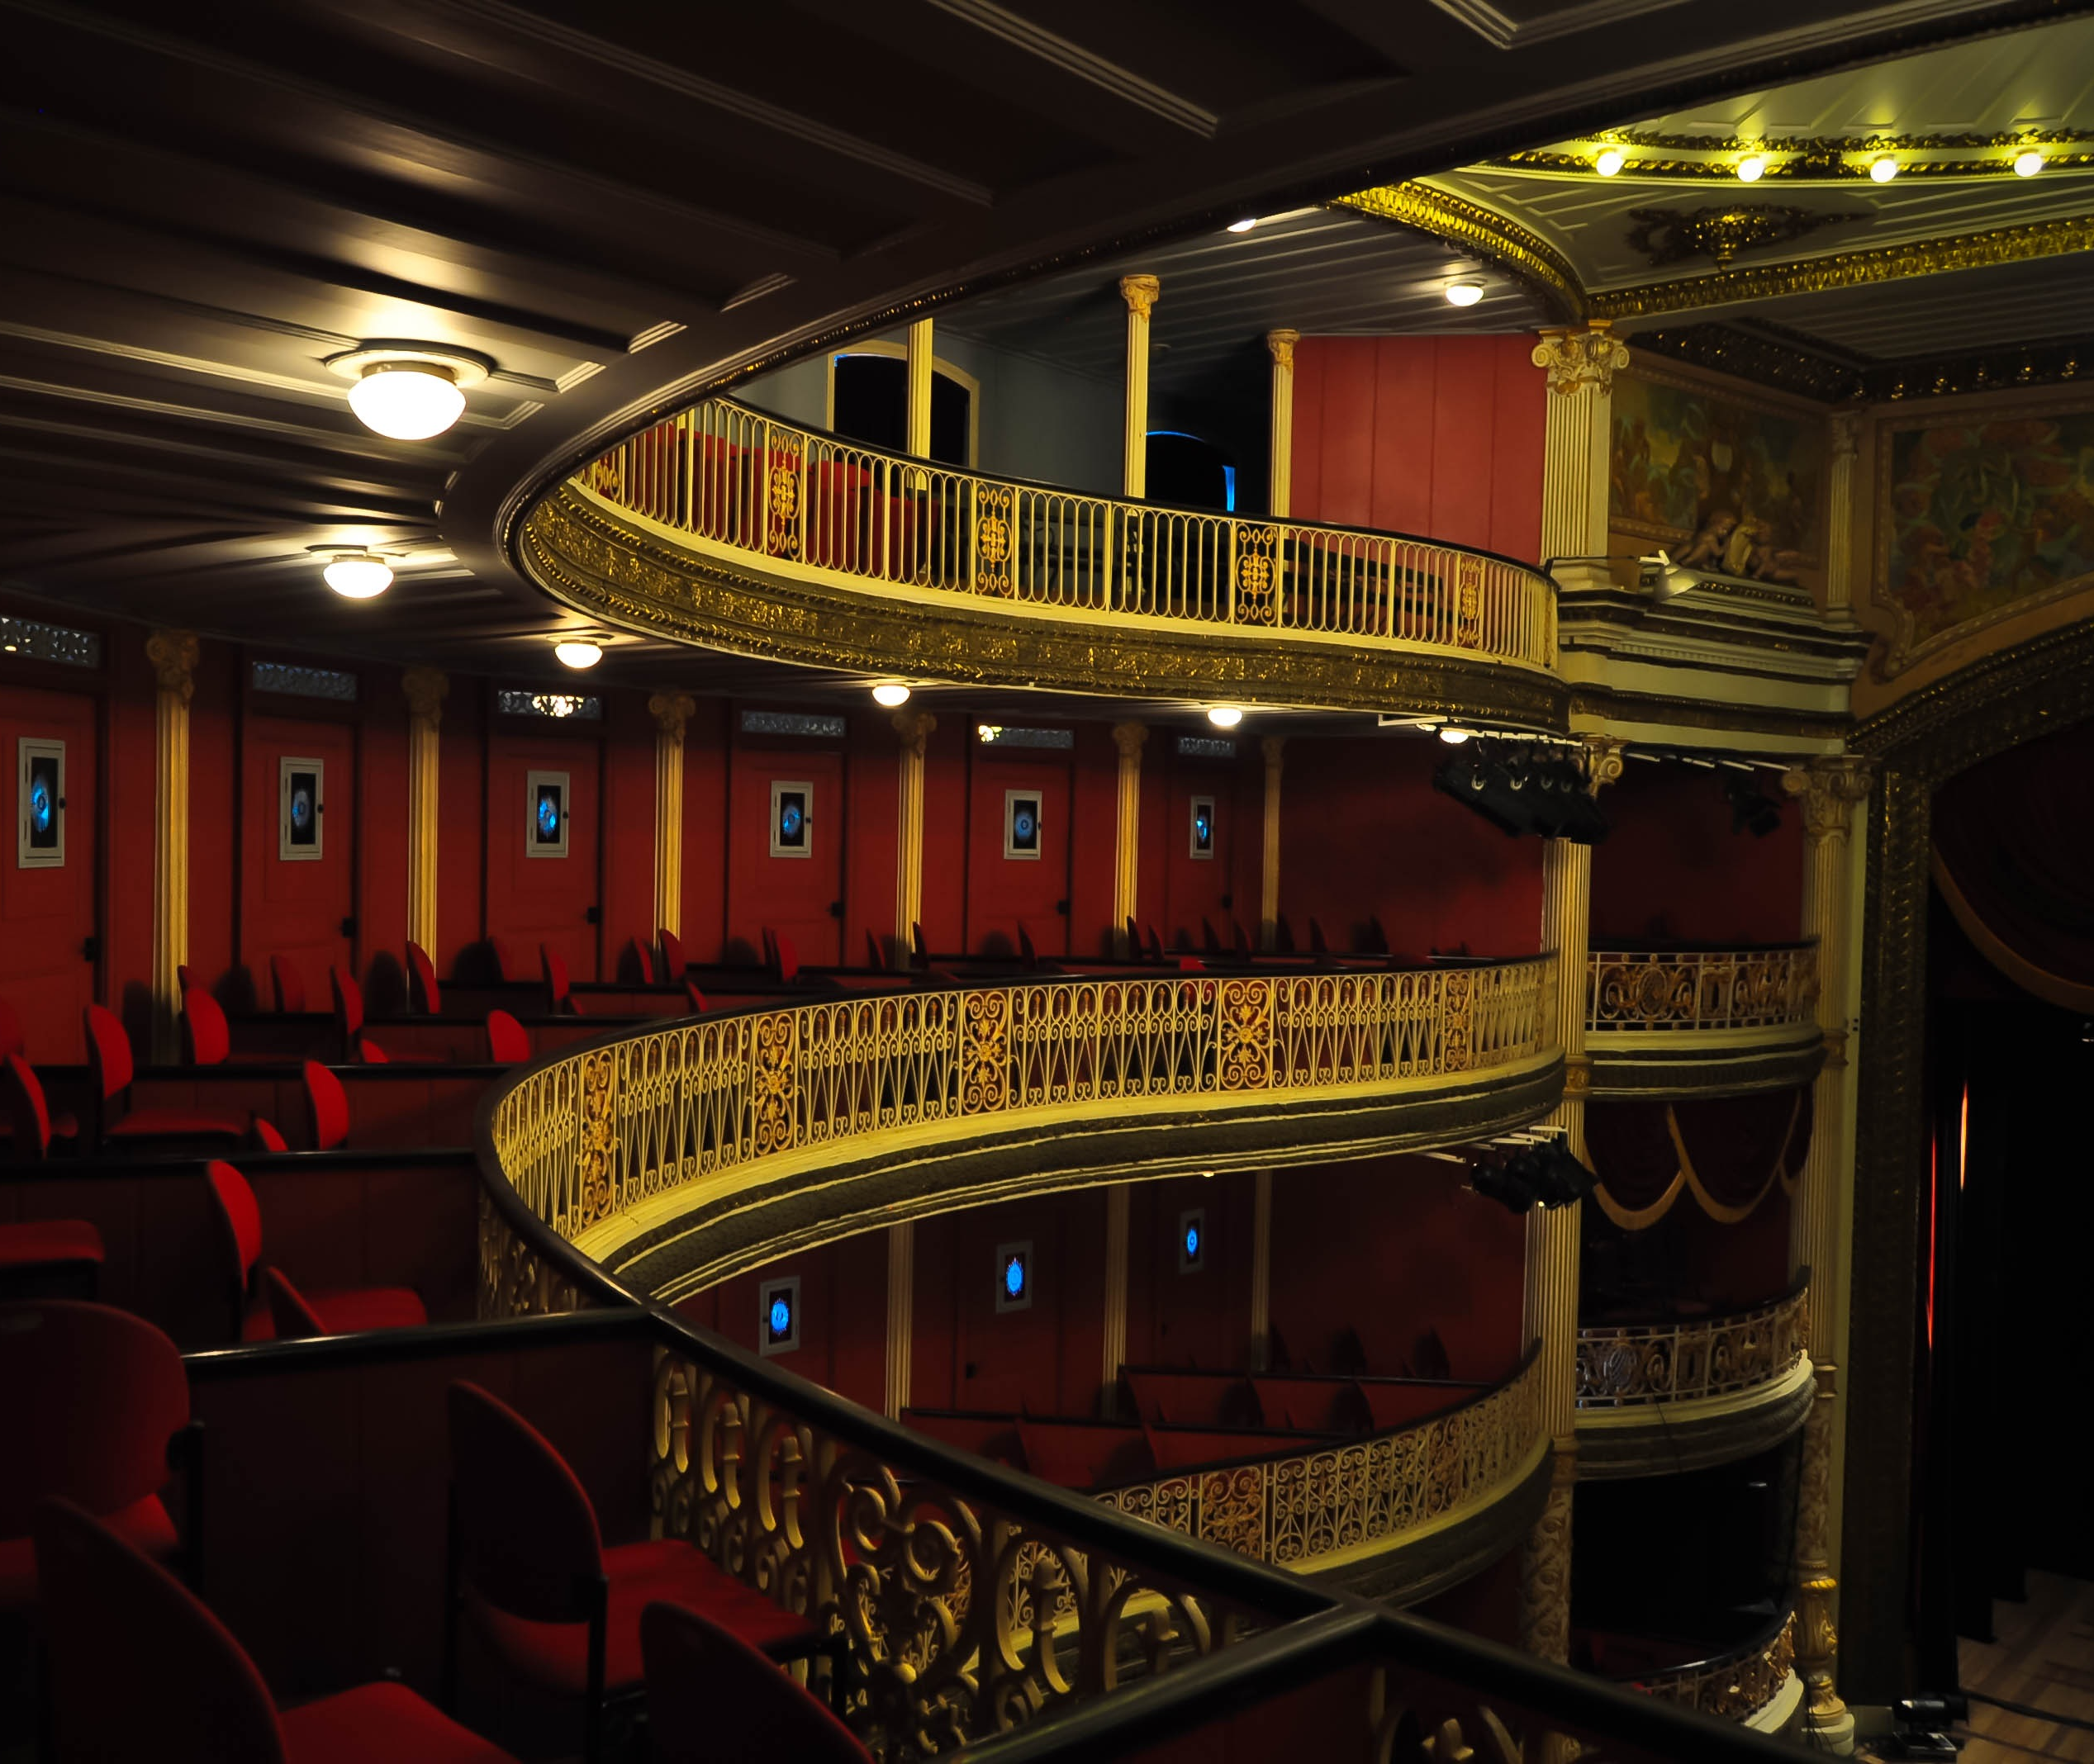


Discussion Starters
This Photo by Unknown Author is licensed under CC BY-SA
This Photo by Unknown Author is licensed under CC BY-NC-ND

Slide 12
Stimulate their Memories: Background
6 minutes
WHAT DO YOU KNOW ABOUT THIS?
Use stimulating video/images or activities
Engage them with pass/play or chat feature
Poll / assessments

Slide 13

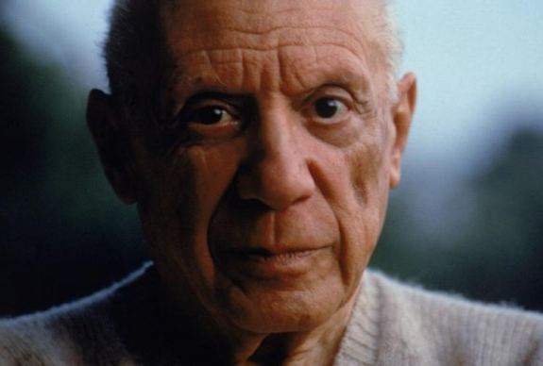
Stellar Images
This Photo by Unknown Author is licensed under CC BY-NC-ND
This Photo by Unknown Author is licensed under CC BY-SA-NC

Slide 14


Demonstrations of Ideas and Concepts
This Photo by Unknown Author is licensed under CC BY
This Photo by Unknown Author is licensed under CC BY-ND

Slide 15
Vocabulary for Discourse: 7 minutes
Choose
Choose several words
Show
Show them what they mean: images are everything
Chat and pass
Chat and pass/play
Use
Use the words in your lesson

Slide 16


Vocabulary for Oral and Written Discourse
Images are integral in assisting students to understand concepts especially in a virtual environment

Slide 17
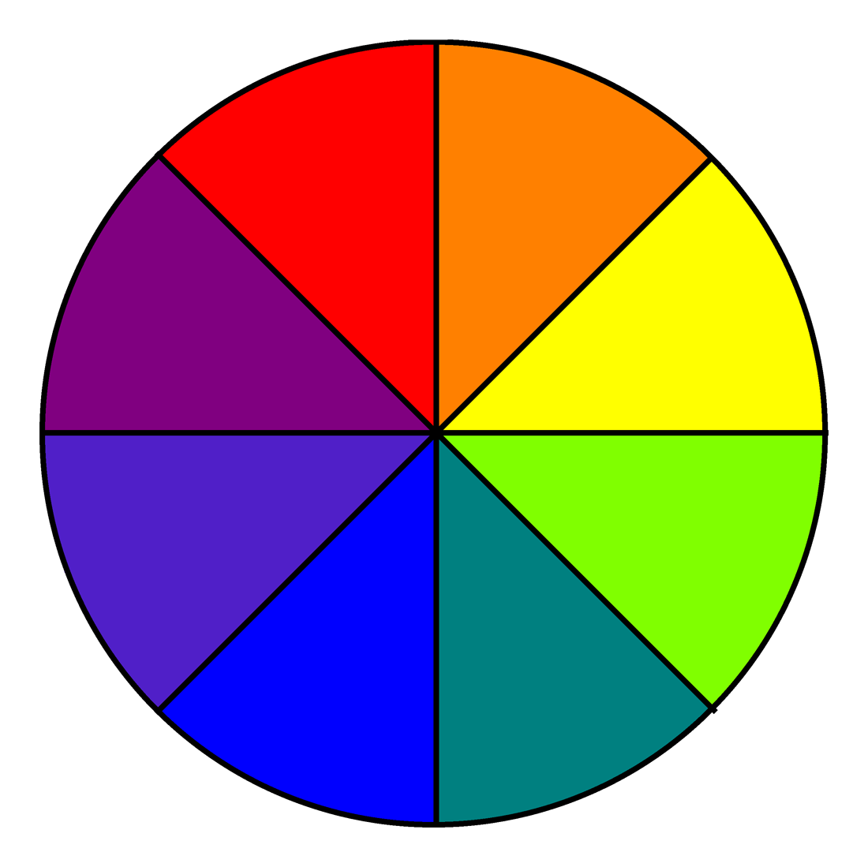
Color Wheel
Primary and Secondary Colors

Slide 18
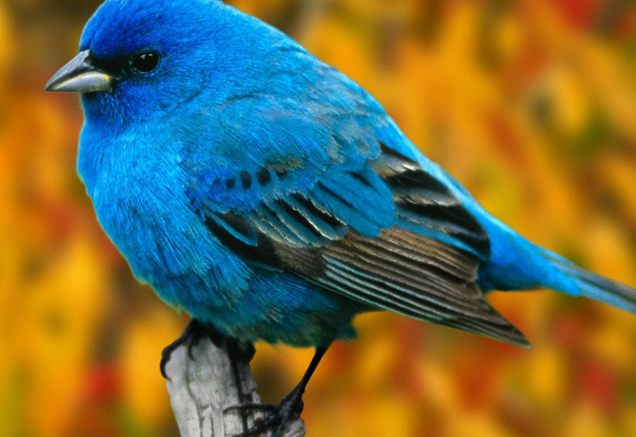
Science Lesson
Learning about animal habitats.

Slide 19
Ways you can help students use their brains……
Linguistic
Visual
Motor
Problem
Solving
Memory

Slide 20



Instructional Process
I DO
WE DO
YOU DO

Slide 21
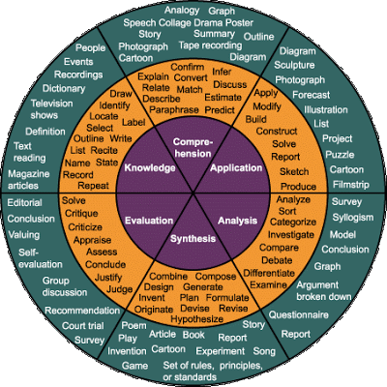
Webb’s Depth of Knowledge Taxonomy

Slide 22
Help them Store in their Memory:
5 minutes
Make sure you leave at least 5 minutes at the end to summarize what you did…
Ask them….tell me one thing you learned today….pass/play

Slide 23

Practice Opportunities:
Extension Activities
Give the students an extension activity.
What can they do to learn more about this….
Websites….
Activities….
This Photo by Unknown Author is licensed under CC BY-ND

Slide 24
Consider this….
Every student has a unique brain and learns differently
Meaning making is an innate need.
We are social learners.
The mind learns parts and wholes simultaneously.
The mind needs to connect facts to conceptual understanding.
We learn through patterns.
Emotions effect learning and storage of new information.
Extreme challenges or threats arrest the process of learning.

Slide 25
Framework for Effective Virtual Instruction ©Catherine Richmond-Cullen
Wake up students’ brains by engaging students in creative process
Stimulate students’ memories through brainstorming and imagery.
Teach academic vocabulary through instruction for discourse.
Provide shared engagement through abbreviated direct instruction.
Ensure closure by assisting students in long term retention through sequential exercises.

