Slide 1
Visual Storytelling

Slide 2
OBJECTIVES
Identify parts of a story
Interpret meaning in
visual elements of a story
Create a visual story

Slide 3
WARM UP
Notes:
Something with color

Slide 4
MATERIALS
Your imagination and attention
Construction paper
scissors
glue stick
sketch pad paper
Your story map

Slide 5
VOCABULARY

Slide 6
HORIZONTAL LINES
Notes:
Collaborate

Slide 7
Vertical Lines
Notes:
Ask for an example.

Slide 8
DIAGONAL LINES
Notes:
Collaborate

Slide 9
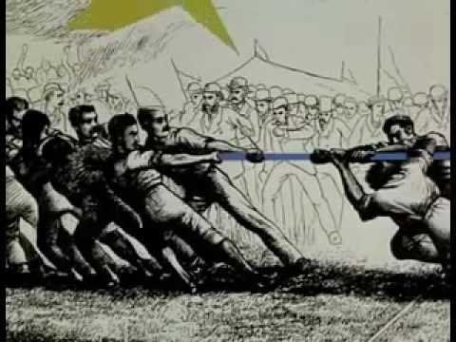

Slide 10
Let’s Create
Our Own
Visual Story

Slide 11
Story
Map
Use your story map as a guide. You’ll make five panels to show your story.
Show your character
Show your setting
Show a scene from the story
Show the conflict
Show the resolution
Notes:
Collaborate

Slide 12
Visual Story Making
Use your story map as a guide.
Work with your partner. Decide who will create each panel.
Use the elements of line, shape, and color we learned to make your illustrations.
Notes:
Collaborate

Slide 13
Story Sharing/Reflection
Working with your partner, imagine you get to pitch your story to a big movie company.
What is the title? How would you share it?
Practice sharing the panels.

Slide 14
REFERENCES

Slide 15
REFERENCES
Animation: giphy.com

