Slide 1
Visual Storytelling

Slide 2
OBJECTIVES
OF THIS LESSON

Slide 3
OBJECTIVES
Identify parts of a story
Interpret meaning in
visual elements of a story
Create a visual story

Slide 4
MATERIALS
FOR THIS LESSON

Slide 5
MATERIALS
Your imagination and attention
Construction paper
scissors
glue stick
sketch pad paper
Your story map from last session

Slide 6
WARM UP
Notes:
Something with color

Slide 7
VOCABULARY

Slide 8
Visual Storytelling
is a story told mostly through the use of visual images, or pictures. The story may be told using photography, illustration, or video, and can be enhanced with graphics, music, voice and other audio.
Notes:
Ask for an example.

Slide 9
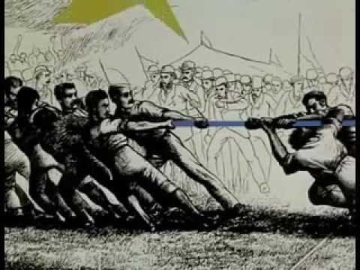

Slide 10
Diagonal lines and shapes give us a feeling of motion and action
Notes:
Collaborate

Slide 11
Horizontal lines give us a feeling of calm
Notes:
Collaborate

Slide 12
Scale (size) of objects
will make them appear
closer or farther away.
Color can make us feel warm
or cool.
This triangle is red.
Warm, or cool?
Notes:
Collaborate

Slide 13
Let’s Create
Our Own
Visual Story

Slide 14
Story
Map
Use your story map as a guide. You’ll make five panels to show your story.
Show your character
Show your setting
Show a scene from the story
Show the conflict
Show the resolution
Notes:
Collaborate

Slide 15
Visual Story Making
Use your story map as a guide.
Work with your partner. Decide who will create each panel.
Use the elements of line, shape, and color we learned to make your illustrations.
Notes:
Collaborate

Slide 16
Story Sharing/Reflection
Working with your partner, imagine you get to pitch your story to a big movie company.
What is the title? How would you share it?
Practice sharing the panels.

Slide 17
REFERENCES

Slide 18
REFERENCES
Animation: giphy.com

