Slide 1
What’s In A Story?

Slide 2
OBJECTIVES
OF THIS LESSON

Slide 3
OBJECTIVES
Identify conflict and resolution
Practice active listening
Collaborate on a story with a partner

Slide 4
MATERIALS
FOR THIS LESSON

Slide 5
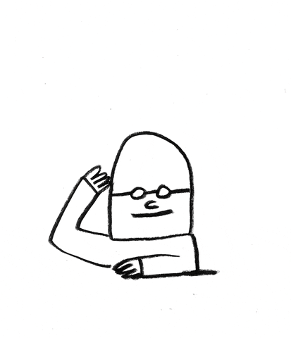
MATERIALS
Your imagination and attention
Pencil and paper
A copy of the Story Map
Your active listening skills

Slide 6
HOW TO BE A GOOD
ACTIVE LISTENER
Give non-verbal encouragement (nod, smile, eye-contact, lean in)
Practice patience - allow for moments of silence
Listen for the meaning in what they are sharing

Slide 7
WARM UP
Notes:
Body warm up. Review of Pencil as character – what does it want? What is it willing to do to get what it wants?

Slide 8
Story Mountain
The parts of a story: characters, setting, plot, conflict, and resolution, all live on story mountain!
The Conflict
The Build-Up
The Resolution
The Beginning
The Ending

Slide 9
VOCABULARY

Slide 10
Personification
Giving human qualities to something inanimate, like an object
The pencil had a crush on her friend, Paper.

Slide 11
Let’s Tell a Story!
Notes:
Brainstorm a pencil story based on one of the warm up ideas

Slide 12
Story
Map
Work with your partner to fill in the blocks with your story ideas.
characters - who are they?
setting - where are they?
plot - what happens?
conflict - what or who gets in the way?
resolution - how is the problem solved?
Notes:
Collaborate

Slide 13
Characters with Conflict
Work with your partner:
Choose two objects to use as characters.
What does each object want?
What are they willing to do to get it?
What gets in the way of them getting what they want?
Examples: paper and pencil, or paper and scissors, or book and iPad
Notes:
Collaborate

Slide 14
Story
Map
Work with your partner to fill in the blocks with your story ideas.
characters - who are they?
setting - where are they?
plot - what happens?
conflict - what or who gets in the way?
resolution - how is the problem solved?
Notes:
Collaborate

Slide 15
Story Sharing
Take turns telling the story to each other. Practice!
What is the beginning?
What happens in the middle?
How does it end?
Use your active listening skills as your partner retells the story.
Notes:
Remind them of active listening.

Slide 16
REFERENCES

Slide 17
REFERENCES
Animation: giphy.com

