Slide 1
What’s In A Story?

Slide 2
OBJECTIVES
OF THIS LESSON

Slide 3
OBJECTIVES
Identify conflict and resolution
Practice active listening
Share a story with a conflict and resolution

Slide 4
MATERIALS
FOR THIS LESSON

Slide 5
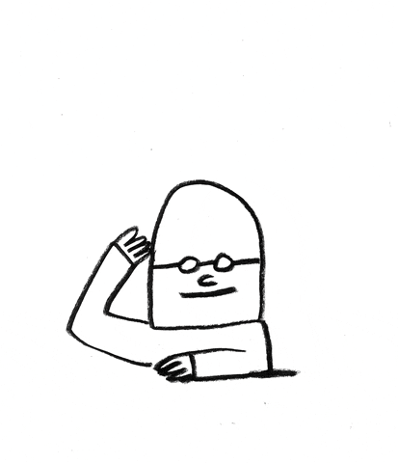
MATERIALS
Your imagination and attention
Pencil and paper
Your active listening skills

Slide 6
HOW TO BE A GOOD
ACTIVE LISTENER
Give non-verbal encouragement (nod, smile, eye-contact, lean in)
Practice patience - allow for moments of silence
Listen for the meaning in what they are sharing

Slide 7
WARM UP
Notes:
Pencil as character – what does it want? What is it willing to do to get what it wants?

Slide 8
VOCABULARY

Slide 9
VOCABULARY
The Parts of a Story:
character
setting
plot
conflict
resolution

Slide 10
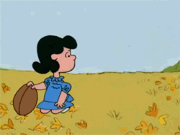
VOCABULARY
Conflict
a struggle between two opposing forces

Slide 11
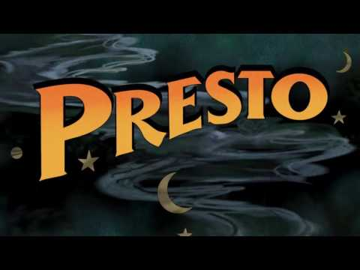
Notes:
What does the rabbit want? What does the magician want? Where is the conflict? How is it resolved. Partner/pair share. Report out.

Slide 12
VOCABULARY
Resolution
The resolution of a story is the conclusion of a story's plot.
It is how the story ends.
How does “Presto” end? What is the resolution?

Slide 13
Let’s Tell a Story!
Notes:
Brainstorm a pencil story based on one of the warm up ideas

Slide 14
Characters with Conflict
Work with your partner:
Choose two objects to use as characters.
What does each object want?
What are they willing to do to get it?
What gets in the way of them getting what they want?
Examples: paper and pencil, or paper and scissors, or book and iPad
Notes:
Collaborate

Slide 15
Story Sharing
Take turns telling the story to each other. Practice!
What is the beginning?
What happens in the middle?
How does it end?
Use your active listening skills as your partner retells the story.
Notes:
Remind them of active listening.

Slide 16
REFERENCES

Slide 17
REFERENCES
Animation: giphy.com
Film: Pixar Animation https://youtu.be/D4Dnm6dkOVI

