Slide 1
What’s In A Story?

Slide 2
OBJECTIVES
OF THIS LESSON

Slide 3
OBJECTIVES
Identify the parts of a story
Collaborate to tell stories with plot
Model the principles of active listening

Slide 4
MATERIALS
FOR THIS LESSON

Slide 5
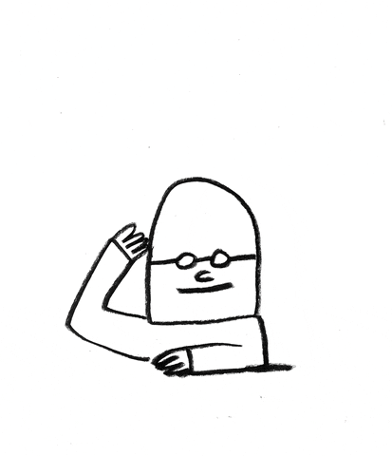
MATERIALS
Your attention
and imagination

Slide 6
WARM UP
Notes:
Grounding/listening techniques

Slide 7
VOCABULARY

Slide 8
VOCABULARY
The Parts of a Story:
character
setting
plot
conflict
resolution

Slide 9
VOCABULARY
Plot
the main events of a story, play, novel, or movie

Slide 10
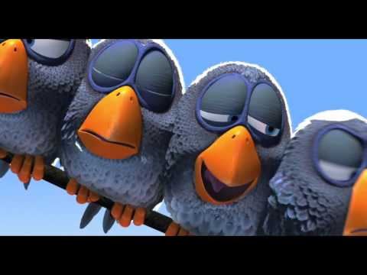
Notes:
What is the main idea of this short film? What are the little birds like as characters? What is the larger bird like? What happens in the story? How do you feel about the little birds? The big bird? What happens at the end?

Slide 11
VOCABULARY
Active Listening
Fully concentrating on what is being said. You listen with all of your senses and give your full attention to the person speaking.

Slide 12
HOW TO BE A GOOD
ACTIVE LISTENER
Give non-verbal encouragement (nod, smile, eye-contact, lean in)
Practice patience - allow for moments of silence
Listen for the meaning in what they are sharing

Slide 13
PASS OR PLAY!
Notes:
Be the listener, have a student tell a story – any story – lean in, lean away

Slide 14
One Minute Story
Tell a story about something that you experienced over the holiday break.
Notes:
Partner work. Then report out on each other’s stories. Discuss the PLOT in them.

Slide 15
INSTRUCTIONS

Slide 16
Story Sharing
Choose a partner. You’ll to take turns telling stories to each other.
As the storyteller, share a story from your life. Your
story should have a clear beginning, middle, and end.
As the listener, use your active listening skills.
Notes:
Remind them of active listening.

Slide 17
Story Sharing
Some ideas to get your storytelling juices flowing:
A story with a food in it
A story about a pet
One time at school …
A story about a sister or brother
A story about friendship
A dream I had once …
The happiest day of my life
Notes:
Let them practice telling stories to each other. Give them two minutes each, then switch.

Slide 18
REFERENCES

Slide 19
REFERENCES
Animation: giphy.com
Film: Pixar Animation https://youtu.be/nYTrIcn4rjg

