Slide 1
What’s In A Story?

Slide 2
OBJECTIVES
OF THIS LESSON

Slide 3
OBJECTIVES
Identify the parts of a story
Connect setting and character
Create an image of a character
in a setting

Slide 4
MATERIALS
FOR THIS LESSON

Slide 5
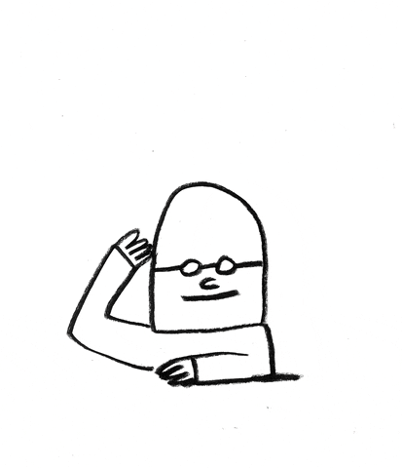
MATERIALS
Paper and pencil
Your setting from last week
Glue stick & scissors
construction paper
Your attention
and imagination

Slide 6
WARM UP
Notes:
laughter yoga

Slide 7
VOCABULARY

Slide 8
VOCABULARY
The Parts of a Story:
character
setting
plot
conflict
resolution

Slide 9
VOCABULARY
Visual Storytelling
is a story told mostly through the use of visual images, or pictures. The story may be told using photography, illustration, or video, and can be enhanced with graphics, music, voice and other audio.

Slide 10
PASS OR PLAY!

Slide 11
What is this character like?
Notes:
Consider color, angles, placement

Slide 12
What is this character like?
Notes:
Consider color, shape, placement

Slide 13
Are they friends?
Notes:
Consider placement

Slide 14
Are they friends?
Notes:
Consider color, placement

Slide 15
Vertical lines and shapes
are exciting and active
They seem to grow
Notes:
What could this be?

Slide 16
What is the feeling
of this setting?
Where is it?
Notes:
Ask then to turn to partner and share.

Slide 17
Who is this character now?
What is the feeling
of this setting?
Notes:
Turn to partner share

Slide 18
Diagonal lines and shapes give us a feeling of motion and action

Slide 19
What is the feeling
of this setting now?
How do you think the
character feels?
Notes:
Quick pair share

Slide 20
Horizontal lines give us a feeling of calm
Notes:
What could this be?

Slide 21
INSTRUCTIONS

Slide 22
Create a Setting With Lines
Cut out a shape that will be your character.
Play with the placement of your character in the setting you created with the paper strips.
When you find a placement of the character in the setting that you think shows the feeling you want in your story, glue it down.
Notes:
model using second camera

Slide 23
Pair Share Instructions
Trade visual stories with a partner.
Look closely at their illustration.
What feeling do you get from it?
What does the character seem like?
What do you think might happen next in their story?
Notes:
Give them time to share – ask them to report out. For recall, ask them to show movement/color/shape

Slide 24
REFERENCES

Slide 25
REFERENCES
Animation: giphy.com Serge Bloch & Emma Darvick, Rafahu
Visual Storytelling inspiration: Picture This: How Pictures Work by Molly Bang

