Slide 1
Object Informercials

Slide 2
OBJECTIVES
OF THIS LESSON

Slide 3
OBJECTIVES
Today we will:
Review improvisation
Review persuasive writing
Write our infomercials and share them

Slide 4
MATERIALS
FOR THIS LESSON

Slide 5

MATERIALS
Paper and pencil
A few objects
Your attention
and imagination

Slide 6
VOCABULARY

Slide 7

What does it mean to
improvise?
When you improvise, you create something without preparation or planning.
Notes:
Example – sing a song based on something in the room or a topic of their choosing.

Slide 8

What is
persuasive writing?
Persuasive writing convinces readers to believe in an idea or opinion and to do an action.
Advertisements are a good example of persuasive writing.
Notes:
Ask them to give an example of an ad they recall. Have them look for an example in the classroom.

Slide 9
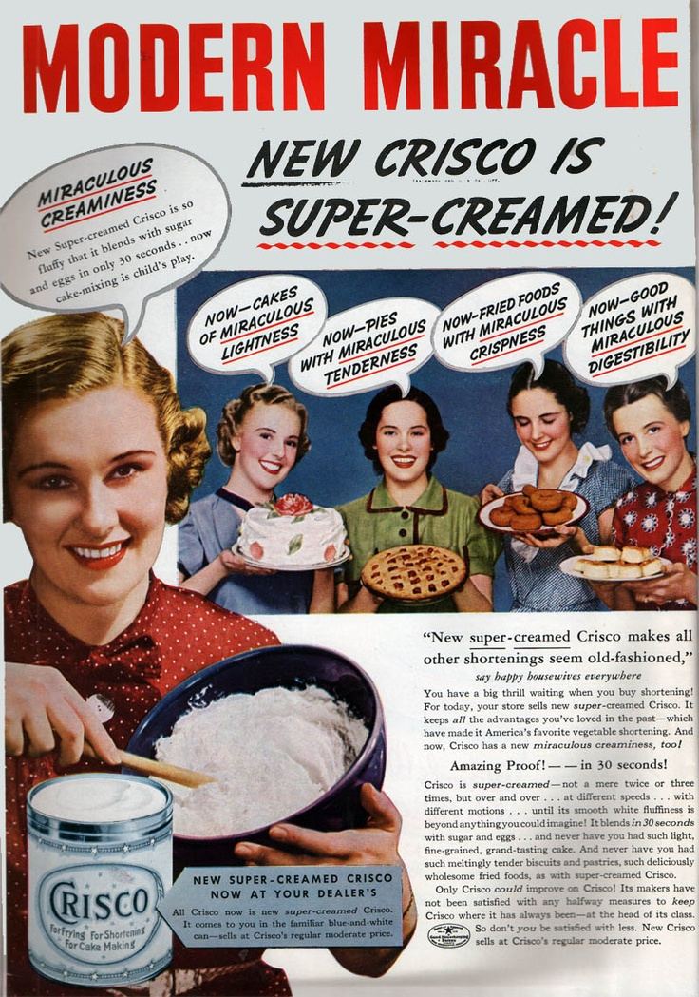

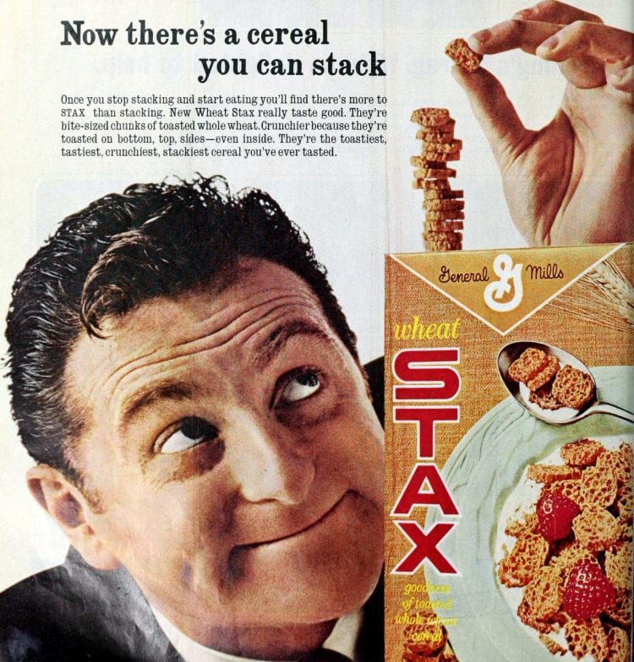
Notes:
Ask them to give an example of an ad they recall. Have them look for an example in the classroom.

Slide 10


Notes:
Ask them to give an example of an ad they recall. Have them look for an example in the classroom.

Slide 11
WARM UP
Notes:
An impro game – pass the face?

Slide 12
INSTRUCTIONS
Describe your
miracle product
What is it called?
What does it do?
Does it solve a problem? If so, what?
What is it made out of?
What makes it different from
other competing miracle products?
Where do we call to order?
How much does it cost?
Notes:
model using second camera

Slide 13
REFLECTION
Turn to a partner.
Share your infomercial ideas with each other.
Was their writing persuasive? How?
Notes:
model using second camera

Slide 14
REFERENCES

Slide 15
REFERENCES
All animations for this lesson came from giphy.com
Video from ABC Family Channel: Whose Line Is It Anyway?

