Slide 1
The Art and math of tapestry weaving
The bold and the beautiful

Slide 2
objectives
of this lesson

Slide 3
objectives
Students will learn the natural connection between math and the visual art of tapestry weaving while creating their own woven tapestry designs!
Students will learn about balance, counting, symmetry, color, storytelling and abstraction.
Students will gain proficiency with measuring tools such as a ruler.

Slide 4
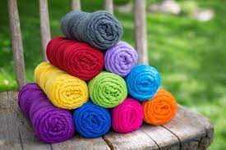
materials
For this lesson

Slide 5
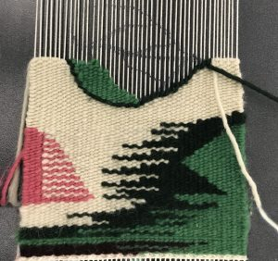
materials
Loom
Scissors
String, yarns, ribbons
Scrap paper
Tape
Marker
Tapestry needle

Slide 6
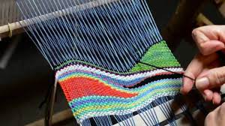
Pass or play!
What do you know about tapestry weaving?

Slide 7
Tapestry weaving
https://www.youtube.com/watch?v=_R0gKo58hDw
William Kentridge Tapestry, 2005

Slide 8
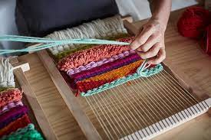
Brief history of tapestry
Tapestry is a form of weaving with various fibers that are meant to hang on the wall
Tapestry weaving was found in Ancient Egypt as early as 1380 BC
This form of weaving allows the artist to interlace the colors in their own small individual patterns

Slide 9
Instructions

Slide 10
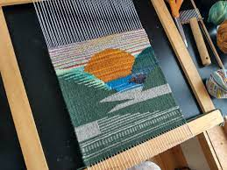
instructions
Students will create a design on scrap paper first and use this to transfer on to the weaving loom warp strings
Students will create a loom and learn to string the warp strings for weaving
Students will draw their design on the warp strings with a marker
Students will use colored string, yarns, ribbons etc to execute their designs in fibers. They will create the weft strings with these materials and learn how to use a shed stick to weave with ease
Students will think about texture and interest for their weaves.

Slide 11
Vocabulary
Math
Measurements
Length, width, height
Half inch, quarter inch, eighth inch
Art
Warp
Weft
Shuttle

Slide 12
vocabulary
Math Vocabulary
Inches
Measure
Art vocabulary
Warp weft
Shed
Tapestry needle

Slide 13
references
https://www.google.com/imgres?imgurl=https%3A%2F%2Fbrownsheep.com%2Fwp-content%2Fuploads%2F2020%2F01%2Fwildfoote.jpg&imgrefurl=https%3A%2F%2Fbrownsheep.com%2Fproduct%2Fwildfoote-sock-yarn%2F&tbnid=axMZ8OmvAtiYlM&vet=12ahUKEwj54Yut3a7zAhVunnIEHUk1AskQMygBegUIARD0Ag..i&docid=DhmxBPxRdZM33M&w=800&h=533&q=yarn&client=safari&ved=2ahUKEwj54Yut3a7zAhVunnIEHUk1AskQMygBegUIARD0Ag
https://www.google.com/imgres?imgurl=https%3A%2F%2Fi.ytimg.com%2Fvi%2FSei1PgkeI3o%2Fmaxresdefault.jpg&imgrefurl=https%3A%2F%2Fwww.youtube.com%2Fwatch%3Fv%3DSei1PgkeI3o&tbnid=6prYSOjwo1l4eM&vet=12ahUKEwinztqa3q7zAhU3qnIEHfjjB1sQMygOegUIARD9Ag..i&docid=qFOHVQu52vf_SM&w=1280&h=720&q=tapesrty%20ingweav&client=safari&ved=2ahUKEwinztqa3q7zAhU3qnIEHfjjB1sQMygOegUIARD9Ag
https://tapestry-art.com/ordering/
https://www.google.com/imgres?imgurl=https%3A%2F%2Fwww.woolmark.com%2Fglobalassets%2F_06-new-woolmark%2F_2-fashion%2Finteriors%2Fdreamweaving%2Ftapestry%2Fgal-9-1.jpg&imgrefurl=https%3A%2F%2Fwww.woolmark.com%2Ffashion%2Fdiy%2Fdreamweaving%2Fhow-to-weave-tapestry%2F&tbnid=7eVUQCvCldoGvM&vet=12ahUKEwiql_iB4K7zAhWJqnIEHQ2KADQQMygKegUIARDwAg..i&docid=B2w2Wi7-7n_wtM&w=900&h=600&q=tapestry%20weaving&hl=en&client=safari&ved=2ahUKEwiql_iB4K7zAhWJqnIEHQ2KADQQMygKegUIARDwAg

Slide 14
References
https://www.google.com/url?sa=i&url=https%3A%2F%2Flearn.reeb.com%2Fknowledge-base%2Fhow-to-read-a-tape-measure%2F&psig=AOvVaw1QQ_Ksz3UkoXVu_5qAbupt&ust=1639430956214000&source=images&cd=vfe&ved=0CAsQjRxqFwoTCMDX0L-a3_QCFQAAAAAdAAAAABAD
https://www.google.com/imgres?imgurl=https%3A%2F%2Fupload.wikimedia.org%2Fwikipedia%2Fcommons%2F5%2F5e%2FWarp_and_weft_2.jpg&imgrefurl=https%3A%2F%2Fen.wikipedia.org%2Fwiki%2FWarp_and_weft&tbnid=d0F8izYB-7rHcM&vet=12ahUKEwjx4LfYmt_0AhXHsHIEHZRRCHkQMygAegUIARDJAQ..i&docid=ViqmdcZhkDynAM&w=377&h=418&itg=1&q=warp%20weft&client=safari&ved=2ahUKEwjx4LfYmt_0AhXHsHIEHZRRCHkQMygAegUIARDJAQ
https://africanah.org/william-kentridge-tapestries/

