Slide 1
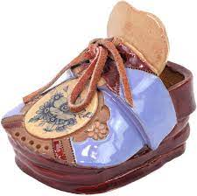
Shoe Sculptures
From Another world!

Slide 2
objectives
of this lesson

Slide 3
objectives
Students will engage creativity and design a pair of sculptural shoes that would only exist in another world.
Students will learn math operations, length, width and volume in this lesson.
Students will have an opportunity to paint and present their sculptures in an online gallery we create.

Slide 4
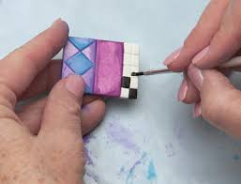
materials
For this lesson

Slide 5
materials
Scrap paper
Pencil
Clay
Paint
brushes

Slide 6
Fabulous other worldy shoes
https://www.youtube.com/watch?v=IdN9Gqah280https://www.youtube.com/watch?v=IdN9Gqah280

Slide 7
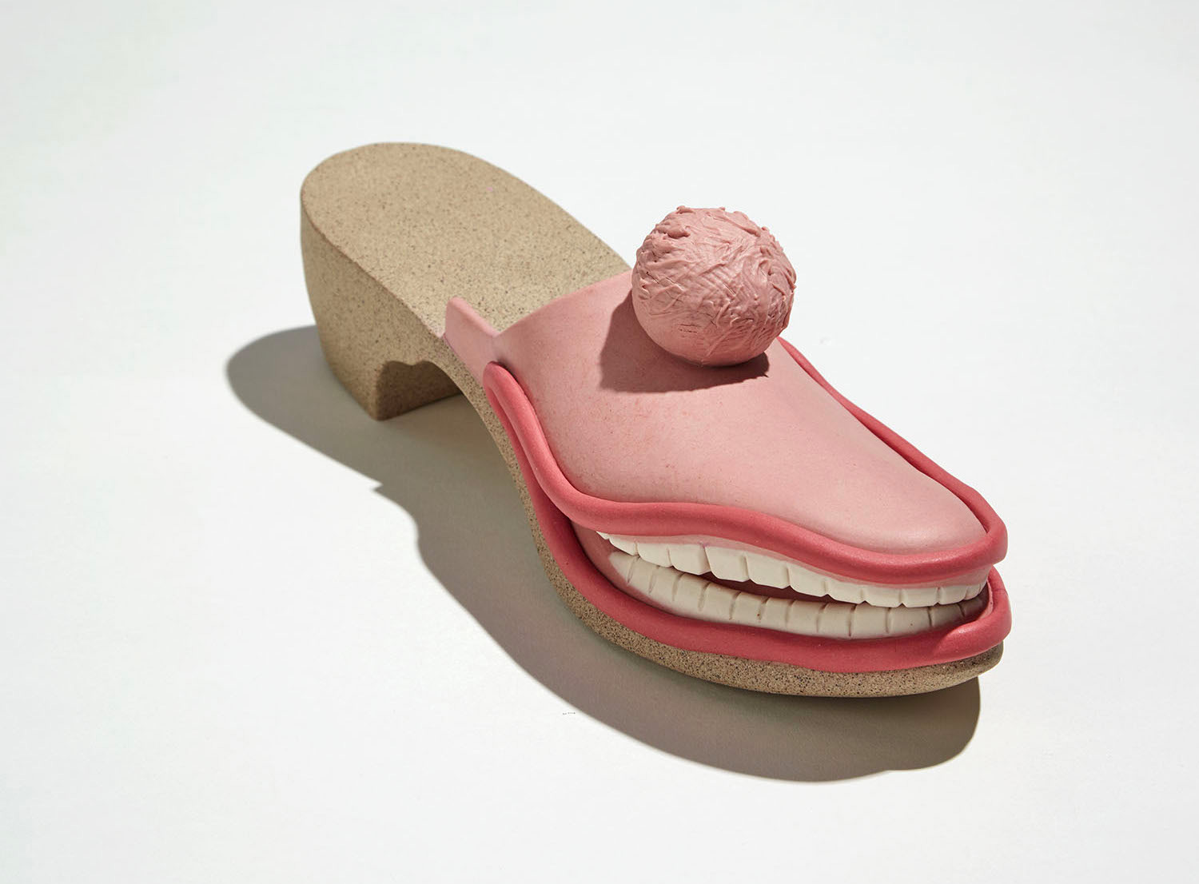
Pass or play!
What do you know about shoes?
What kind of world or environment will you be interested in creating shoes for?

Slide 8
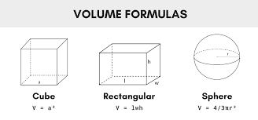
vocabulary
Math:
Volume
Length
Width
ART:
Sculpture in the round
undercut

Slide 9
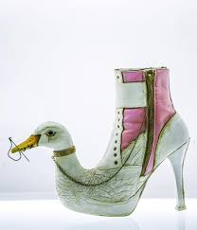
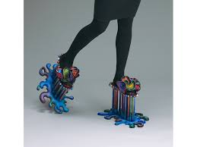
instructions
Shoes from another world

Slide 10
instructions
Students will draw at least 5 thumbnail sketches of their shoes also describing the kind of world these shoes would exist within
Students will narrow down to their best design and execute this design in air dry clay to ½ the size of real shoes. (Using about the size of a golf ball of clay for each shoe not including embellishments)
Students will add color with paints after the sculptures have dried
I will be doing a demonstration of this technique prior to them using the clay

Slide 11
references
https://www.google.com/imgres?imgurl=https%3A%2F%2Fm.media-amazon.com%2Fimages%2FI%2F71eMPI7%2B83L._AC_SL1500_.jpg&imgrefurl=https%3A%2F%2Fwww.amazon.com%2FHollys-Laguna-Ceramics-Crafted-Sculpture%2Fdp%2FB00XISA80I&tbnid=TLsEcL1qVQihqM&vet=12ahUKEwi6kvuG4rDzAhVTqnIEHek1DeoQMygBegUIARC8Ag..i&docid=UPIntX7x5Vvt7M&w=1500&h=1493&q=painted%20clay%20shoe%20sculptures&client=safari&ved=2ahUKEwi6kvuG4rDzAhVTqnIEHek1DeoQMygBegUIARC8Ag
https://www.google.com/imgres?imgurl=https%3A%2F%2Fs22459.pcdn.co%2Fwp-content%2Fuploads%2F2010%2F12%2FPaintingTilesimage.jpg&imgrefurl=https%3A%2F%2Fwww.createmixedmedia.com%2Fmake%2Fmocaics%2Fpainting-polymer-clay-tiles&tbnid=RdFvf98LNzvDnM&vet=10CFcQMyi9AWoXChMI0IS4u-Kw8wIVAAAAAB0AAAAAEAY..i&docid=l42MmF8rR0ECfM&w=521&h=399&q=clay%20and%20paint&client=safari&ved=0CFcQMyi9AWoXChMI0IS4u-Kw8wIVAAAAAB0AAAAAEAY
https://www.google.com/imgres?imgurl=https%3A%2F%2Flookaside.fbsbx.com%2Flookaside%2Fcrawler%2Fmedia%2F%3Fmedia_id%3D2858373934379685&imgrefurl=https%3A%2F%2Fwww.facebook.com%2FCostaMagarakisArt%2F&tbnid=tJuodk8RFYZHeM&vet=10COMBEDMoywFqFwoTCMCe24jisPMCFQAAAAAdAAAAABAF..i&docid=Y3gVsRQPKsdJAM&w=1440&h=1680&q=painted%20clay%20shoe%20sculptures&client=safari&ved=0COMBEDMoywFqFwoTCMCe24jisPMCFQAAAAAdAAAAABAF
https://www.google.com/imgres?imgurl=https%3A%2F%2Fartjewelryforum.org%2Fsites%2Fdefault%2Ffiles%2F1.16_AINT_MLAMBERT_Schick_4b_600x800px.jpg&imgrefurl=https%3A%2F%2Fartjewelryforum.org%2Ftaxonomy%2Fterm%2F207%2Fall%3Fpage%3D0%252C0%252C0%252C0%252C0%252C22&tbnid=b9s7ZTKDoGXHWM&vet=10CC0QMyjiAWoXChMIwJ7biOKw8wIVAAAAAB0AAAAAEAY..i&docid=GMR5V6VUoH1luM&w=800&h=600&q=painted%20clay%20shoe%20sculptures&client=safari&ved=0CC0QMyjiAWoXChMIwJ7biOKw8wIVAAAAAB0AAAAAEAY
https://www.google.com/url?sa=i&url=https%3A%2F%2Fwww.thisiscolossal.com%2F2019%2F08%2Fsculptures-by-genesis-belanger%2F&psig=AOvVaw0yk0dnqMbT_92BEZMUOQjI&ust=1633437244336000&source=images&cd=vfe&ved=0CAsQjRxqFwoTCMCe24jisPMCFQAAAAAdAAAAABAJ
https://www.google.com/imgres?imgurl=https%3A%2F%2Fcdn.inchcalculator.com%2Fwp-content%2Fuploads%2F2020%2F11%2Fvolume-formulas.png&imgrefurl=https%3A%2F%2Fwww.inchcalculator.com%2Fvolume-calculator%2F&tbnid=1fkW3p1pI7l89M&vet=12ahUKEwi04_2i5rDzAhXSrnIEHfAvBiUQMygHegUIARDaAQ..i&docid=1PrQ0WnteYQVQM&w=1200&h=562&q=volume&client=safari&ved=2ahUKEwi04_2i5rDzAhXSrnIEHfAvBiUQMygHegUIARDaAQ

