Slide 1
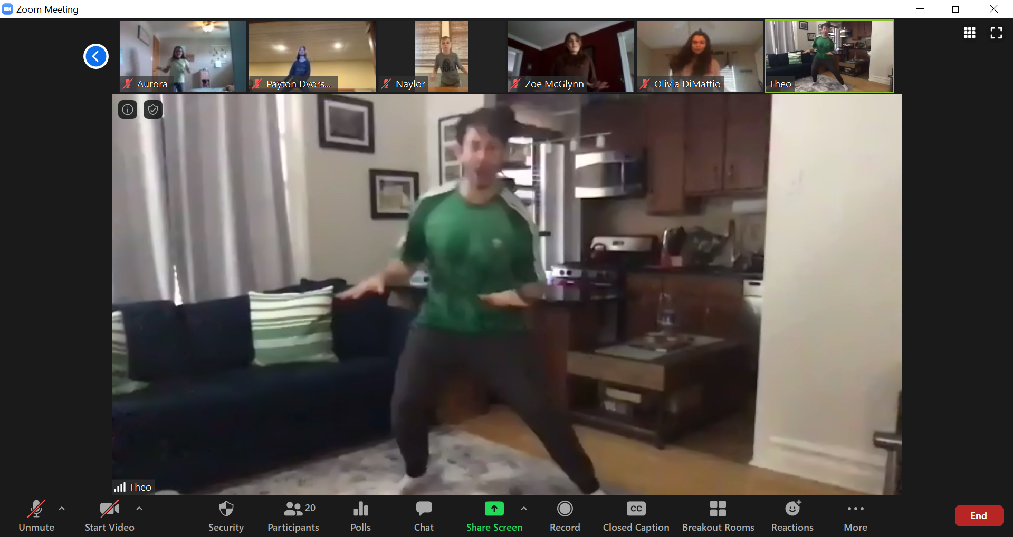
The Connected Teacher
Catherine Richmond-Cullen, Ed.D
neuroLEARN 2020

Slide 2
Why integrate the content areas?
Engage the entire brain
More brain = more memory

Slide 3
Watch these next few slides….
Remember the last lesson we had together…..Teach to the BRAIN!
Which one is the virtual classroom you want?
Think about the questions….

Slide 4
Cerebral Cortex
Frontal Lobe- associated with reasoning, planning, parts of speech, movement, emotions, and problem solving
Parietal Lobe- associated with movement, orientation, recognition, perception of stimuli
Occipital Lobe- associated with visual processing
Temporal Lobe- associated with perception and recognition of auditory stimuli, memory, and speech

Slide 5
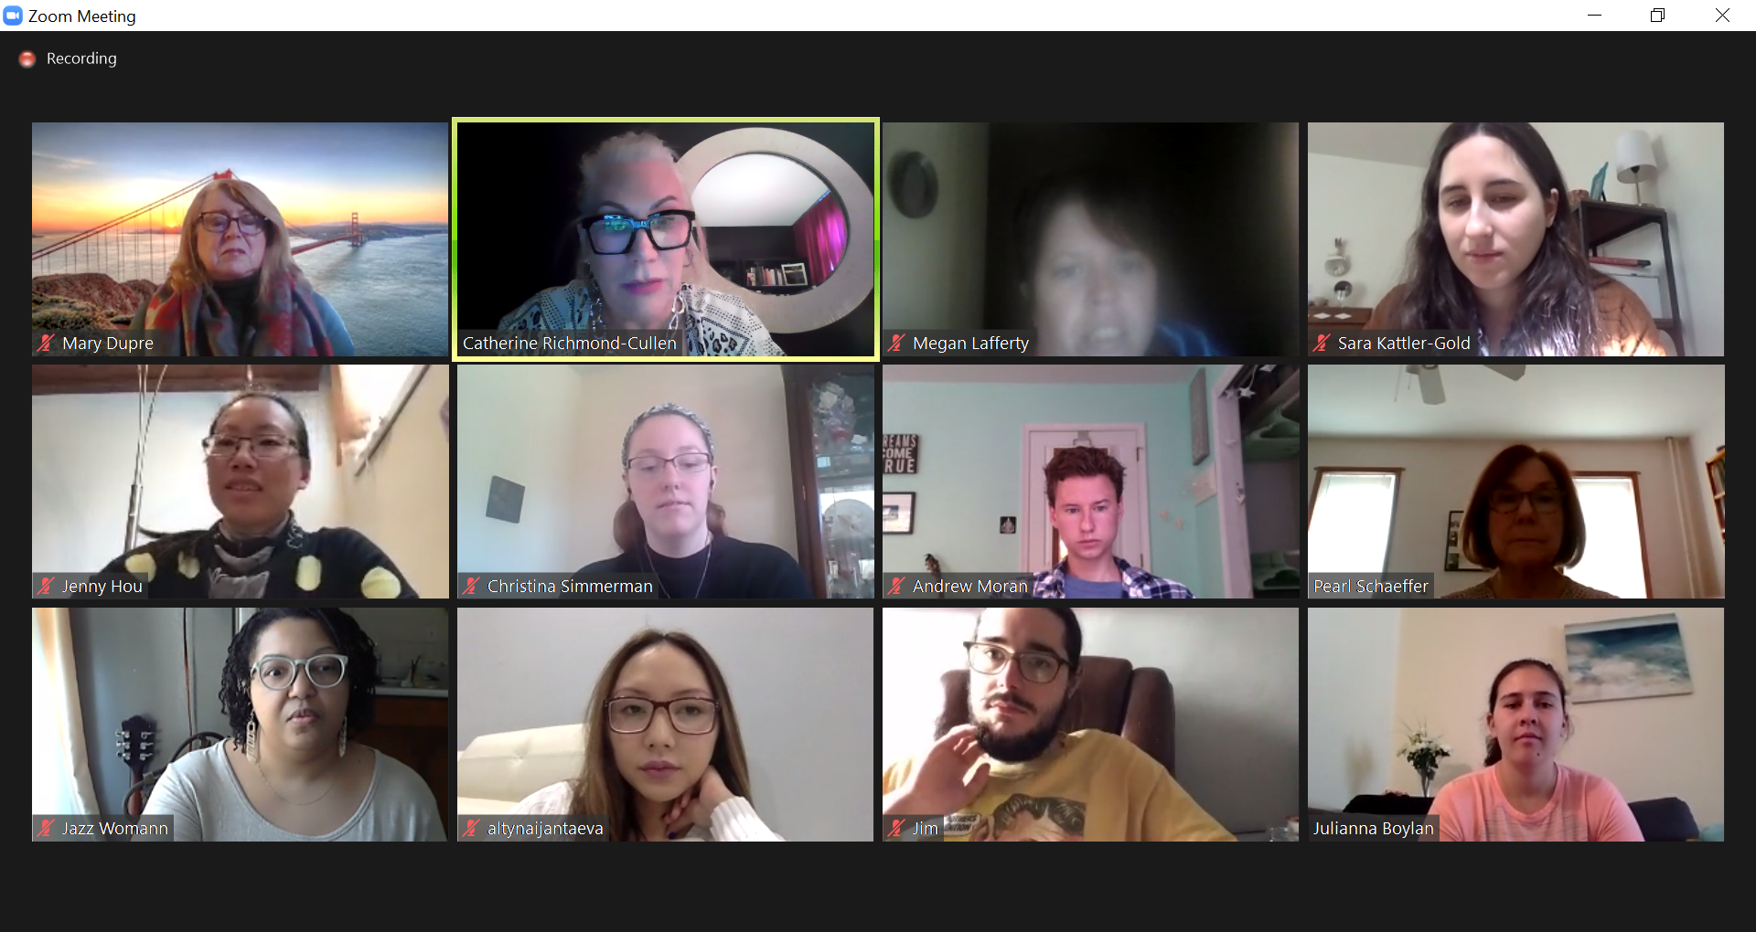
Does this look like fun?

Slide 6
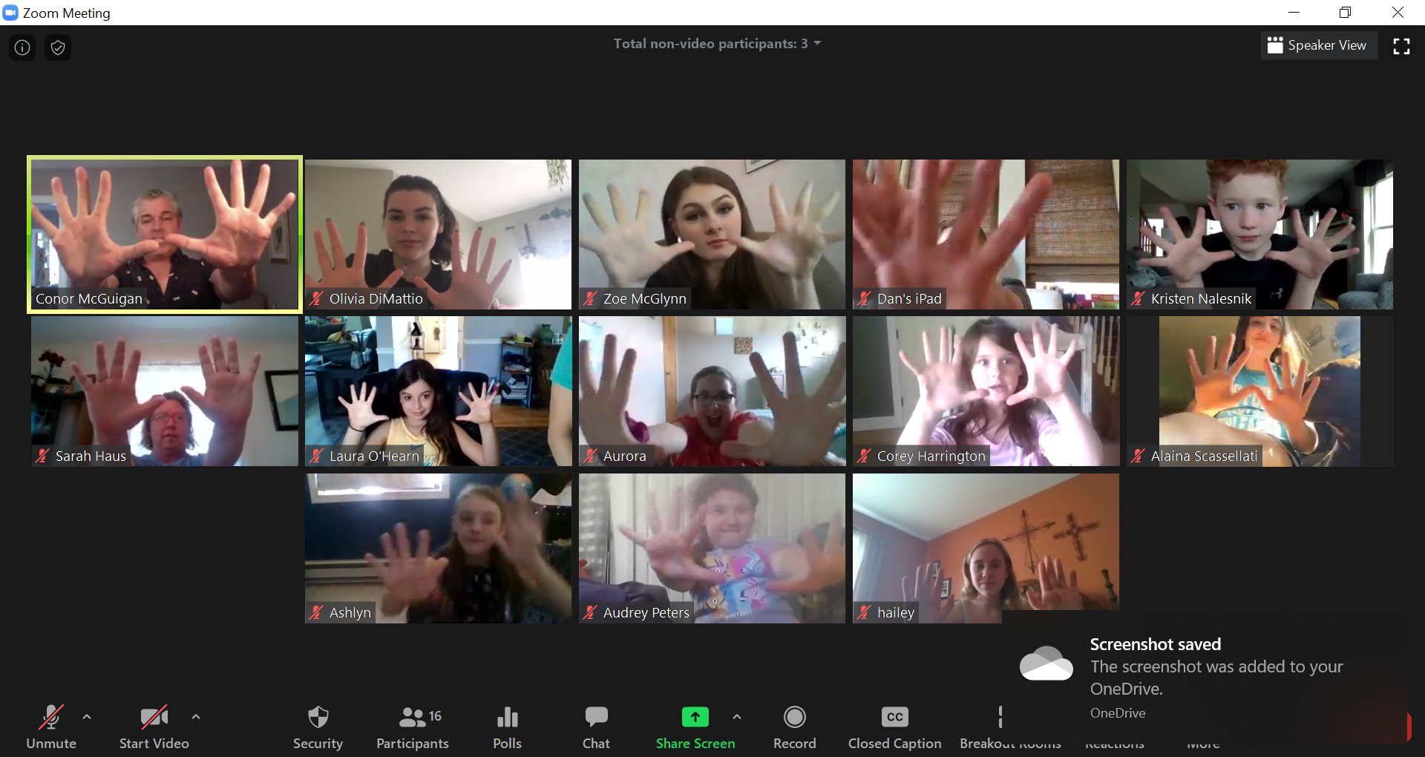
Happy Children: Theatre

Slide 7
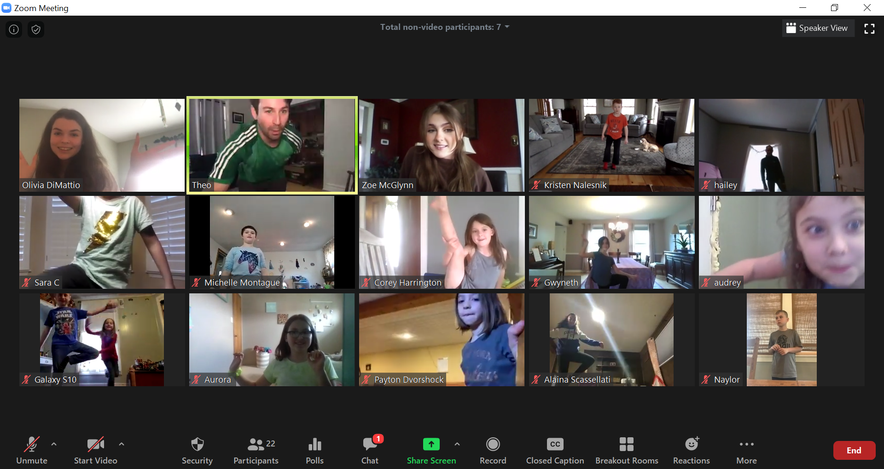
Happy Children: Dance

Slide 8
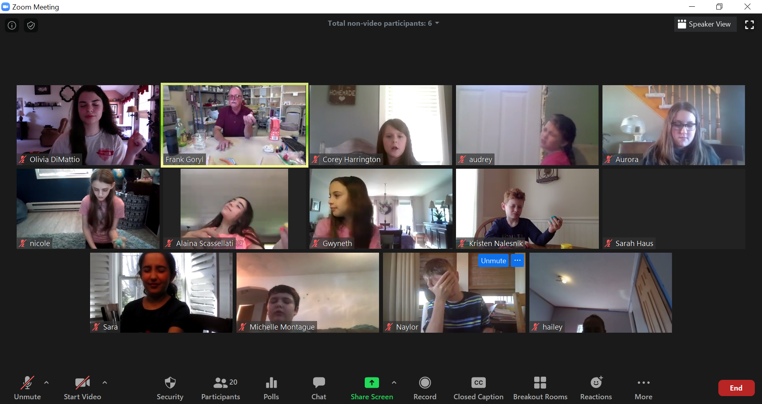
Children using imagery in art.

Slide 9
Remember our classrooms? Thinking about teaching online……
What is working?
What are your challenges?

Slide 10
Framework for Creating and Teaching Engaging Lessons ©Richmond-Cullen, 2020
Statement of Learning
Today you will discover how research on learning can be applied to a virtual classroom to engage students more effectively.

Slide 11
Framework for Creating and Teaching Engaging Lessons ©Richmond-Cullen, 2020
Teachers use evidence based instructional strategies.
Framework consistent in all lessons.
Using visual images and video is essential.
Chat room and Q&A engage students.

Slide 12
Teaching Framework: 5 Simple Steps
Wake up the Brain: Do something creative
Stimulate their Memories: brainstorm and imagery.
Teaching vocabulary for discourse.
I do, you do, WE do engagement.
Help them store in their memory.

Slide 13
Reticular Activating System: RAT

Slide 14
How can we begin our lessons?
Get their attention through sensory stimulus.

Slide 15
Limbic System: Emotional Connections First
Notes:
The neocortex occupies the bulk of the cerebrum. This is a six-layered structure of the cerebral cortex which is only found in mammals. It is thought that the neocortex is a recently evolved structure, and is associated with "higher" information processing by more fully evolved animals (such as humans, primates, dolphins, etc). For more information about the neocortex, click here.

Slide 16
How can you stimulate the whole brain?

Slide 17
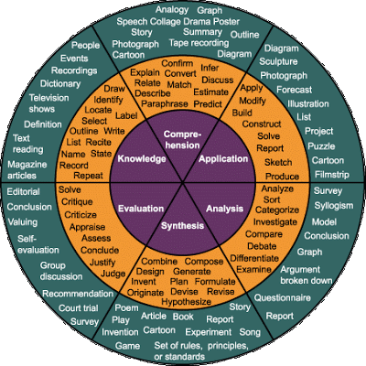
Webb’s Depth of Knowledge Taxonomy

Slide 18
Wake up the Brain: 5 minutes
Start with art….have them DOING something right away or watch you do something
Use sensory experiences: what do they see, hear, smell, taste….what is happening around them?

Slide 19
Stimulate their Memories: Background 6 minutes
WHAT DO YOU KNOW ABOUT THIS?
Pass or Play
Graphic Organizers

Slide 20
brainstorm

Slide 21
Vocabulary for Discourse: 7 minutes
Choose several words
Show them what they mean: images are everything
Chat and pass/play
Use the words in your lesson

Slide 22
Vocabulary for Oral and Written Discourse
Images are integral in assisting students to understand concepts especially in a virtual environment

Slide 23
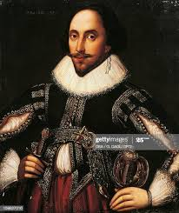
Iambic Pentameter

Slide 24
Color Wheel
Primary and Secondary Colors

Slide 25
Ways you can help students use their brains……
Linguistic
Visual
Motor
Problem
Solving
Memory

Slide 26
Instructional Process
I DO
YOU DO
WE DO

Slide 27
Engage the children in activities
Create
Engage

Slide 29
Theatre

Slide 30
Extension Activities
Extension activities for students and their families.

Slide 31
Letter from a teacher
I really am enjoying being a student and it has made me more mindful of my own students who sometimes are nervous or lack confidence in their
artistic abilities.
The lesson structure has given me some ideas on how I might run an online class in a normal class period time frame if that is what is going to happen at school, next year.

Slide 32
Too much talk…get them UP and GOING

Slide 33
Clap along…..

Slide 34
Help them Store in their Memory: 5 minutes
Make sure you leave at least 5 minutes at the end to summarize what you did…
Ask them….tell me one thing you learned today….pass/play

Slide 35
Practice Opportunities: Extension Activities
Give the students an extension activity.
What can they do to learn more about this….
Websites….
Activities….

Slide 36
Materials List
What
Create a materials list for your class. Include moving the furniture out of the way if necessary…or having access to the phone…downloading a tune….paper, pencils, etc.

Slide 37
Consider this….
Every student has a unique brain and learns differently
Meaning making is an innate need.
We are social learners.
The mind learns parts and wholes simultaneously.
The mind needs to connect facts to conceptual understanding.
We learn through patterns.
Emotions effect learning and storage of new information.
Extreme challenges or threats arrest the process of learning.

Slide 38
Parts and Whole: 5 Simple Steps
Wake up the Brain: Do something creative
Stimulate their Memories: brainstorming and imagery.
Teaching vocabulary for discourse.
I do, you do, WE do engagement.
Help them store in their memory.

