Slide 1
Pop Art
Part 3

Slide 2
objectives
of this lesson

Slide 3
objectives
Finish our Pop Art Stencil Project

Slide 4
materials

Slide 5
materials
Colored Paper
Stencils from last class
Pastels

Slide 6
Pass or Play!

Slide 7
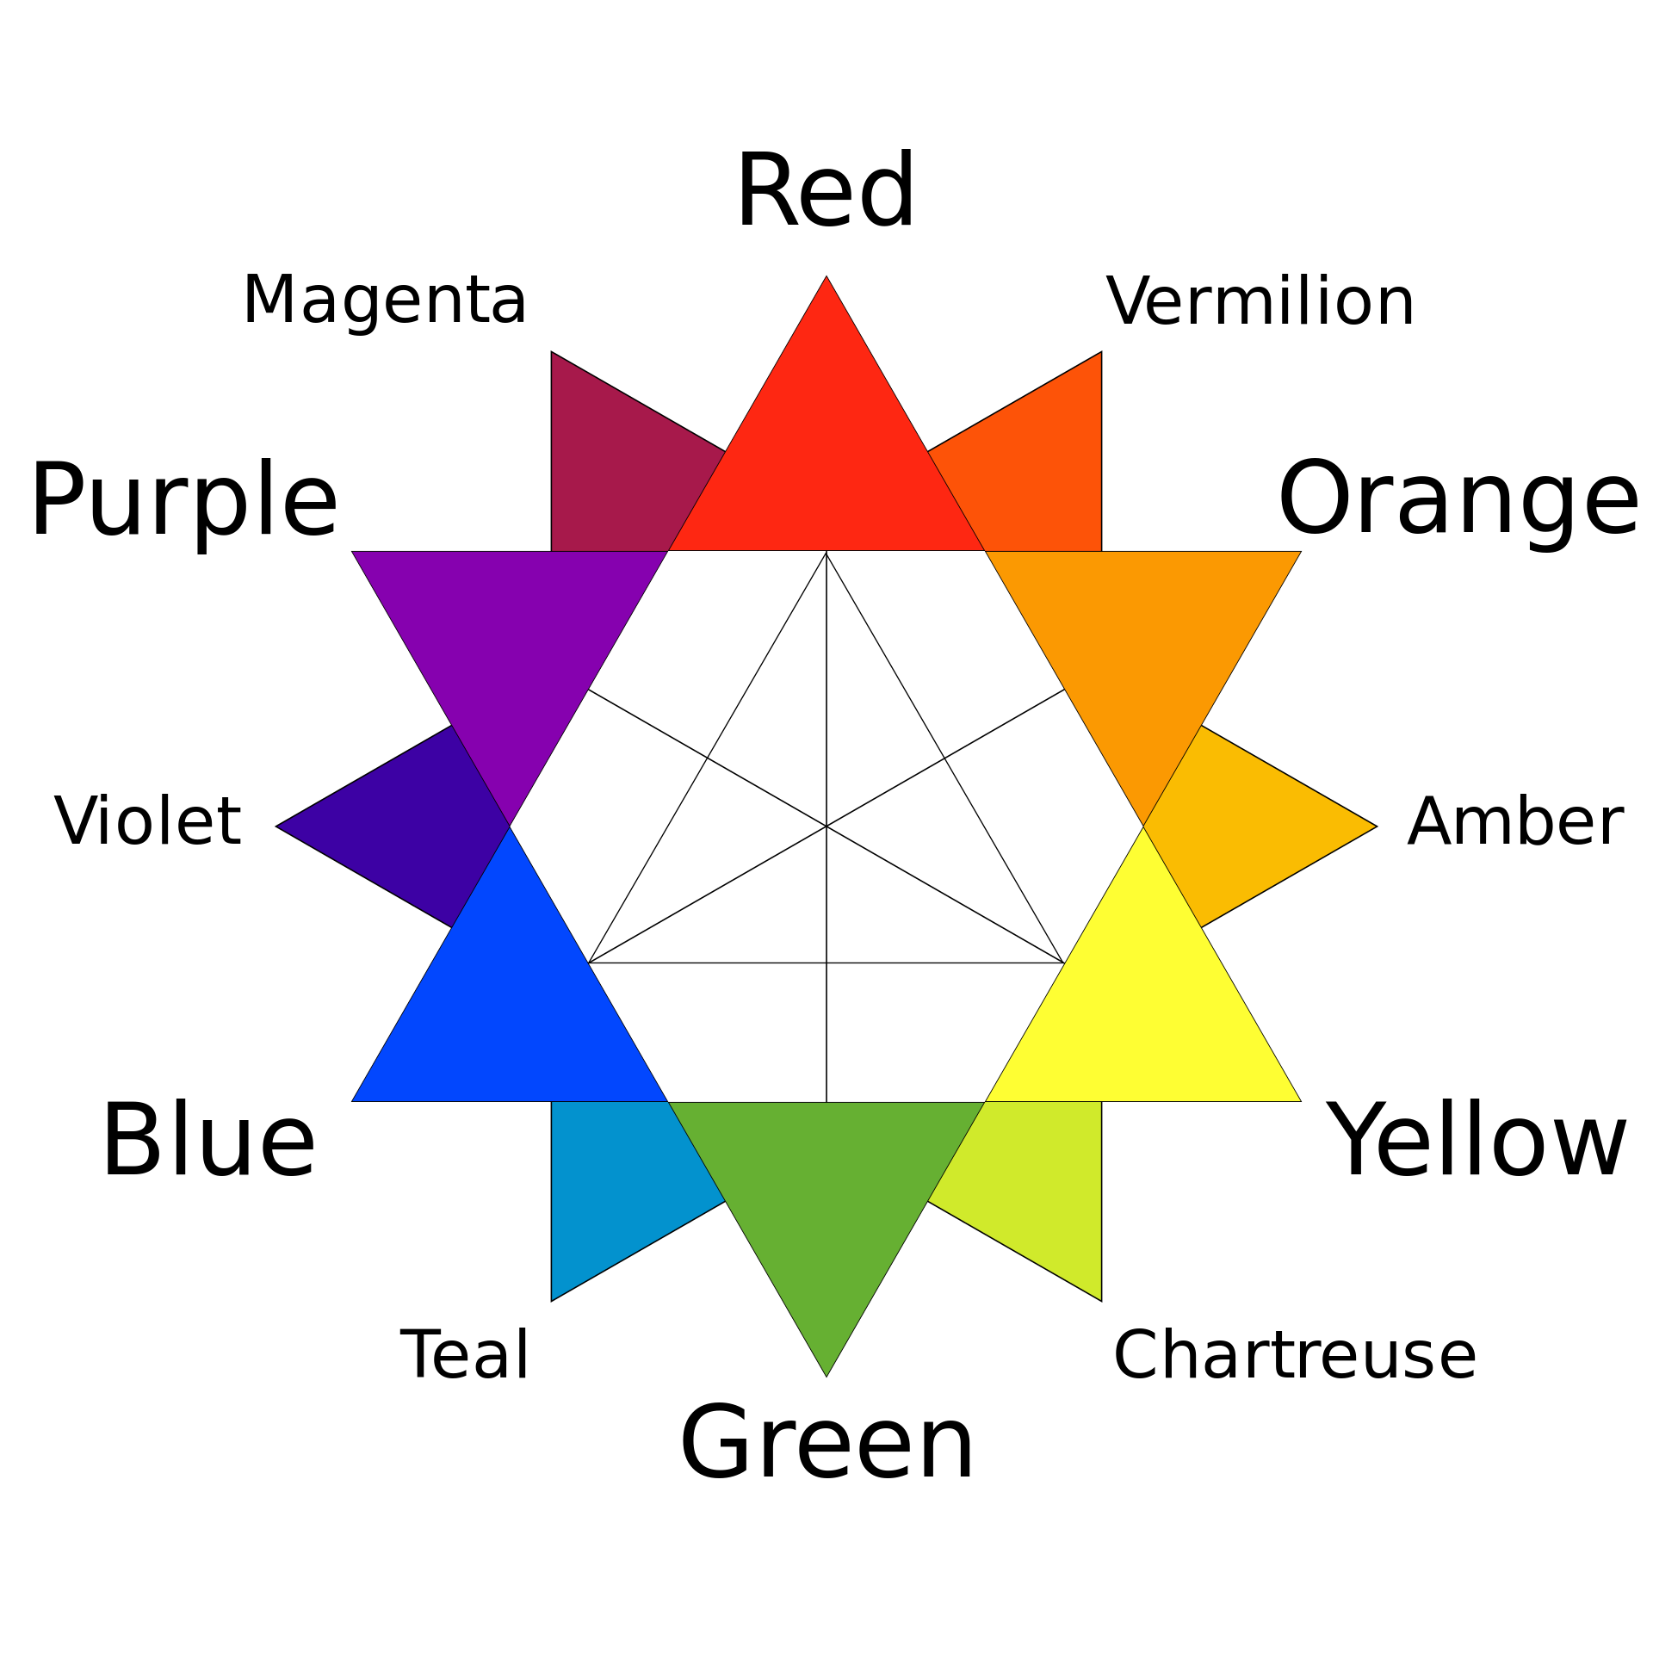

Slide 8
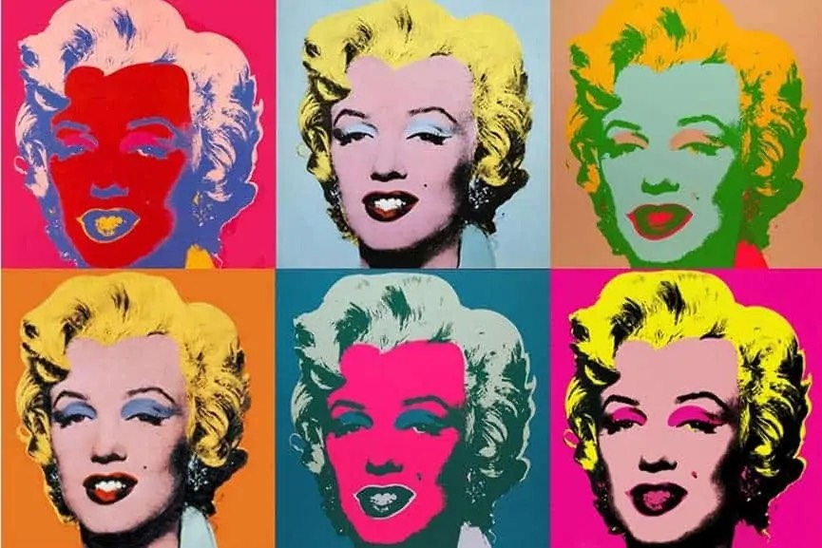

Slide 9
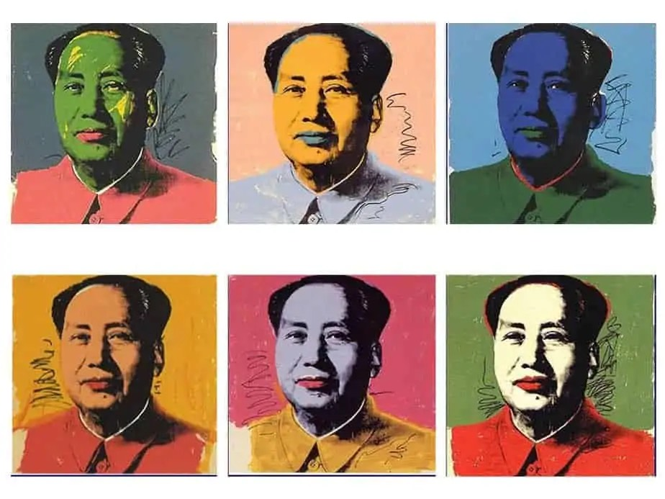

Slide 11
vocabulary

Slide 12
vocabulary
Complementary Colors
Colors across from each other on the color wheel. They add contrast to our work! (red & green, orange & blue, yellow & purple)
Contrast
arrangement of opposite elements (light and dark, rough and smooth, large and small)
Repetition
the use of the same visual effect a number of times in the same composition
Value
how light or dark a color can be. Using light and dark colors adds contrast vs using all light colors

Slide 13
instructions

Slide 14
instructions
Continue your project from last class. Repeat all of the steps for each piece of paper (at least 4 total)
Begin with one outline of the main stencil (in any color),
Offset and fill in the same stencil (in another color different from the last one)
Fill in the shadow stencil (in the same color as last step or a different color)
Create ridges (depending on the coin) by drawing lines over the shadow stencil (to help keep the lines within the boarders of the shadow shape).
Repeat to fill all four squares! Switch the colors and use a variety like Warhol! Make sure you have bold contrasting colors!

Slide 15
Count your repeated coins! How Much money is your art project worth?

Slide 16
references
Images:
https://www.artsy.net/artwork/andy-warhol-complete-set-of-6-dollar-signs-1981
moma.org/collection/works/61240
https://www.moma.org/collection/works/79809
https://www.tate.org.uk/art/artists/andy-warhol-2121/what-was-andy-warhol-thinking
https://smarthistory.org/warhol-marilyn-diptych/
https://www.theartist.me/art-inspiration/famous-andy-warhol-paintings/
https://impact-nw.com/the-basics-of-screen-printing/
https://www.artsy.net/artwork/andy-warhol-flowers-fs-ii-dot-69-5
https://www.youtube.com/watch?v=DhEyoDCTSDQ&t=84s

