Slide 1
Paper Sculptures
Part 4

Slide 2
objectives
of this lesson

Slide 3
objectives
Apply the paper sculpture techniques we learned to our sculpture project

Slide 4
materials

Slide 5
materials
Pencil
Paper
Glue
Scissors

Slide 6
Pass or play!

Slide 7
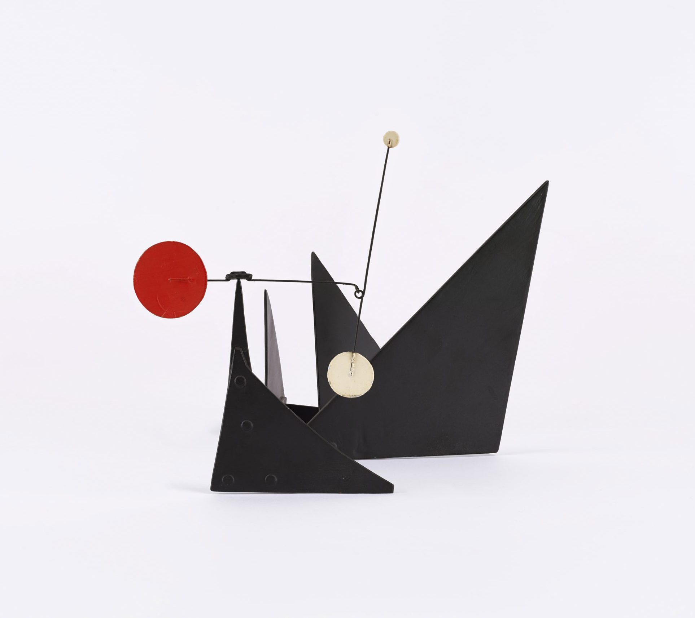

Slide 8
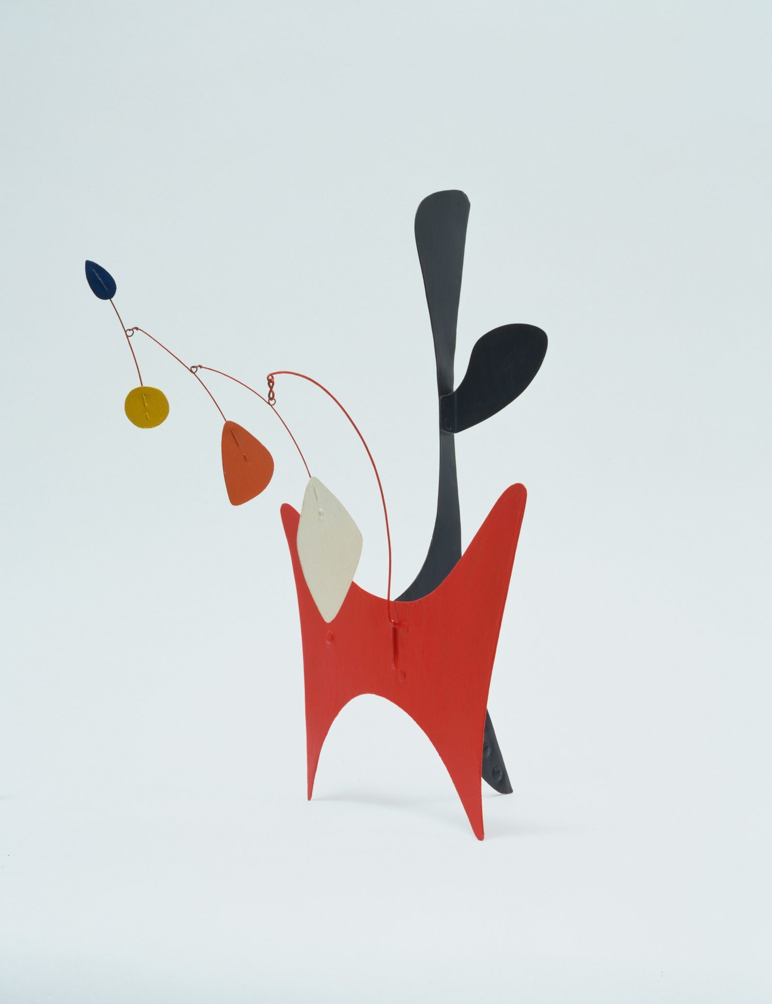

Slide 9
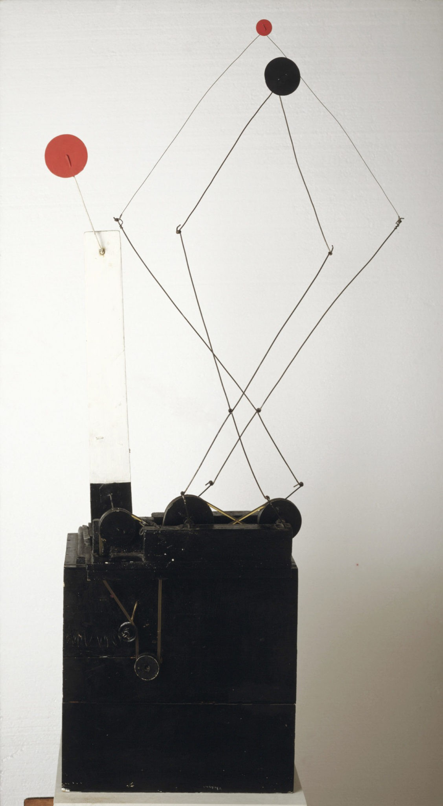

Slide 10
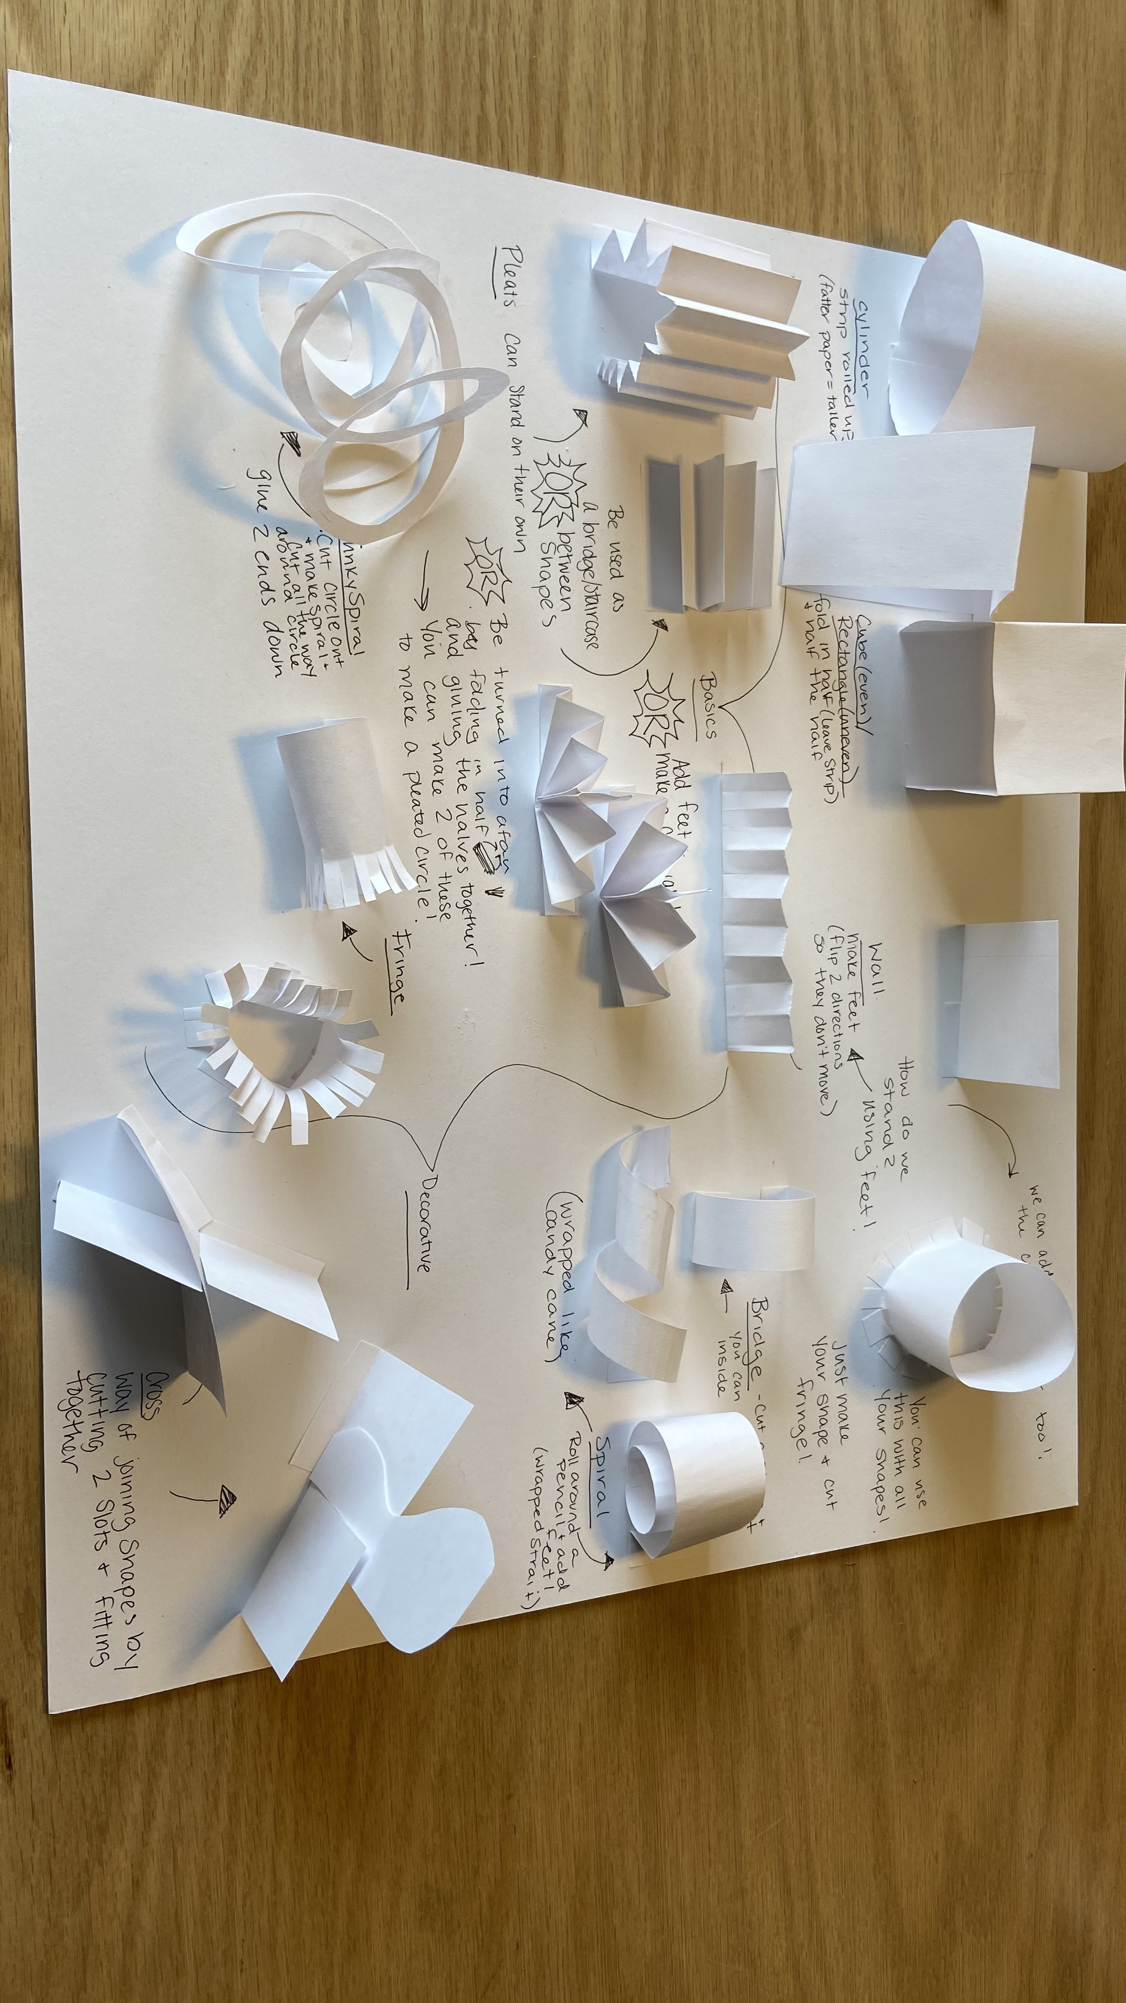

Slide 11
vocabulary

Slide 12
vocabulary
Shape
  Geometric Shape
  Organic Shape
2D Shape
3D Shape

Slide 13
instructions

Slide 14
instructions
Start constructing your sculpture using the techniques we learned last class. Remember you must use at least 4 DIFFERENT geometric shapes and at least 2 DIFFERENT organic shapes
Begin with shapes at the bottom of your sculpture. Add anything close to the base. You can include some flat shapes here to decorate your paper plate.
Start building up your sculpture. Connect different shapes with cross joints, bridges, or feet
Add some decorative elements like fringe, spirals, or pleats

Slide 15
references
https://www.moma.org/calendar/events/6988
https://calder.org/
https://www.youtube.com/watch?v=j3OqfduWdhc&t=6s

