Slide 1
Paper Sculptures
Part 3

Slide 2
objectives
of this lesson

Slide 3
objectives
Finish learning about paper sculpture techniques we can use to turn our 2D drawings into 3D sculptures

Slide 4
materials

Slide 5
materials
Pencil
Paper
Glue
Scissors

Slide 6
Pass or play!

Slide 8
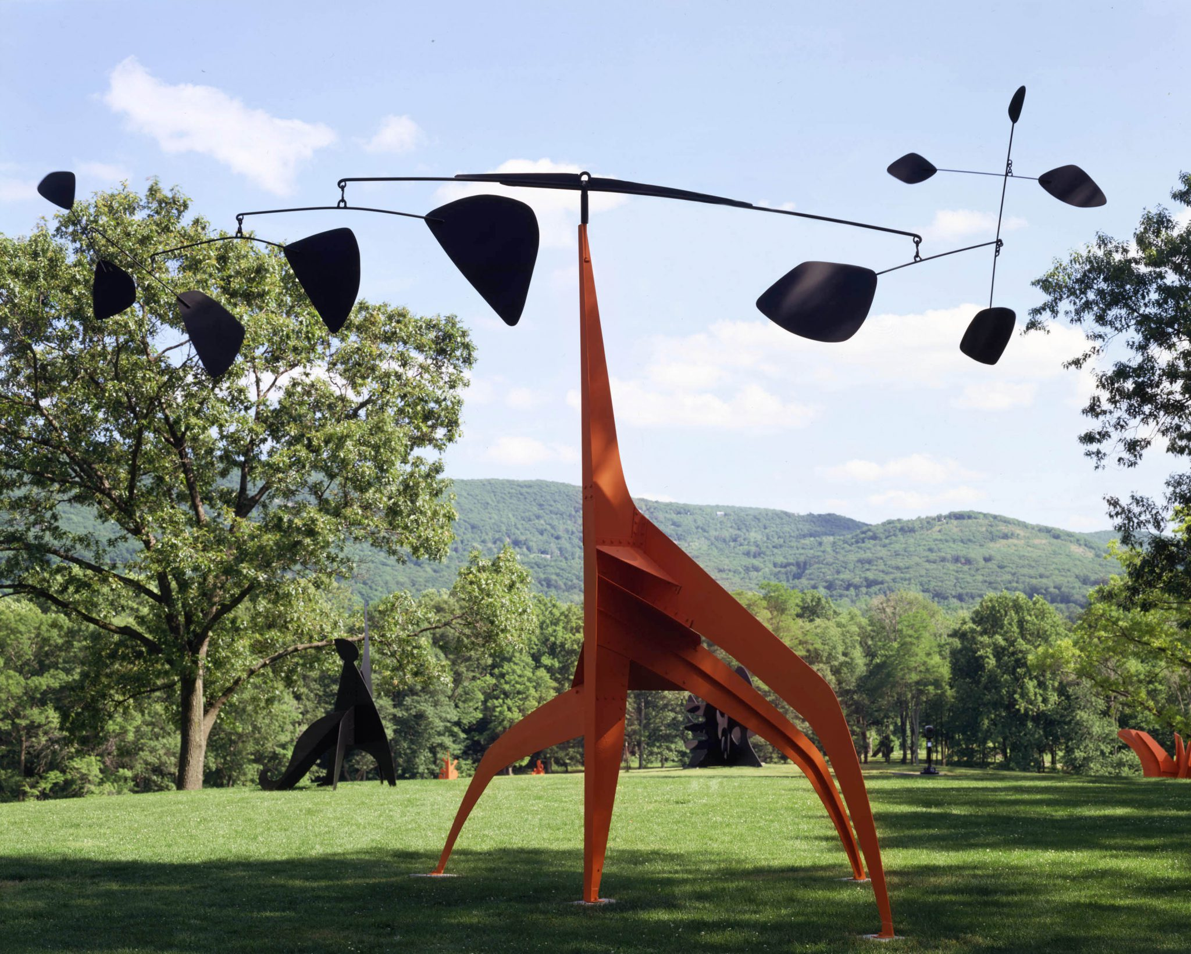

Slide 9
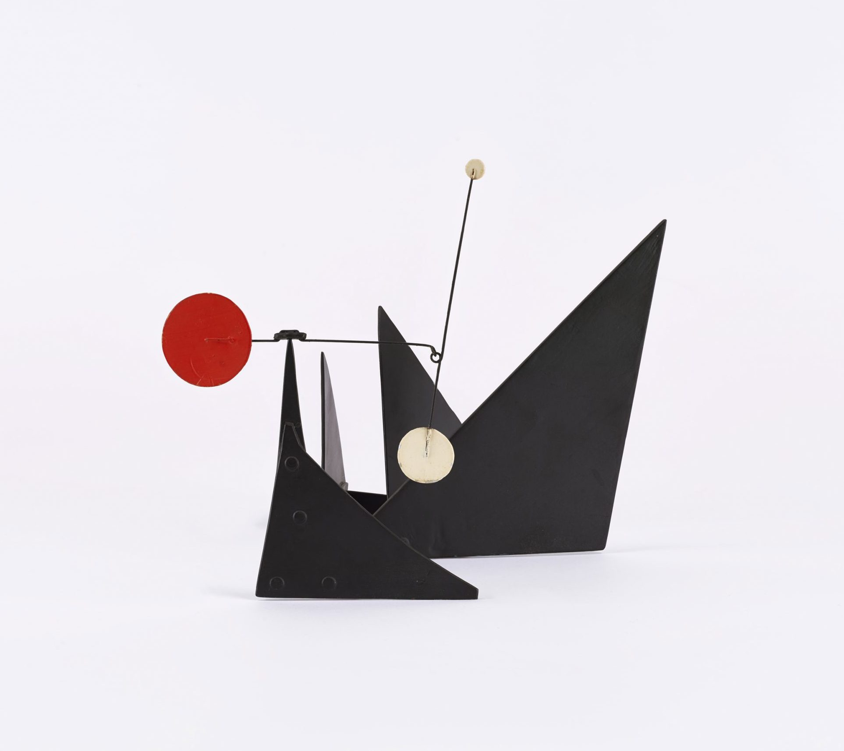

Slide 10
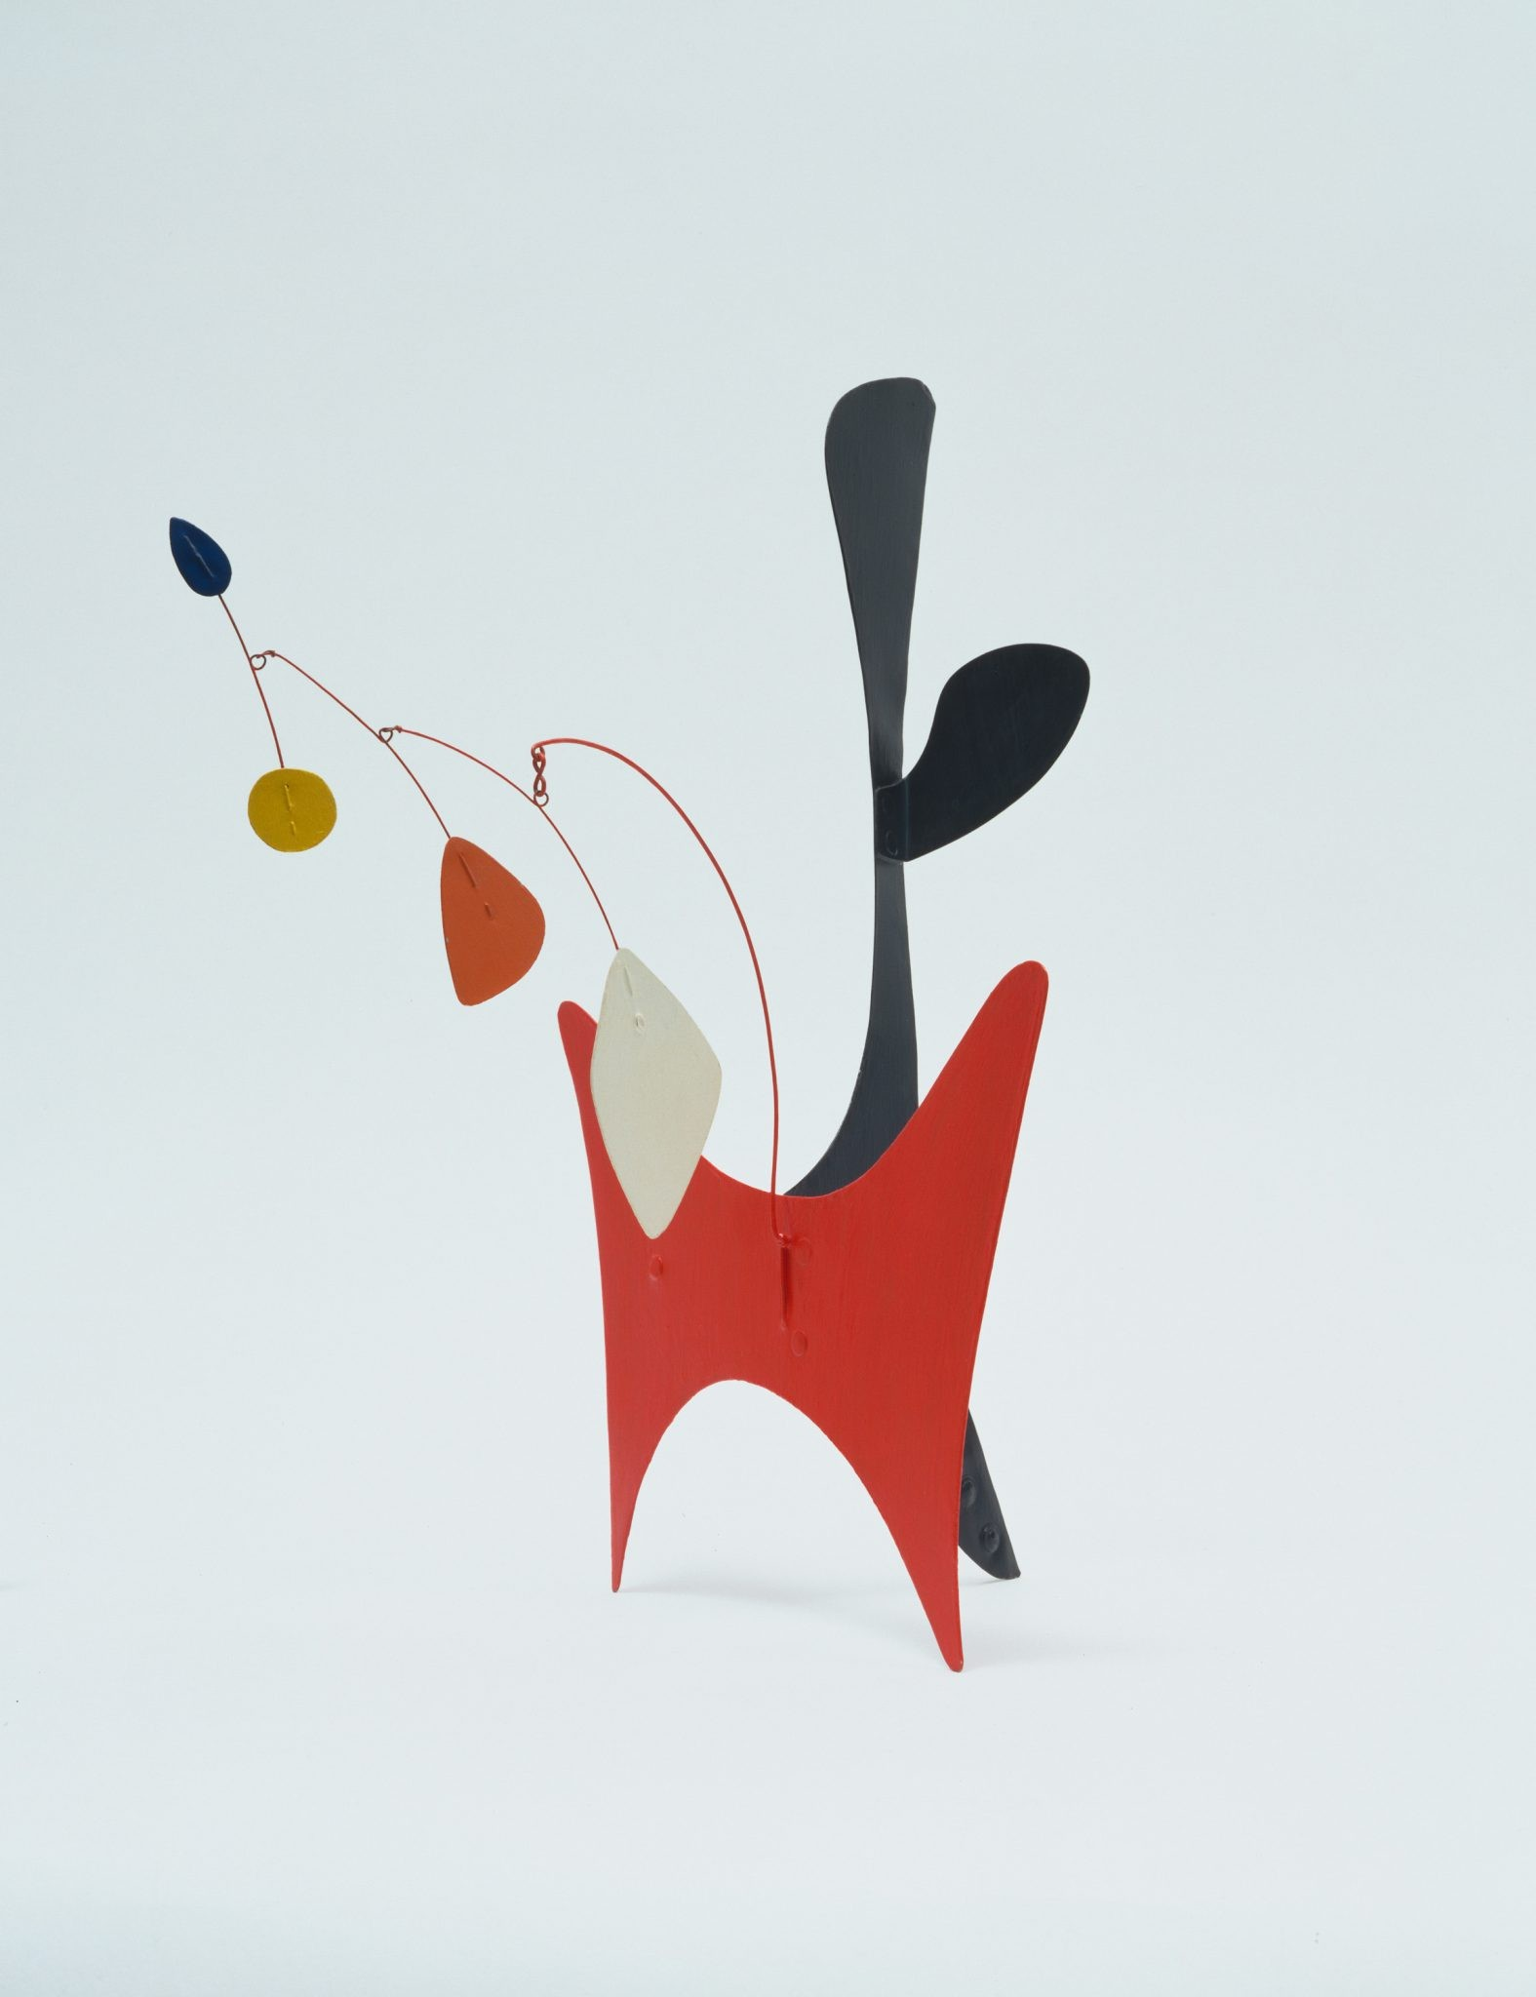

Slide 11
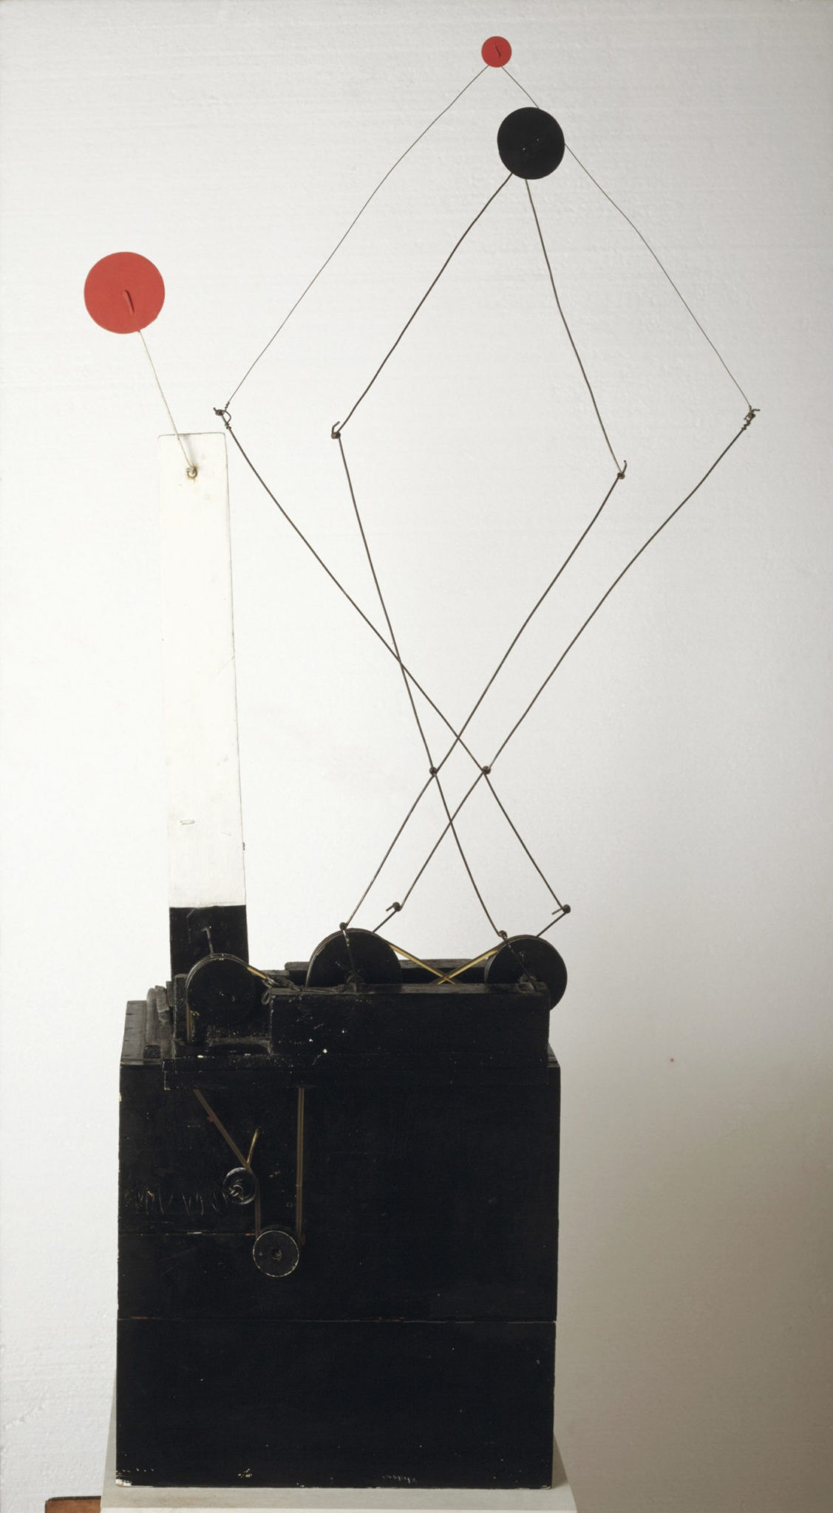

Slide 12
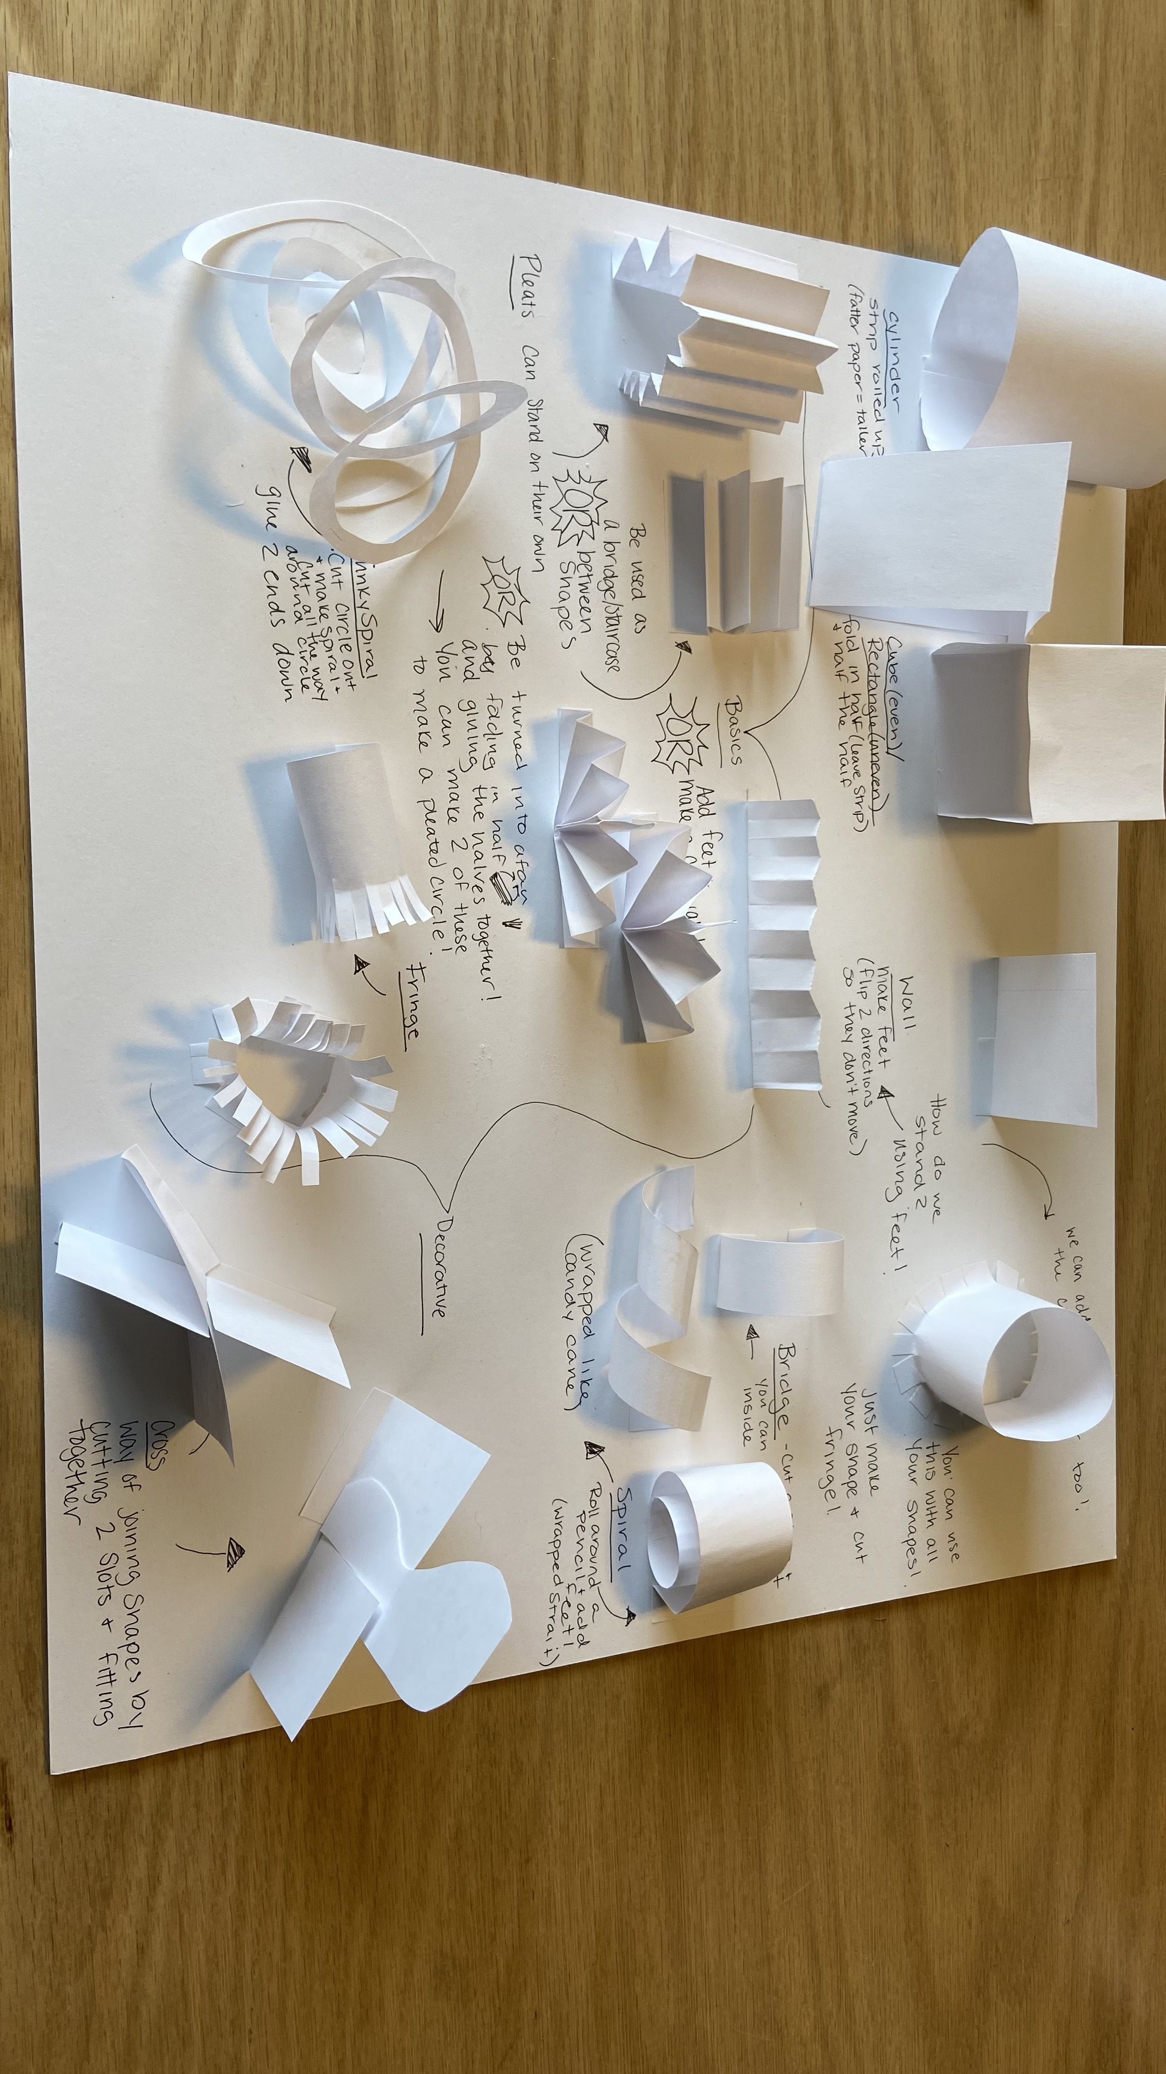

Slide 13
vocabulary

Slide 14
vocabulary
Shape
Geometric Shape
Organic Shape
2D Shape
3D Shape

Slide 15
instructions

Slide 16
instructions
First, we will learn different ways of joining those shapes to our paper or other shapes
Feet
Cross joining
Bridge
Last, we will learn different ways of decorating our shapes and adding texture
Pleats
Fringe
Spirals

Slide 17
references
https://www.moma.org/calendar/events/6988
https://calder.org/
https://www.youtube.com/watch?v=j3OqfduWdhc&t=6s

