Slide 1
Paper Sculptures
Part 2

Slide 2
objectives
of this lesson

Slide 3
objectives
Review different types of shapes
Learn paper sculpture tools to apply to our project

Slide 4
materials

Slide 5
materials
Pencil
Paper
Glue
Scissors

Slide 6
Pass or play!

Slide 7
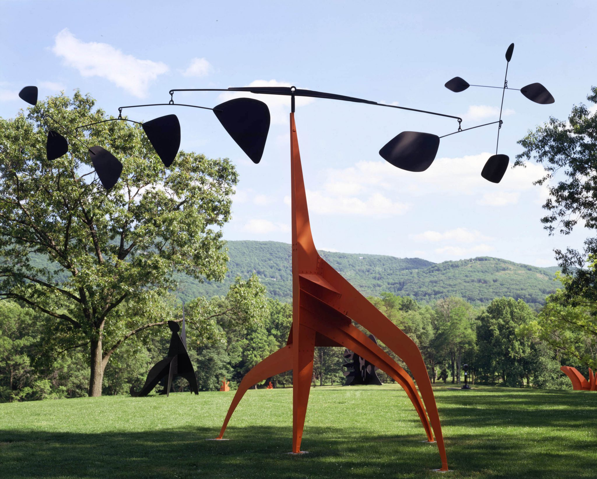

Slide 8
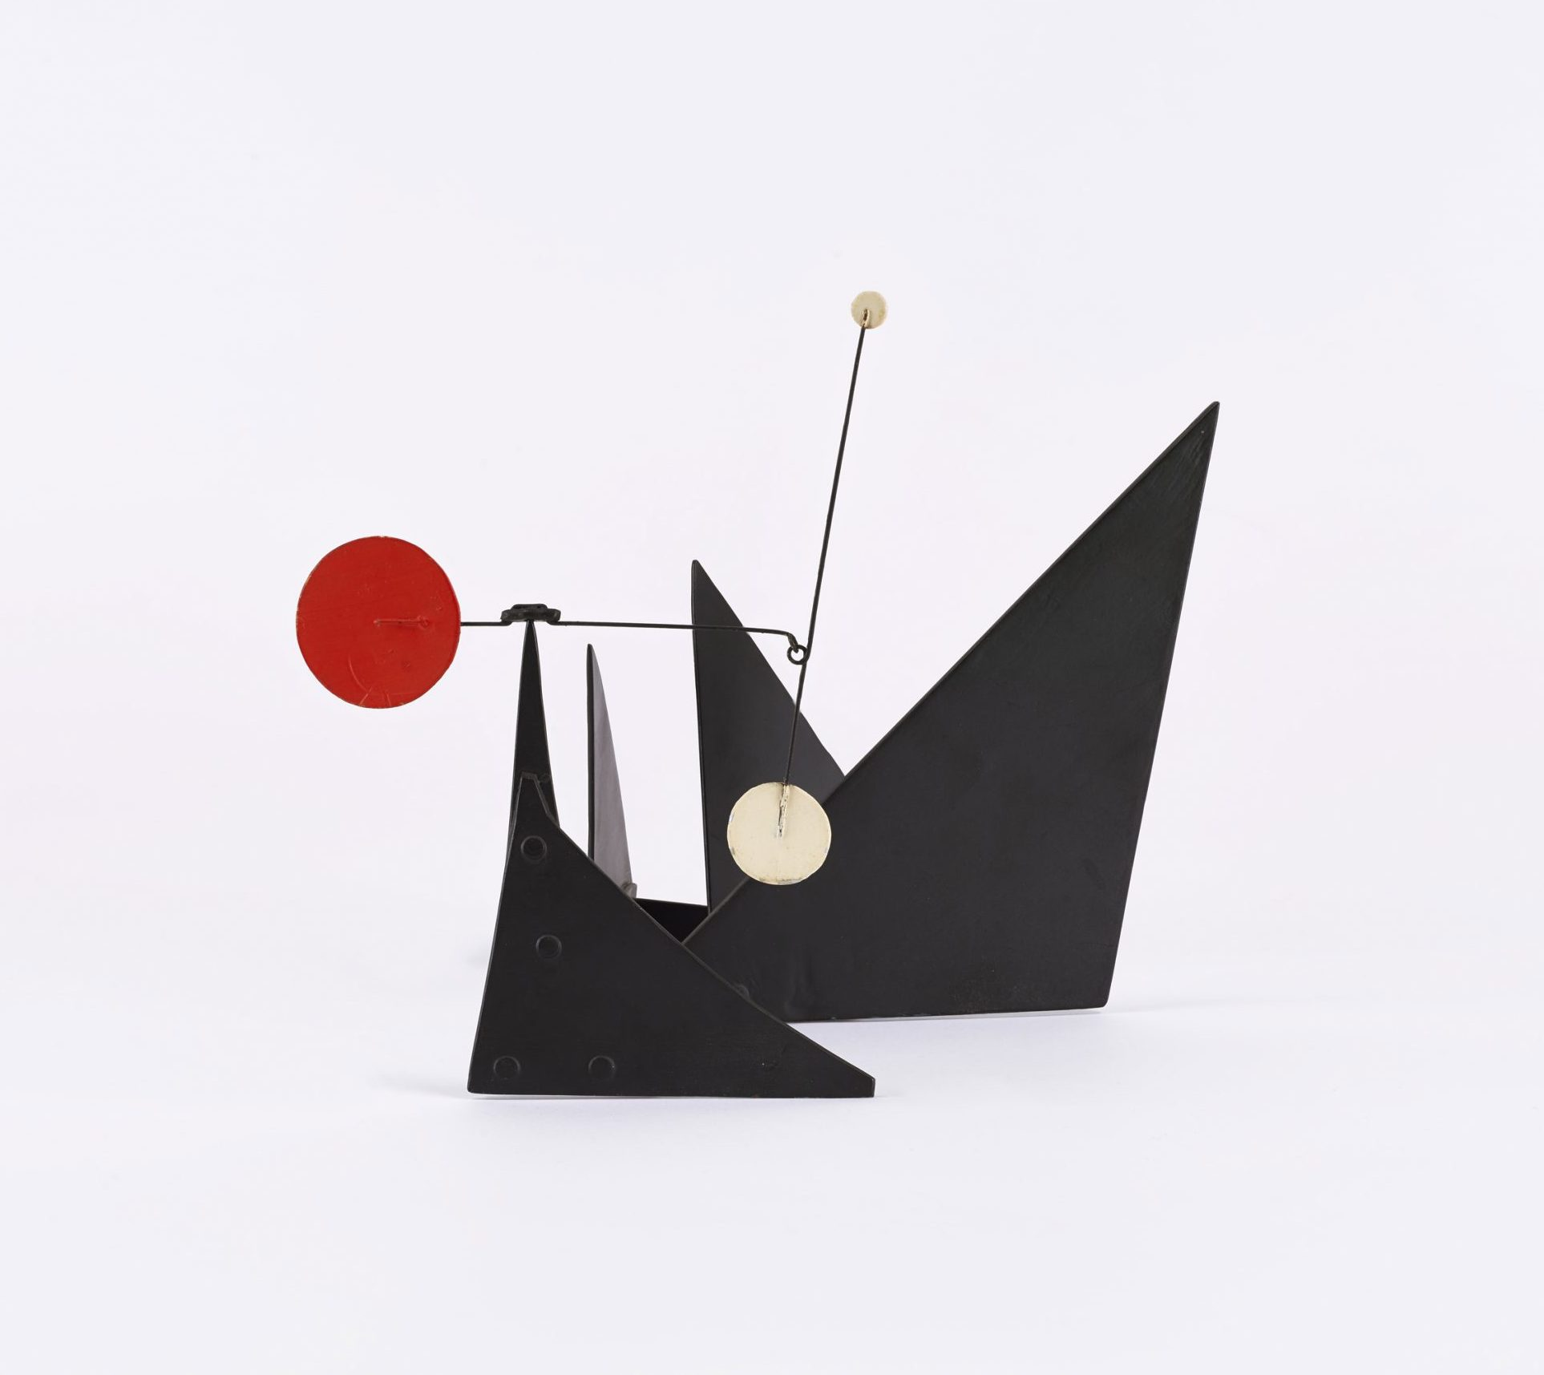

Slide 9
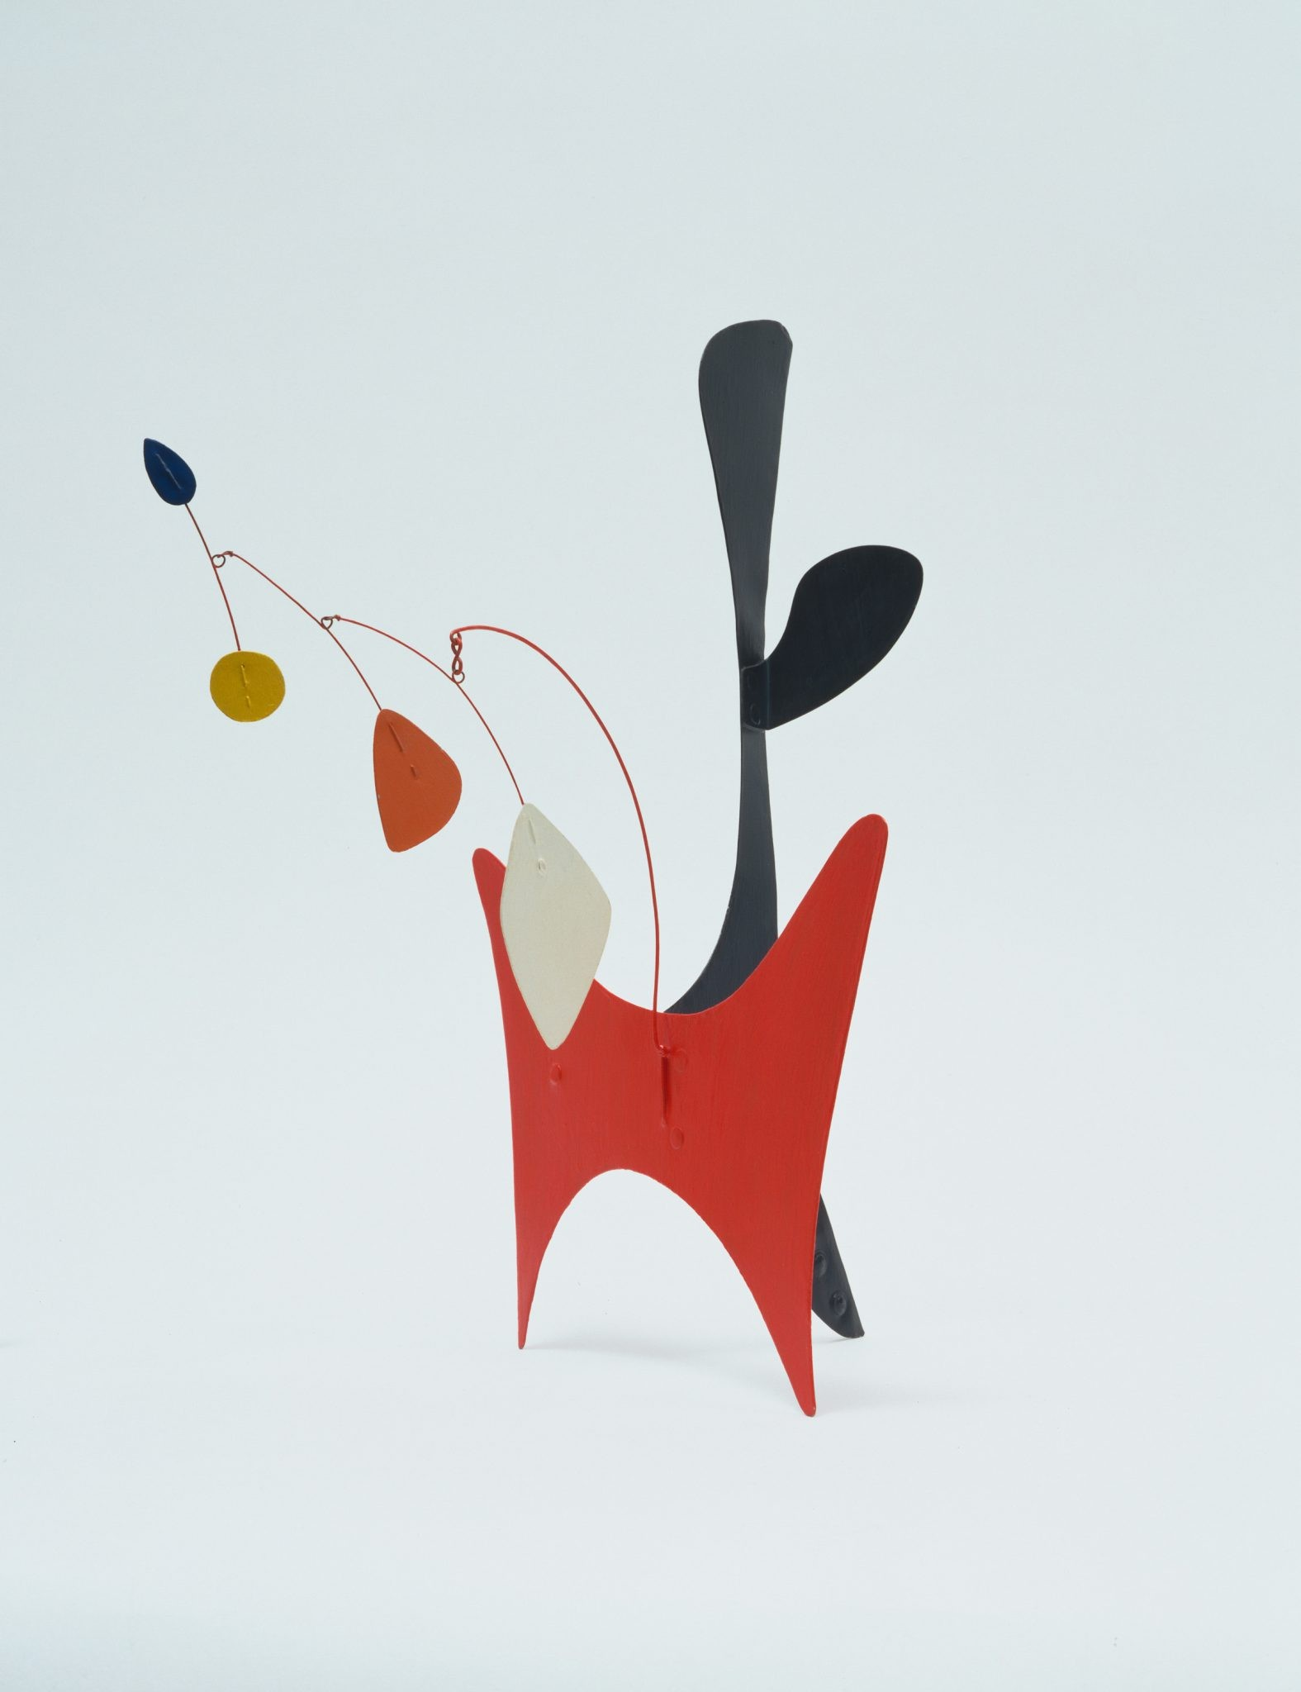

Slide 10
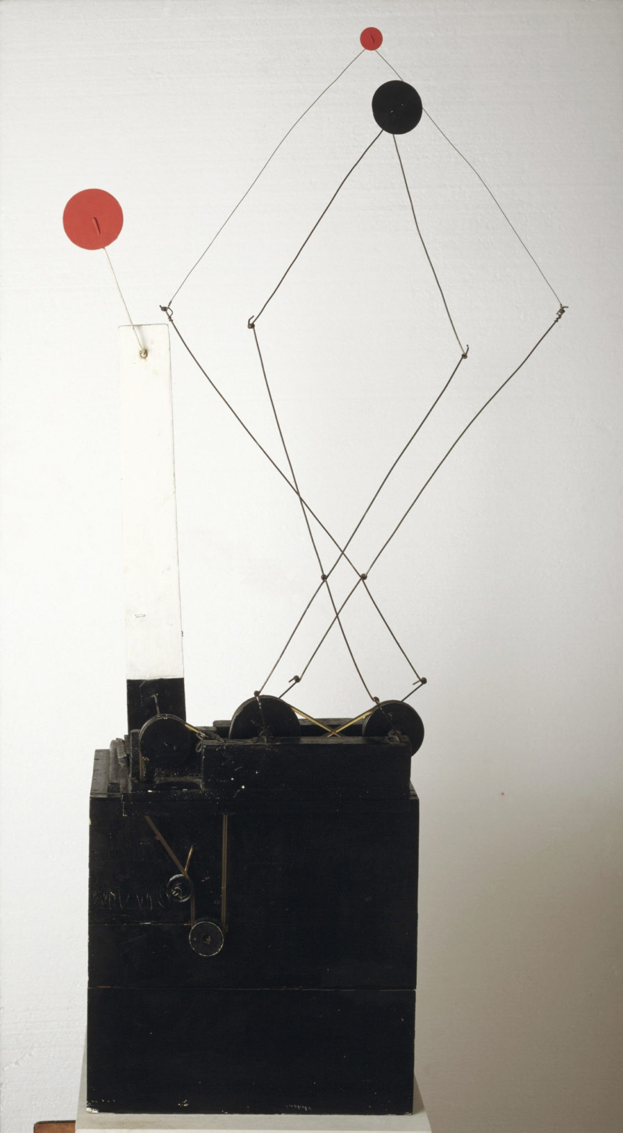

Slide 12
vocabulary

Slide 13
vocabulary
Shape
Geometric Shape
Organic Shape
2D Shape
3D Shape

Slide 14
How do we make 2d Paper shapes 3d?

Slide 15
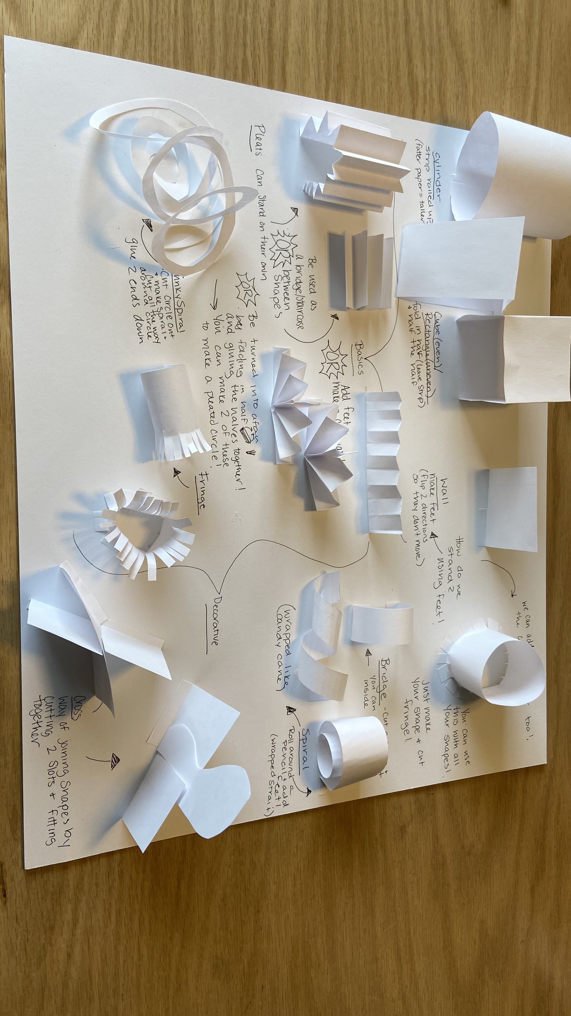

Slide 16
instructions

Slide 17
instructions
First, we will learn different basic techniques and make some simple shapes:
Fold
Roll
Next, we will learn different ways of joining those shapes to our paper or other shapes
Feet
Cross joining

Slide 18
references
https://www.moma.org/calendar/events/6988
https://calder.org/
https://www.youtube.com/watch?v=j3OqfduWdhc&t=6s

