Slide 1
Landscape Painting
Part 3

Slide 2
objectives
of this lesson

Slide 3
objectives
Learn about texture
Continue our landscape painting

Slide 4
materials

Slide 5
materials
Oil pastels
Painting from last class
Paintbrush

Slide 6
Pass or play!

Slide 7
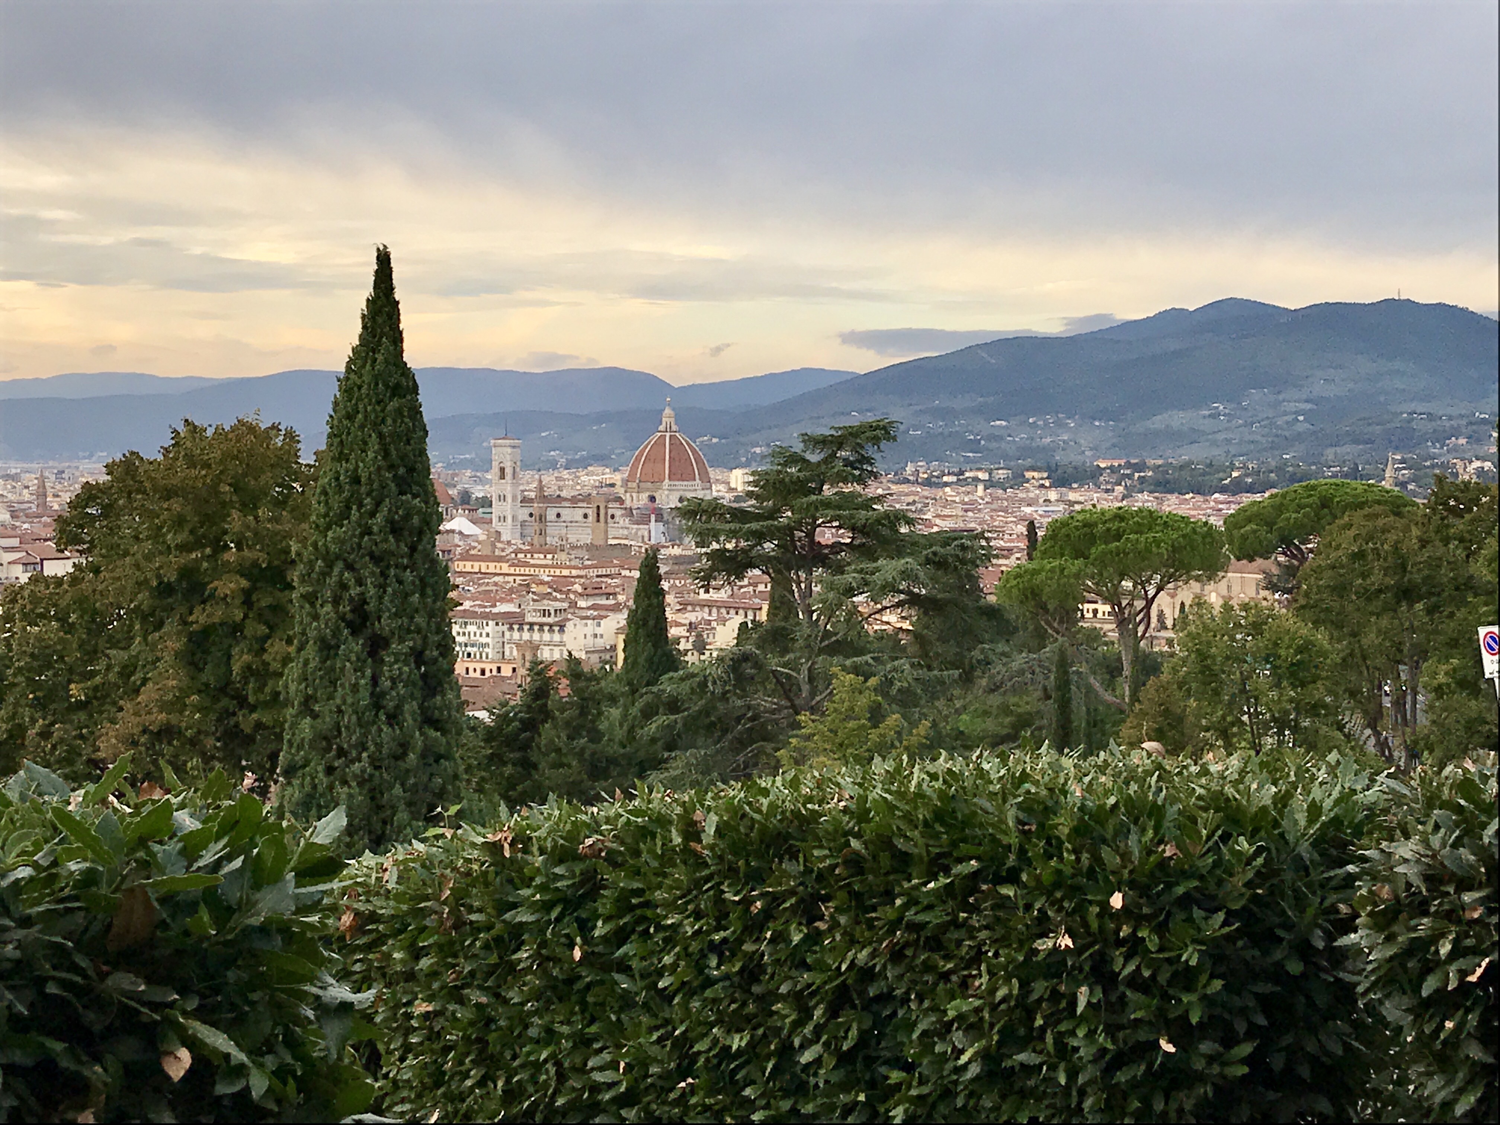

Slide 8
vocabulary

Slide 9
vocabulary
Atmospheric Perspective
effect the atmosphere has on the appearance of an object viewed from a distance
Texture
perceived surface quality
Foreground
part of painting closest to viewer
Repetition
the use of the same visual effect a number of times in the same composition

Slide 10
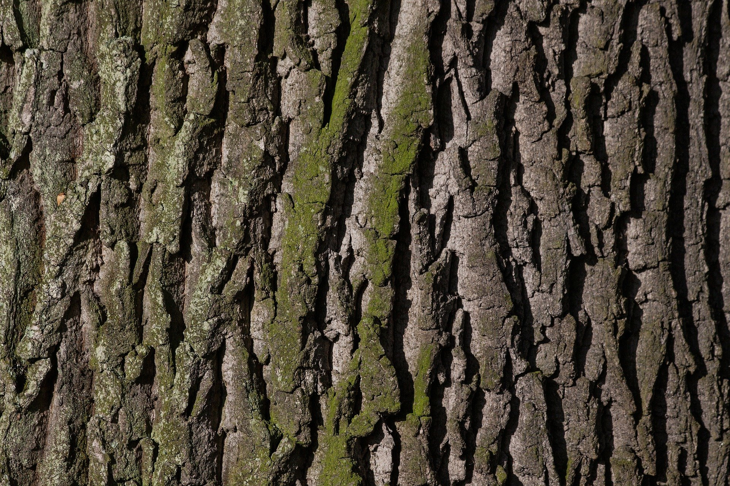

Slide 11
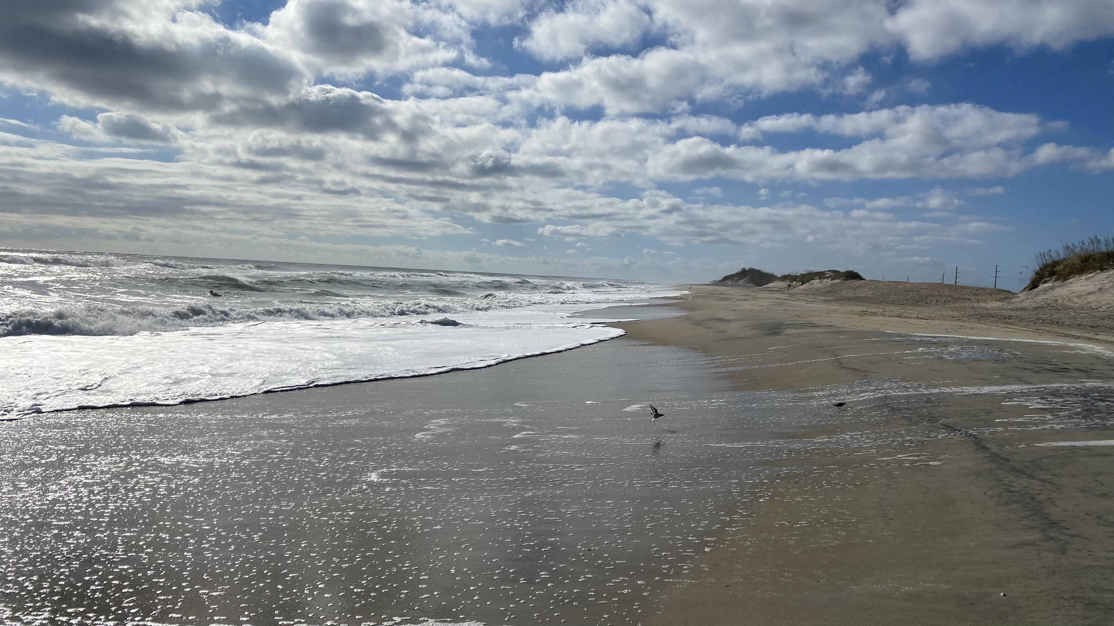

Slide 12
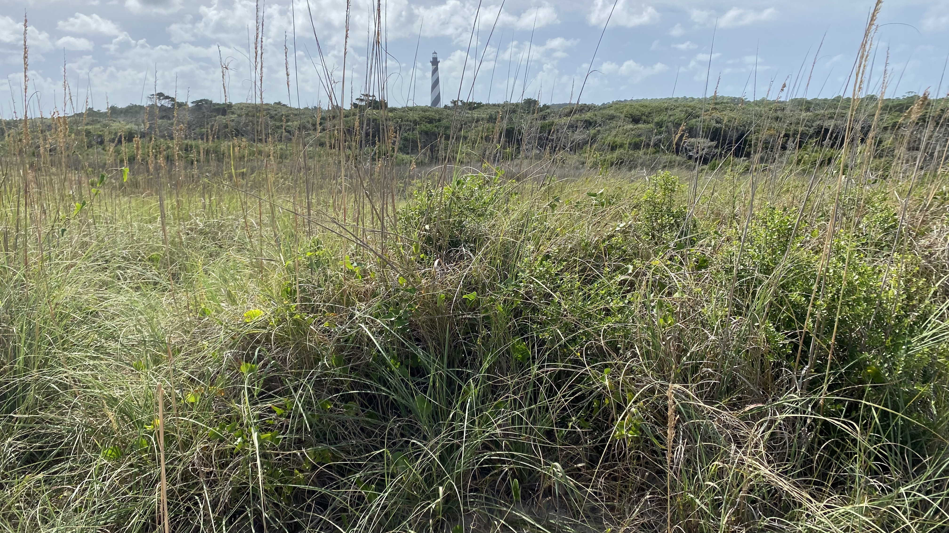

Slide 13
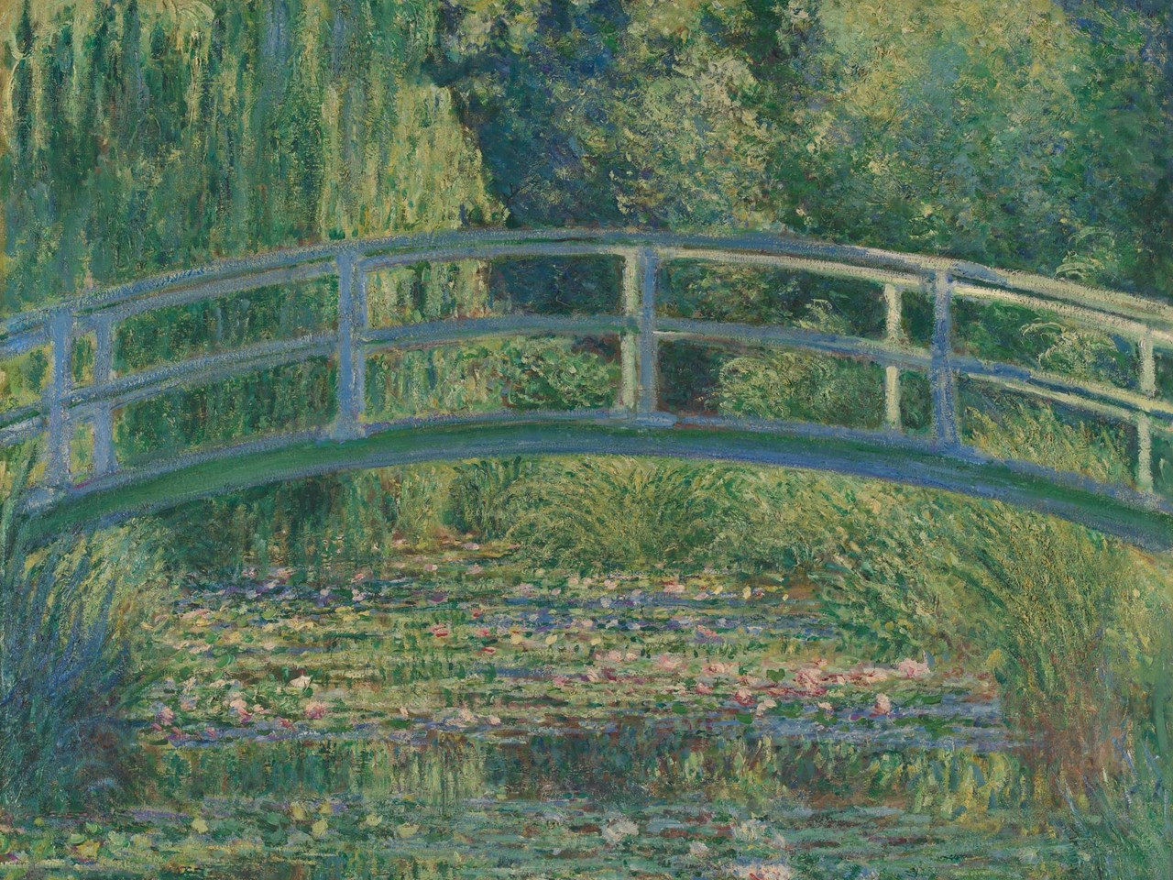

Slide 14
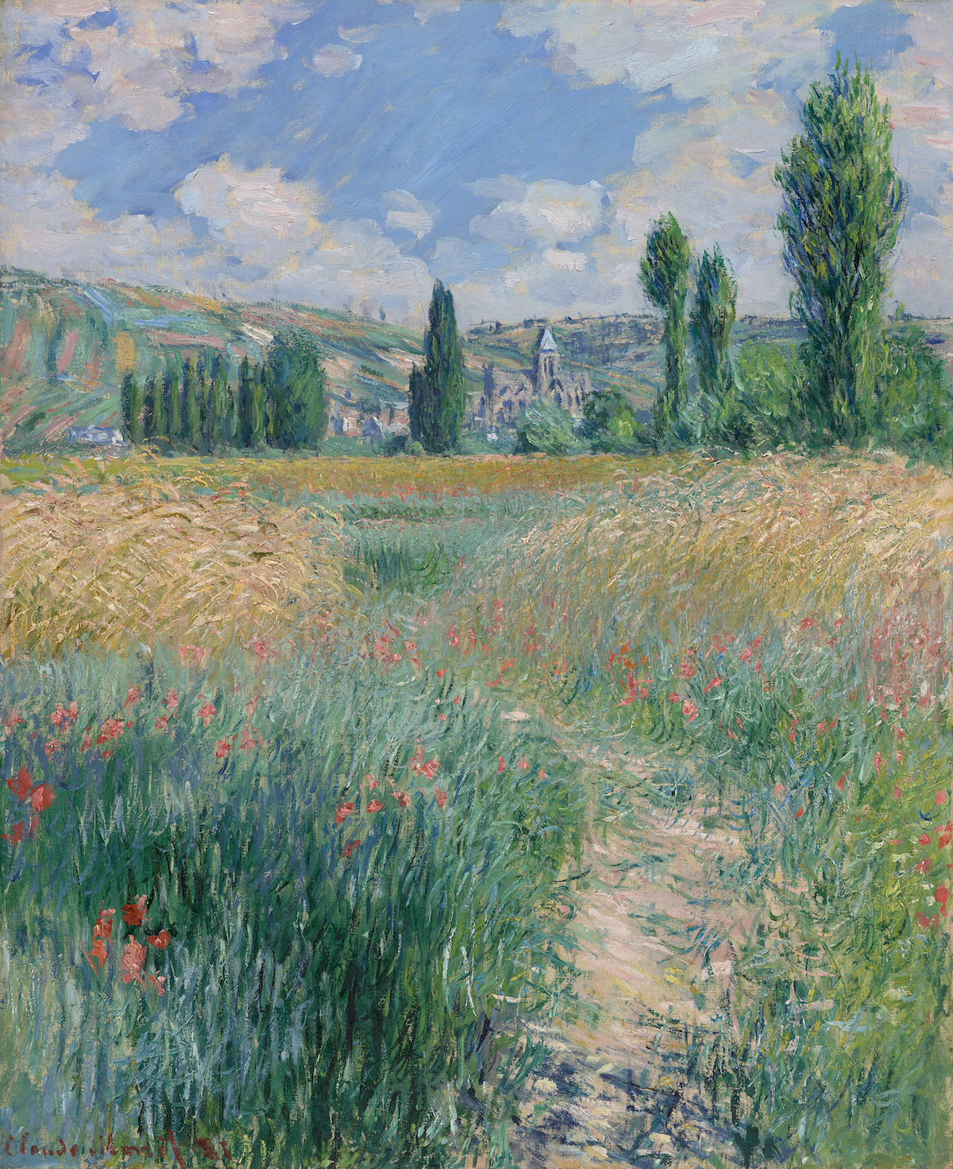

Slide 15
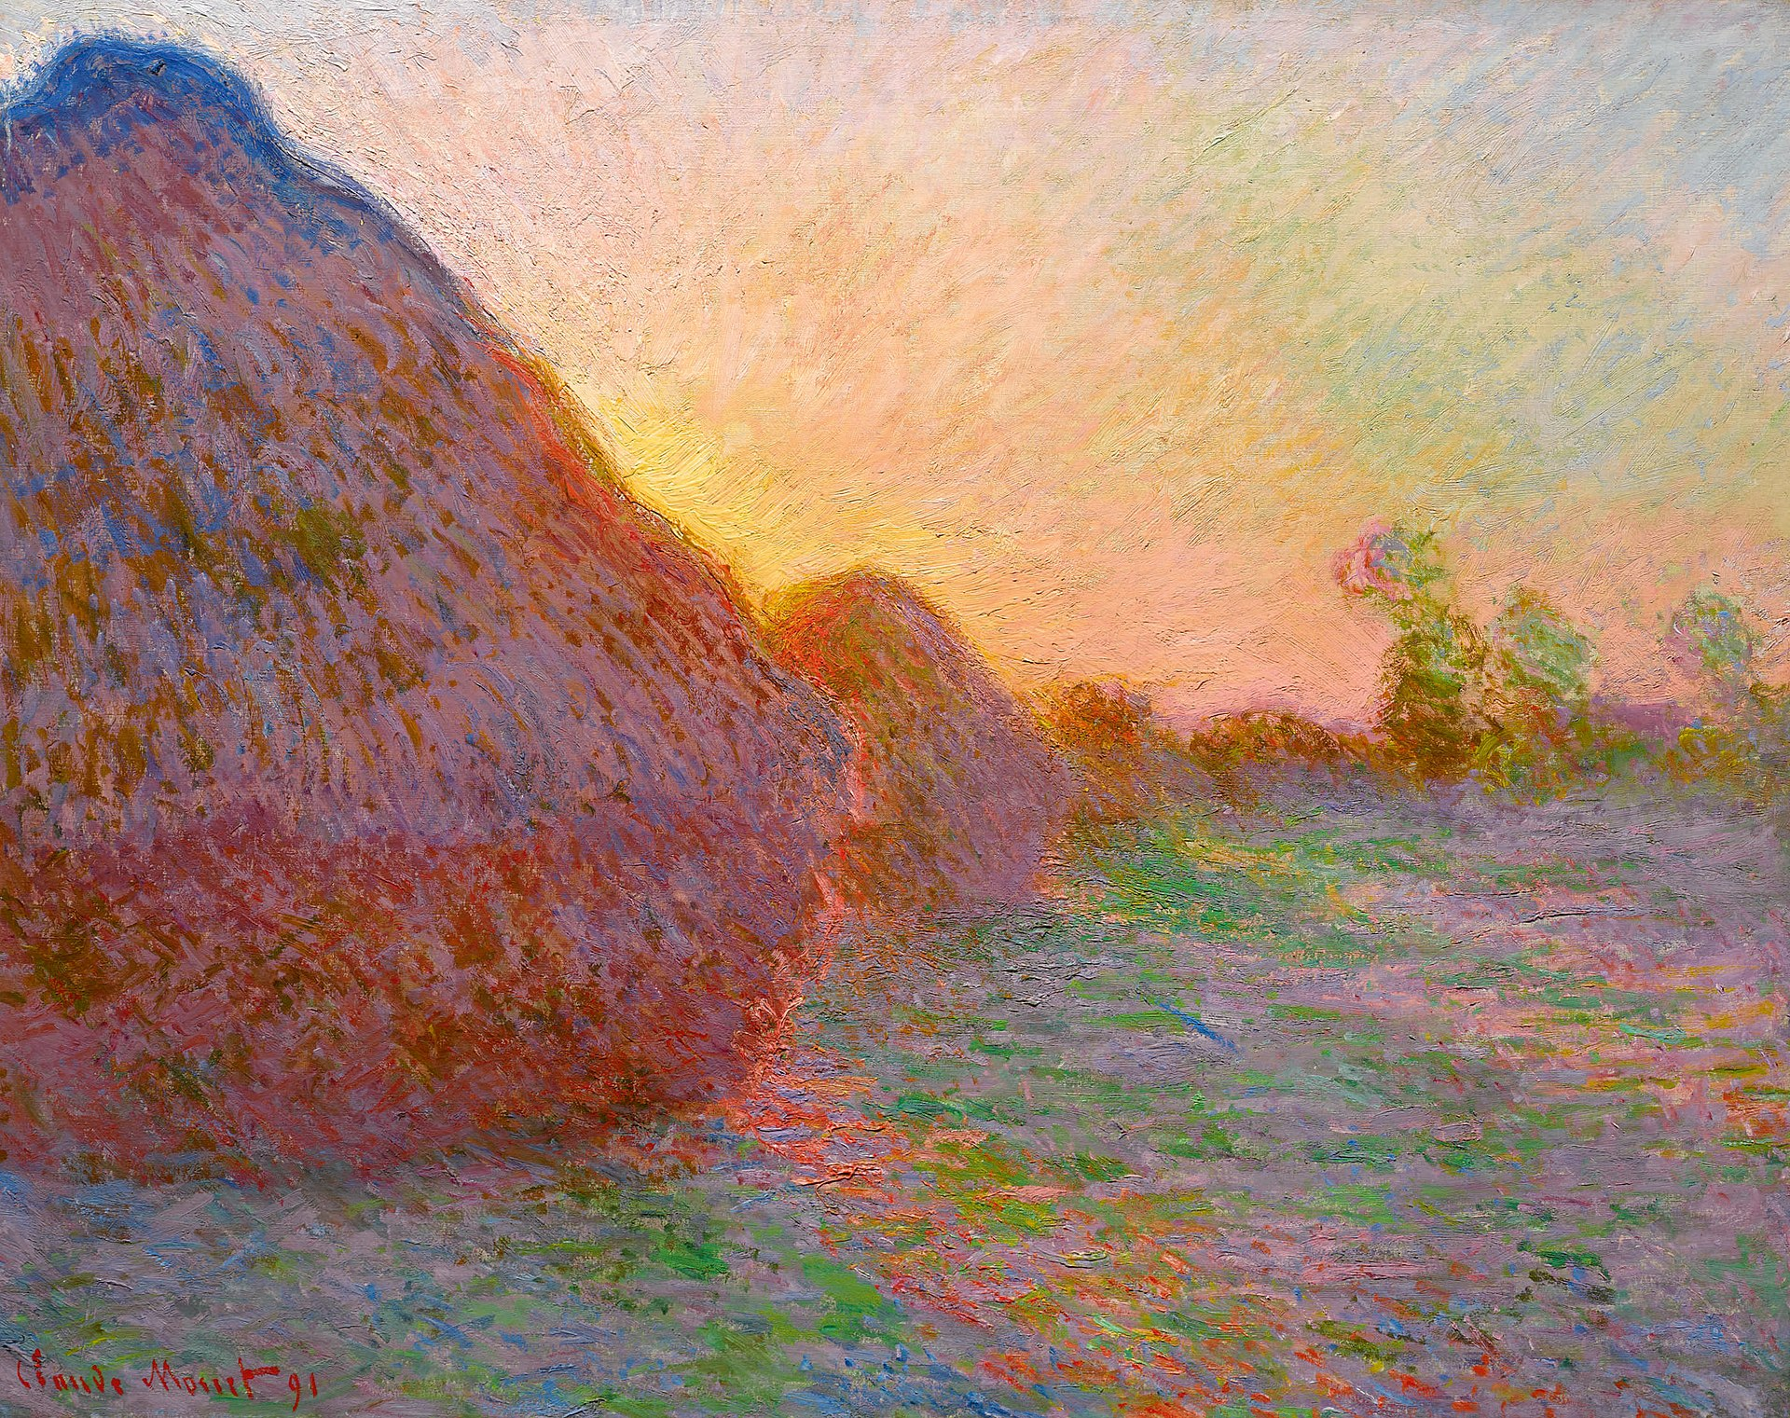

Slide 16
instructions

Slide 17
instructions
Draw shadows in for trees in the foreground using black
Let’s add some middle colors like brown and tan. Blend those!
Go back and add knots and texture using black and blending into the brown
Add some large dots to create leaves in the tree! It can be fall or spring in your painting. You decide!

Slide 18
references
https://en.wikipedia.org/wiki/Claude_Monet#/media/File:Claude_Monet_1899_Nadar_crop.jpg
https://www.metmuseum.org/toah/hd/cmon/hd_cmon.htm
Images: https://www.artnews.com/art-news/artists/claude-monet-best-paintings-1234580881/
https://www.nationalgallery.org.uk/paintings/claude-monet-the-water-lily-pond
https://www.youtube.com/watch?v=nesTk_6j-0c
https://pixabay.com/photos/bark-tree-oak-moss-trunk-wood-207252/
https://en.wikipedia.org/wiki/Haystacks_(Monet_series)#/media/File:Claude_Monet_-_Meules_(W_1273).jpg

