Slide 1
Landscape Painting
Part 1

Slide 2
objectives
of this lesson

Slide 3
objectives
Learn about atmospheric perspective
Continue our landscape painting inspired by Monet

Slide 4
materials

Slide 5
materials
Watercolor paint
Drawing from last class
Paintbrushes

Slide 6
Pass or play!

Slide 7
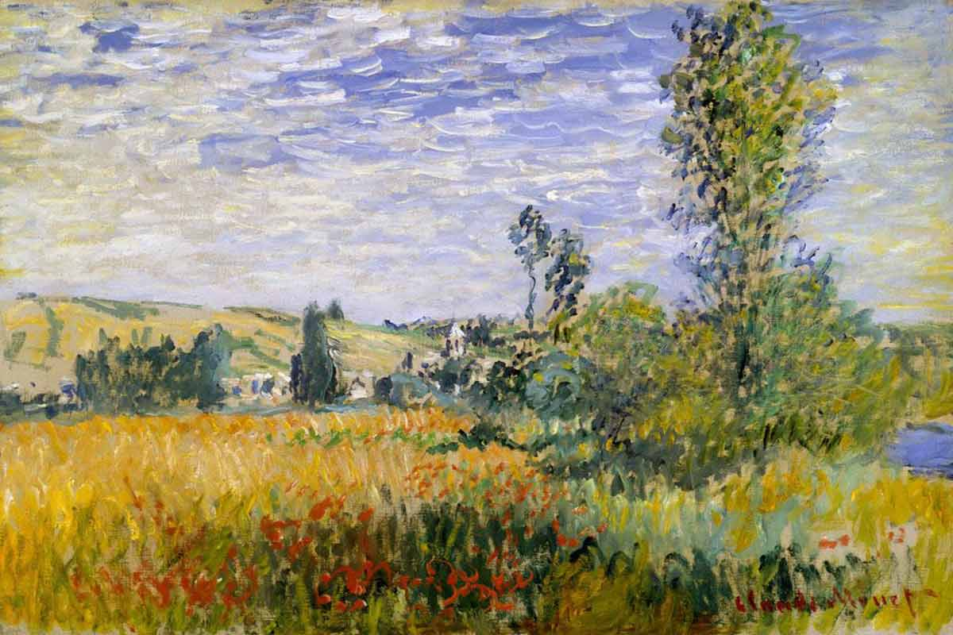
Breaking down a painting
Background
Horizon Line
Foreground
Middleground

Slide 8
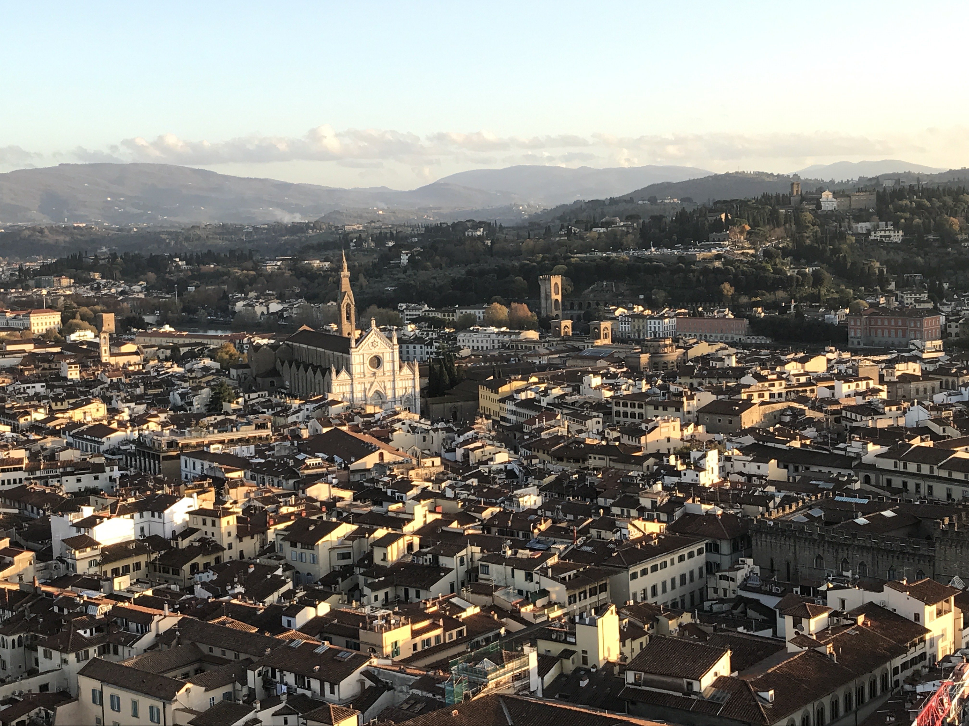

Slide 9
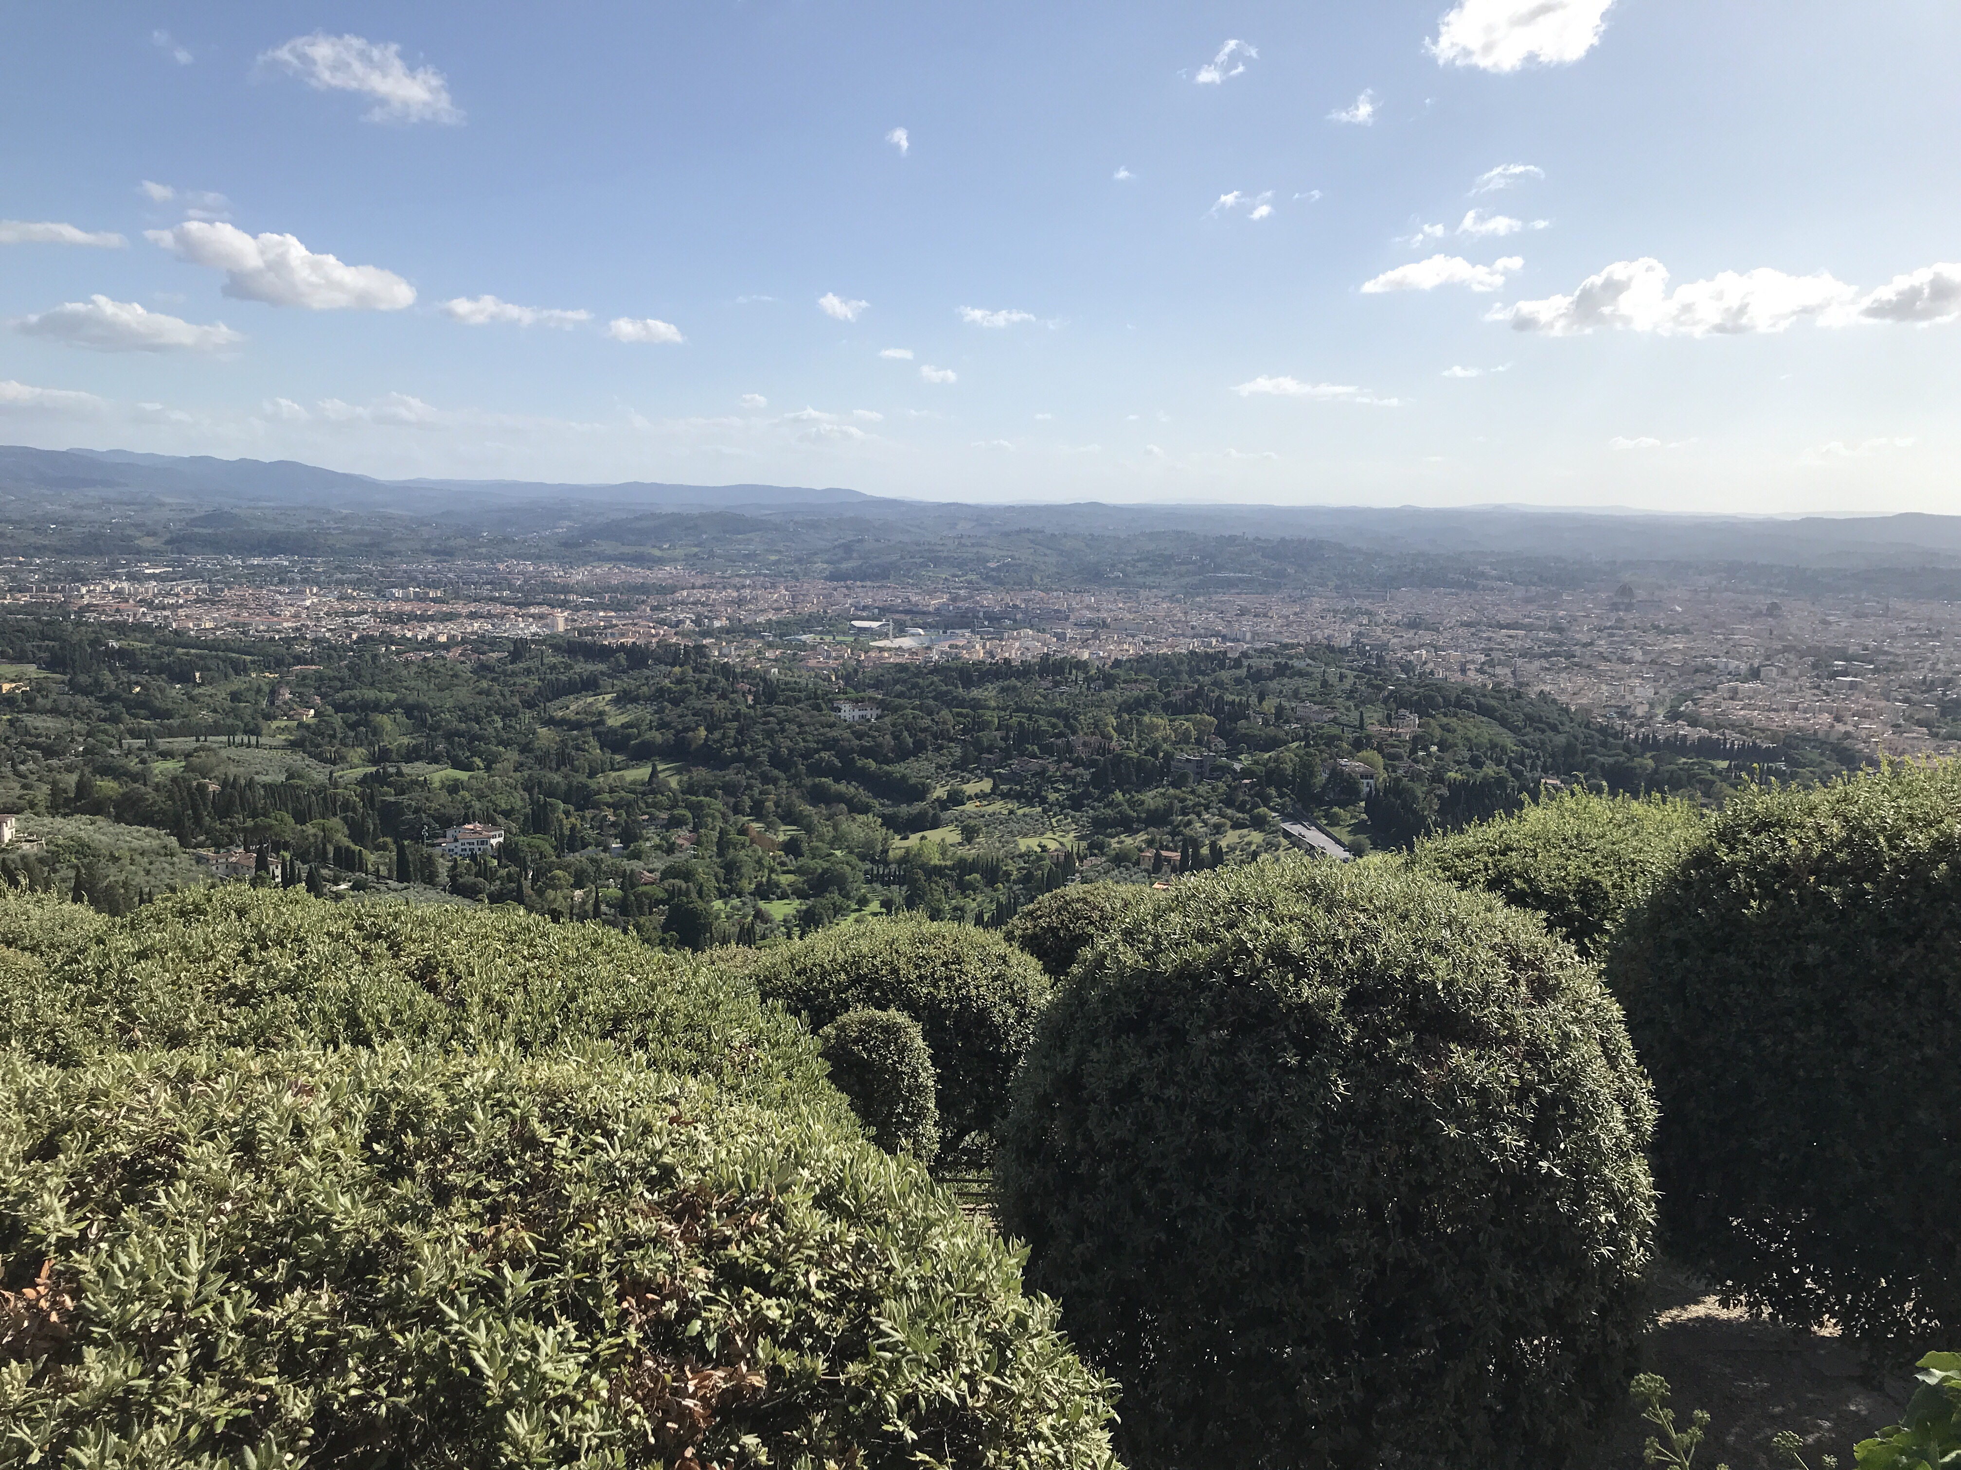

Slide 10
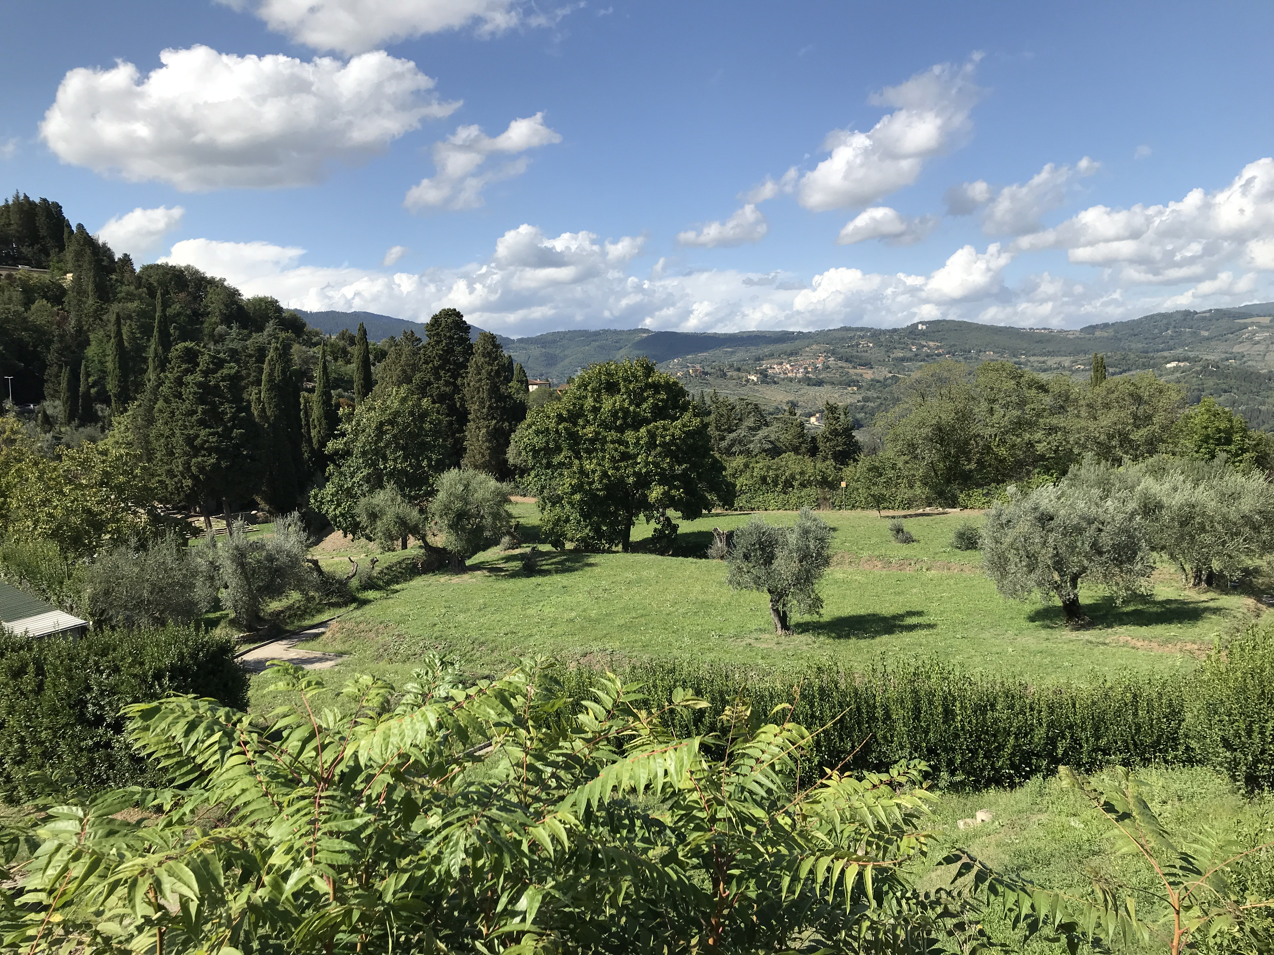

Slide 11
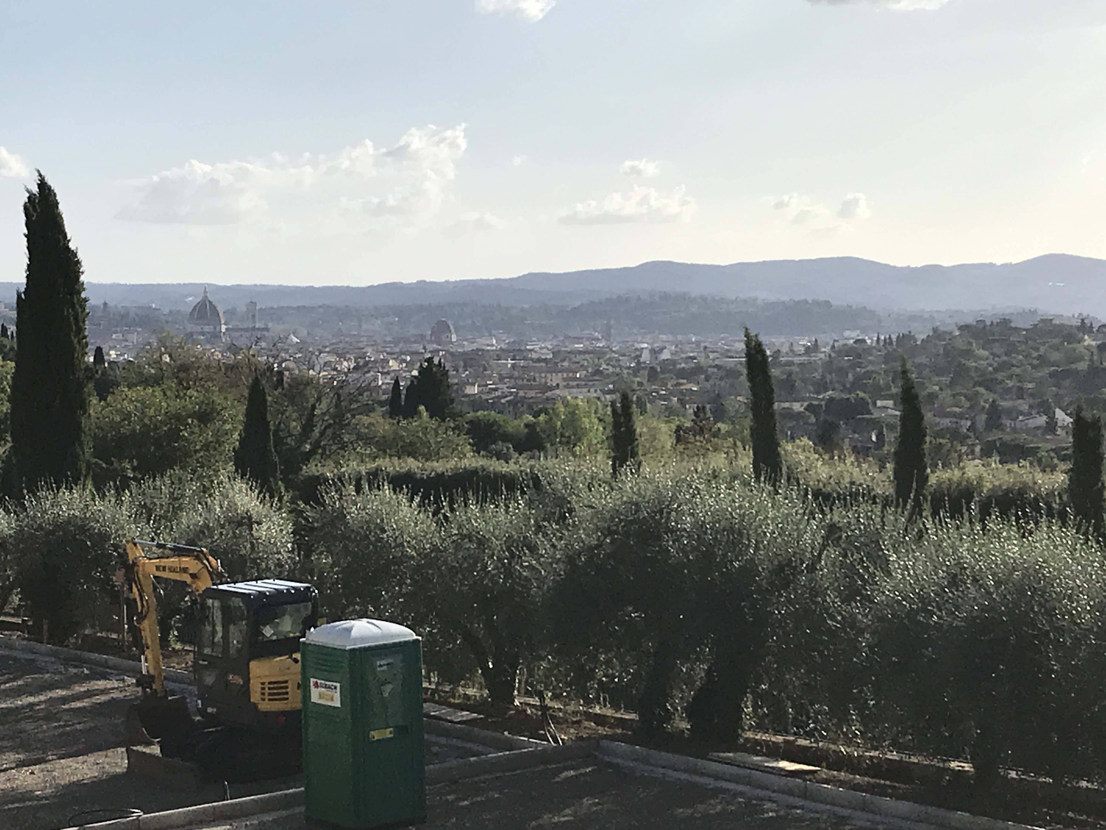

Slide 12
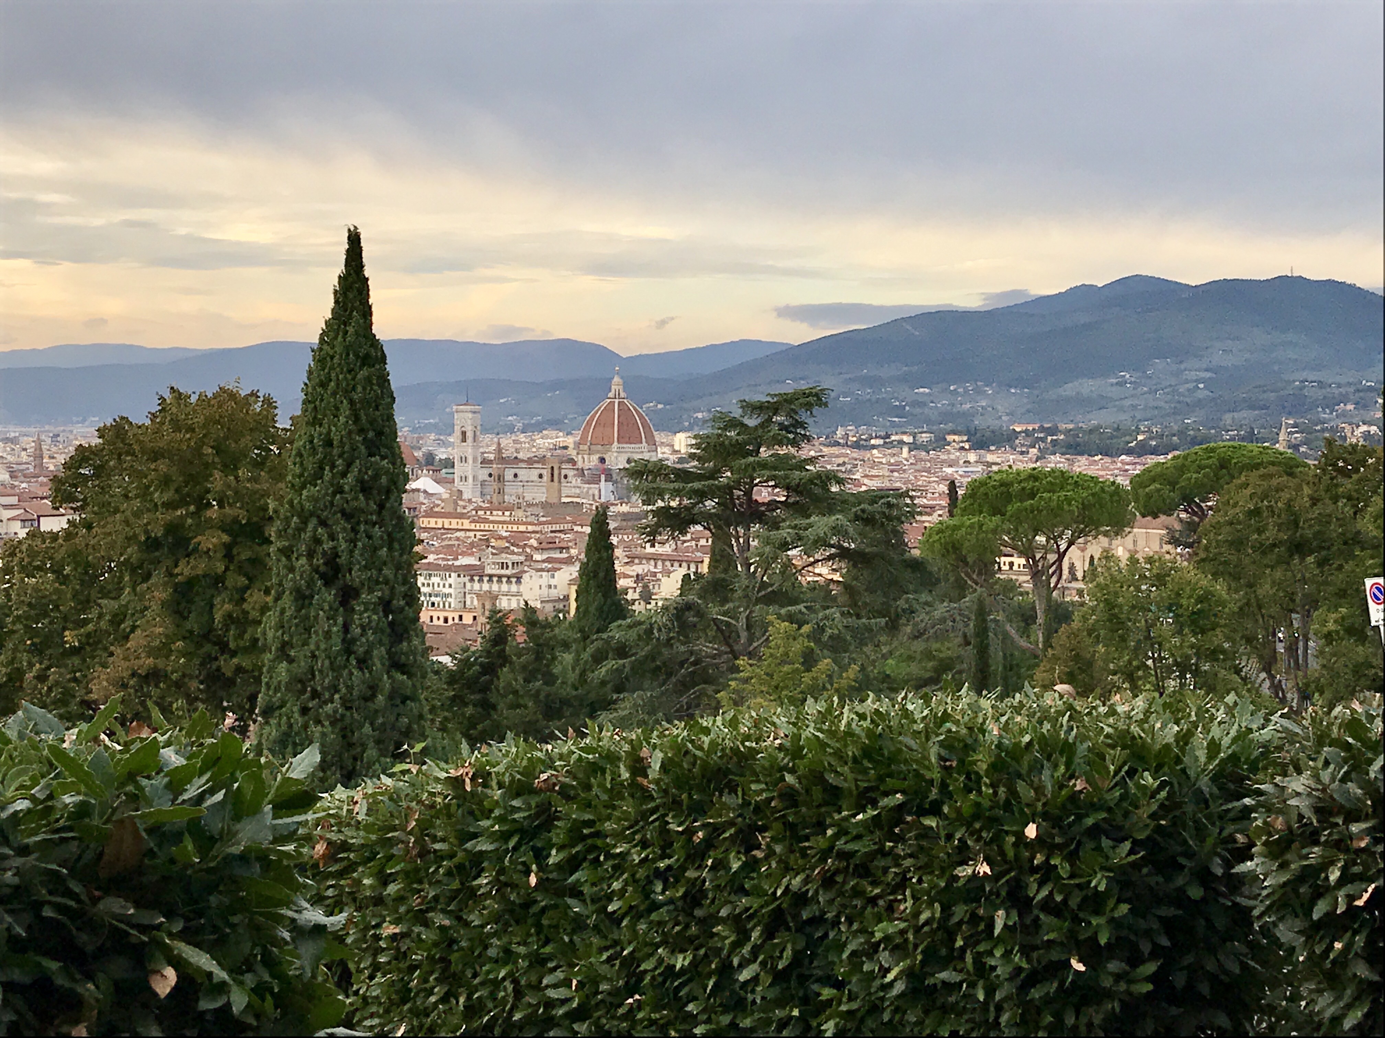

Slide 14
vocabulary

Slide 15
vocabulary
Color
Tint
color mixture of any color with white
Atmospheric Perspective
effect the atmosphere has on the appearance of an object viewed from a distance

Slide 16
instructions

Slide 17
instructions
Let’s practice some color mixing! First let’s try and make a color for our sky. Are you making a sunset or a sunny day?
Next step is to paint your sky!
Now we will observe what we drew in our backgrounds. What kinds of colors do you need? Mix those next!
Now, since it is in our background and we want to create atmospheric perspective, we are going to make a tint of the colors we just created by adding white! Because our watercolor palette does not have white, we will mix a color with more water than paint. This will do the same thing as adding white!
Take the color you just made and start painting your background!
We will repeat the last two steps for our middle ground, BUT, do not add as much water. Add less waterthan last time so those objects look closer!

Slide 18
references
https://en.wikipedia.org/wiki/Claude_Monet#/media/File:Claude_Monet_1899_Nadar_crop.jpg
https://www.metmuseum.org/toah/hd/cmon/hd_cmon.htm
Images: https://www.artnews.com/art-news/artists/claude-monet-best-paintings-1234580881/
https://www.nationalgallery.org.uk/paintings/claude-monet-the-water-lily-pond
https://www.youtube.com/watch?v=nesTk_6j-0c

