Slide 1
Landscape Painting
Part 1

Slide 2
objectives
of this lesson

Slide 3
objectives
Learn about impressionism and Claude Monet
Begin a landscape painting inspired by Monet

Slide 4
materials

Slide 5
materials
Pencil
Paper
Ruler

Slide 6
Pass or play!

Slide 7
Video on Impressionism
https://www.youtube.com/watch?v=nesTk_6j-0c

Slide 8
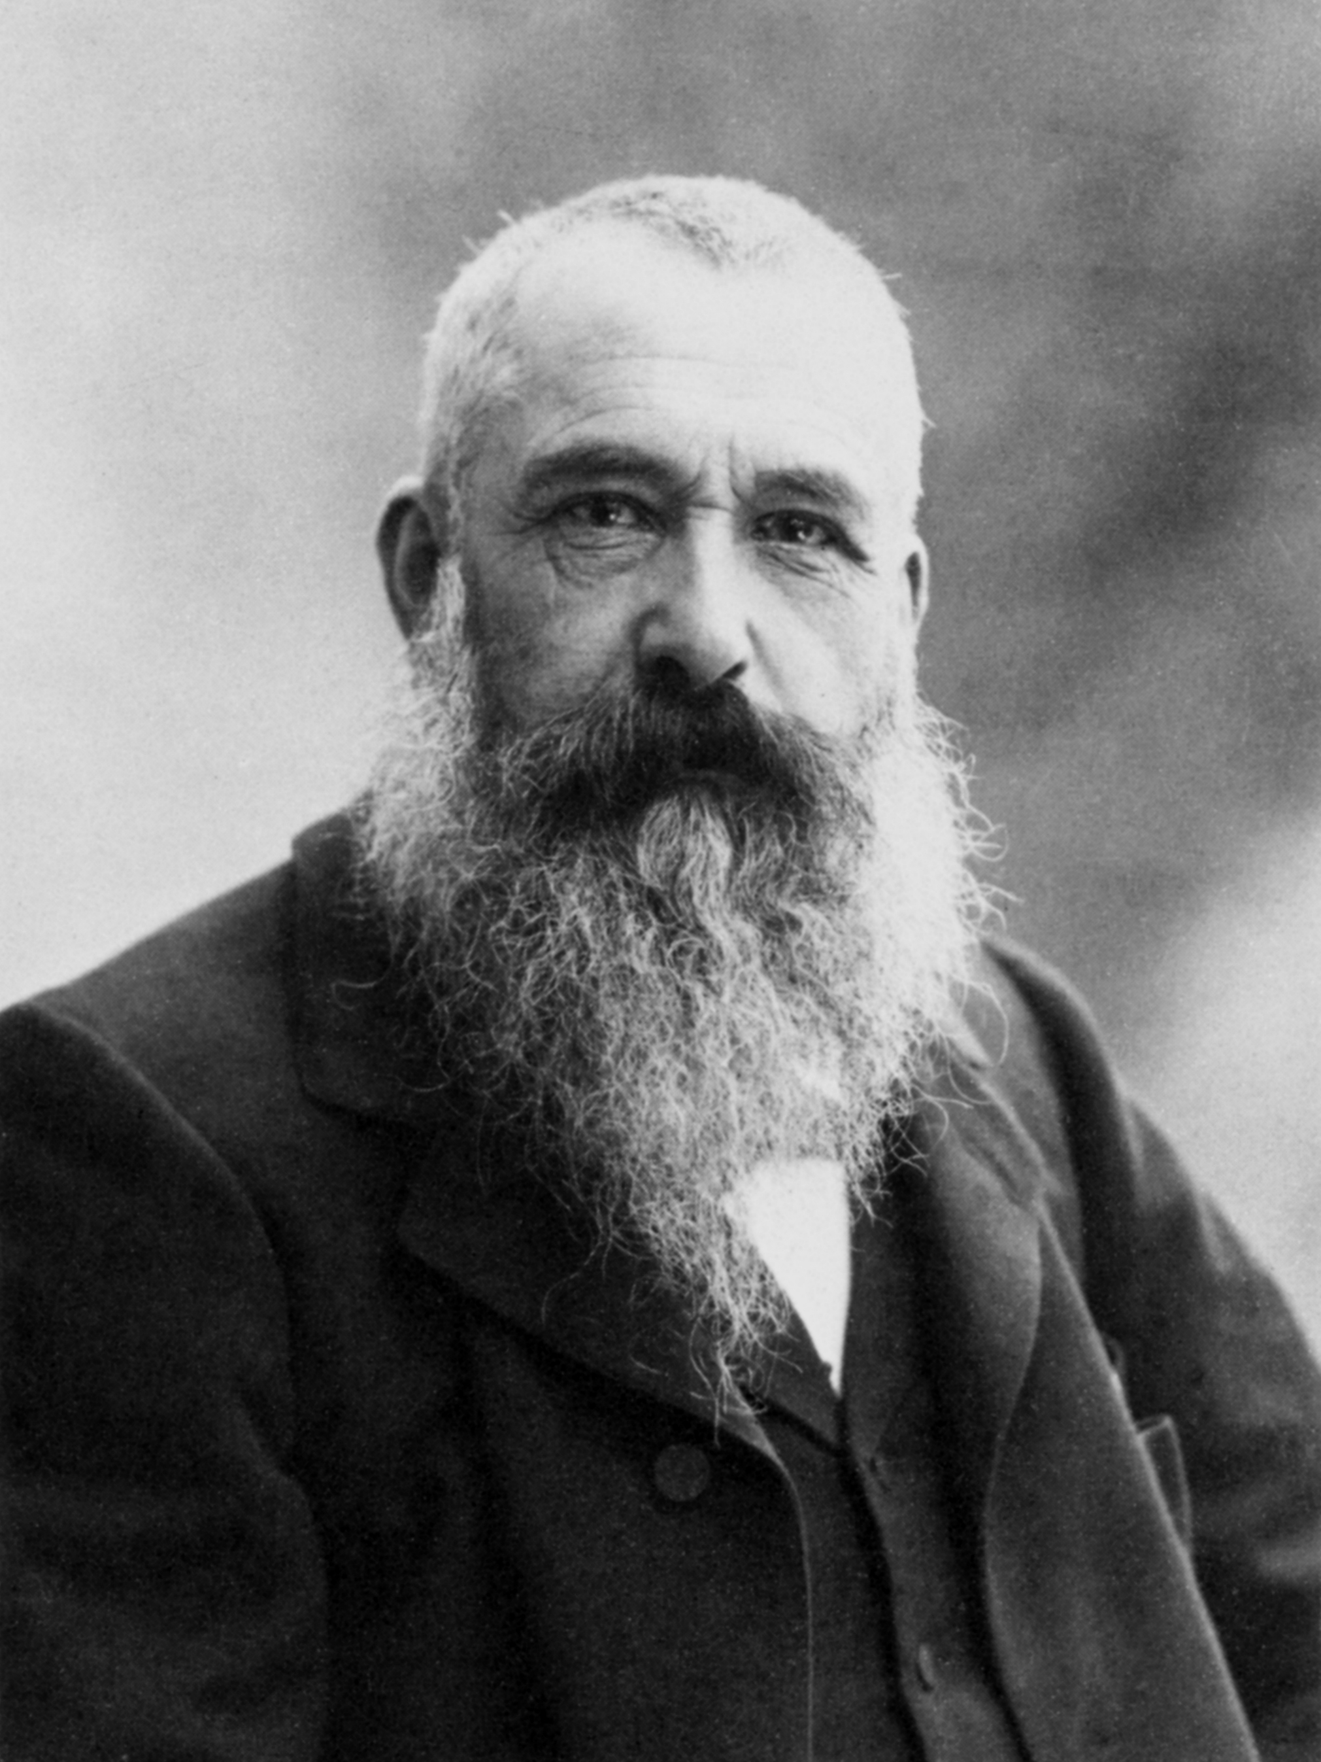
About Monet
Born in France in 1840
Impressionist Painter
His painting “Impression Sunrise” is where the art movement got its name!
Famous for his water lily paintings but created many different paintings that focused on everyday life.
Other art at the time was very serious.

Slide 9
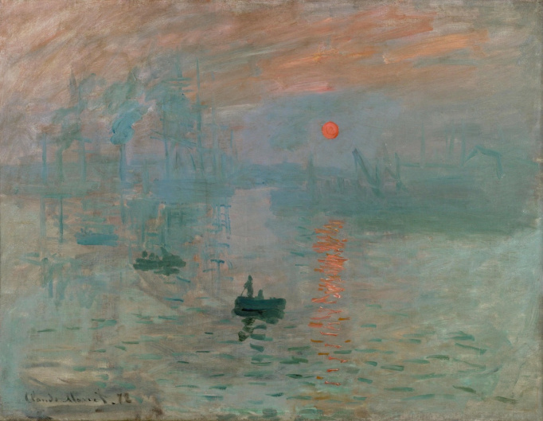

Slide 10
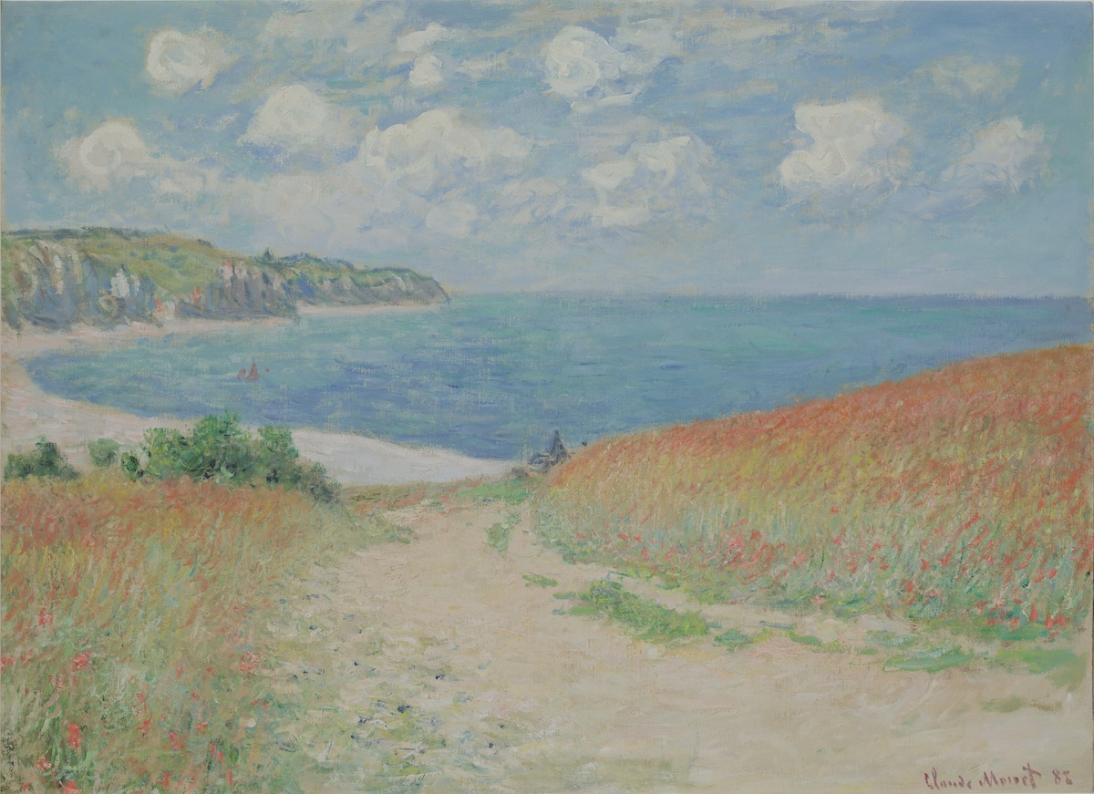

Slide 11
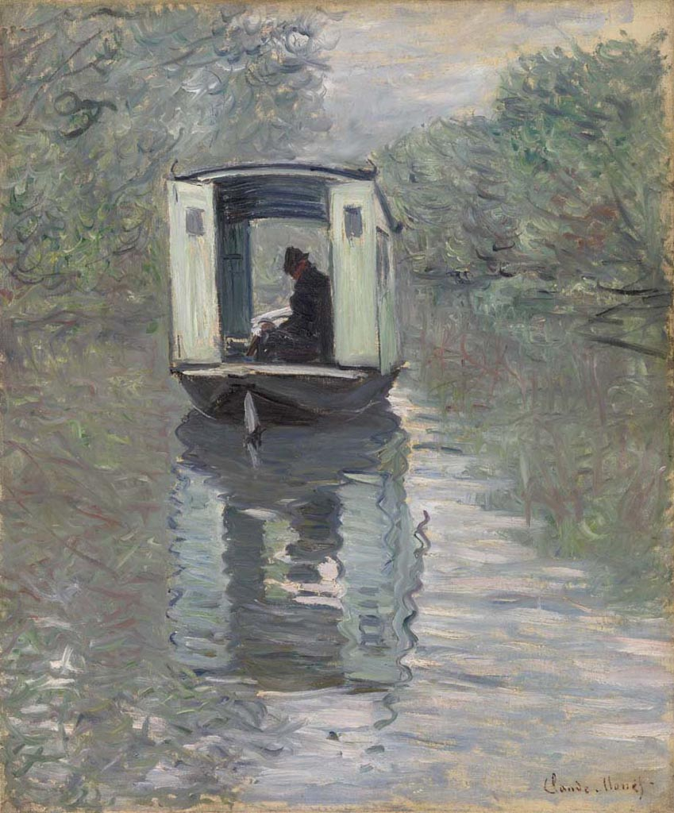

Slide 12
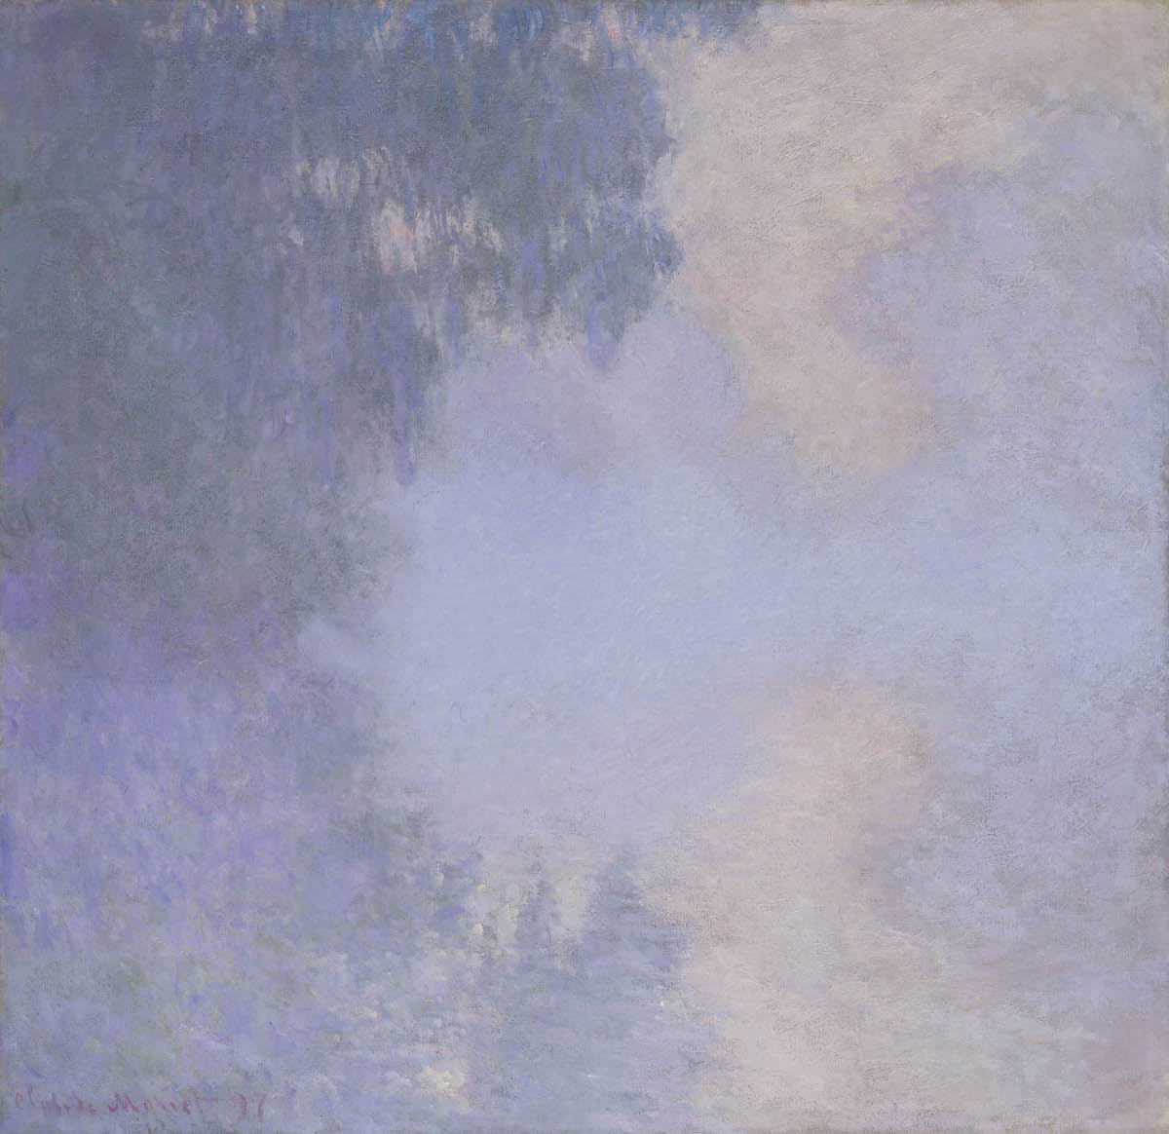

Slide 13
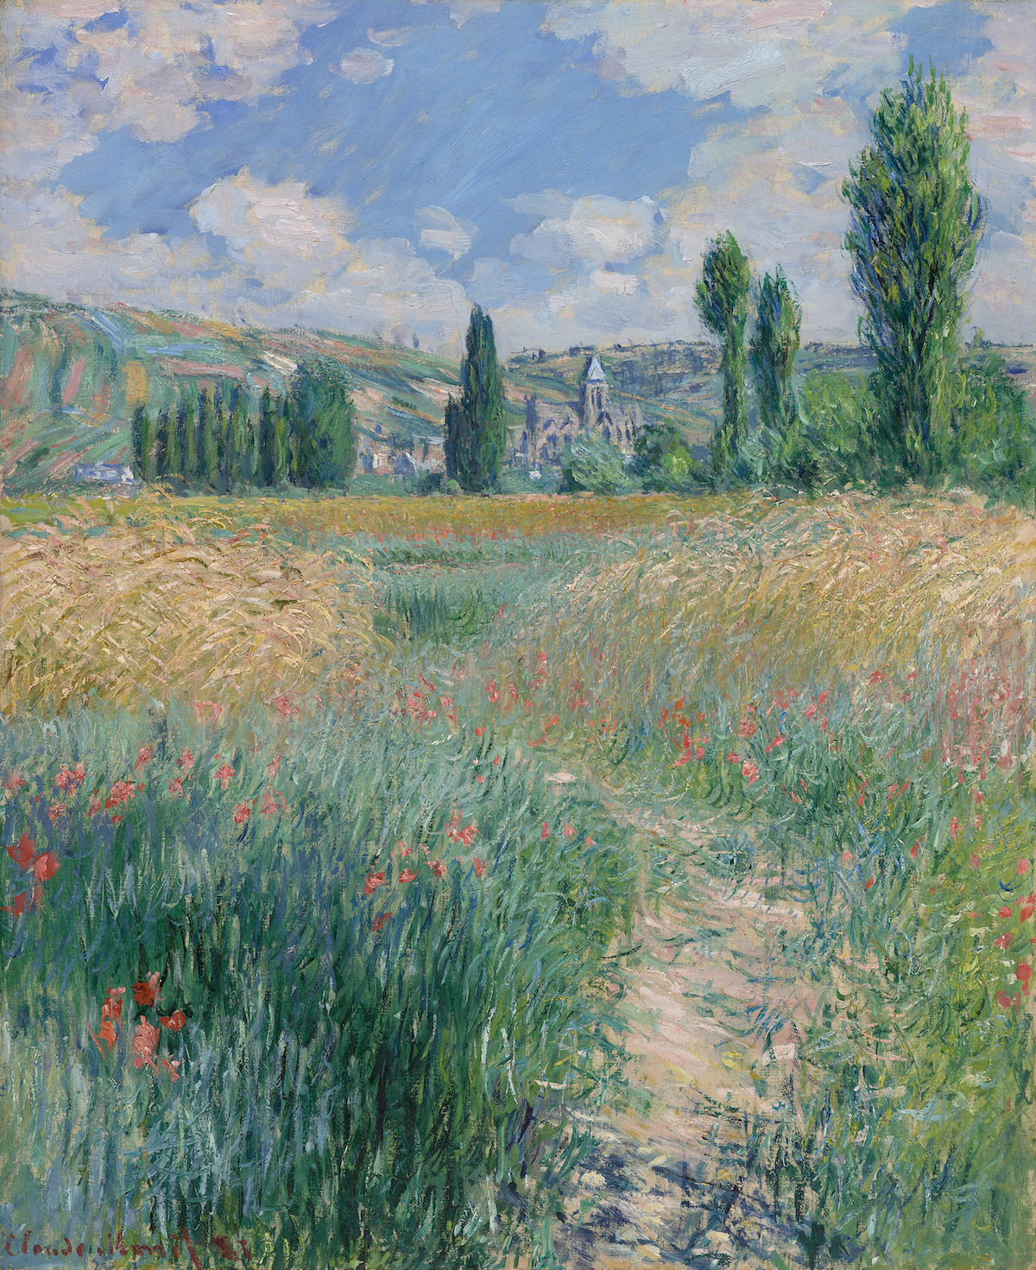

Slide 14
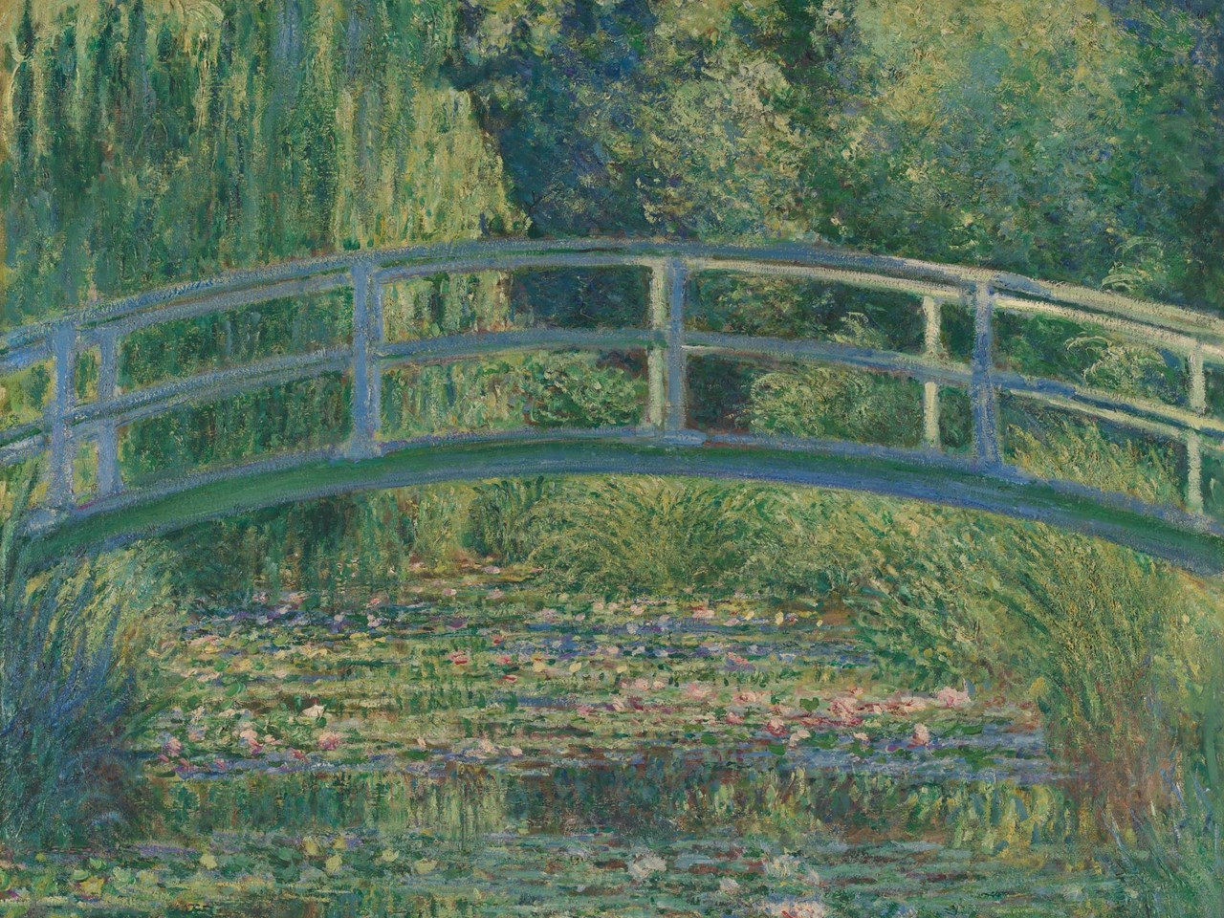

Slide 15
vocabulary

Slide 16
vocabulary
Line
path traced by the point of a tool or medium as it moves across an area
Horizon Line
line that separates the ground and the sky
Background
part of painting furthest from the viewer
Middleground
part of the painting in between the background and foreground
Foreground
part of the painting closest to the viewer

Slide 17
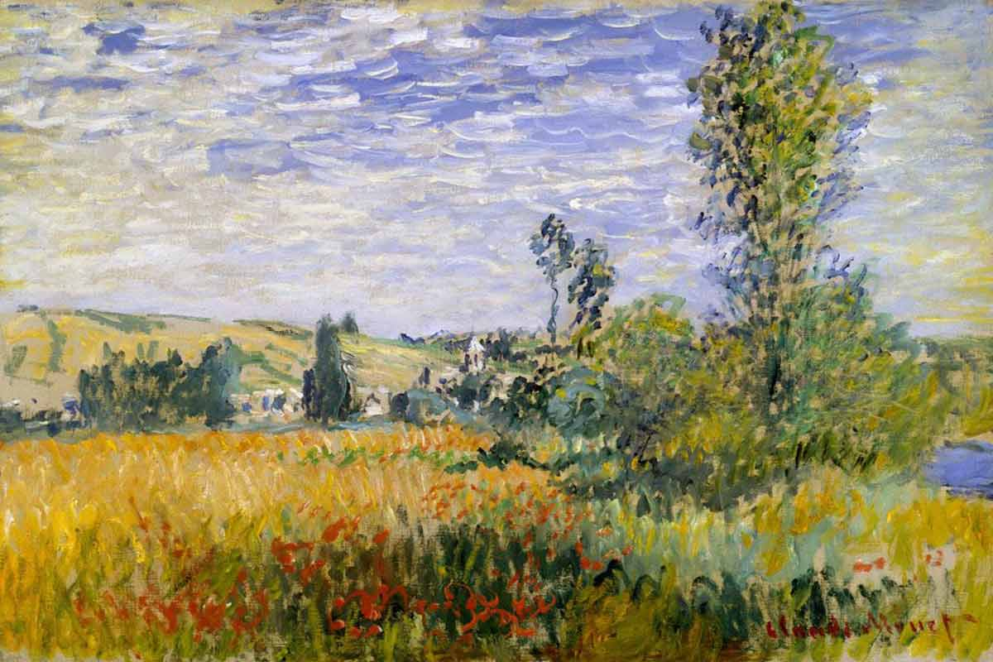
Breaking down a painting
Background
Horizon Line
Foreground
Middleground

Slide 18
instructions

Slide 19
instructions
Draw your horizon line. Because we want depth in our painting, we are going to make the line closer to the top of our paper
Draw some hills and trees near your horizon line. We are going to make these really small so they look far away!
Next, draw the middle ground area. We can add simple homes or barns here. Maybe some small animals and more trees.
Last, we will draw some very close trees. This helps us achieve depth even more!

Slide 20
references
https://en.wikipedia.org/wiki/Claude_Monet#/media/File:Claude_Monet_1899_Nadar_crop.jpg
https://www.metmuseum.org/toah/hd/cmon/hd_cmon.htm
Images: https://www.artnews.com/art-news/artists/claude-monet-best-paintings-1234580881/
https://www.nationalgallery.org.uk/paintings/claude-monet-the-water-lily-pond
https://www.youtube.com/watch?v=nesTk_6j-0c

