Slide 1
Enhancing Learning Through Brain Research
Dr. Catherine Richmond-Cullen
President, neuroLEARN llc
catcullen@gmail.com

Slide 2
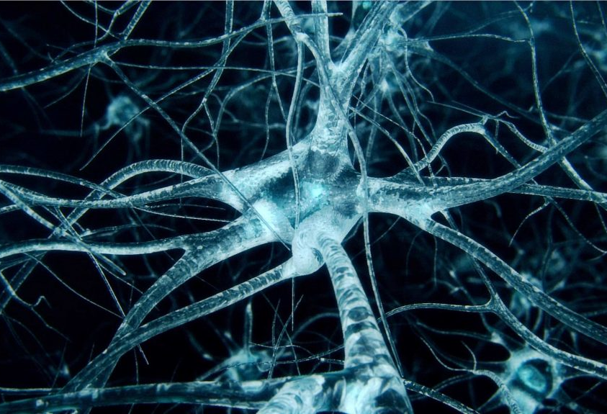
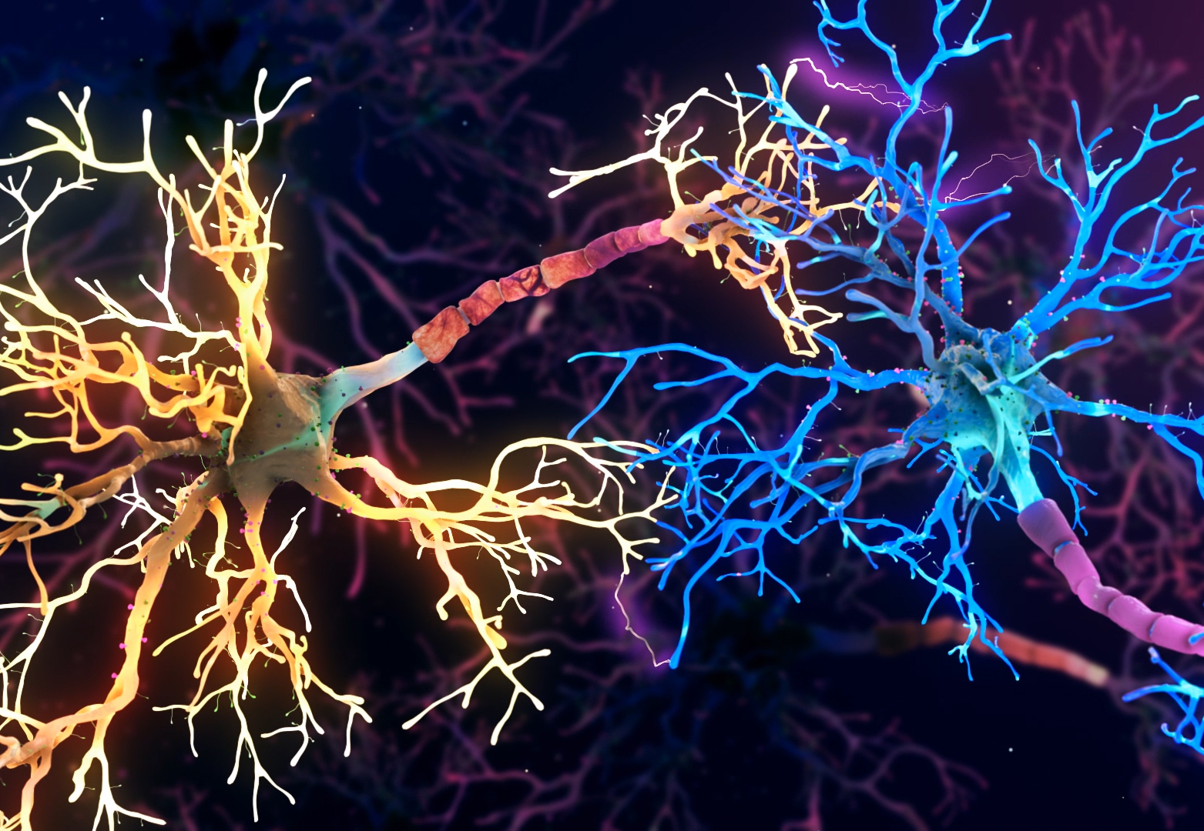
Neuroimaging: Offers new insights into how the brain learns

Slide 3
Reticular Activating System

Slide 4
Limbic System
involved in functions including homeostasis, emotion, thirst, hunger, circadian rhythms, and control of the autonomic nervous system. In addition, it controls the pituitary.
a coronal
involved in functions including homeostasis, emotion, thirst, hunger, circadian rhythms, and control of the autonomic nervous system. In addition, it controls the pituitary.
a coronal
Thalamus: all sensory data is synapsed here and sent to cerebrum, motor activity
Hypothalamus: homeostasis, emotion, thirst, hunger, circadian rhythms, and control of the autonomic nervous system.
Amygdala: fear center, emotional center
Hippocampus: converts short term to long term memory

Slide 5
Cerebral Cortex
Frontal Lobe- associated with reasoning, planning, parts of speech, movement, emotions, and problem solving
Parietal Lobe- associated with movement, orientation, recognition, perception of stimuli
Occipital Lobe- associated with visual processing
Temporal Lobe- associated with perception and recognition of auditory stimuli, memory, and speech

Slide 6
The Process of Learning
Sensory data received by the RAS
Data sent to limbic system
emotional
Searching the cerebrum for stored patterns
Working memory activated in frontal lobe
New learning processes in sequential patterns for LTM storage

Slide 7
Functions of the Brain: Neurons that Fire Together Wire Together
Linguistic
Visual / Spatial
Motor
Executive Functions / Attentional
Memory
Notes:
Categorize what artists DO into these 5 functions

Slide 8
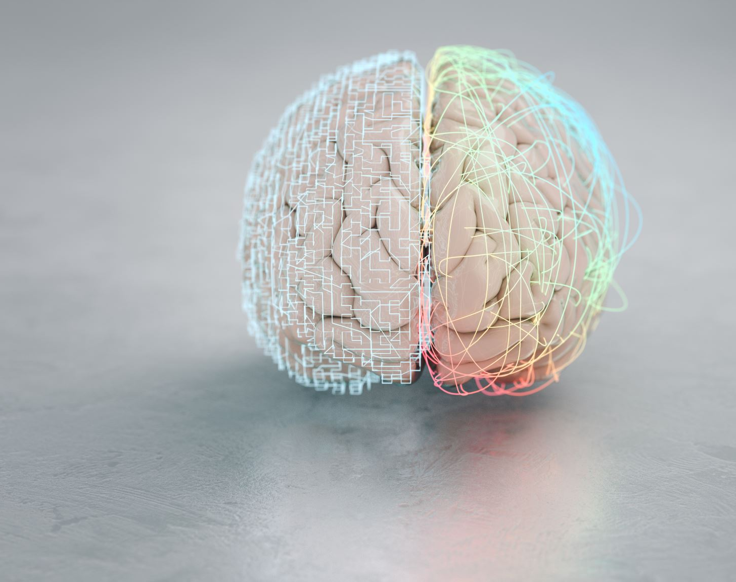
Caine and Caine Brain/ Mind Learning Principles

Slide 9
Each brain is uniquely organized.

Slide 10
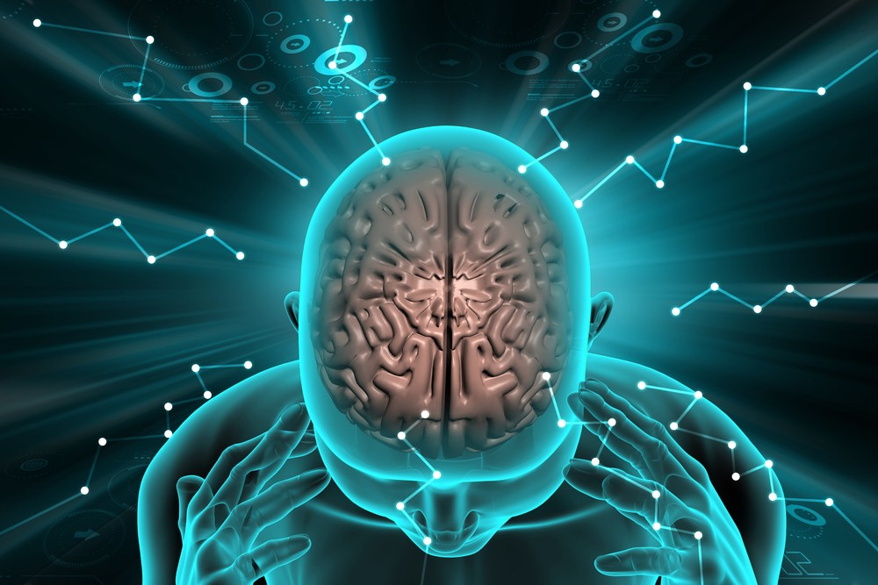
All Learning is Physiological

Slide 11
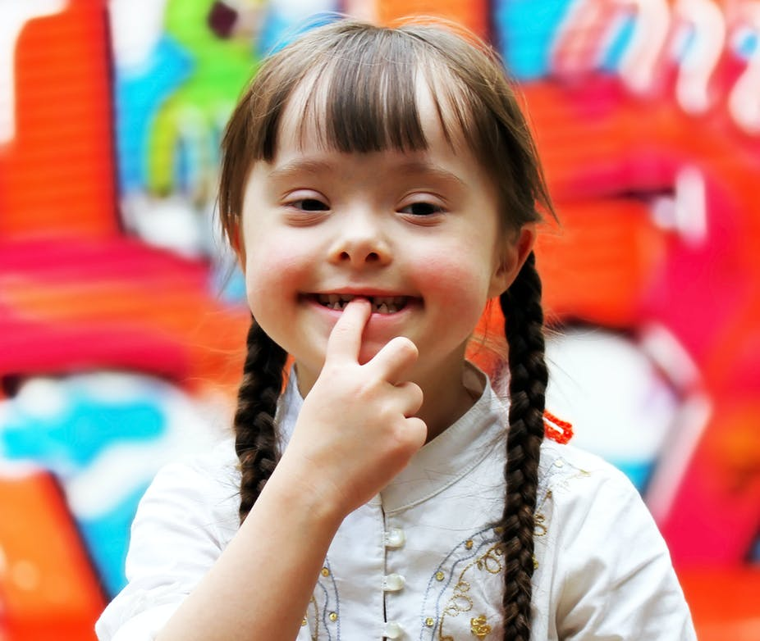
Learning is Developmental

Slide 12
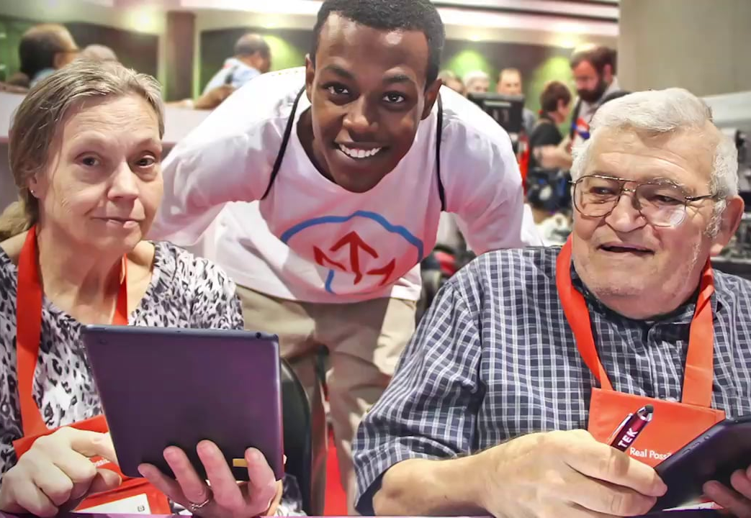
The brain is social
This Photo by Unknown Author is licensed under CC BY-SA

Slide 13
The search for meaning is innate.

Slide 14
Learning involves both conscious and unconscious processes
This Photo by Unknown Author is licensed under CC BY-SA-NC

Slide 15
We learn through patterns.

Slide 16
Emotions are critical to patterning and storage
This Photo by Unknown Author is licensed under CC BY-SA
This Photo by Unknown Author is licensed under CC BY

Slide 17
The brain learns parts and wholes simultaneously

Slide 18
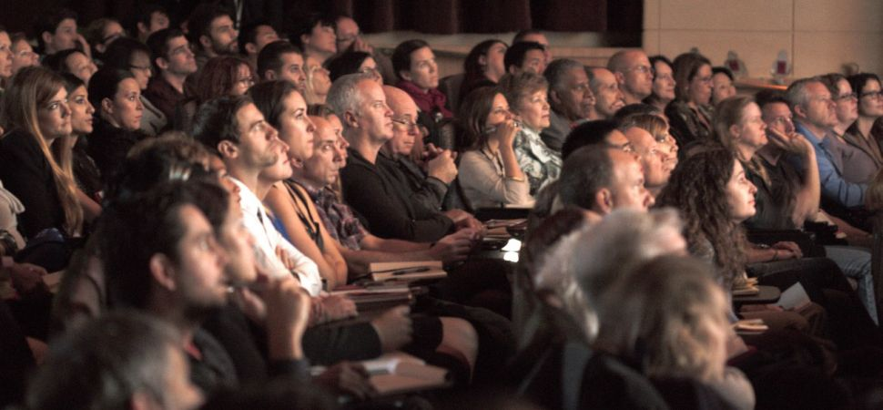
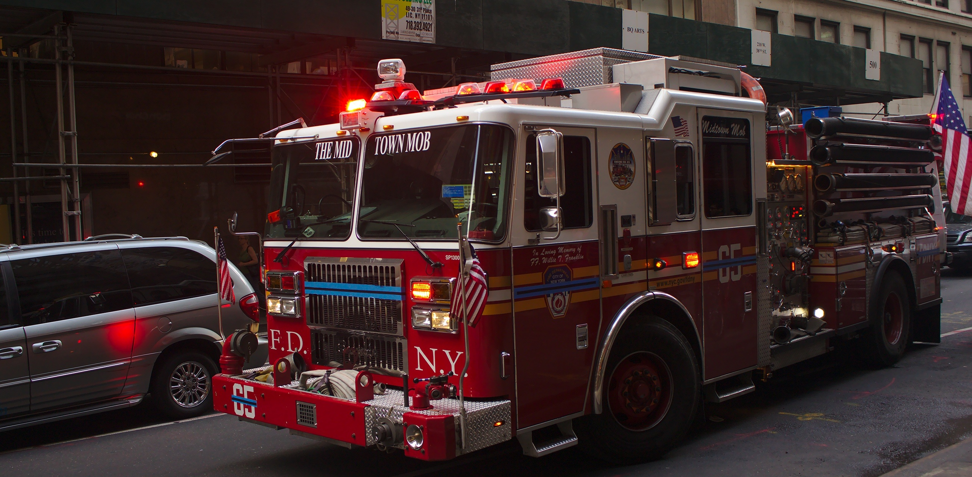
Learning involves focused attention and peripheral perception
Notes:
Discuss environment

Slide 19
Complex learning is enhanced by challenge and limited by threat

