Slide 1
Coil Pots
Part 2

Slide 2
objectives
of this lesson

Slide 3
objectives
Use shapes, patterns, and lines to make pictograms
Finish your coil pot from the previous class

Slide 4
materials

Slide 5
materials
Watercolor Paint
Water
Paintbrush
Pencil
Paper

Slide 6
Pass or play!

Slide 7
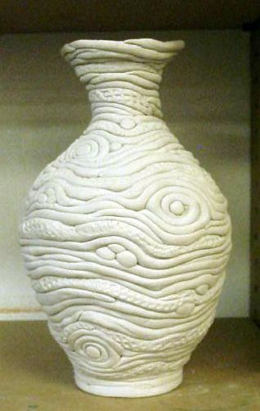
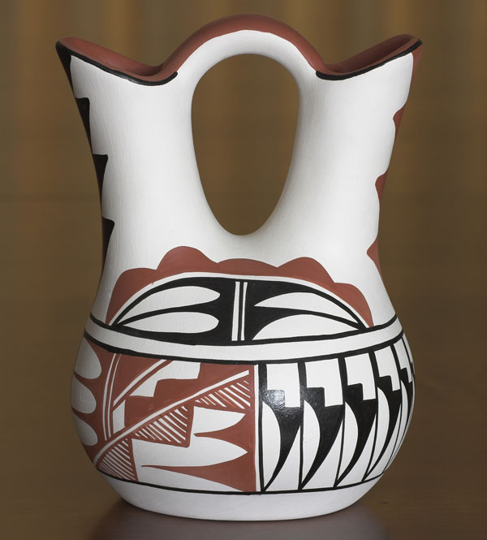
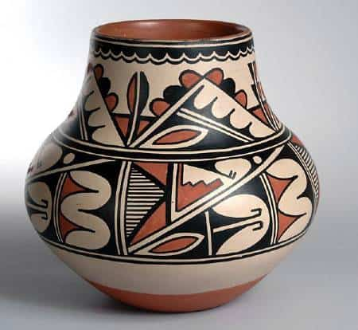
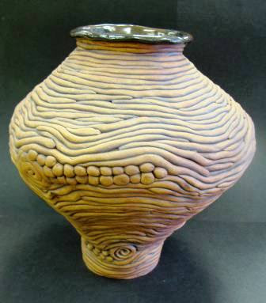
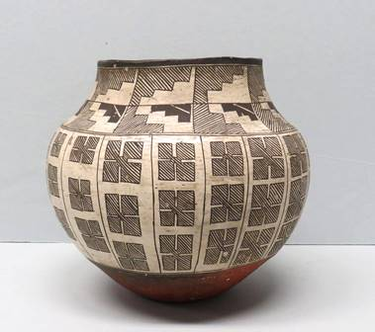
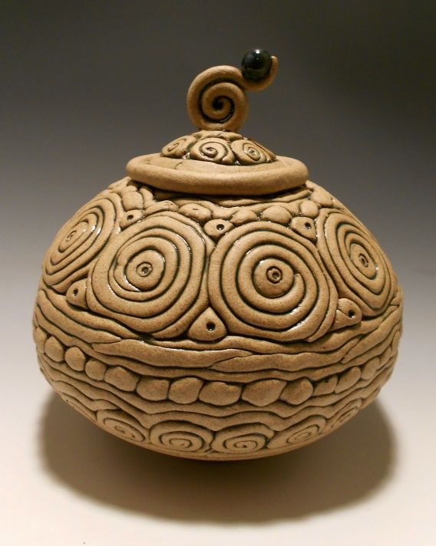

Slide 8
vocabulary

Slide 9
vocabulary
Pattern
a repeated element and/or design that is usually varied
Repetition
the use of the same visual effect a number of times in the composition
Pictogram
a pictorial symbol for a word or phrase
Balance
equal weight/importance on both sides of a composition

Slide 10
instructions

Slide 11
instructions
Think of some shapes, symbols, and patterns you can use as pictograms for your coil pot
Practice drawing them out on your paper
Once you are satisfied with your design, start applying it to your coil pot
Make sure your coil pot is balanced!

Slide 12
references
Vocab: Ocvirk, Otto G. Art Fundamentals: Theory and Practice, 10th ed., McGraw-Hill, New York, NY, 2005.
https://www.youtube.com/watch?v=S_WYikJ4DJs

