Slide 1
Coil Pots
Part 1

Slide 2
objectives
of this lesson

Slide 3
objectives
Learn about coil pots and additive sculpture
Create your own coil pot

Slide 4
materials

Slide 5
materials
Air dry clay
Water
Paintbrush

Slide 6
Pass or play!

Slide 7
5 Minute Video Warm Up!

Slide 8
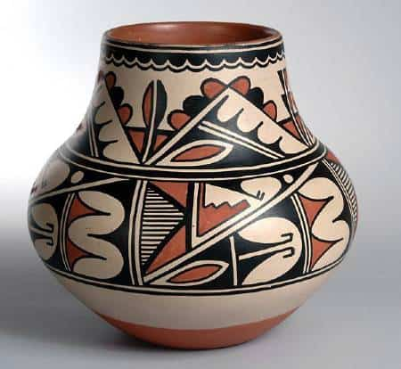
About Coil Pots
Tradition is 2,000 years old
Made for tasks such as cooking and carrying water
Not for decorative use
Designs called pictographs were painted onto the pots

Slide 9
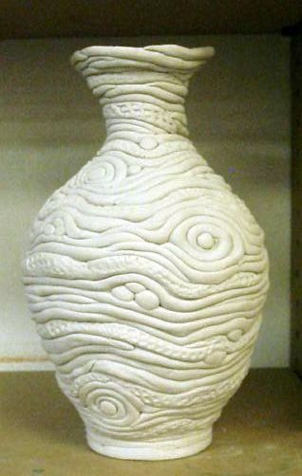
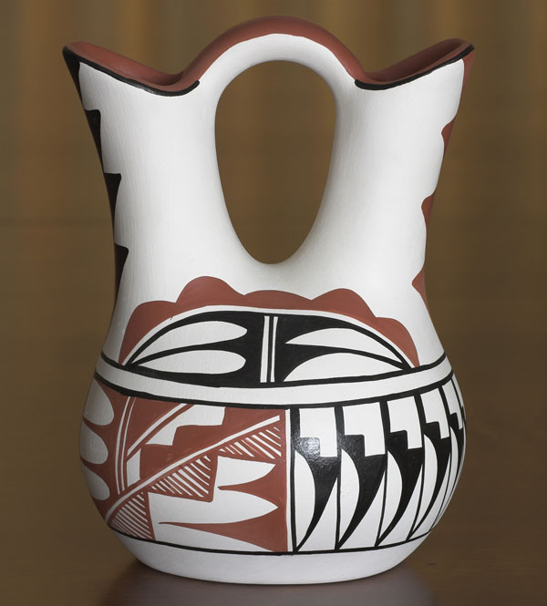
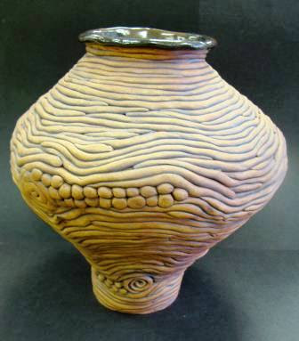
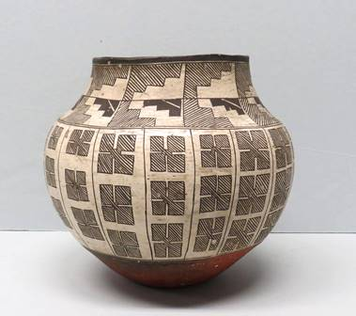
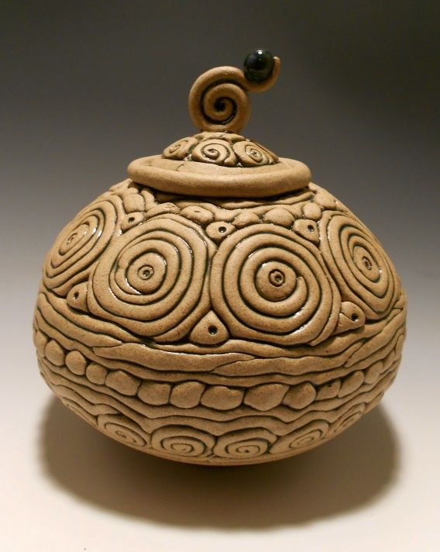

Slide 10
vocabulary

Slide 11
vocabulary
Additive Sculpture
process when materials (clay) are built up to create the sculpture’s form
Pattern
a repeated element and/or design that is usually varied
Repetition
the use of the same visual effect a number of times in the composition
Form
the total appearance or organization of an artwork

Slide 12
instructions

Slide 13
instructions
Flatten out a circle for your base
Take some clay and roll it into a cylinder shape in your hands
Stretch the cylinder into a snake like shape by rolling it on the table. This will be your coil!
Repeat the last two steps to keep making more coils
Use the slip and score method to attach your first coil to the base
Continue adding coils. Note that if you stack the coils directly onto of each other you will get a straight shape. If you offset them slightly you can make a more rounded shape.

Slide 14
references
Vocab: Ocvirk, Otto G. Art Fundamentals: Theory and Practice, 10th ed., McGraw-Hill, New York, NY, 2005.
https://www.youtube.com/watch?v=S_WYikJ4DJs

