Slide 1
Elizabeth Murray
Shaped canvas paintings

Slide 2
objectives
of this lesson

Slide 3
objectives
Students will study the works of Elizabeth Murray shaped canvases and create one of their based on everyday objects.
Students will learn about the math concepts of area and perimeter and measurements.
Students will build their skills with painting, drawing , problem solving and aesthetics.

Slide 4
materials
For this lesson

Slide 5
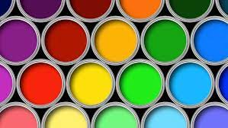
materials
Scrap paper
Pencil
Heavy paper
Scissors
Tape
paints

Slide 6
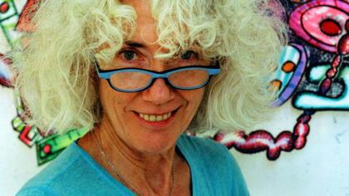
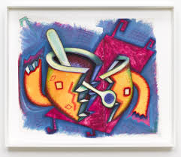
Pass or play!
Who is Elizabeth Murray?

Slide 7
Elizabeth Murray
https://youtu.be/uy3_7mWu3IEhttps://youtu.be/uy3_7mWu3IE

Slide 8
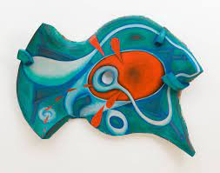
Elizabeth Murray
She was a 20th century American artist known for her use of the shaped canvas
She emerged in the 1970’s and her work was a reaction to cubist minimalism and surrealist pop art.
She twisted the shapes of her canvases and gave the paintings a space of their own.

Slide 9
Weeping Woman, Pablo Picasso, 1937
Cubism-the idea that images could be traced to geometrical forms. The emphasis is on the two dimensionality of the picture plane here.

Slide 10
Composition in Red Blue Yellow 1930 Piet Mondrian
Minimalism art- The images were boiled down to the basic elements and principles of art, line, shape, color. The simplest elements were used to create a dynamic effect.

Slide 11
The False Mirror, René Magritte, 1929
Surrealism- The fusion of fantasy with objects from the real world to form a kind of hyper reality.

Slide 12
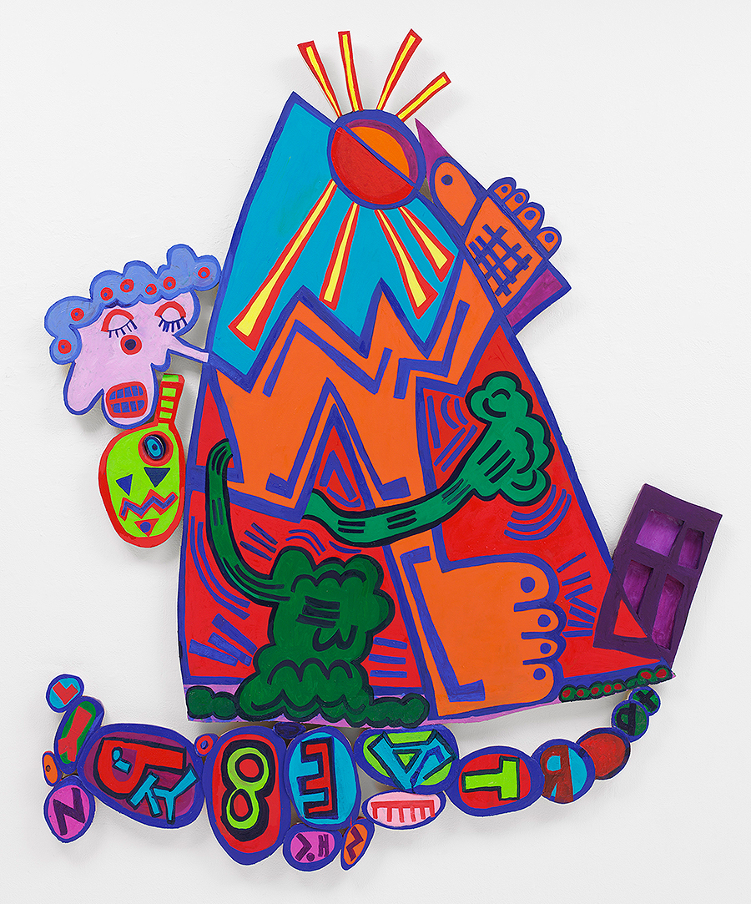
instructions
How to create our own Elizabeth Murry inspired shaped canvas

Slide 13
instructions
Students will draw at least 3 ideas on scrap paper for a design incorporating everyday objects.
Students will choose their best design and turn this into a shaped “canvas” on heavy paper.
Students will use paint to enhance their designs.
Students will think about edges of their works and use of texture, color to balance their design and move the viewers eye around the painting.
I will demonstrate this technique.

Slide 14
vocabulary
Math and Art

Slide 15
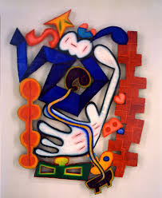
vocabulary
Math:
Area, perimeter
Measurement
Art:
Shaped canvas
Cubism
Minimalism
Pop art

Slide 16
references
In order of how they appear in the presentation

Slide 17
references
https://www.google.com/imgres?imgurl=https%3A%2F%2Fimages.immediate.co.uk%2Fproduction%2Fvolatile%2Fsites%2F4%2F2018%2F07%2FGettyImages-176875573-4581401.jpg%3Fquality%3D90%26resize%3D768%2C574&imgrefurl=https%3A%2F%2Fwww.sciencefocus.com%2Fscience%2Fwhats-in-emulsion-paint%2F&tbnid=TN9F6Z5xT-TZoM&vet=12ahUKEwjkkurjiLLzAhXzlXIEHablADYQMygIegUIARCMAw..i&docid=pwtZs4aiAXJ4aM&w=940&h=529&q=paints&client=safari&ved=2ahUKEwjkkurjiLLzAhXzlXIEHablADYQMygIegUIARCMAw
https://www.google.com/imgres?imgurl=https%3A%2F%2Fupload.wikimedia.org%2Fwikipedia%2Fen%2Fd%2Fdb%2FElizabeth_Murray_%2528artist%2529.jpg&imgrefurl=https%3A%2F%2Fen.wikipedia.org%2Fwiki%2FElizabeth_Murray_(artist)&tbnid=yXIOZhu078YyZM&vet=12ahUKEwicodjsibLzAhUXrXIEHb2zCwsQMygTegUIARDIAQ..i&docid=61Bvlbi8OwUGfM&w=421&h=236&q=elizabeth%20murry&client=safari&ved=2ahUKEwicodjsibLzAhUXrXIEHb2zCwsQMygTegUIARDIAQ
https://www.google.com/imgres?imgurl=https%3A%2F%2Fwww.moma.org%2Fmedia%2FW1siZiIsIjE2OTE0NiJdLFsicCIsImNvbnZlcnQiLCItcXVhbGl0eSA5MCAtcmVzaXplIDIwMDB4MjAwMFx1MDAzZSJdXQ.jpg%3Fsha%3D639a550043bc6559&imgrefurl=https%3A%2F%2Fwww.moma.org%2Fcollection%2Fworks%2F86856&tbnid=0dh2rAykrMoGGM&vet=12ahUKEwicodjsibLzAhUXrXIEHb2zCwsQMygVegUIARDMAQ..i&docid=brGVD044_zpLvM&w=2000&h=1736&q=elizabeth%20murry&client=safari&ved=2ahUKEwicodjsibLzAhUXrXIEHb2zCwsQMygVegUIARDMAQ
https://www.google.com/imgres?imgurl=https%3A%2F%2Fsfmoma-media-dev.s3.us-west-1.amazonaws.com%2Fwww-media%2F2018%2F08%2F25233100%2FFC.519_01_H02-Large-TIFF_4000-pixels-long.jpg&imgrefurl=https%3A%2F%2Fwww.sfmoma.org%2Fartwork%2FFC.519%2F&tbnid=2VcC8vHTM_sYjM&vet=12ahUKEwia54jpi7LzAhUGrHIEHfg7CHcQMygRegUIARDtAQ..i&docid=KsgkNweJvre2wM&w=4000&h=3140&q=elizabeth%20murray&hl=en&client=safari&ved=2ahUKEwia54jpi7LzAhUGrHIEHfg7CHcQMygRegUIARDtAQ

Slide 18
References
https://www.google.com/imgres?imgurl=http%3A%2F%2Fwww.buffalo.edu%2Fcontent%2Fdam%2Fwww%2Freporter%2F2021%2F06%2Felizabeth-murray-exhibition%2FMurray-2006-The-New-World.jpg&imgrefurl=http%3A%2F%2Fwww.buffalo.edu%2Fubnow%2Fstories%2F2021%2F06%2Fmurray-exhibition.html&tbnid=bynzz0IBO0zkqM&vet=12ahUKEwia54jpi7LzAhUGrHIEHfg7CHcQMyggegUIARCQAg..i&docid=6D8qIPthImMaHM&w=900&h=1083&q=elizabeth%20murray&hl=en&client=safari&ved=2ahUKEwia54jpi7LzAhUGrHIEHfg7CHcQMyggegUIARCQAg
https://www.google.com/imgres?imgurl=https%3A%2F%2Frandolphcollege.edu%2Fmaier%2Fwp-content%2Fuploads%2Fsites%2F62%2F2021%2F07%2FMurray_Heart-with-Bricks.jpg&imgrefurl=http%3A%2F%2Fmaiermuseum.org%2Fjournal%2Fafter-the-demise-of-the-swines-sister-by-mary-ellen-talley%2F&tbnid=k4BXx6amh4XkZM&vet=12ahUKEwia54jpi7LzAhUGrHIEHfg7CHcQMygtegUIARCqAg..i&docid=3R1pdQzrofUYdM&w=760&h=930&q=elizabeth%20murray&hl=en&client=safari&ved=2ahUKEwia54jpi7LzAhUGrHIEHfg7CHcQMygtegUIARCqAg
cubism%20art&client=safari&ved=2ahUKEwjF-ZzJld_0AhUOqHIEHTinA50QMygnegUIARCZBA

